Slide 1
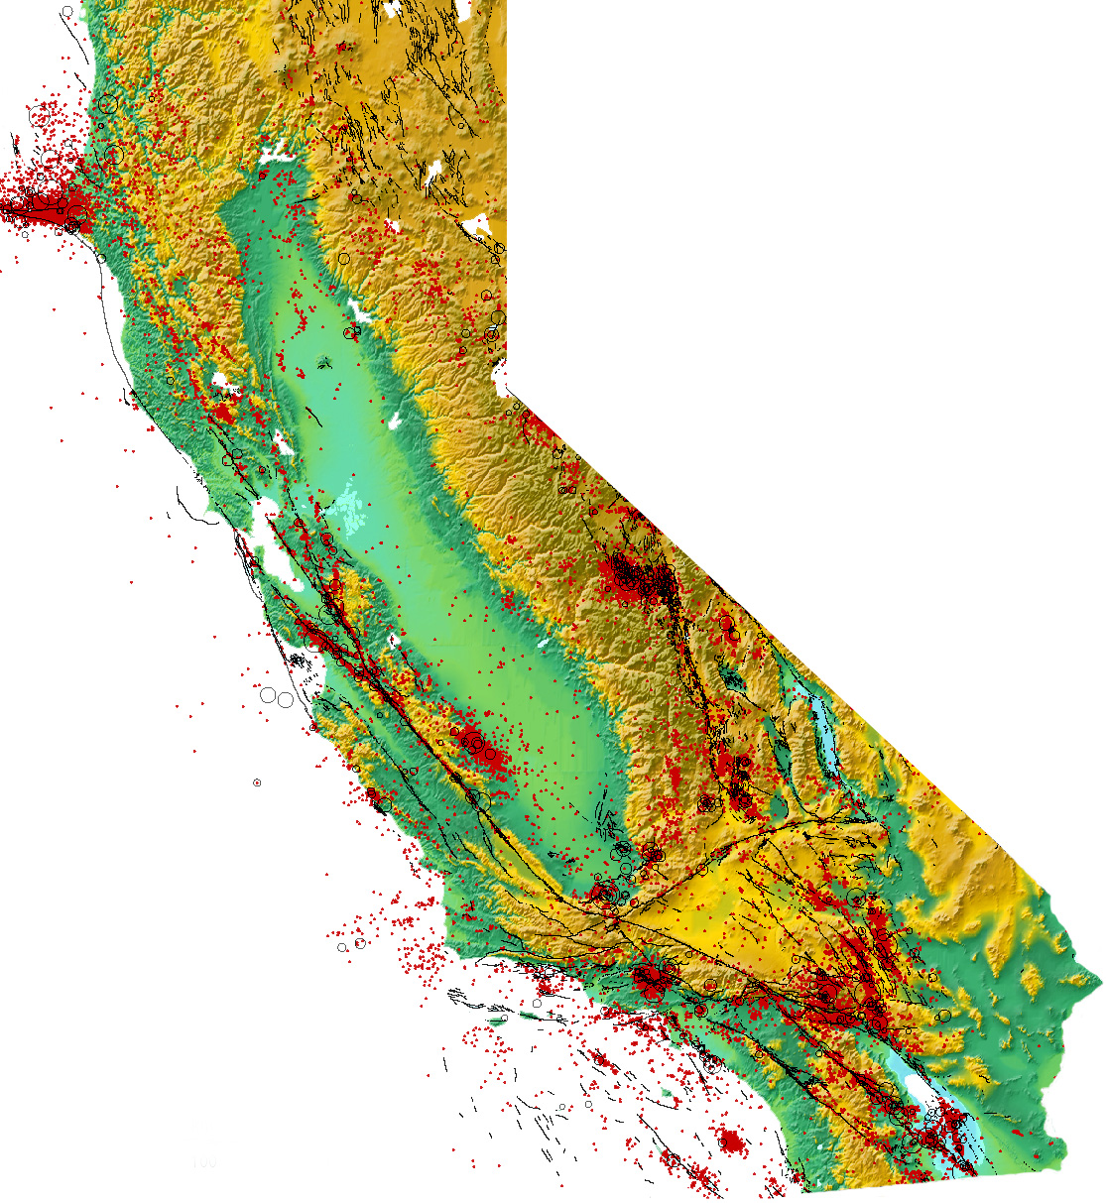
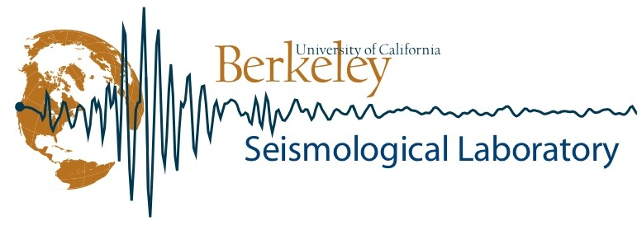
Earthquakes in our Backyard
Peggy Hellweg
Berkeley Seismological Laboratory
UC Berkeley
Notes:
1

Slide 2
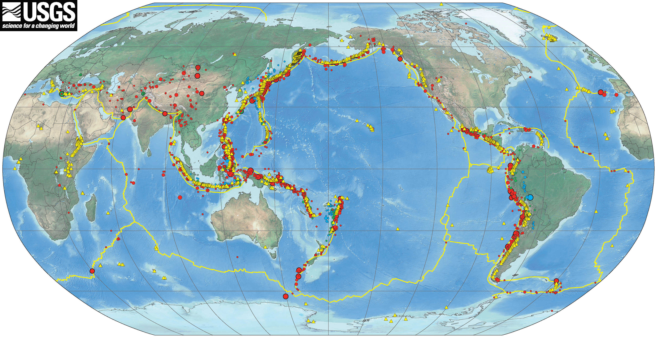
Earthquakes at Plate Edges

Slide 3
Types of Plate Margins
Transform Converg(oceanic,continental Divergent

Slide 4
Types of Plate Margins – Types of Faults
Strike-Slip Thrust/Reverse Normal

Slide 5
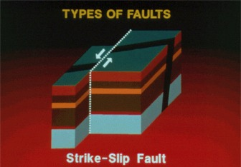
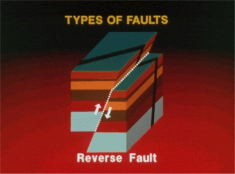
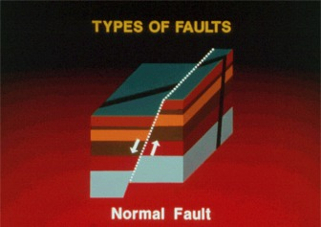
Types of plate margins – Types of Faults
Strike-Slip Thrust/Reverse Normal

Slide 6
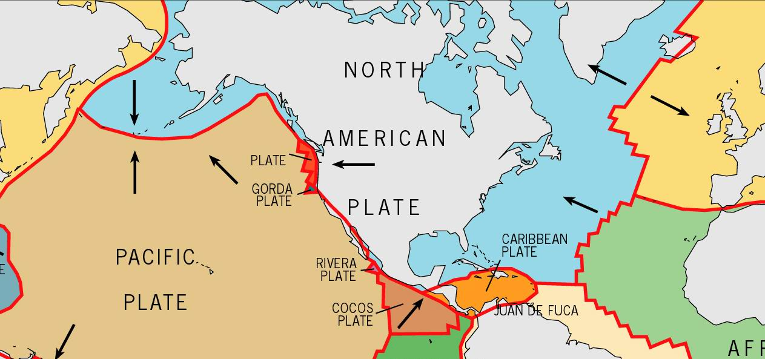
“Our” edge of the plate

Slide 7
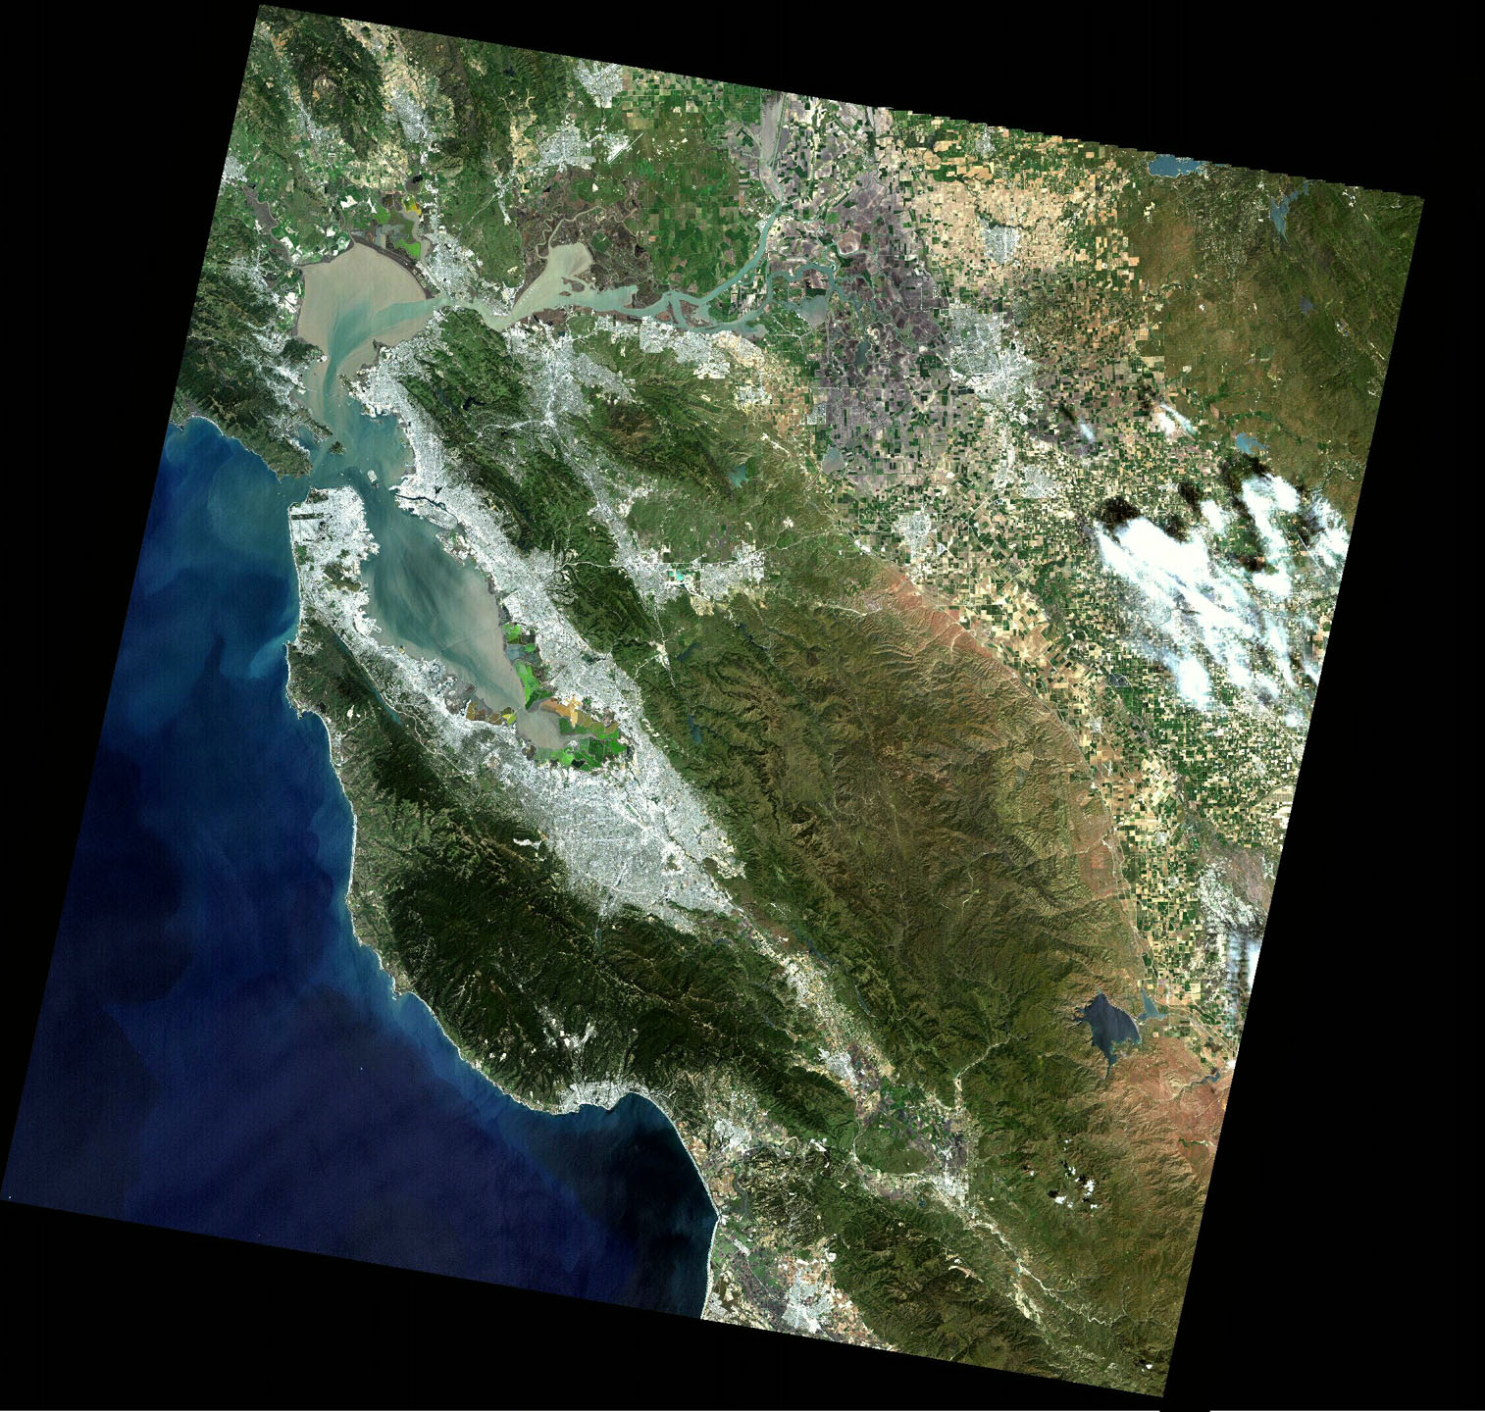
Hayward
40 cm (2.5 in) per year
Calaveras
San Andreas

Slide 8
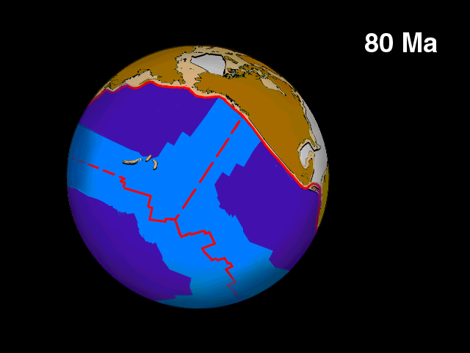
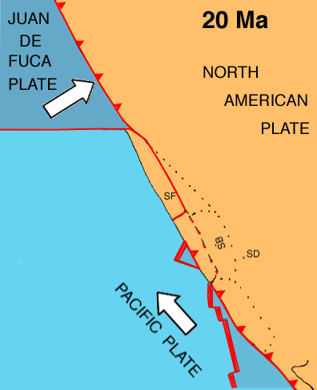
Global plate movement (80 million years)
California view of plate movement (20 million years)

Slide 9
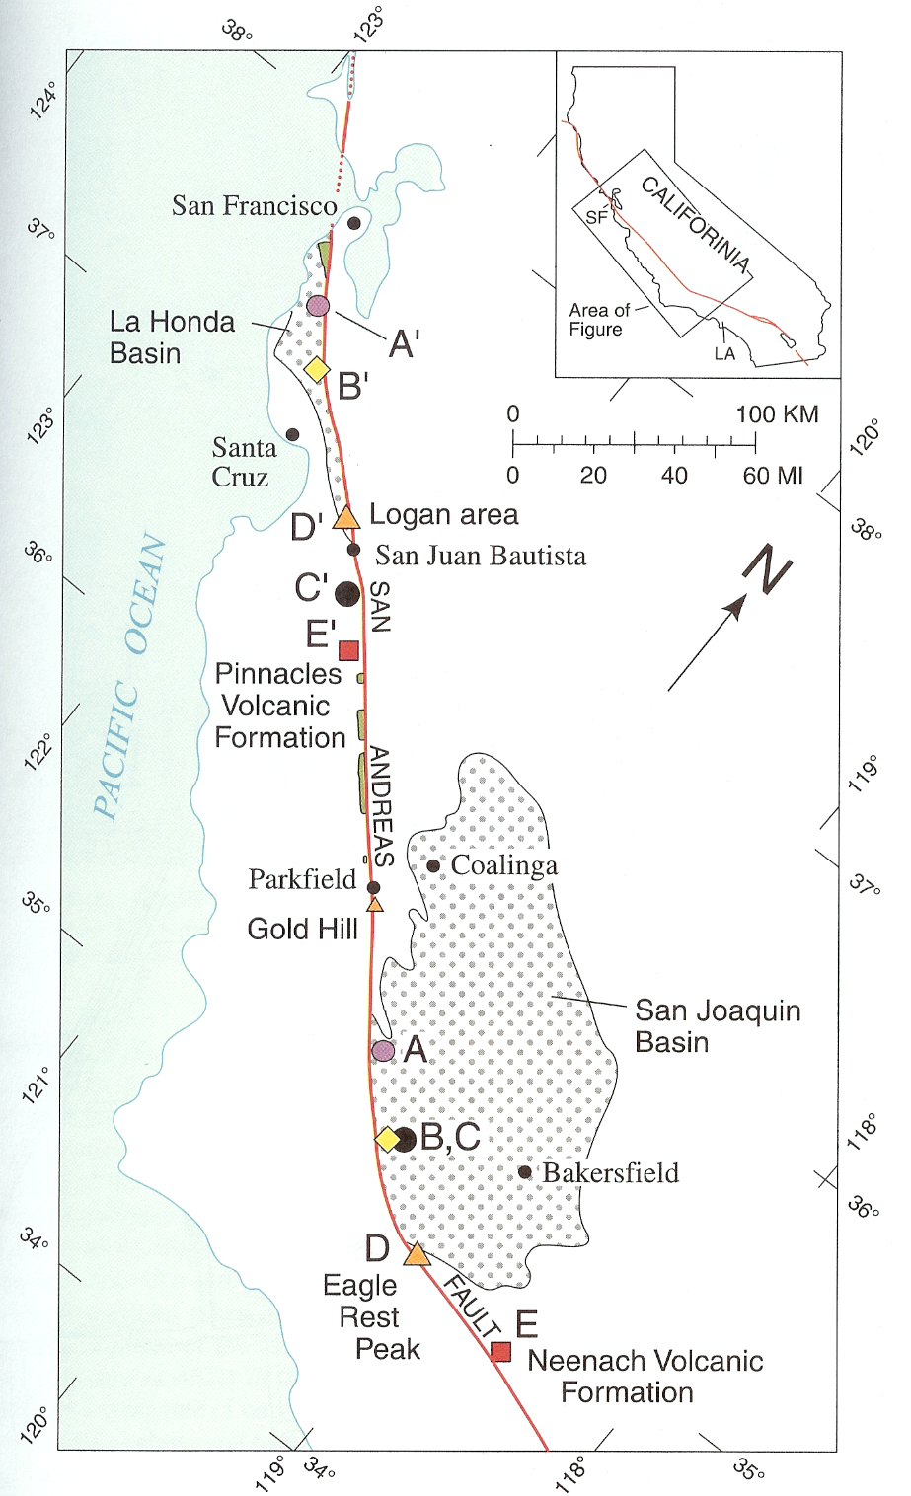
Plate Rates along
the San Andreas Fault
Geologic Evidence
Time scale: 10⁶ years
Plate movement: ~ 5 cm/year

Slide 10
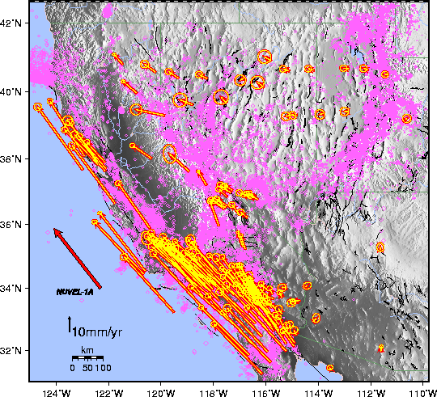
Plate Rates along
the San Andreas Fault
Geodetic/GPS measurements
Time scale: 10s years
Plate movement:
~ 5 cm/year

Slide 11
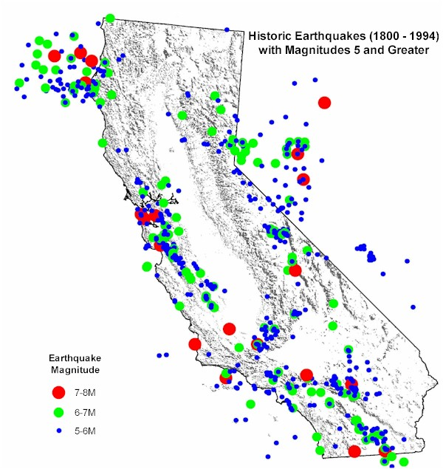
Historical Earthquakes in California
1906
1872
1868
1857

Slide 12
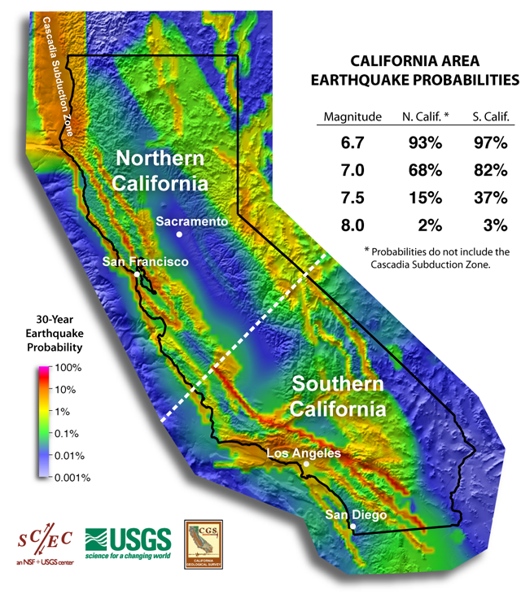
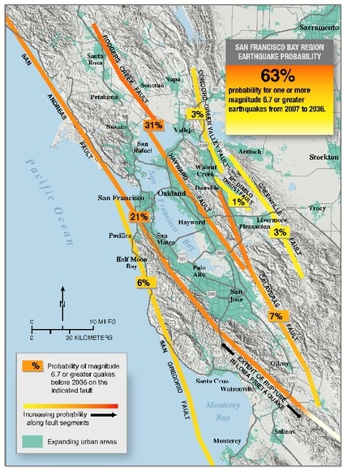
When will the “Next One” be?
http://www.wgcep.org/

Slide 13
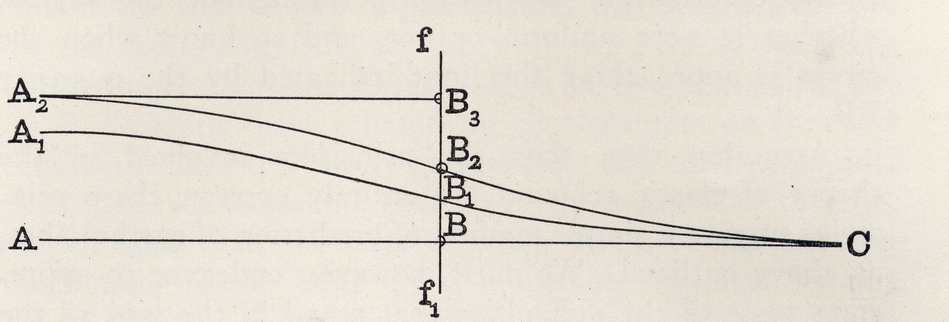
Earthquake Forecasting
“if the amount of strain which the earth will endure has been ascertained, and the rate at which the earth’s crust is creeping toward the breaking point has been learned, when and where the break will occur is a mere matter of calculation.”
Andrew Lawson

Slide 14
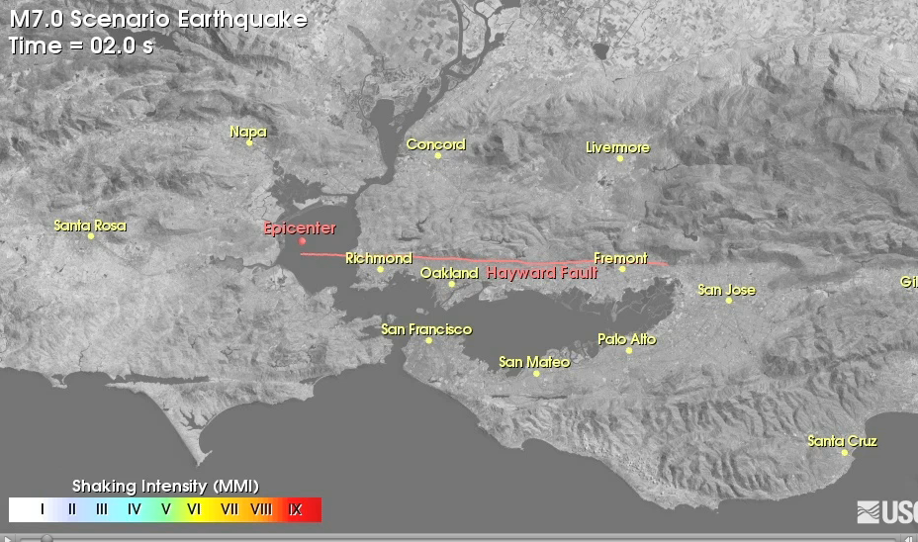
How Big will the Next One Be?
B. Aagaard et al., Ground Motion Simulations of Scenario Earthquake Ruptures of the Hayward Fault
Notes:
With that information, geophysicists can create models of how ground shaking will be like and how intense shaking could be.
This helps emergency planners understand the extent of the affected areas and to prioritize on how they

Slide 15
The Berkeley Seismological Laboratory
… to reliably produce seismic data of high quality
… to report quickly and reliably on NC earthquakes
.. to develop and implement useful new earthquake information products
Operations
Operations
Research

Slide 16
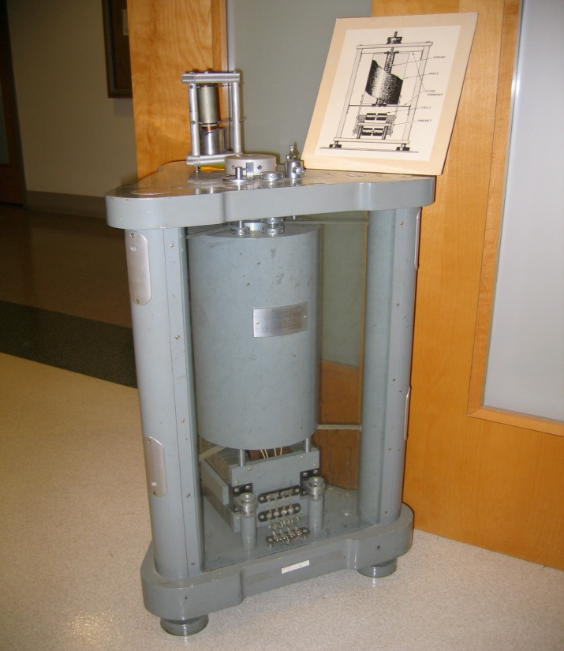
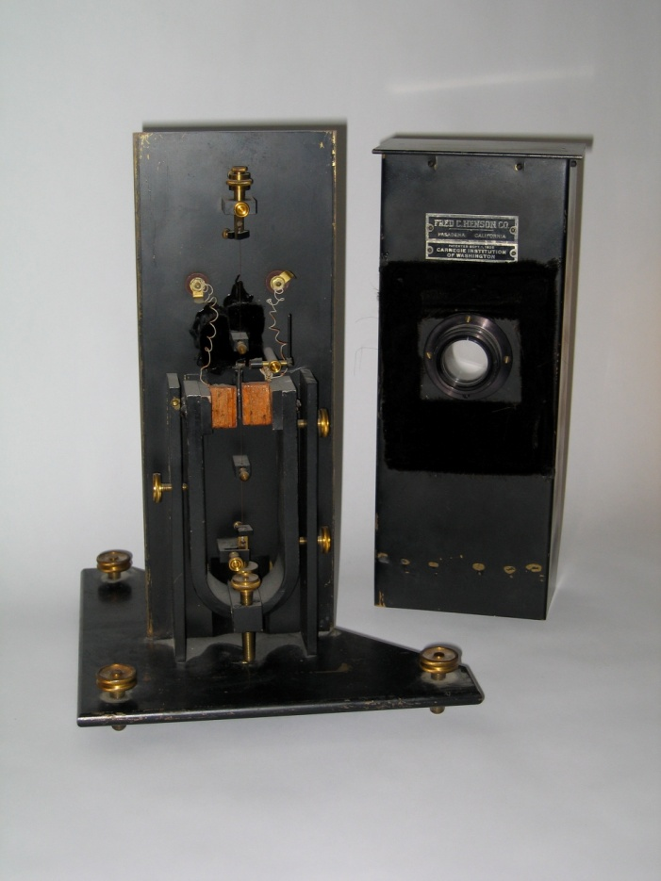
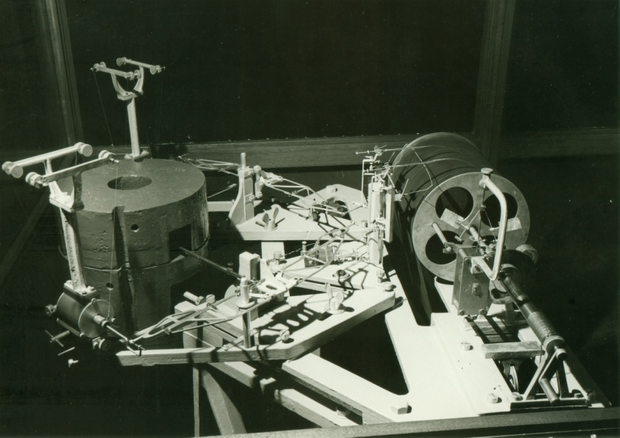
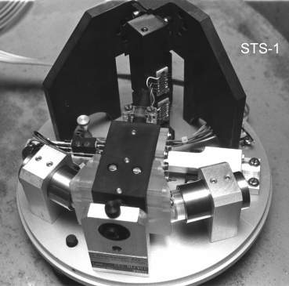
BSL - Monitoring EQs since 1887
Benioff
Ewing
Wiechert
Wood-Anderson

Slide 17
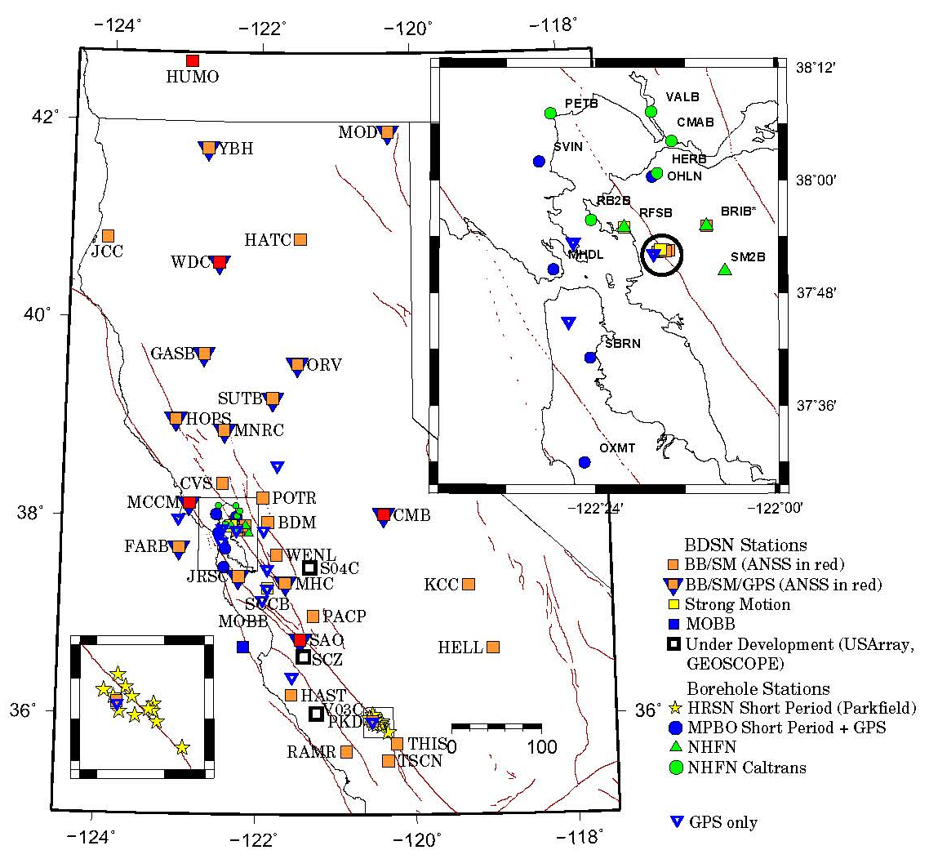
37 BB/SM stations
1 BB-OBS station
2 SM stations
30 borehole stations in the Bay Area and near Parkfield
Berkeley Digital
Seismic Network (BDSN)

Slide 18
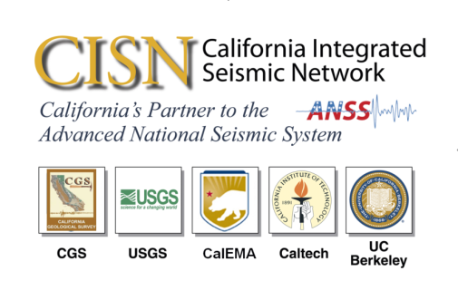
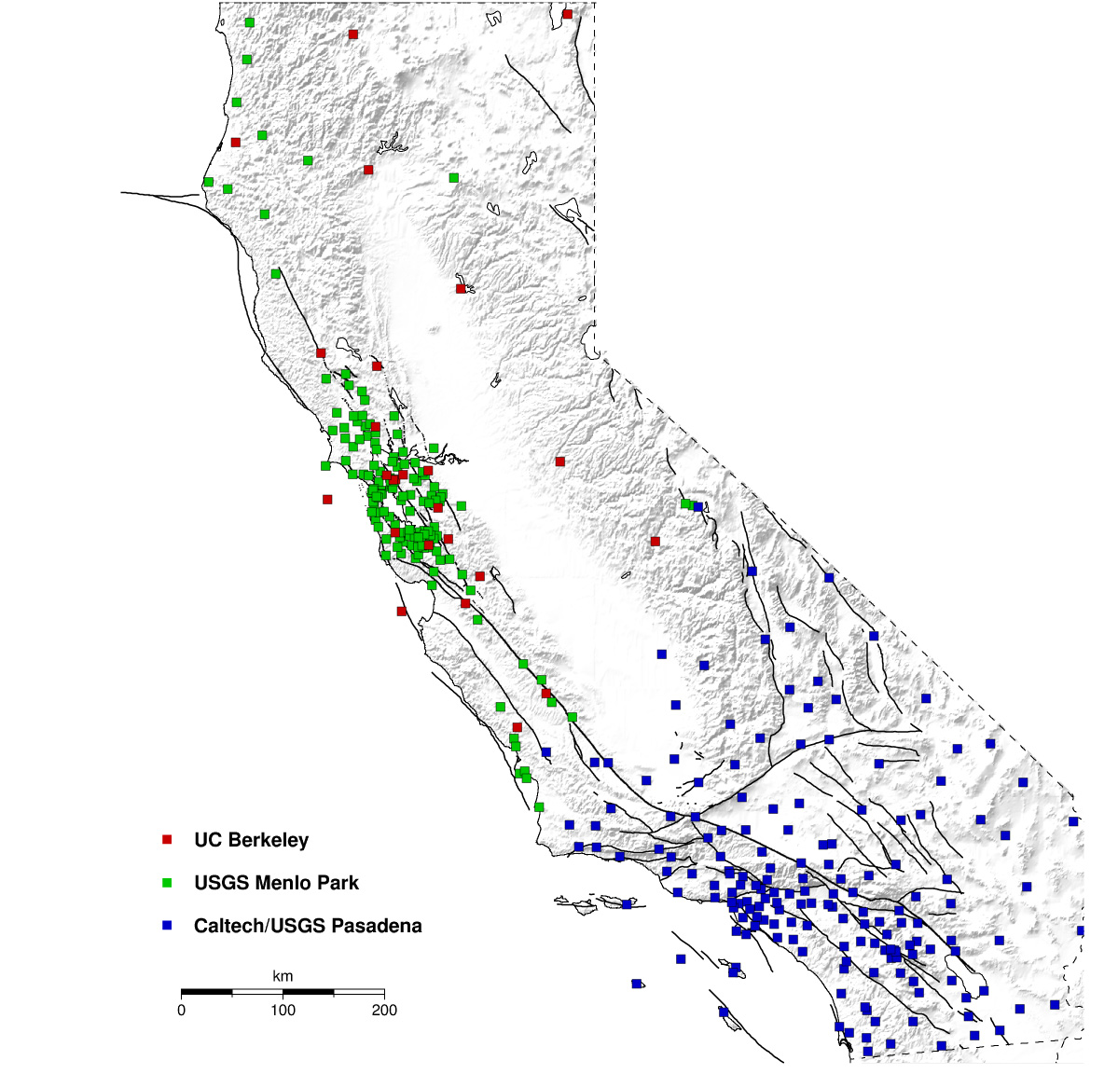
BSL: Member of the
California Integrated Seismic Network
Goal: Statewide reporting of earthquakes for emergency management, the public
CISN partners operate more than 3000 seismic stations
USGS MP
UCB
Caltech/USGS Pasadena UCSD
UCSB
UNR, DWR, PG&E
CGS/USGS NSMP

Slide 19
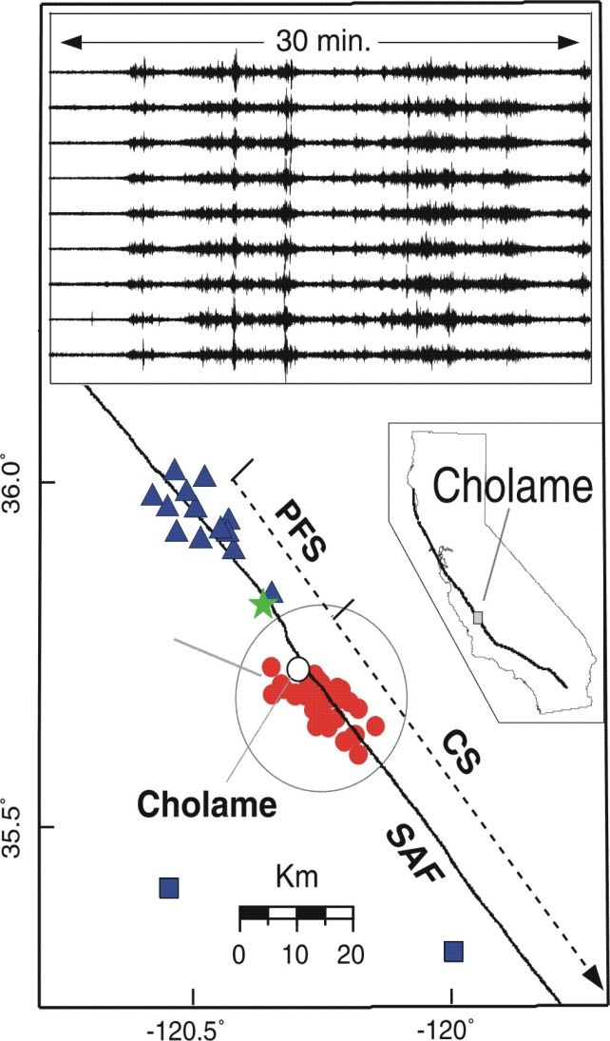
BDSN and Research:
Unusual Seismic Signals
Non-volcanic tremor at Parkfield –
precursor to big earthquakes?
The Earth’s hum – evidence of climate change?
27Sep2004
M6 Parkfield
Stations
Tremors
Stations
From Rhie and Romanowicz, 2005

Slide 20
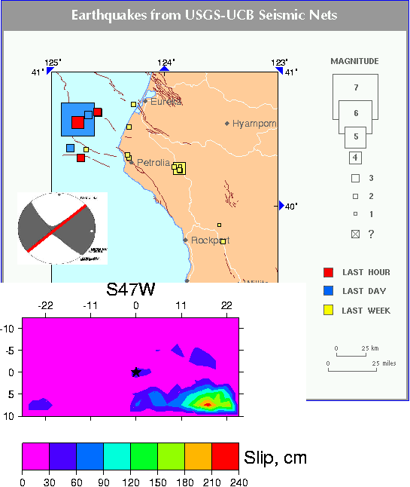
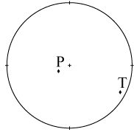
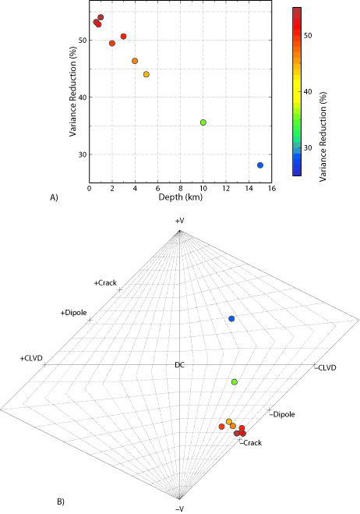
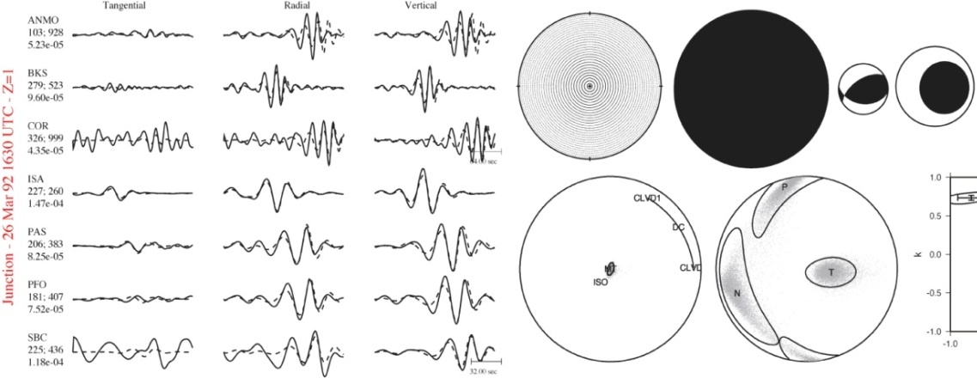
BDSN and Research: Seismic Sources
Nuclear Explosions and Mine Collapses
Nuclear Explosion
Earthquake Source Processes

Slide 21
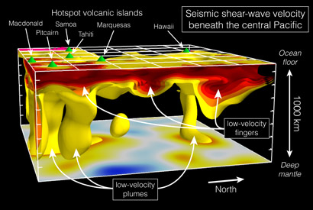
BDSN and Research: Earth Structure
The source of “plumes” (French et al, 2013)

Slide 22

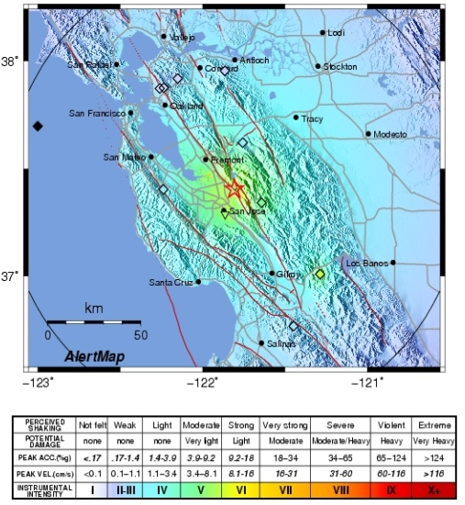
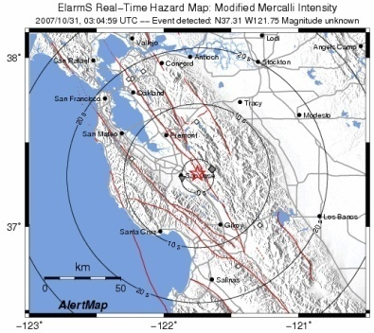
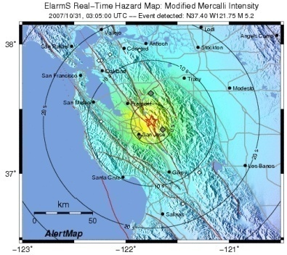
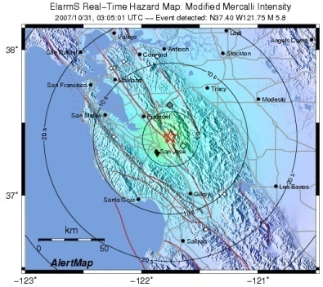
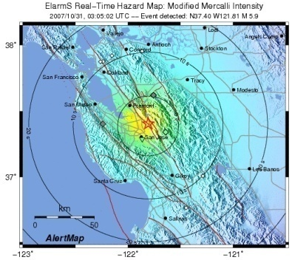
BDSN and Research: Earthquake Early Warning
Earthquake
intensity VIII
in 5 sec
Get under desk
Rapid-ShakeMap
currently at 1.5 min
1, 3, 5, 7, 10… stations trigger
origin
time
time
detection
+ 1 sec
+ 2 sec
+ 3 sec
Stream of earthquake information starts with first trigger

Slide 23
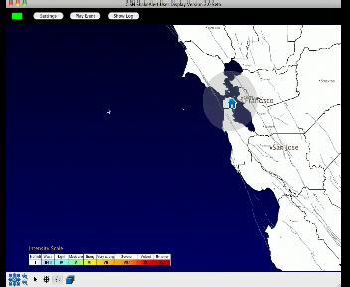
BDSN and Research: Earthquake Early Warning
Earthquake
intensity VIII
in 5 sec
Get under desk
Rapid-ShakeMap
currently at 1.5 min
1, 3, 5, 7, 10… stations trigger
origin
time
time
detection
+ 1 sec
+ 2 sec
+ 3 sec
Stream of earthquake information starts with first trigger

Slide 24
BDSN and Research: Earthquake Early Warning
rapid detection of earthquake nucleation
instant alerts of forthcoming ground shaking
updated shaking predictions as ground motion propagates
more rapid
“post-earthquake” information
➔ a continuum of earthquake information

Slide 25
Questions?
remember to be prepared
Thursday (Oct 17) is the anniversary of the Loma Prieta Earthquake and
The 2013 Great ShakeOut

