Slide 1
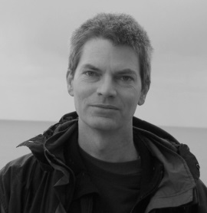
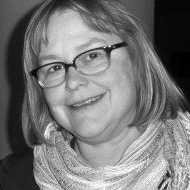
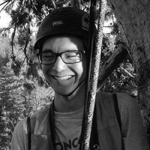

Eel River
http://criticalzone.org/eel
http://sensor.berkeley.edu
Berkeley Sensor Database
Collin Bode, Data Manager
Ginger Ogle, Database Programmer
Chris Wong, Field Tech
Coming Soon!
Wendy Baxter, Field Tech
Funding by Eel River CZO & UC Natural Reserve System
Previous funding by W.M. Keck Foundation &
National Center for Earth-surface Dynamics

Slide 2
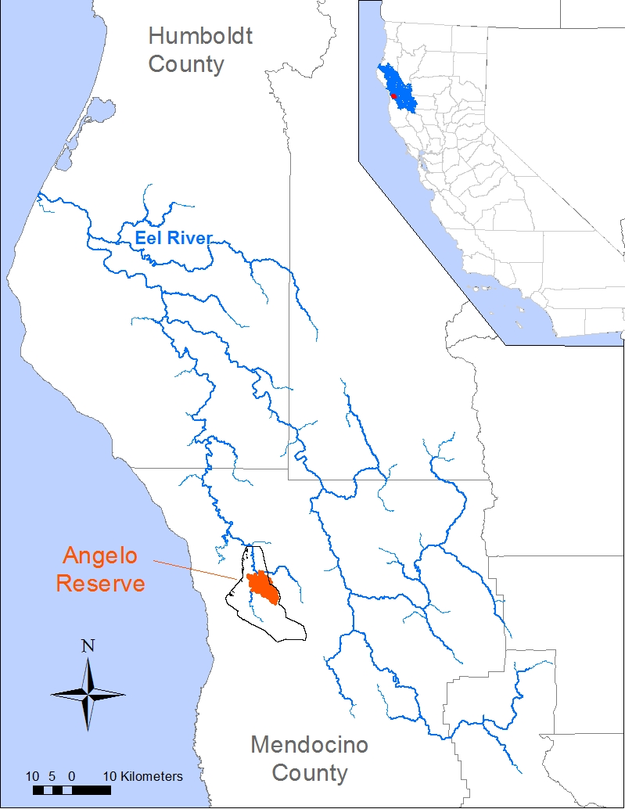
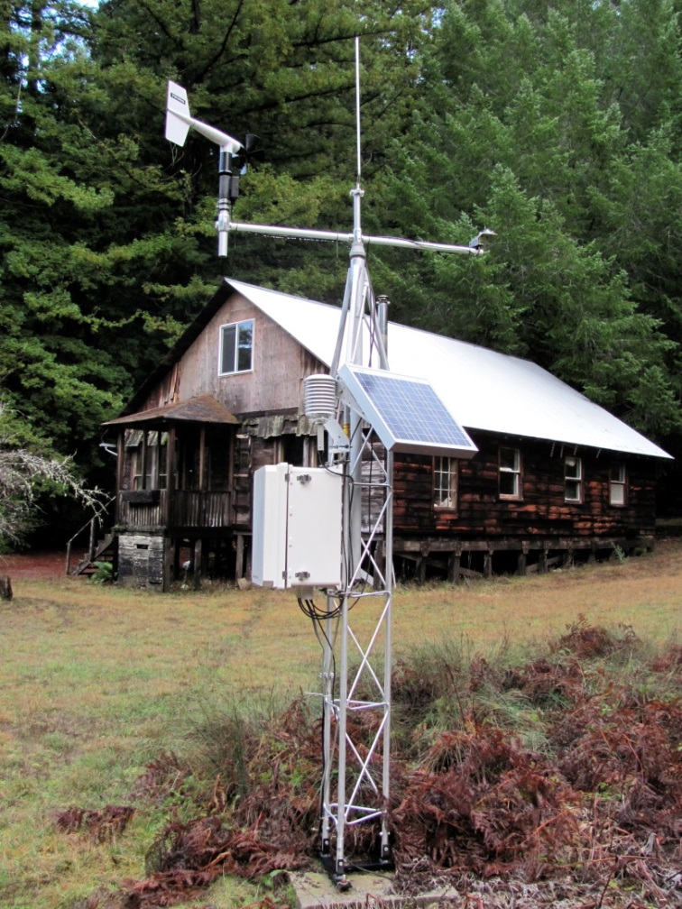
Eel River, California
Angelo
Sagehen
Angelo Coast Range Reserve
UC Natural Reserve System
Blue Oak
Ranch
Notes:
Largest mostly undammed river in CA. Short, steep, rapidly eroding in soft sedimentary rock of the CA coastal range.

Slide 3
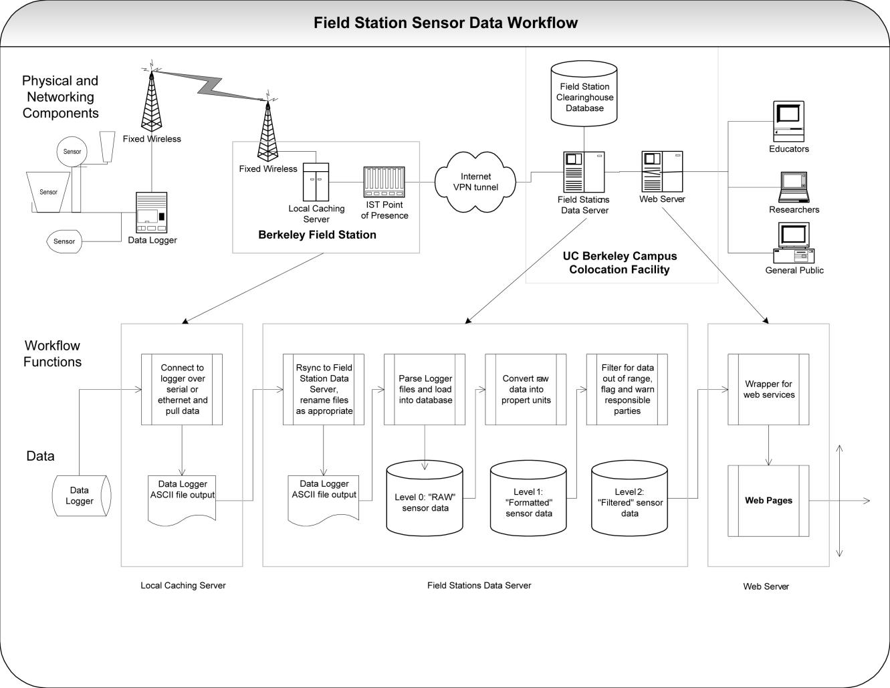
Wireless Sensor Network
Sensors
Networking
Informatics

Slide 4
Sensor Observatory: Sensors
Sensors

Slide 5
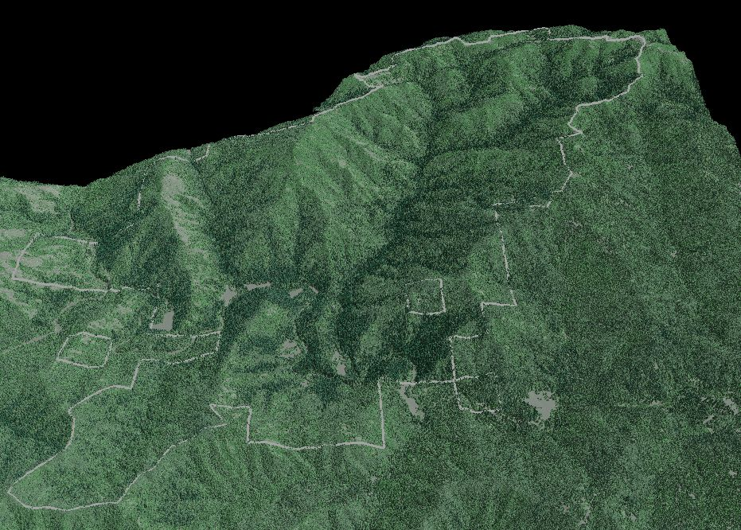
Angelo Coast Range Reserve
Cahto Peak
Sensor Stations
Air
Chemistry
2 Stream Gaging Stations
4 Weather Stations
1 Air Chemistry
Rivendell
South Meadow
Soil Moisture
USGS
Gage
Rivendell
Angelo
Meadow
HQ
Stilling Well
East
North
Notes:
Image of the Reserve and Rivendell

Slide 6
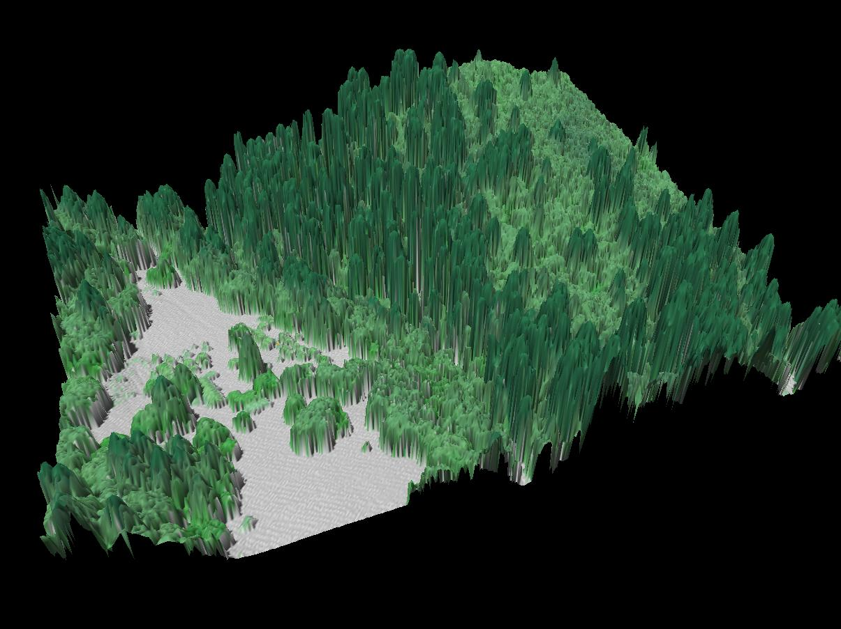
Rivendell Study Site

Slide 7
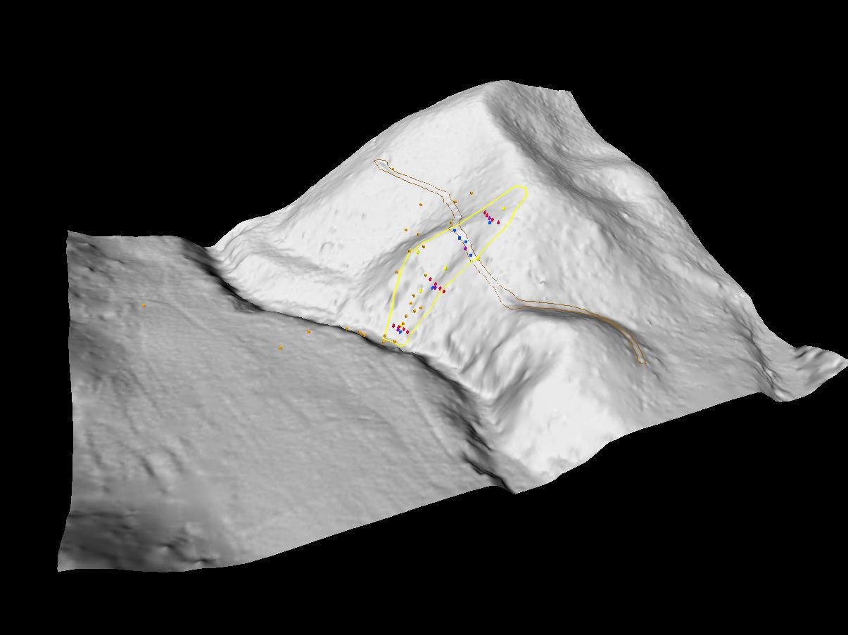

Slide 8
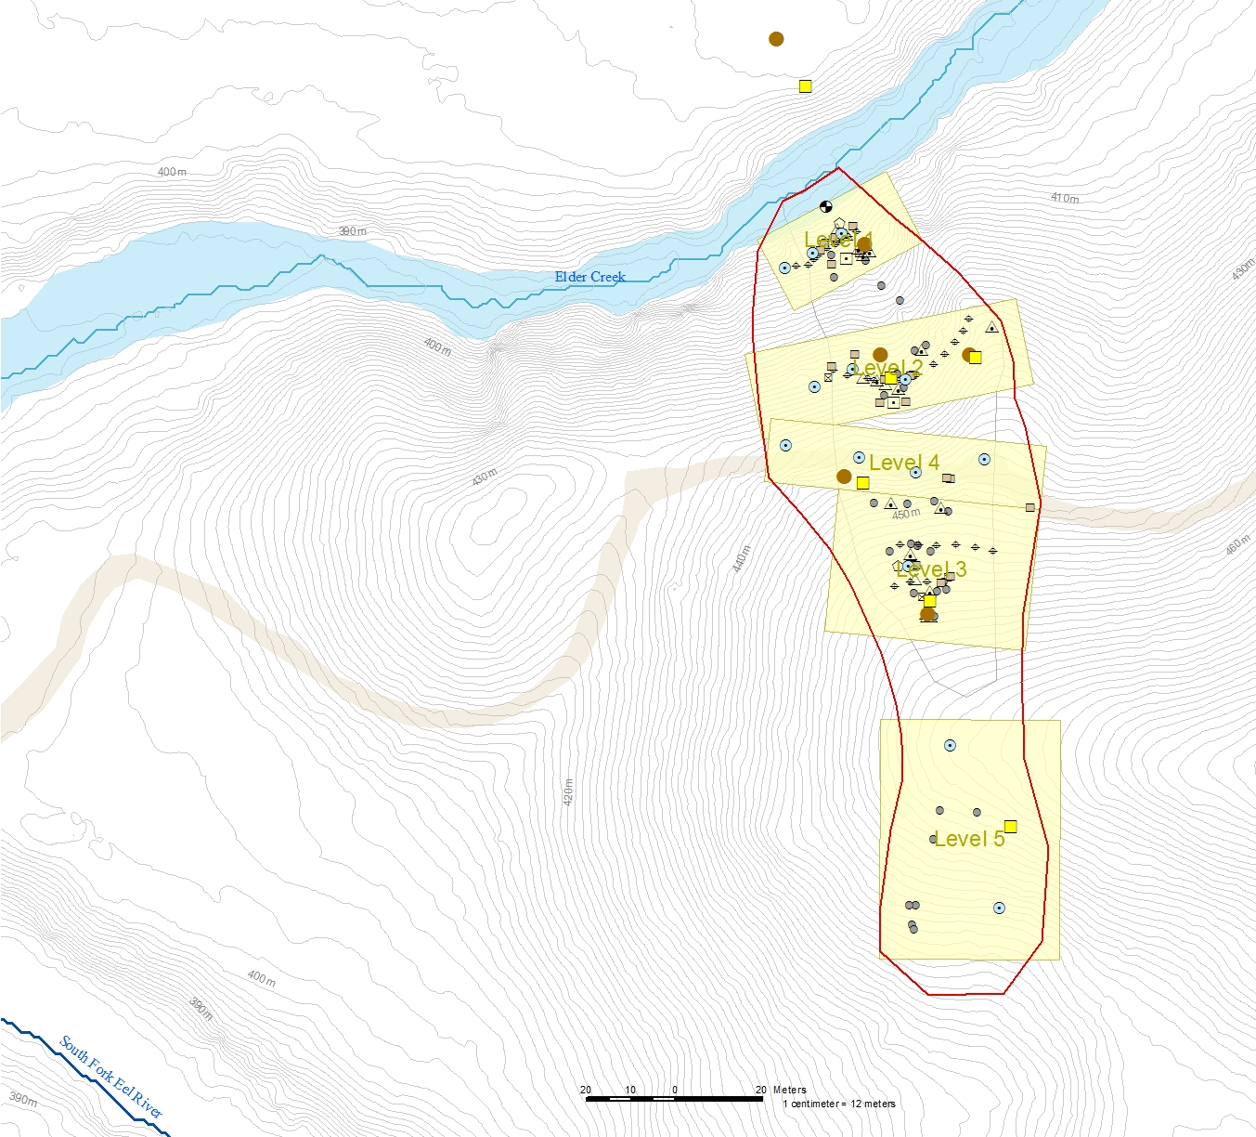
Rivendell Sensor List
Value Measured | Instruments
Barometric pressure | 7
CO2 Sensor | 2
Light, net radiometer | 1
Light, shortwave | 12
Light, shortwave, offline | 30
Logger, battery voltage | 15
Logger, temperature | 15
Precipitation, tipping bucket | 9
Relative humidity | 15
Sap flow | 122
Snow pack height, sonic | 1
Soil Hygrometer/Psychrometer | 54
Soil moisture, Electrical resistance | 192
Soil moisture, sm200 | 30
Soil moisture, time domain reflectometer | 100
Temperature, air | 14
Temperature, air, offline | 30
Temperature, water | 3
Water content reflectometers | 15
Water samples, isco | 4
Water turbidity | 1
Well and stream water level | 23
Well water level, manual | 12
Wind, direction | 6
Wind, speed | 7
Total | 718
Notes:
scaling issues with large numbers of sensors. reliability becomes more important than cost. online critical.

Slide 9
Sensor Observatory: Networking & Power
Networking

Slide 10
Angelo Coast Range Reserve
Wireless Infrastructure
Cahto Peak
Internet Access Point
Relay
Wilderness Lodge
Relay
Steward’s Residence
Rivendell Research Site
ERCZO
Relay
Headquarters
Backbone 2.4ghz Network
Campbell 900mhz Network
Relay
Wifi (802.11) Network
Notes:
ANWI: Angelo Network Wireless Infrastructure
Tier 1: Backbone
30 km2 Angelo Reserve
Heavily forested, rugged topography challenges for placing equipment and transmitting signal through the reserve.
Line of sight for high data rates/high frequency
Fresnel Zone requires additional clearance

Slide 11
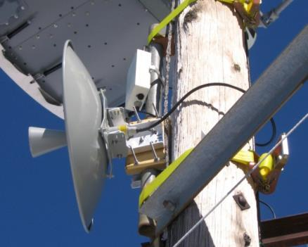
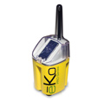
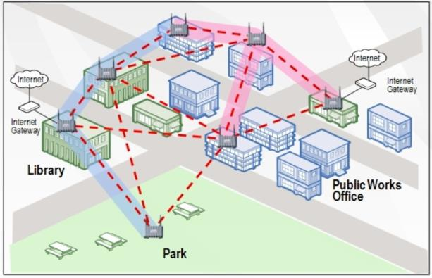
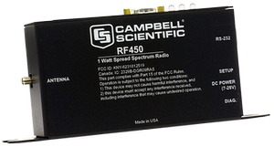
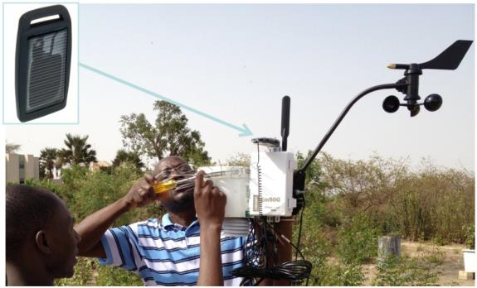
Networking: Internet Radio Types
Backhaul: High Power P2P Radios (5-15 watts)
Ubiquiti Rocket
Motorola Canopy
Eion VIP110-24
Mesh Radios
Prof. Steven Glazer NeoMotes
TerraSense Arduino Motes
Tranzeo Mesh
Memsic Eko Motes
Uplink Radios (1-5 watts)
Campbell Scientific RF450
Custom Wifi radios
Low Power Radios (milliwatts)
Cellular modems
VHF, UHF Telemetry radios
Satellite Modems
Phone credit John Selker

Slide 12

Networking: Radio Frequencies
Frequency | Use
530kHz – 1.7MHz | AM Radio
88 – 108MHz | FM Radio
3 - 30MHz | VHF – ship radios
170 – 698MHz | TV broadcast (Whitespace)
30 – 300MHz | UHF – animal tracking
700MHz | 4G – AT&T, Verizon
800MHz | Cell phones
900MHz | Unlicensed
1.5GHz | GPS
1.7GHz | 4G – Sprint, T-Mobile, USA, MetroPCS
2.4GHz | WiFi, Unlicensed
4.8GHz | Point-to-point, Unlicensed
12.0GHz | Satellite
Low frequencies
better transmission
bad interference
lower data transfer
low power
High frequencies
poor transmission
less interference
higher data transfer
high power
X
(Rappaport, 2002)

Slide 13
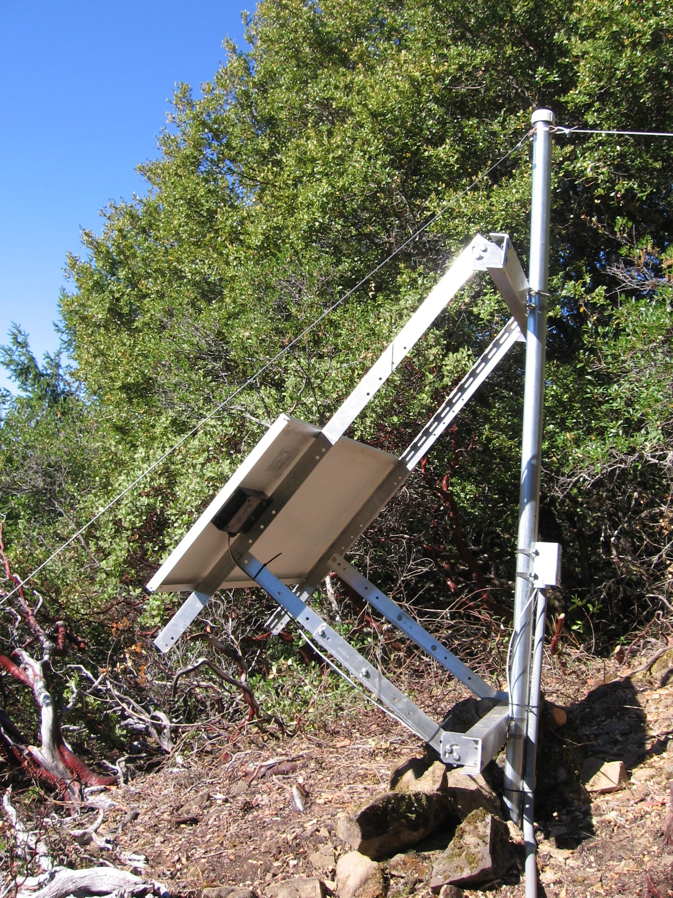
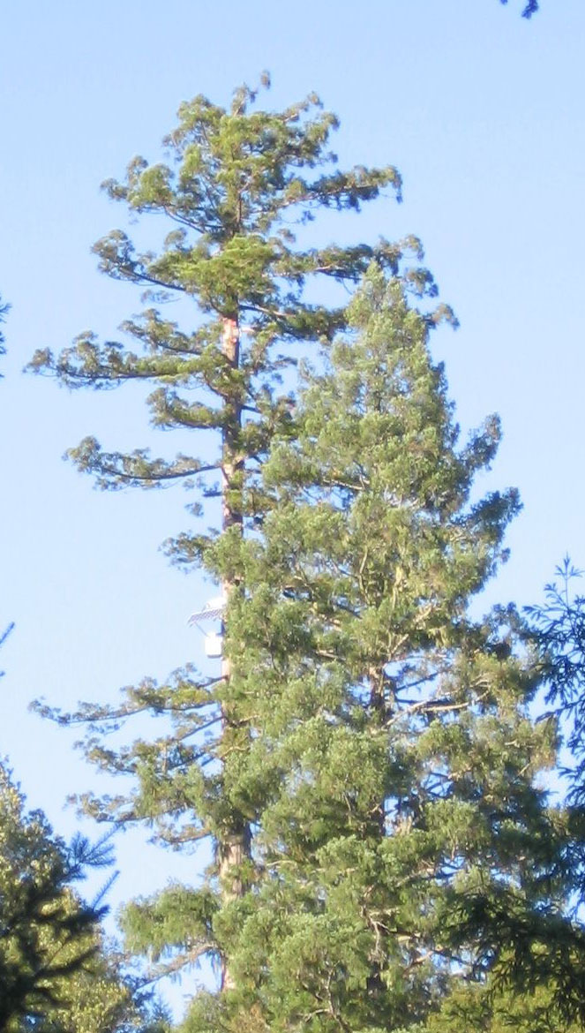
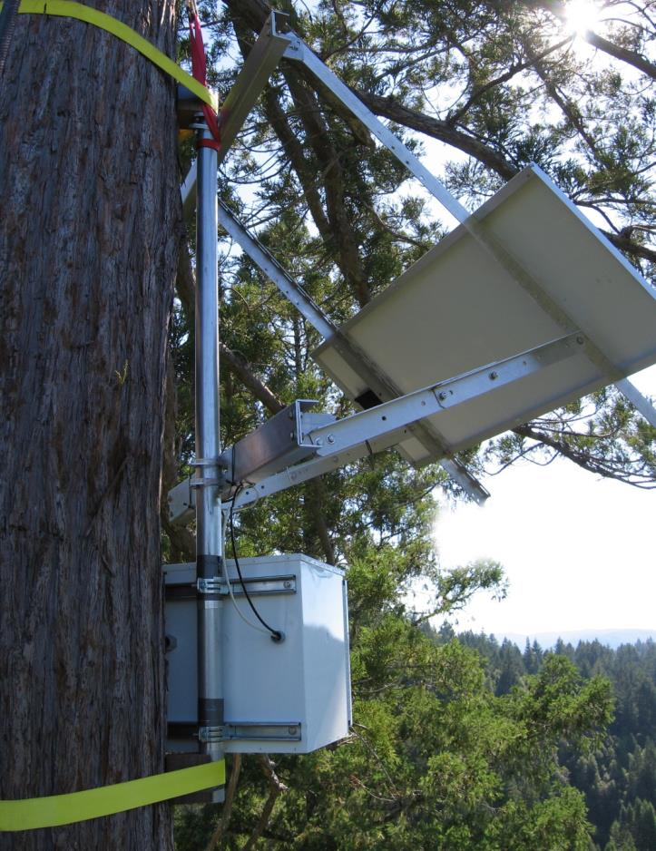
Solar Power: Tree & Ground

Slide 14
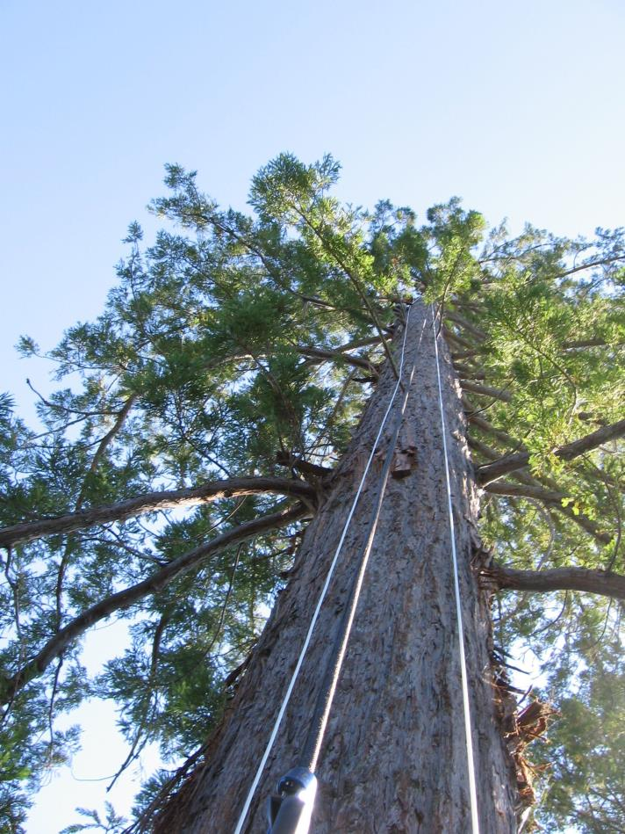
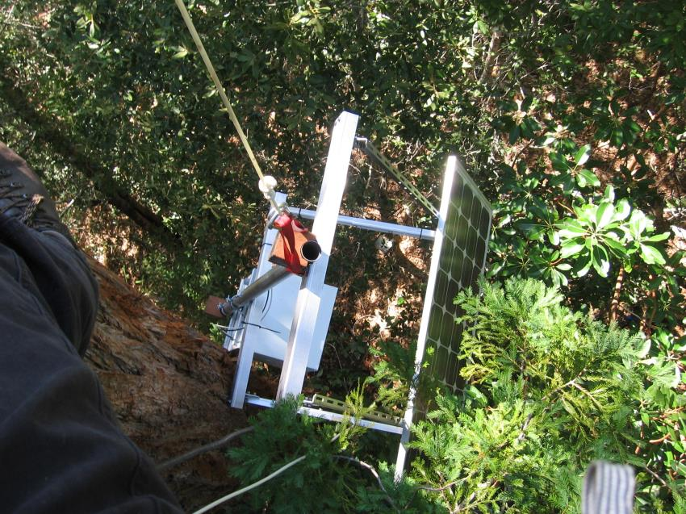
Network & Power
Redwood height: 40 meters
Solar System total weight: 80kilos
Arms: very sore

Slide 15
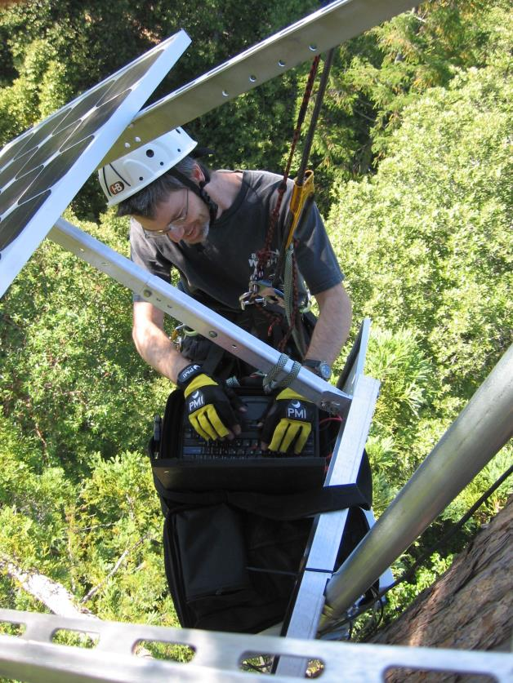
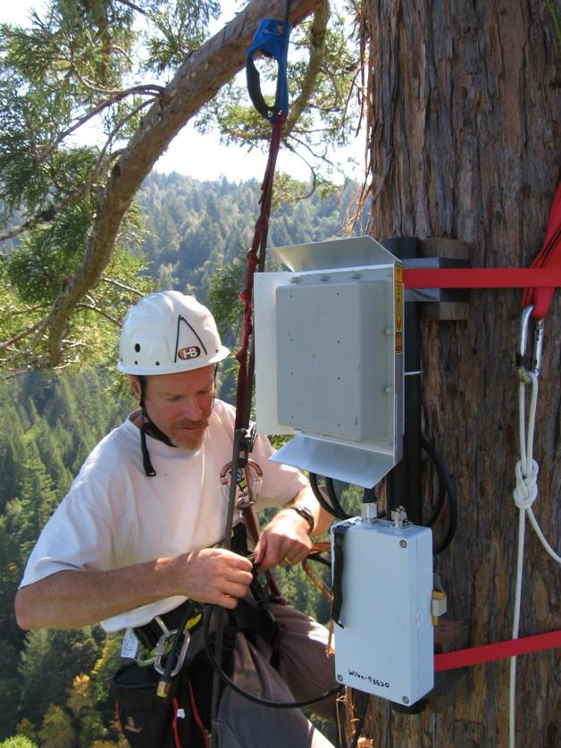
Network & Power
Collin Bode, configuring at 35 meters
Peter Steel, Reserve Steward,
Setting up radio and antenna

Slide 16
Informatics: Bereley Sensor Database
Sensor Database Design Goals
Standardization
Automation
System Maintenance
Quality Control
Informatics

Slide 17
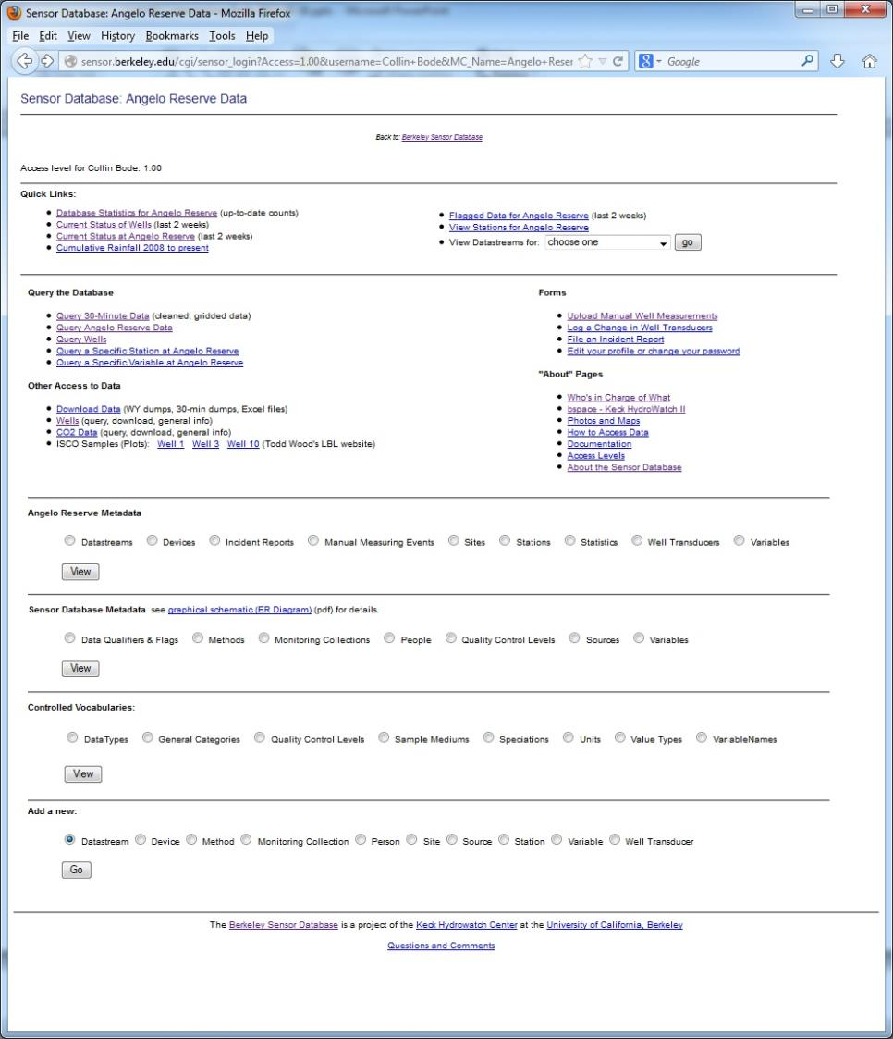
Informatics:
http://sensor.berkeley.edu
Sensor Database
Number of users: 60
Data storage, retrieval
Data quick visualization
Maintenance

Slide 18
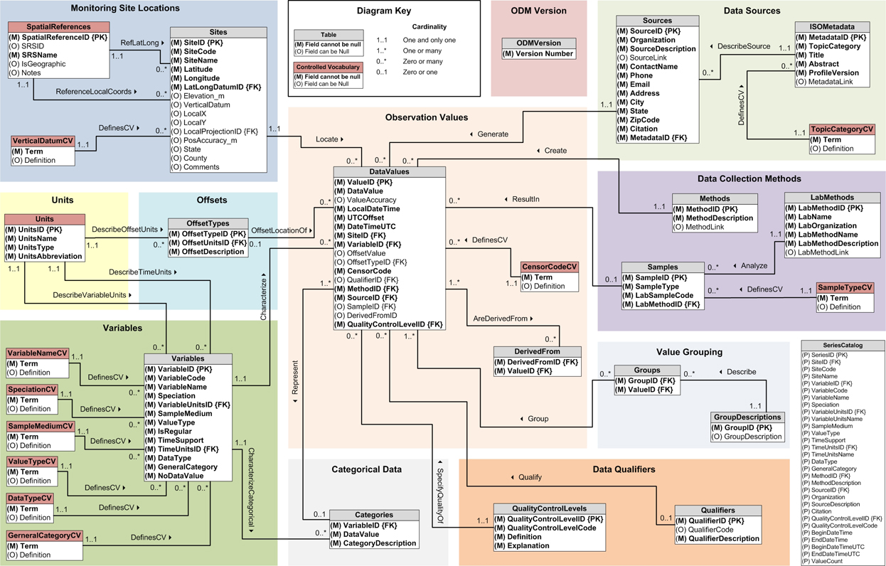
CUAHSI Observations Data Model (ODM) 1.1
Microsoft SQL Server Database Schema

Slide 19
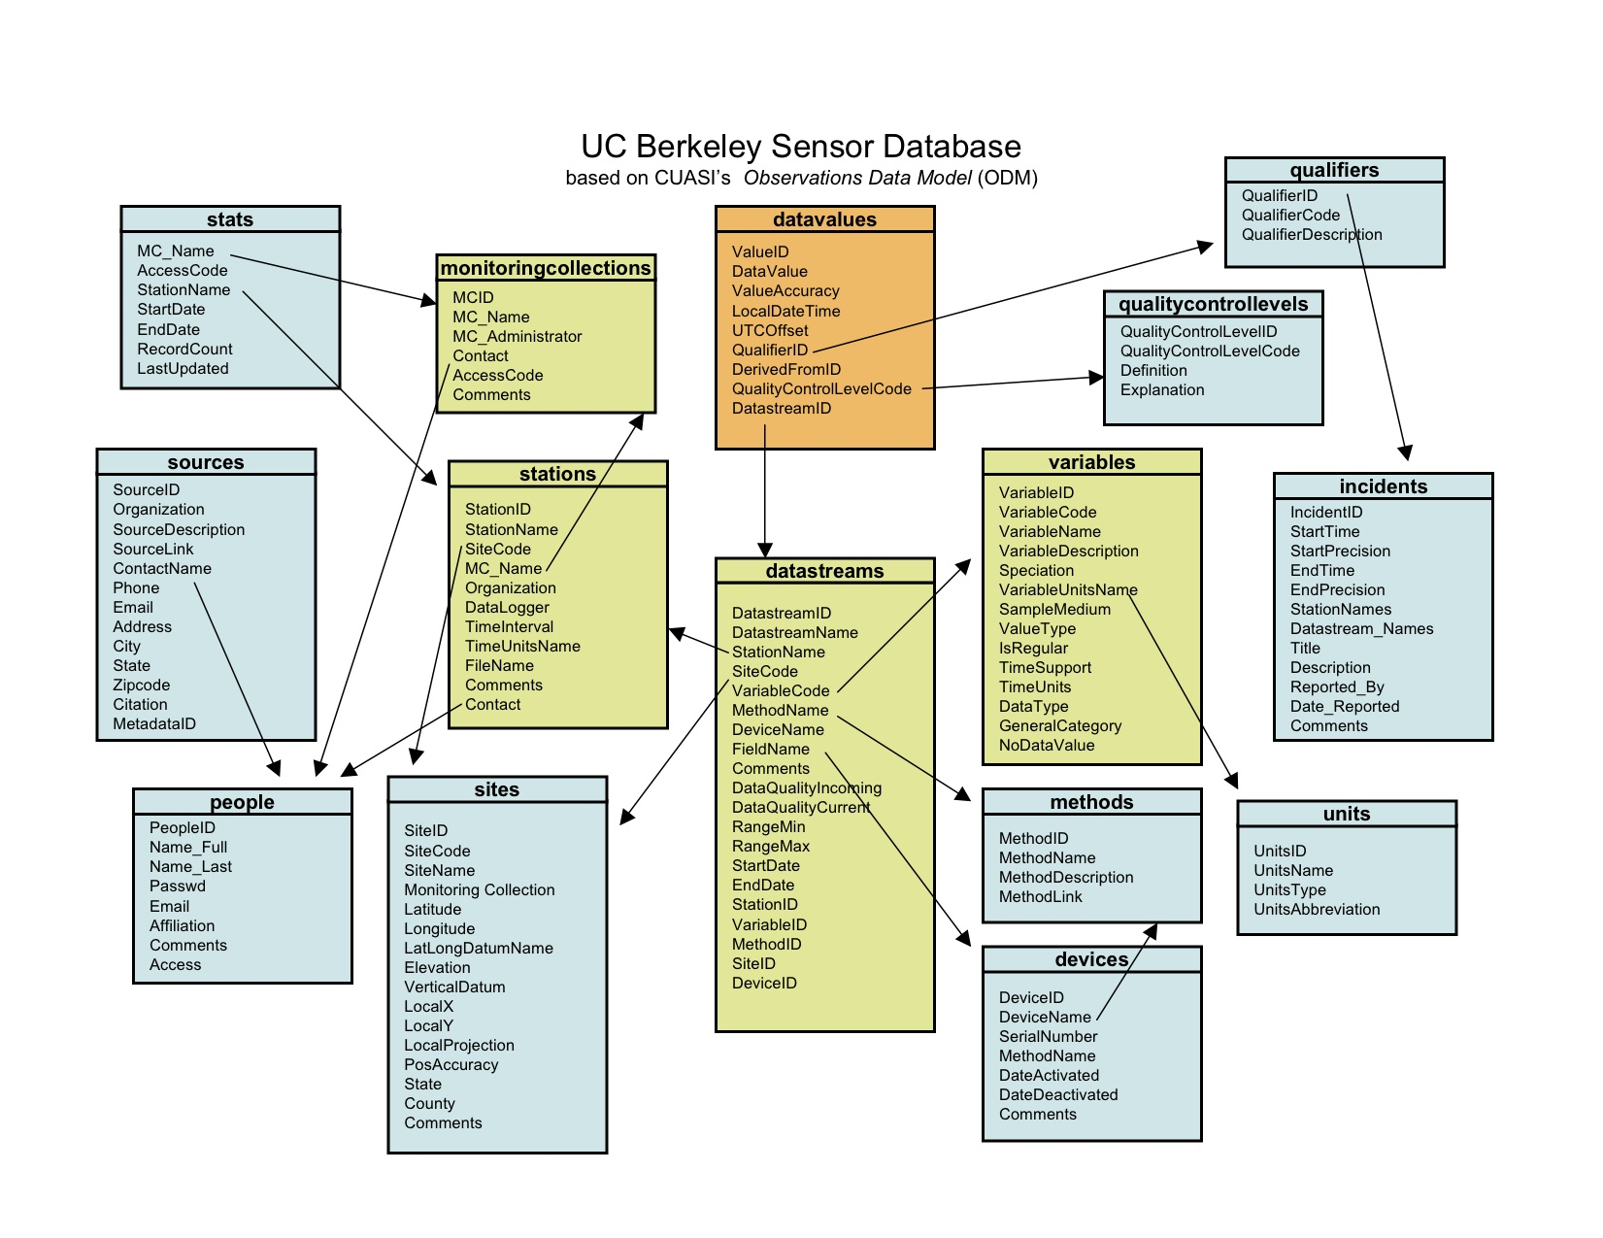
Berkeley Sensor Database
http://sensor.berkeley.edu/implementation.html
LAMP (Linux,Apache,MySQL,Perl)
Focus on Managing & Quality Control
310 million records as of 13 Sep 2015
Online since Oct, 2008
Notes:
Focus on management and data quality

Slide 20
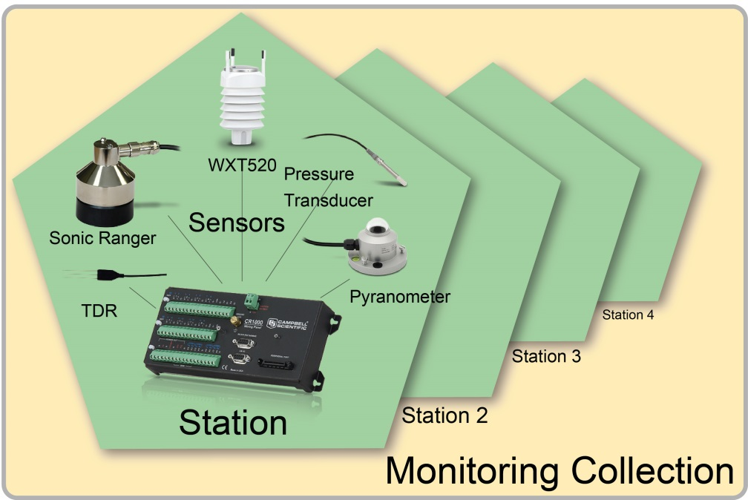
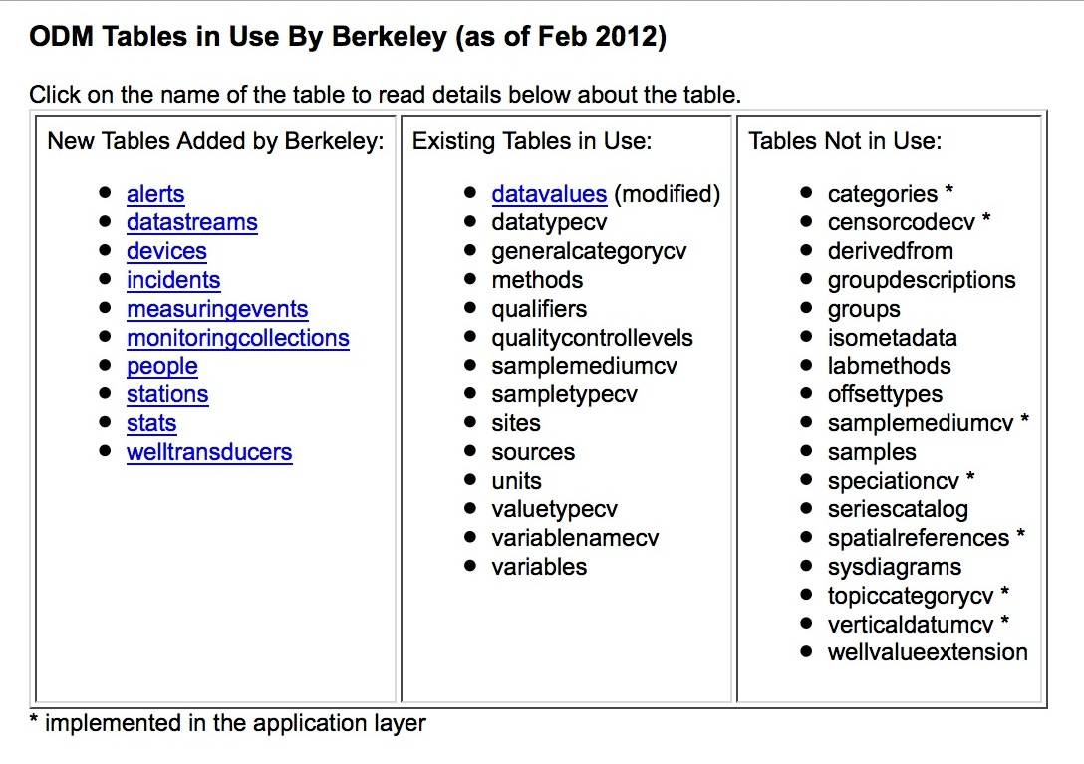
Conceptual Differences from ODM 1.1
Monitoring Collection: A conceptual grouping of stations, usually being used by a specific research project or organization. Access Control
Station: One datalogger with sensor devices attached, such as a weather station. The Station is also used to define the output data file which is pulled from the logger.
Method: A way to measure a parameter. Usualy a particular instrument make and model. Already exists in ODM.
Device: A specific instance of a method that is installed. A device can be decommissioned, or moved to another location.
Datastream: The "data flow" of one type of data from a device of a particular method at a particular location.
Keck
HydroWatch

Slide 21
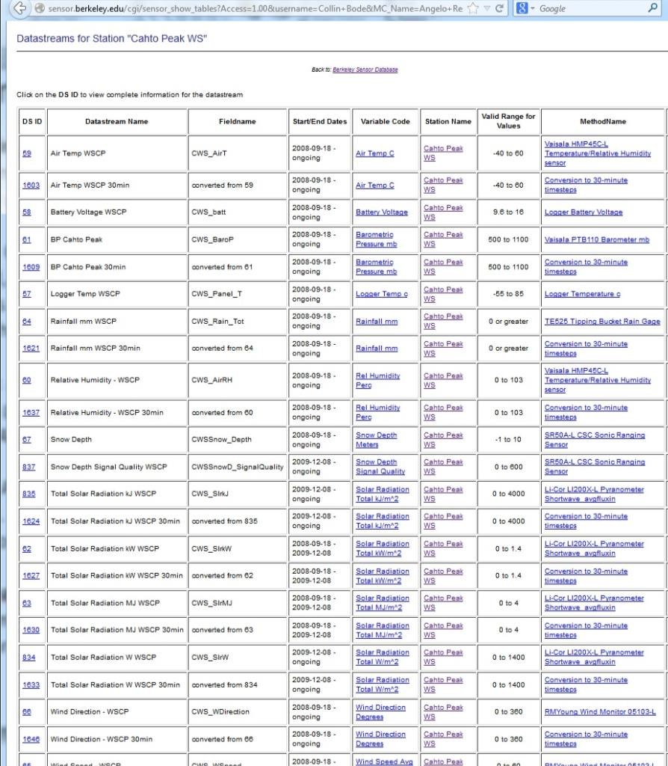
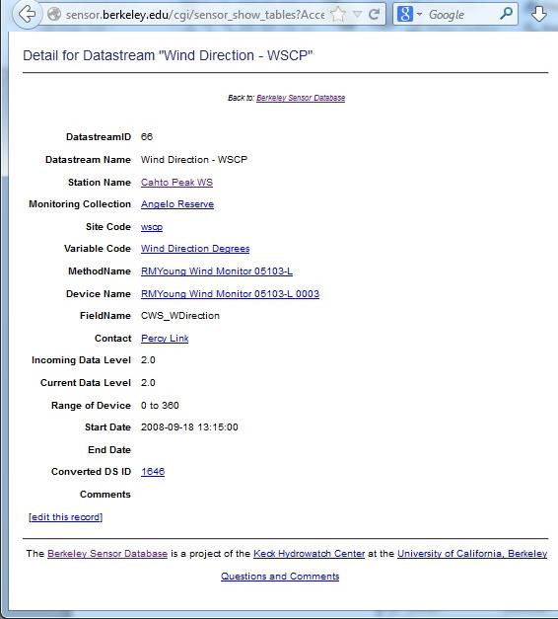
Informatics: Datasreams
Datastream: The "data flow" of one type of data from a device of a particular method at a particular location.

Slide 22
Quality Control
Project Requirements:
• Store all versions of data (raw, converted, derived)
• Automated Sanity check on incoming data
• Allow users to manually flag data
• Show flags & annotations on all data
Tables
odm.qualifiers
odm.qualityconrollevels (mod)
odm.alerts
odm.incidents
NASA/EOS Data Quality Levels
Data Flags
Level | Definition
0 | Instrument Data
1A | Instrument Data + Metadata
1B | Instrument Data in Sensor Units + Metadata
2 | Geophysical Units
3 | Geophysical Units + Space/Time Uniformly Scaled
4 | Derived Data, from Multiple Variables or from a Model
Data Flag | Description
P | Passed sanity check
U | Unchecked value, no sanity check
NV | No value recorded (NaN)
VB | Value below device minimum range
VE | Value exceeds device minimum range
X | Invalid Data: equipment malfunction

Slide 23
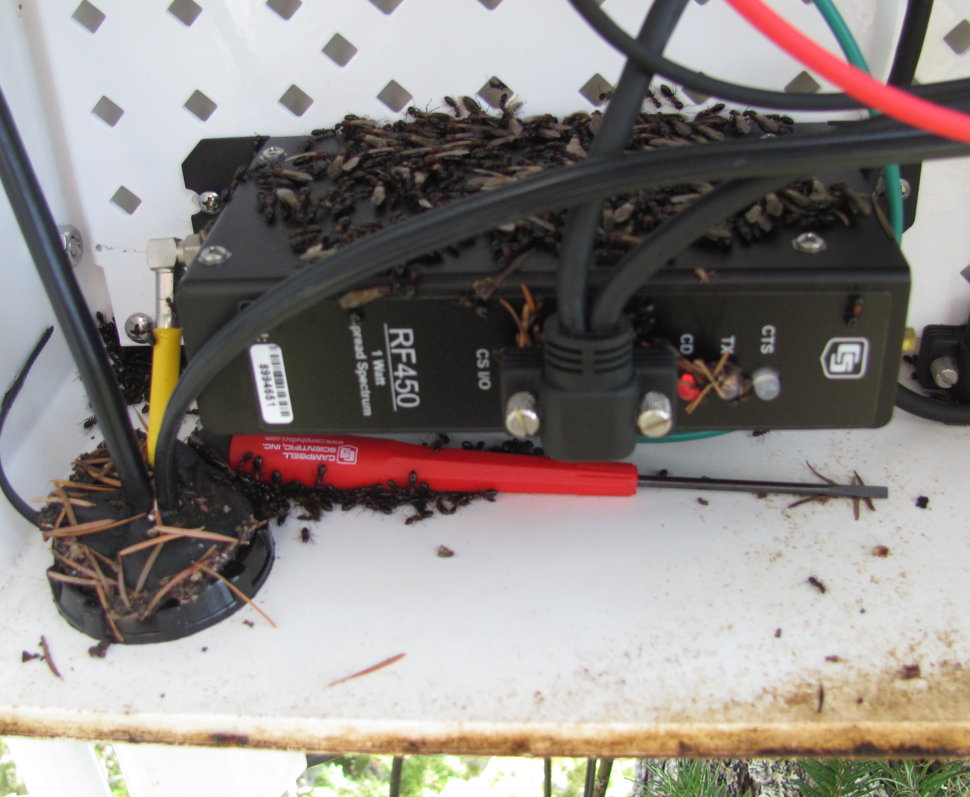
Incident Reports
Tables
odm.incidents
Incident ID 428
Title: Ant Colony Corrodes Radio
Station Name(s): WSIC
Datastream(s): resistance probes,
rain collector
wells
Data Flagged: ERPs: 90,304 values
Well 6: 3,024 values
Well 7: 3,024 values
StartTime: 2014-03-24 (+/- 1 days)
EndTime: 2014-04-08 (+/- 1 days)
Reported By: Collin Bode
(2014-04-09 00:00:00)
Description:
Okay, I wasn't expecting that. I climb 40 meters up a Ingrid (douglas fir tree) to figure out why my data logger's wireless stopped working. I open the box, and surprise! An ant colony is using the wireless radio as an egg warmer.
The colony somehow corroded the connectors between the radio and the logger so badly that the firmware got corrupted. All slave radios were offline until I replaced the radio a spare.
I left the box open to allow them to naturally disperse, then swept the stragglers out with a paintbrush. Replugged the hole with weather goop.

Slide 24
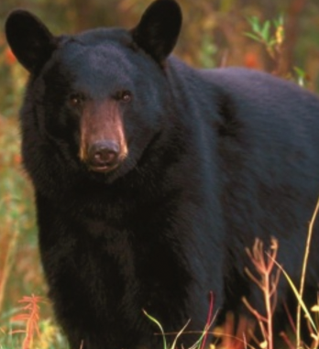
Berkeley Sensor Database: Incident Reports
Incident ID 1
Title: Bear damage
Station Name(s): L1_1, L1_2, L2_1, L2_2,
L3_1, L3_2, L4_1
Datastream(s): resistance probes,
rain collector
wells
Data Flagged: ERPs: 290,304 values
Well 6: 3,024 values
Well 7: 3,024 values
StartTime: 2009-09-24 (+/- 1 months)
EndTime: 2009-10-24 (+/- 1 days)
Reported By: Bill Dietrich (2009-10-26 00:00:00)
Description:
Daniella, Jasper and I visited the site this past weekend. Unfortunately a bear did some damage recently. It systematically knocked over and chewed on everyone of the plastic bag covered resistance probes. They were each snapped at the soil boundary. I haven't had a chance to check to see when this might have happened according to the online record. The bear also knocked over the rainfall collector (James says he has found teeth marks in it before). It broke the extended plastic tube on well 7 and the wooden stake holding up the plastic tarp. and it knocked off the cap of well 6. We didn't detect other damage-- but there could be some. I encourage you all to check your favorite on line device. We put the cap back on 6, propped up well 7 tube and put back a stake. and reset up the rain collector.

Slide 25
Datastreams
Abstracts sensors
Optimizes datavalues table
Includes QC Information (min/max value)
The "data flow" of one type of data from a device of a particular method at a particular location.

Slide 26
Access Control
Tables
odm.monitoringcollections
odm.people
Data Principle
Encumbered Data
Individualized Access

Slide 27
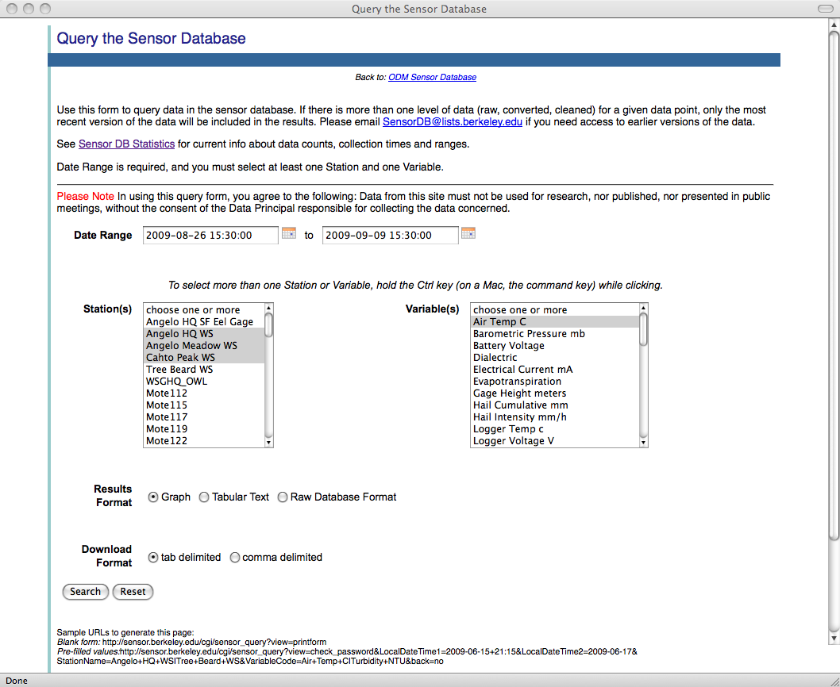
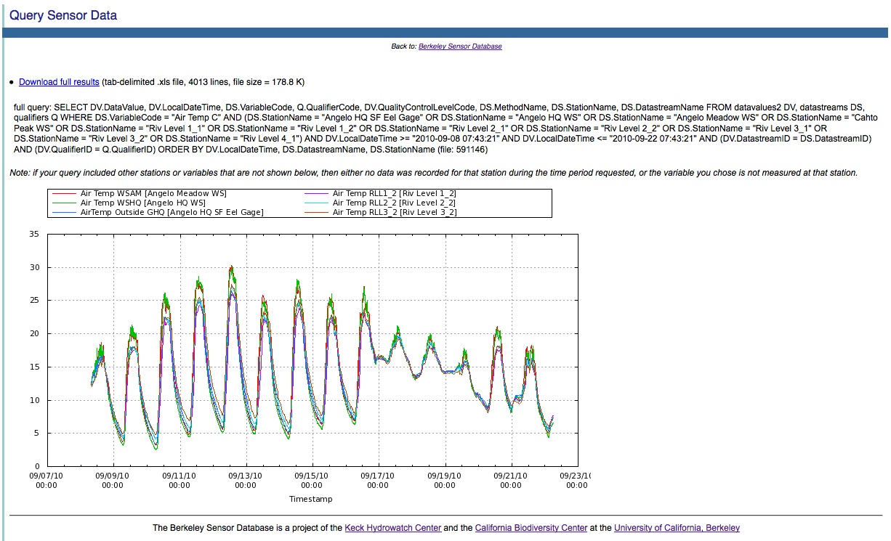
Researcher Use (60 active users)
http://sensor.berkeley.edu
Type of Access | Description | Data Format
Web Access | Rapid visualization & download. Valid project login | Graph & CSV download
Scripting | Python, Matlab, R | matrices
Bulk Data Dumps | Valid project login | Zipped, CSV, weekly refresh

Slide 28
Lessons Learned:
Data Principle: Each set of sensors requires an individual who is responsible for their functioning.
Receive email alerts when data is out of bounds
Check sensor database graphs for unusual behavior
Write incident reports when something goes wrong
Get credit on publications using their data
Wireless Motes: Wonderful idea. Excellent potential. Difficult to realize.
Power: real-time systems require a lot of power. Planning for sufficient power for your climate and deployment is critical to its success.
Maintenance: the infrastructure takes a lot of maintenance. Large deployments need an informaticist.

Slide 29
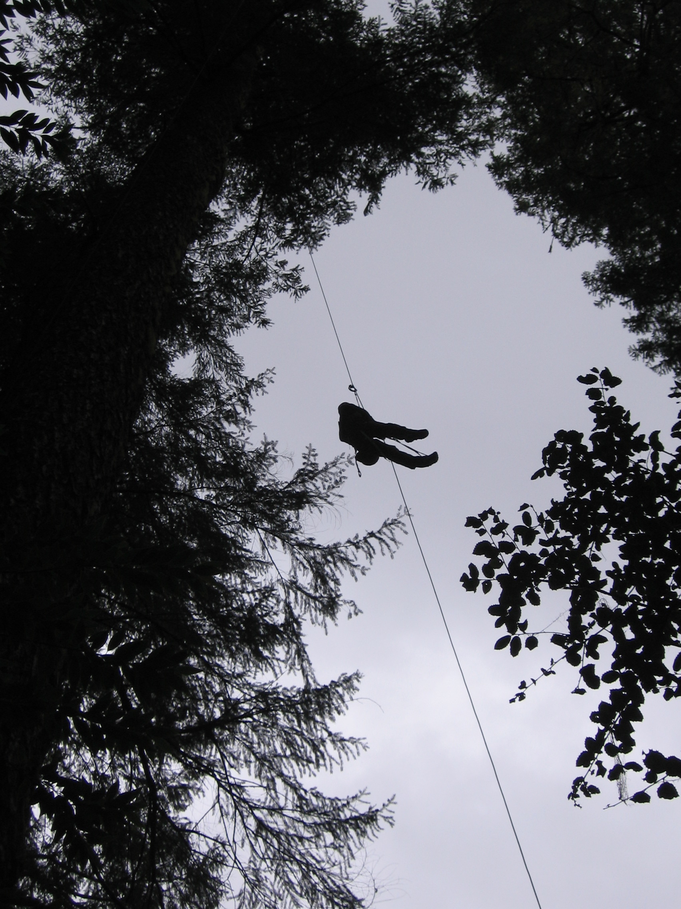

Slide 30
Extra slides

Slide 31
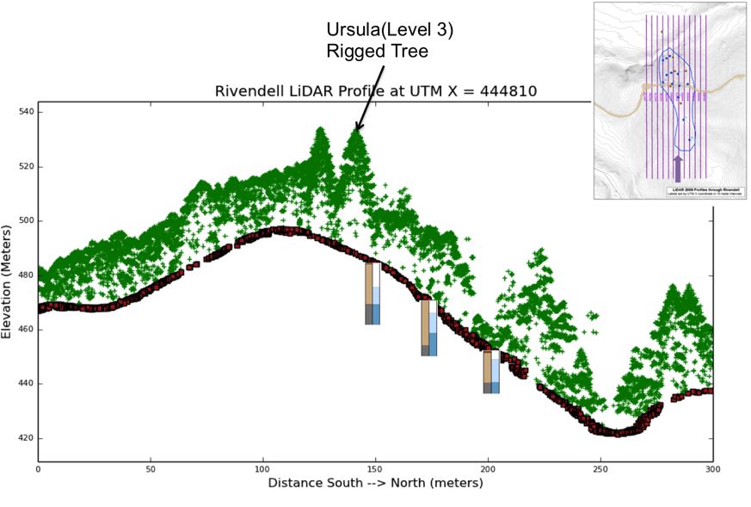
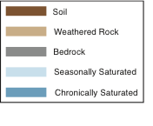
wells
Notes:
Vegetation on S and N slopes differ markedly and this represents an opportunity to use ‘slope’ as a proxy for future climate change. Percy’s WRR paper show that the tree species transpiration are driven by different things.

Slide 32
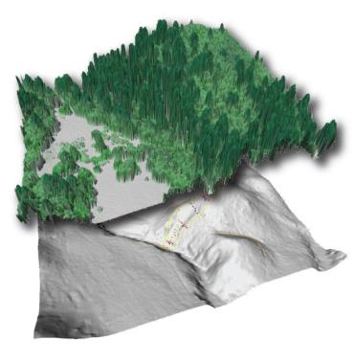
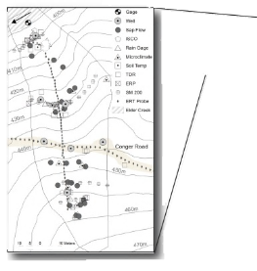
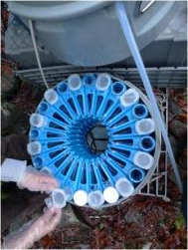
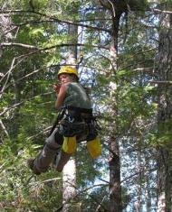
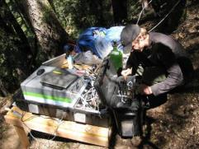
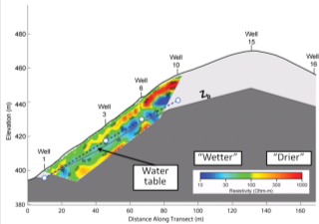
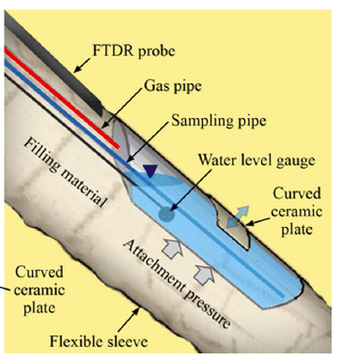
Data Collection
Sensor Observatory
GIS & LiDAR
  2(2) LiDAR flights 2004,2009, (2014 green, 2015)
  10 years of GIS layers
Automated water collection: chemical & isotope analysis
  Four 24 –position Isco water samplers: 3 wells, 1 stream
  Networked for remote sampling adjustment
  Modified bottle collectors to isolate water
Manual Sampling and Monitoring
  Tracing isotopes through the system: vegetation, soil, lysimeter water, well, stream
  Well level hand measurements
  Collection of Isco water bottle samples
  Rain water collection
Targeted Field Campaigns
  Picarro CRDS analyzer in situ monitoring of d¹⁸O and dD in water & vapor
  Conservative tracer experiments during dry season
Geophysics: mapping fractured rock moisture
  Electrical Resistivity Tomography (ERT)
  Seismic refraction
  Neutron logging in wells
New Tools
  Vadose-Zone-Monitoring System (VMS)
  Tree psychrometer
Notes:
tree psychrometer: directly tests the relationships between moisture, lithology, and water balance in the dominant vegetation types

Slide 33
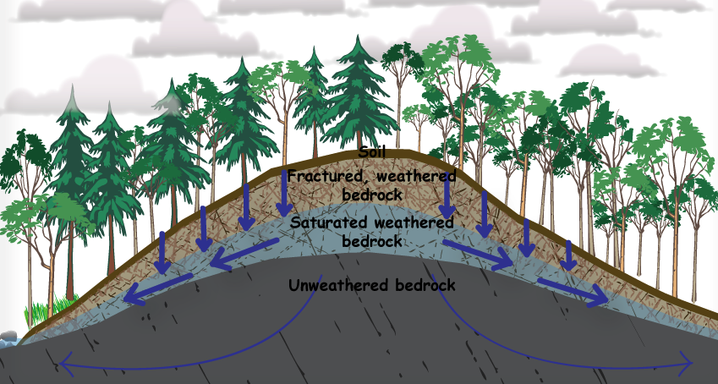
evaporation
transpiration
transpiration
z_{b}
-The unmeasured zone: the unsaturated weathered bedrock through which meteoric water passes to the groundwater;
-Rock moisture: a significant source for water return to the atmosphere (via Doug Fir transpiration) from unsaturated weathered bedrock?
(e.g. Zwieniecki and Newton, 1996, see review in Schwinning, Ecohydrology, 2010)

Slide 34
Precipitation
Topography
Vegetation
Geology
Potential 2nd Site:
Melánge
Primary site:
Coastal Belt
Angelo Reserve
Notes:
The setting and BOTH sites on very different substrates

