Slide 1
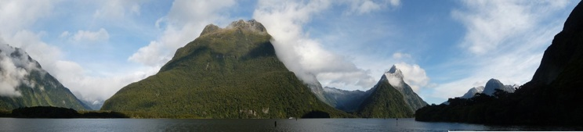
Tectonic Geomorphology
2nd Edition
Burbank and Anderson
Chapter 10: Tectonic geomorphology at late Cenozoic time scales
Figures, Boxes, Plates, Tables

Slide 2
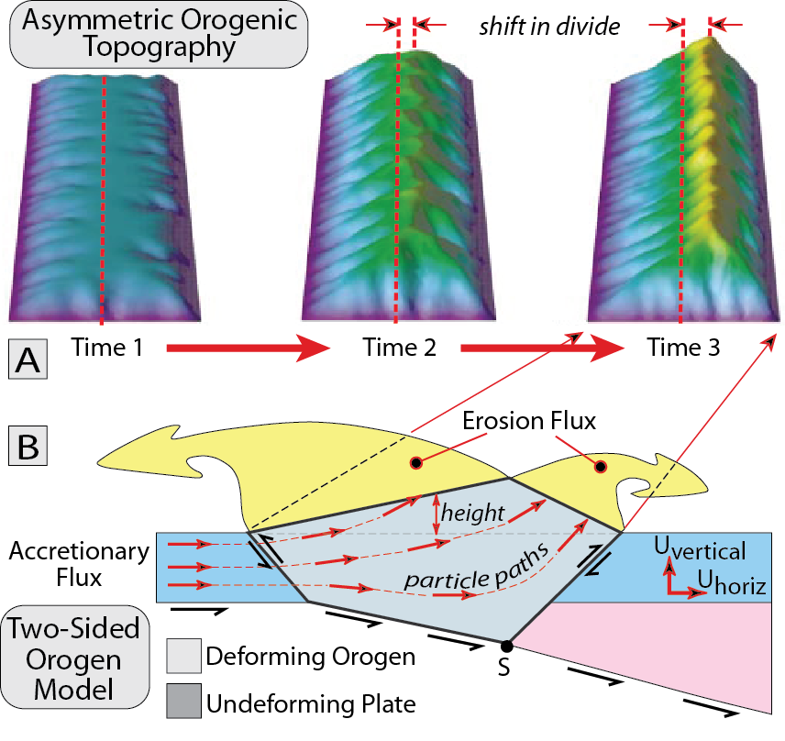
Burbank and Anderson, 2011, Tectonic Geomorphology, Chapter 10

Slide 3
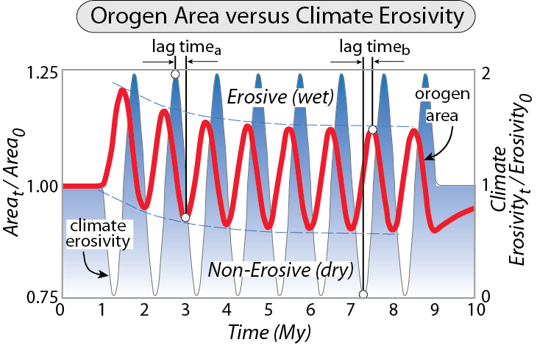
Burbank and Anderson, 2011, Tectonic Geomorphology, Chapter 10

Slide 4
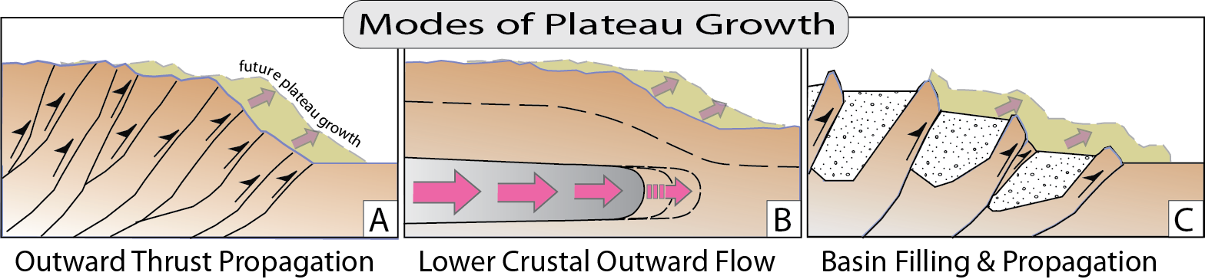
Burbank and Anderson, 2011, Tectonic Geomorphology, Chapter 10

Slide 5
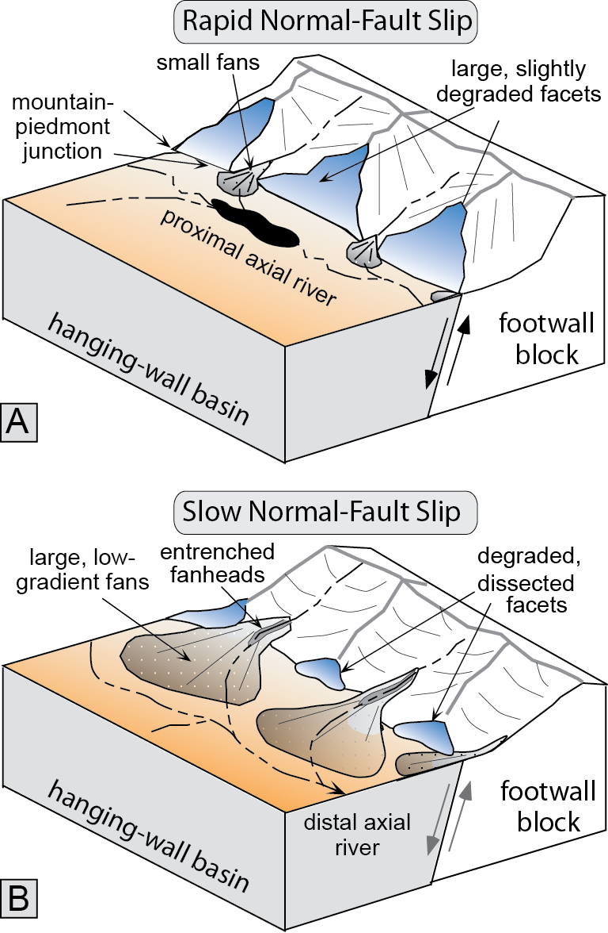
Burbank and Anderson, 2011, Tectonic Geomorphology, Chapter 10

Slide 6
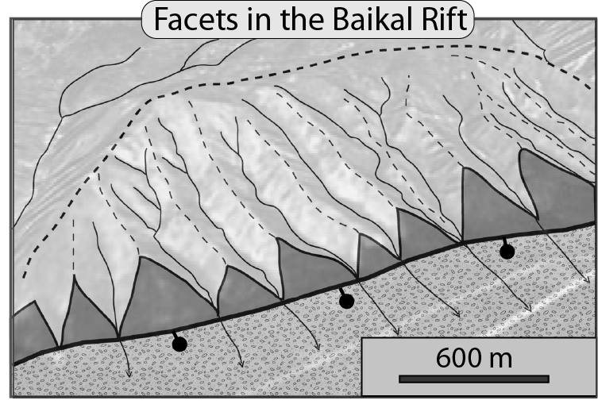
Burbank and Anderson, 2011, Tectonic Geomorphology, Chapter 10

Slide 7
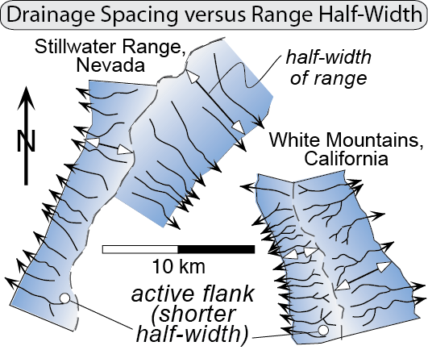
Burbank and Anderson, 2011, Tectonic Geomorphology, Chapter 10

Slide 8
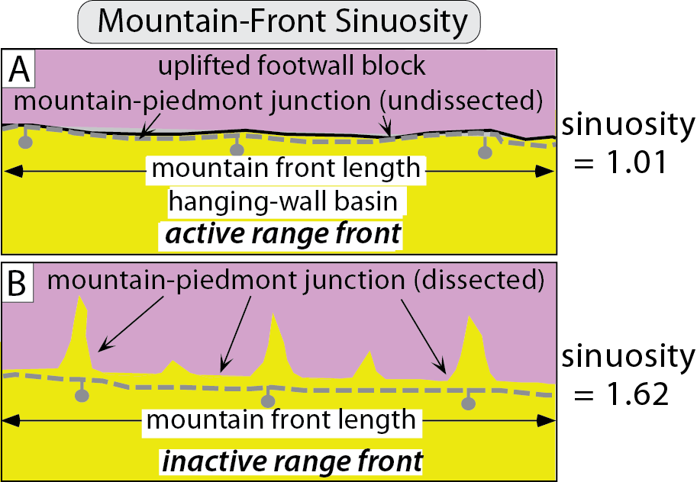
Burbank and Anderson, 2011, Tectonic Geomorphology, Chapter 10

Slide 9
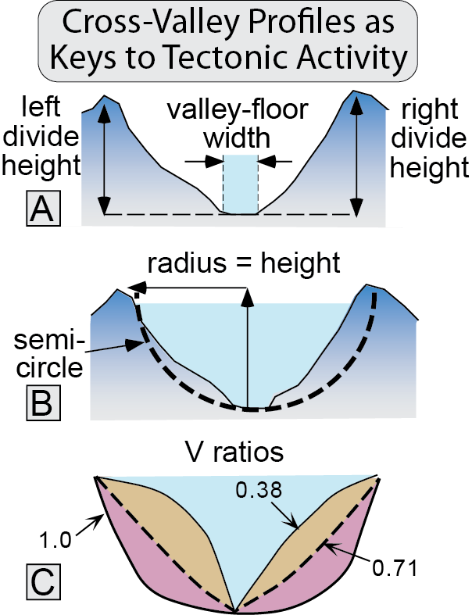
Burbank and Anderson, 2011, Tectonic Geomorphology, Chapter 10

Slide 10
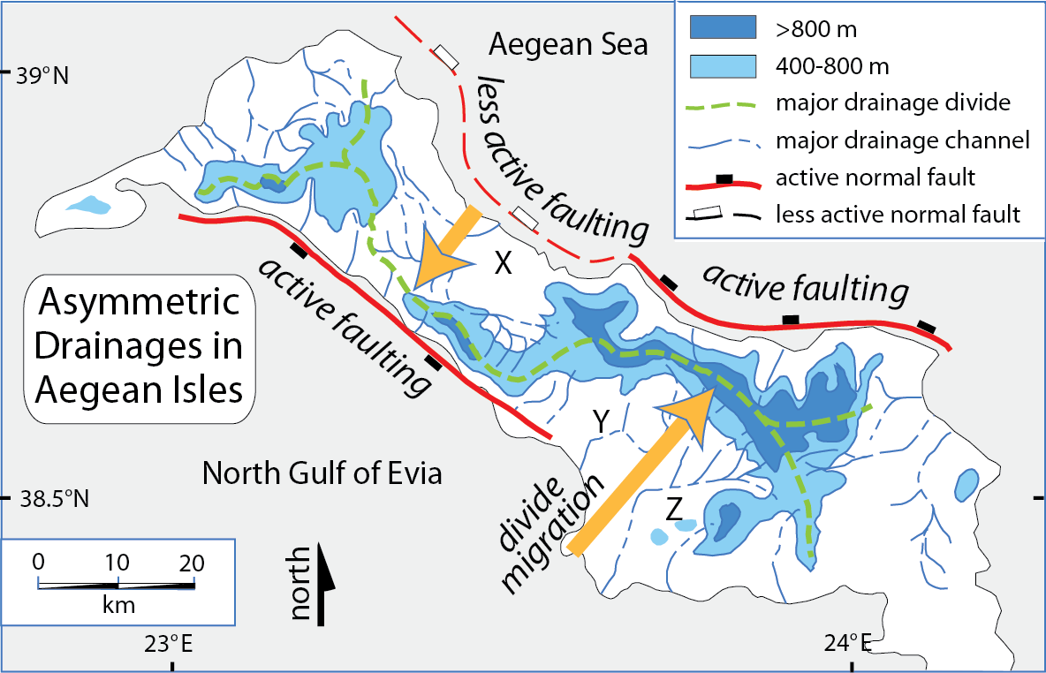
Burbank and Anderson, 2011, Tectonic Geomorphology, Chapter 10

Slide 11
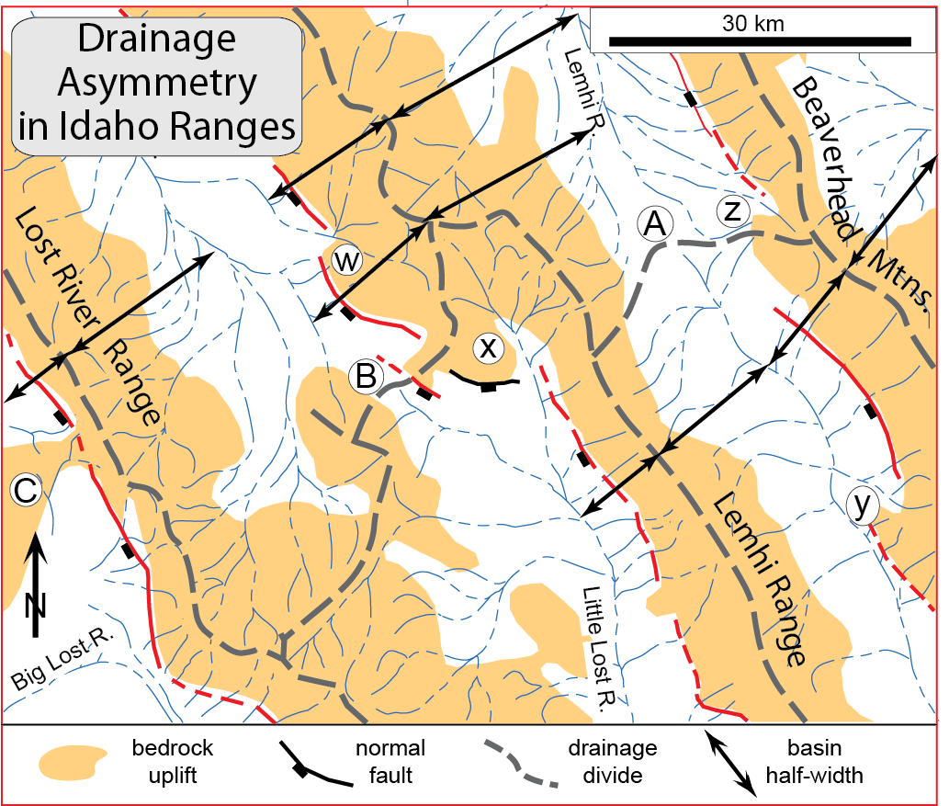
Burbank and Anderson, 2011, Tectonic Geomorphology, Chapter 10

Slide 12
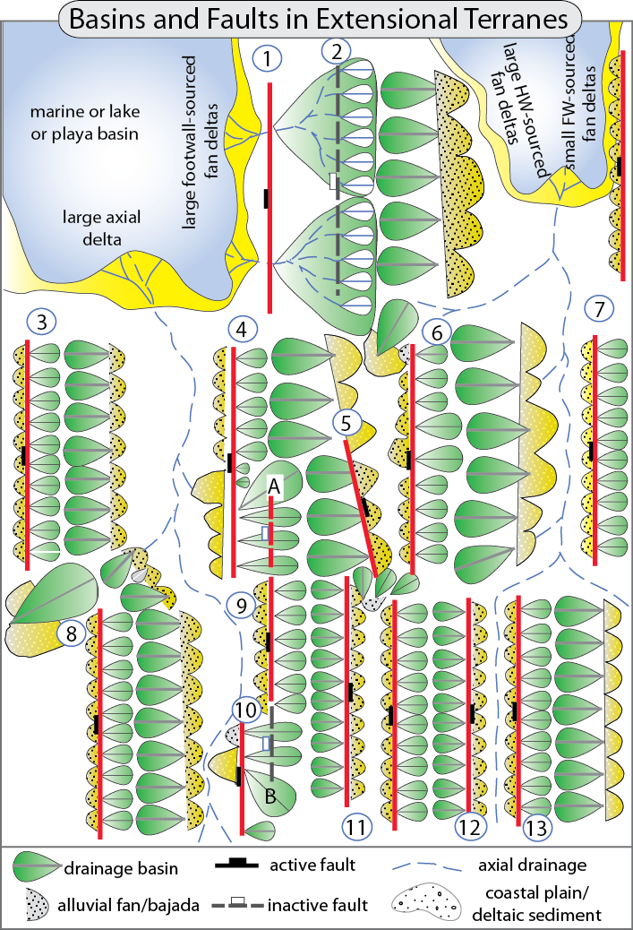
Burbank and Anderson, 2011, Tectonic Geomorphology, Chapter 10

Slide 13
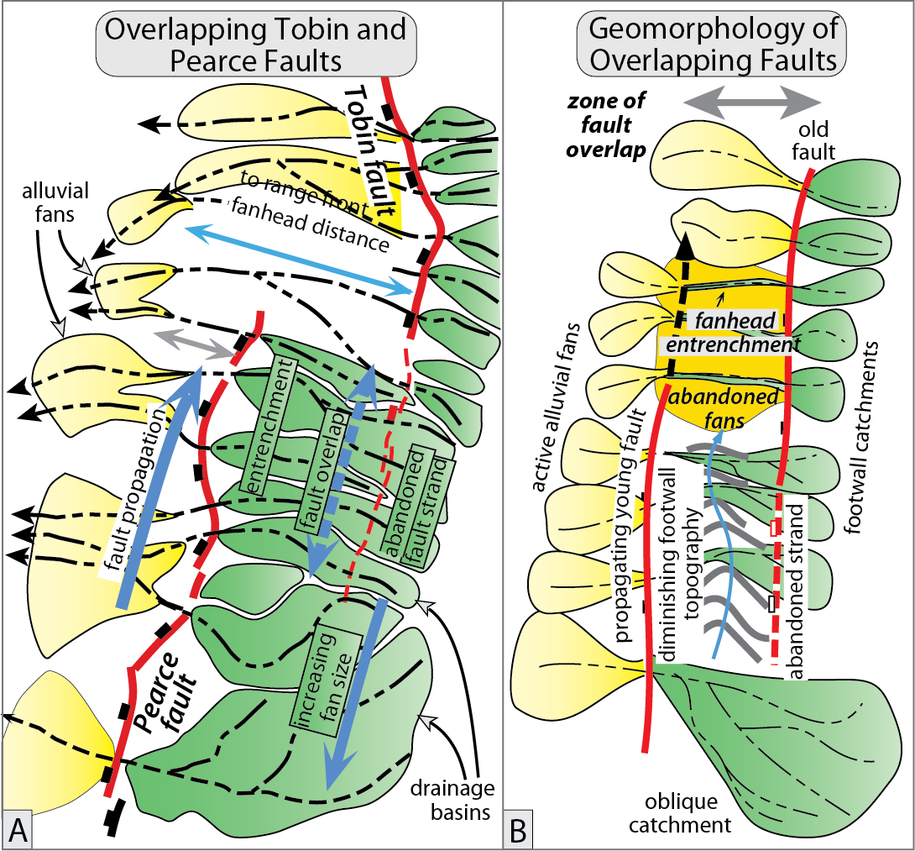
Burbank and Anderson, 2011, Tectonic Geomorphology, Chapter 10

Slide 14
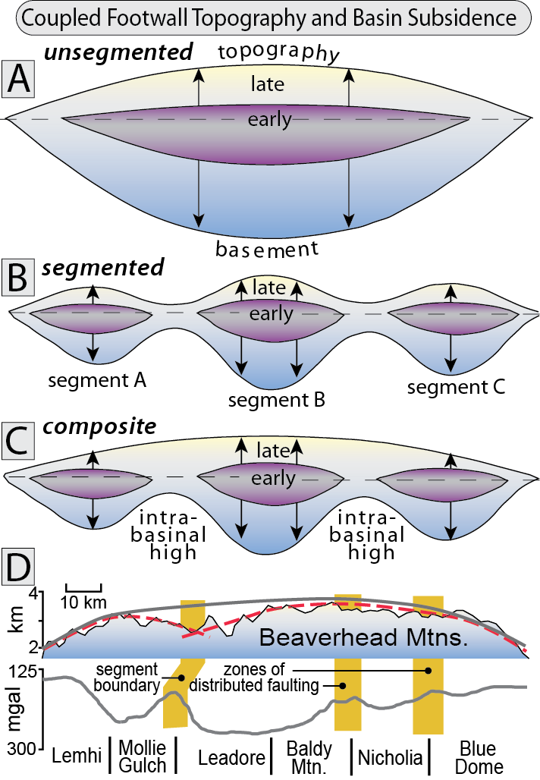
Burbank and Anderson, 2011, Tectonic Geomorphology, Chapter 10

Slide 15
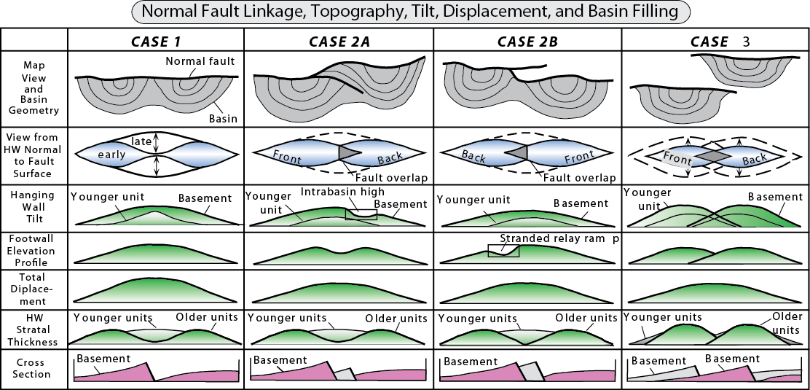
Burbank and Anderson, 2011, Tectonic Geomorphology, Chapter 10

Slide 16
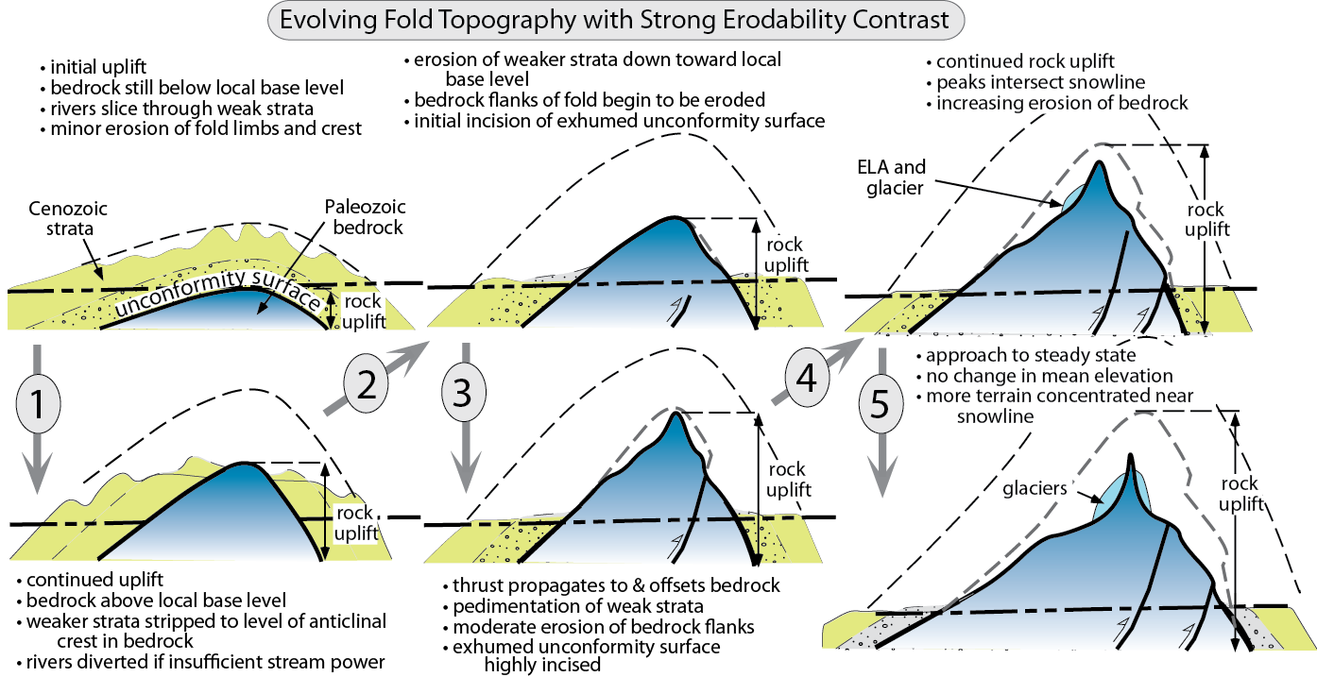
Burbank and Anderson, 2011, Tectonic Geomorphology, Chapter 10

Slide 17
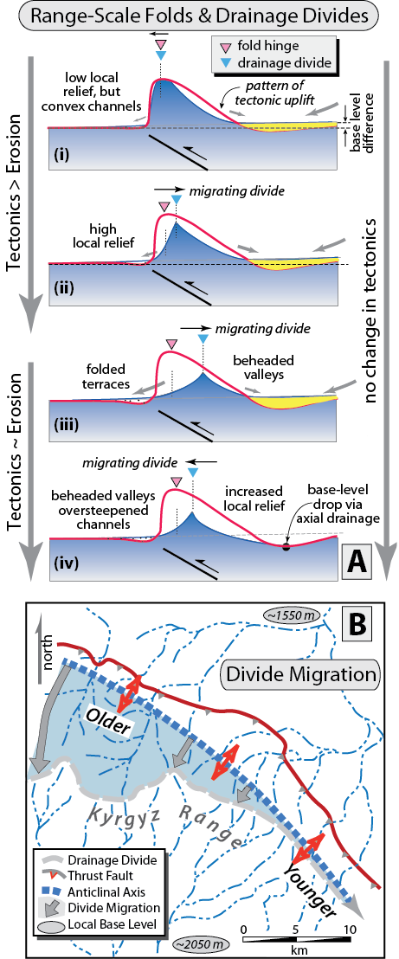
Burbank and Anderson, 2011, Tectonic Geomorphology, Chapter 10

Slide 18
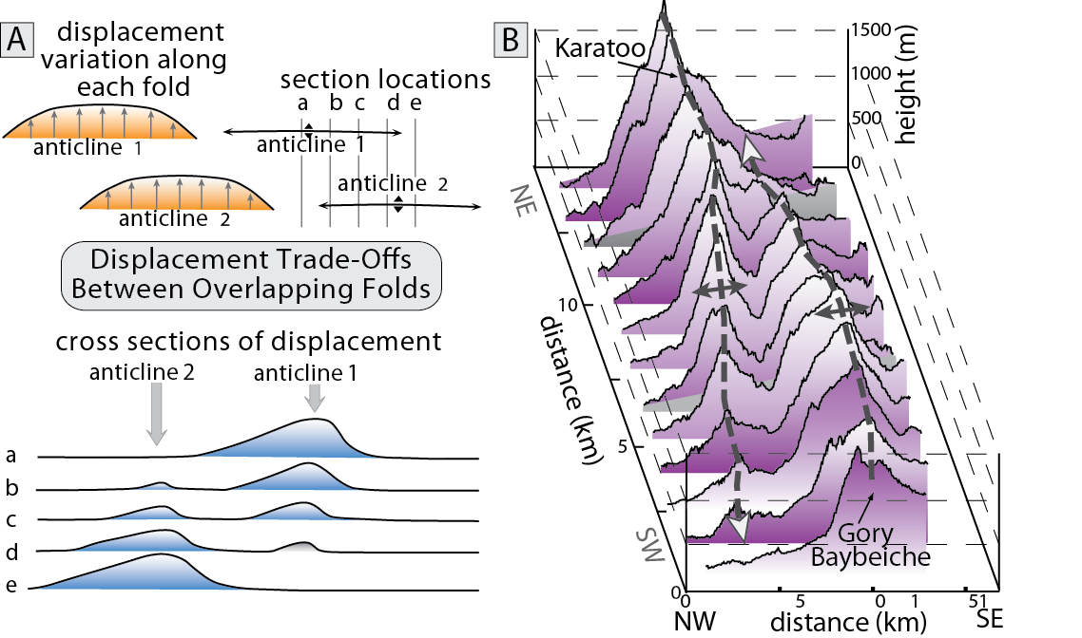
Burbank and Anderson, 2011, Tectonic Geomorphology, Chapter 10

Slide 19
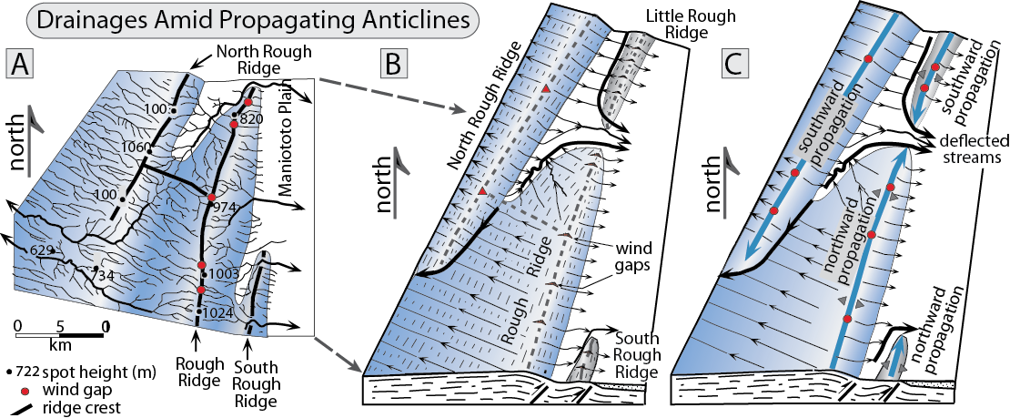
Burbank and Anderson, 2011, Tectonic Geomorphology, Chapter 10

Slide 20
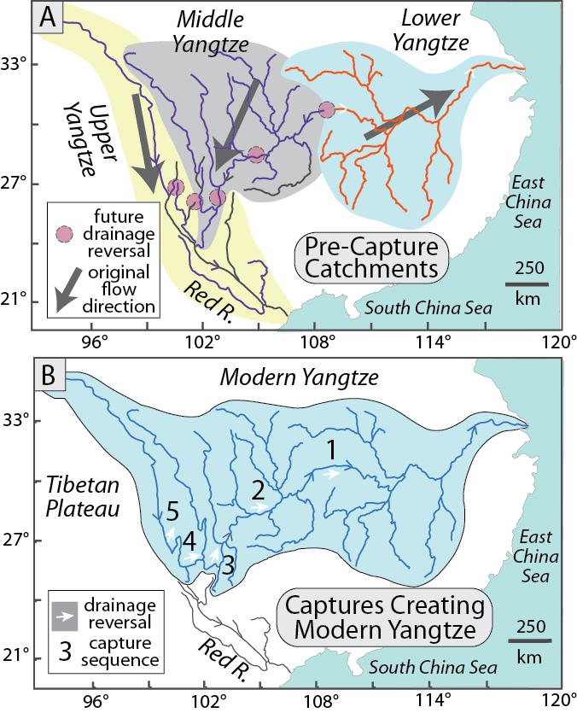
Burbank and Anderson, 2011, Tectonic Geomorphology, Chapter 10

Slide 21
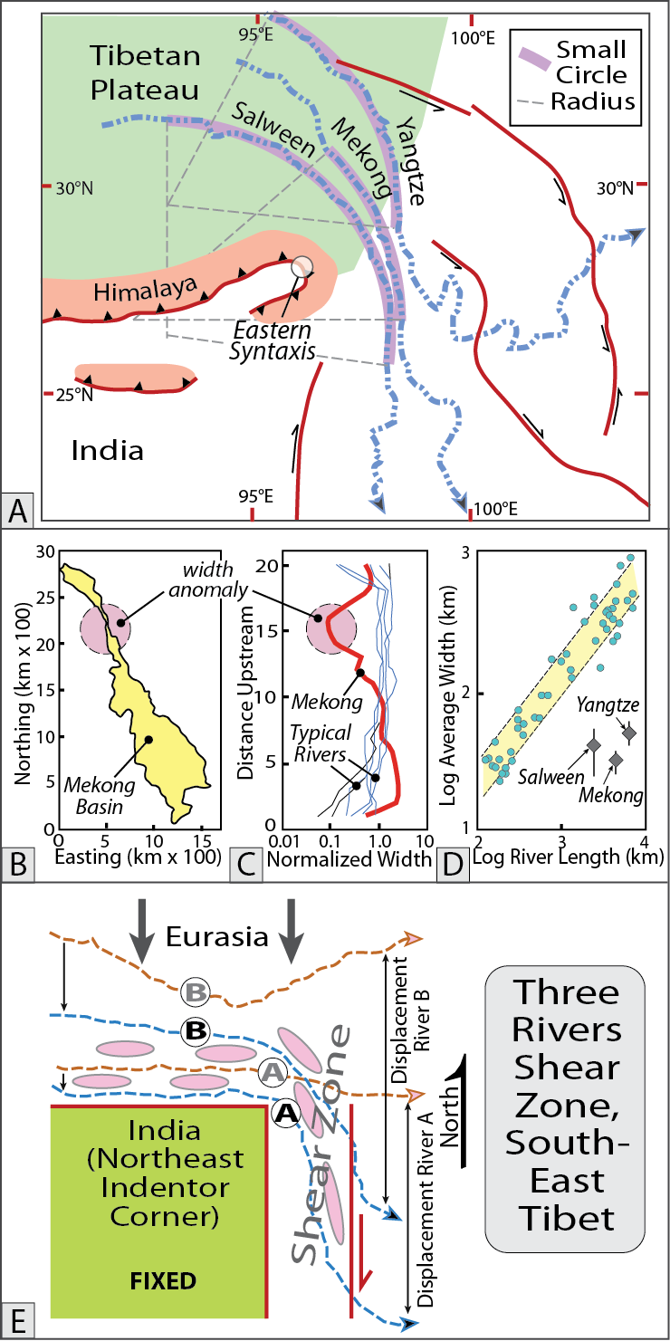
Burbank and Anderson, 2011, Tectonic Geomorphology, Chapter 10

Slide 22
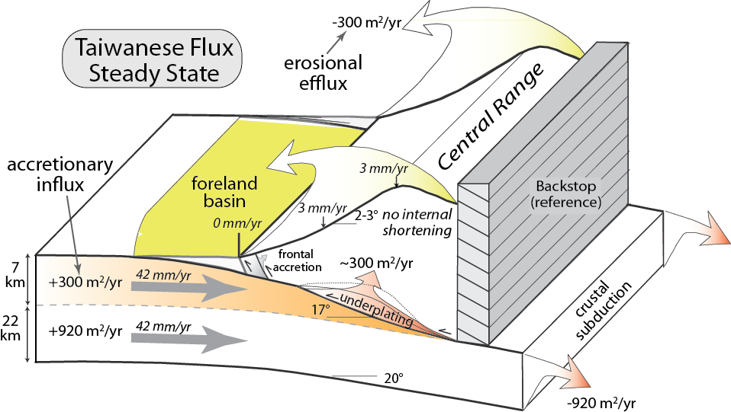
Burbank and Anderson, 2011, Tectonic Geomorphology, Chapter 10

Slide 23
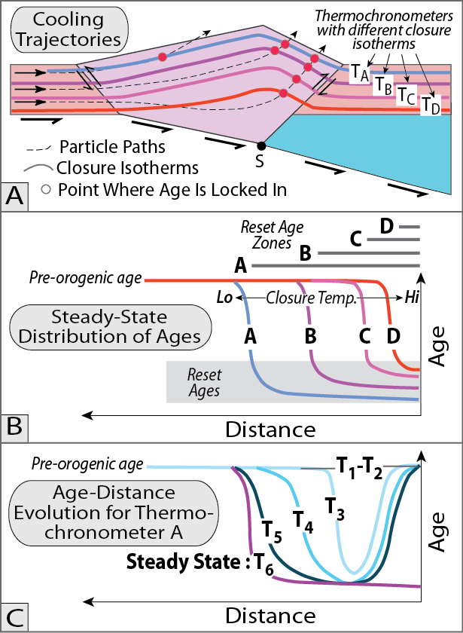
Burbank and Anderson, 2011, Tectonic Geomorphology, Chapter 10

Slide 24
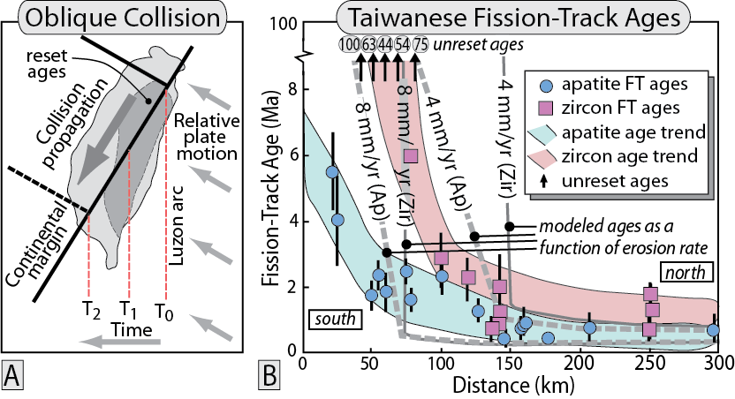
Burbank and Anderson, 2011, Tectonic Geomorphology, Chapter 10

Slide 25
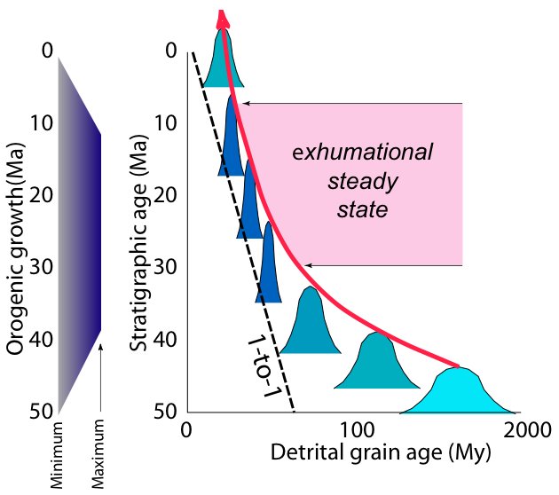
Sequential erosion of an orogen
Lag times of cooling ages
PDFs of youngest comp-onent peak of detrital ages

Slide 26
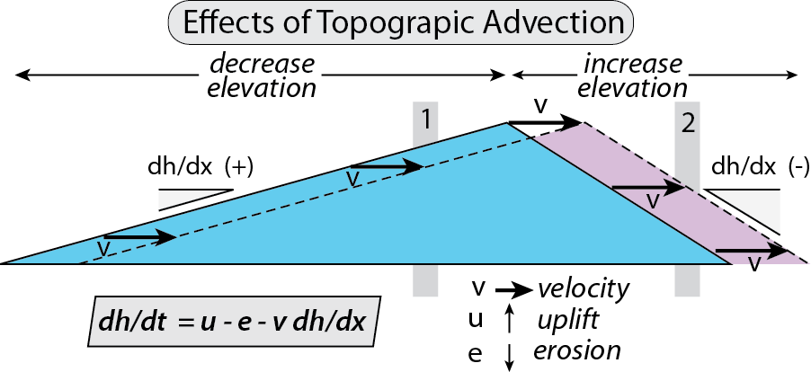
Burbank and Anderson, 2011, Tectonic Geomorphology, Chapter 10

Slide 27
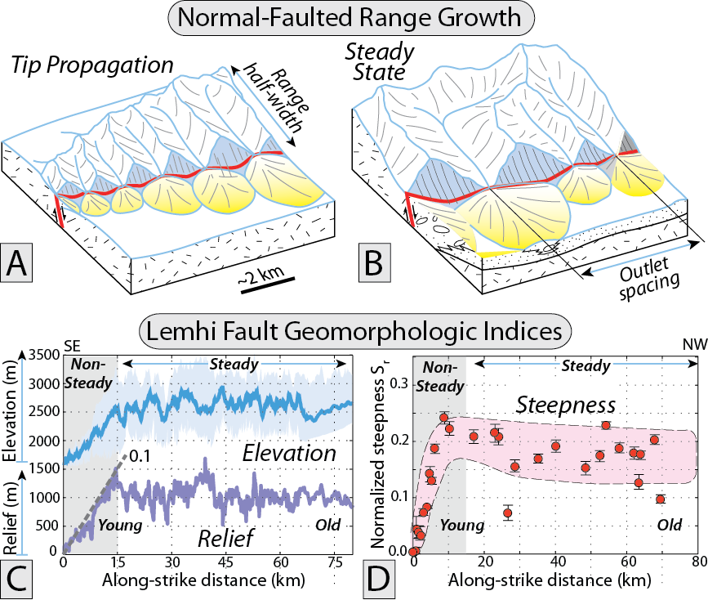
Burbank and Anderson, 2011, Tectonic Geomorphology, Chapter 10

Slide 28
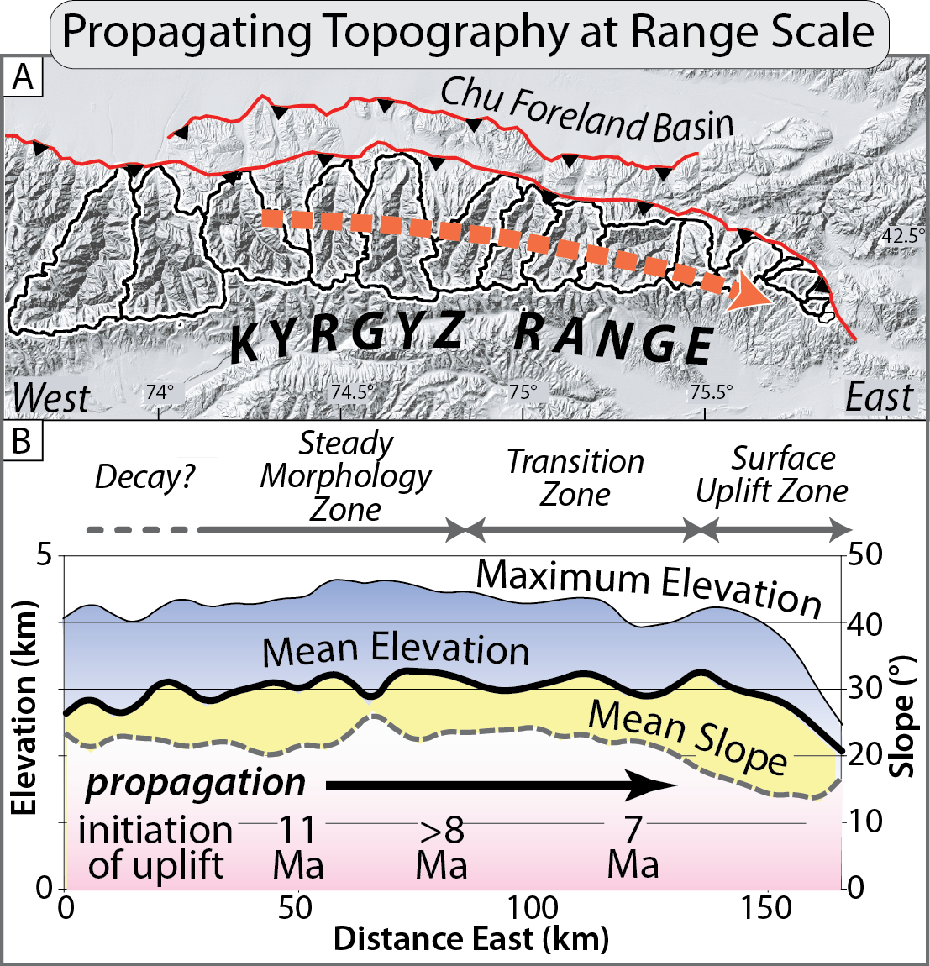
Burbank and Anderson, 2011, Tectonic Geomorphology, Chapter 10

Slide 29
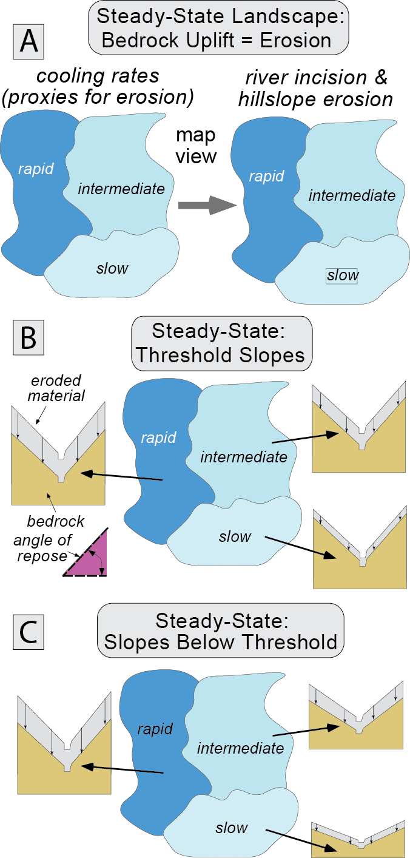
Burbank and Anderson, 2011, Tectonic Geomorphology, Chapter 10

Slide 30
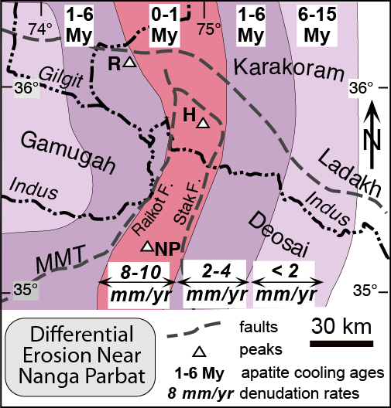
Burbank and Anderson, 2011, Tectonic Geomorphology, Chapter 10

Slide 31
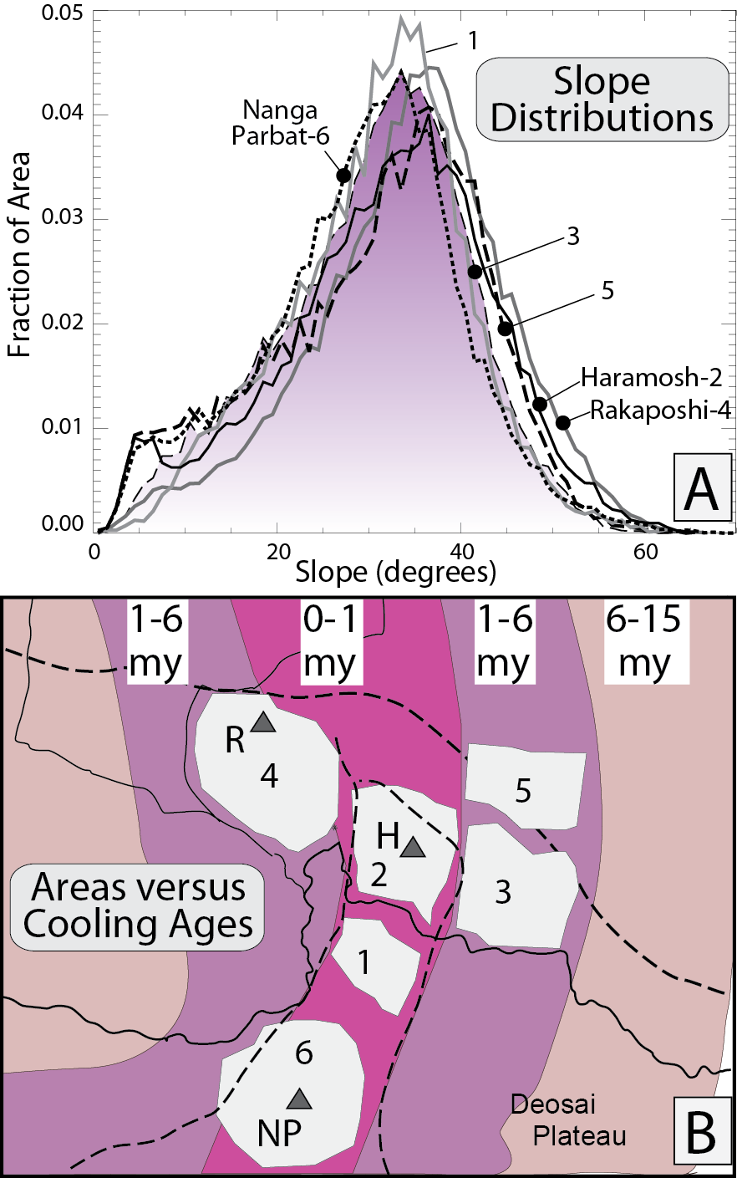
Burbank and Anderson, 2011, Tectonic Geomorphology, Chapter 10

Slide 32
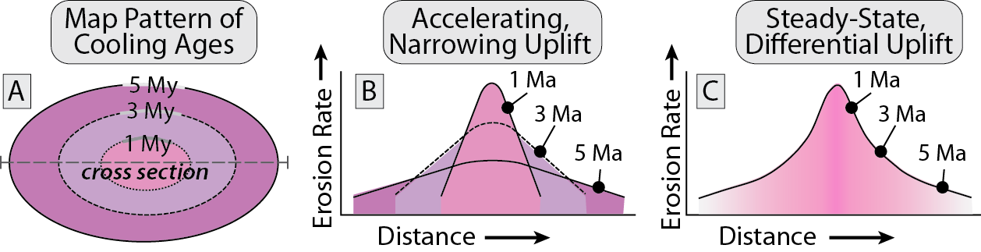
Burbank and Anderson, 2011, Tectonic Geomorphology, Chapter 10

Slide 33
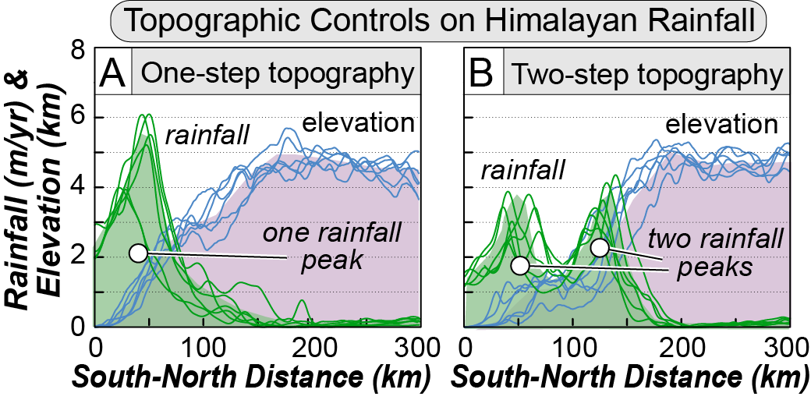
Burbank and Anderson, 2011, Tectonic Geomorphology, Chapter 10

Slide 34
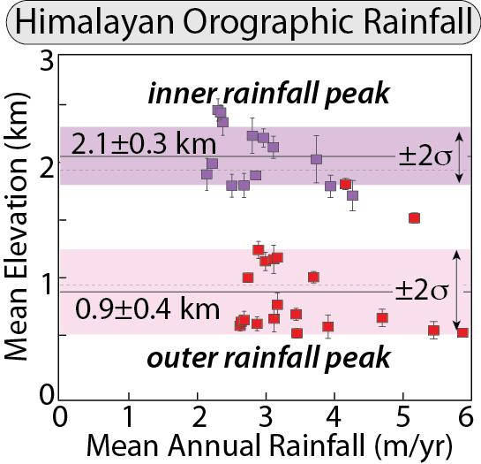
Burbank and Anderson, 2011, Tectonic Geomorphology, Chapter 10

Slide 35
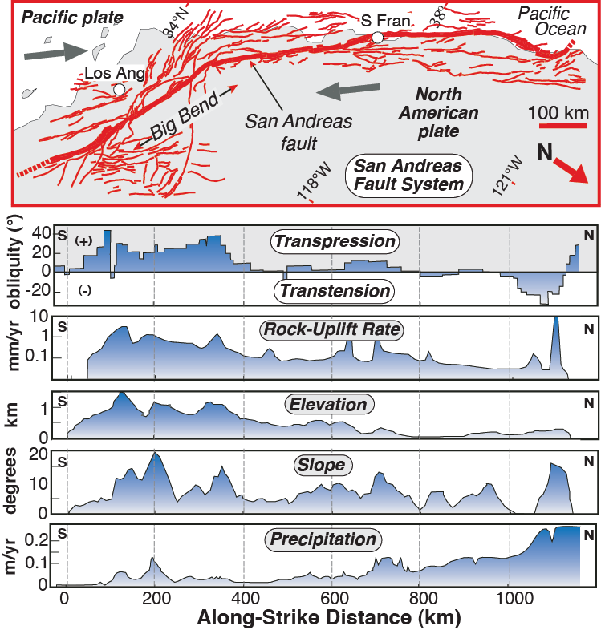
Burbank and Anderson, 2011, Tectonic Geomorphology, Chapter 10

Slide 36
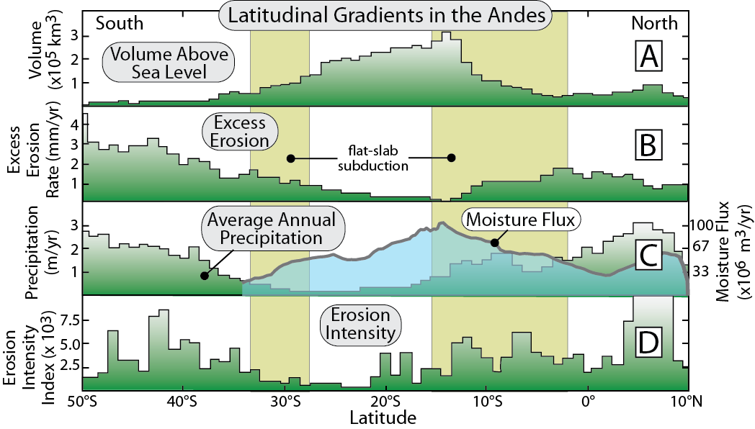
Burbank and Anderson, 2011, Tectonic Geomorphology, Chapter 10

Slide 37
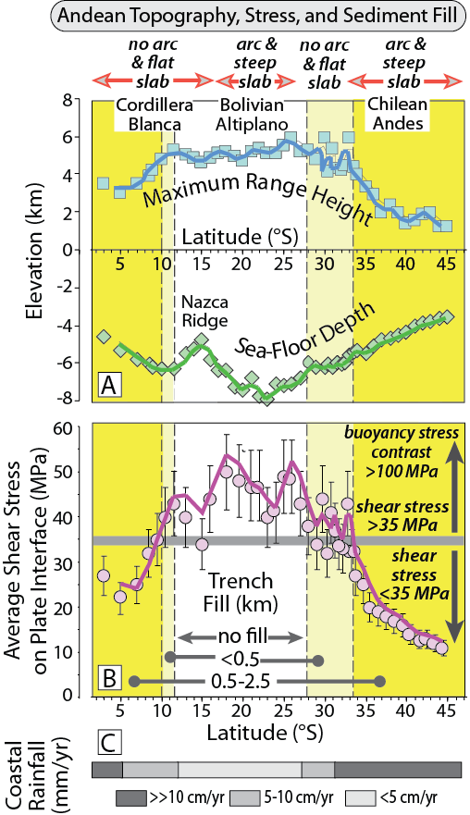
Burbank and Anderson, 2011, Tectonic Geomorphology, Chapter 10

Slide 38
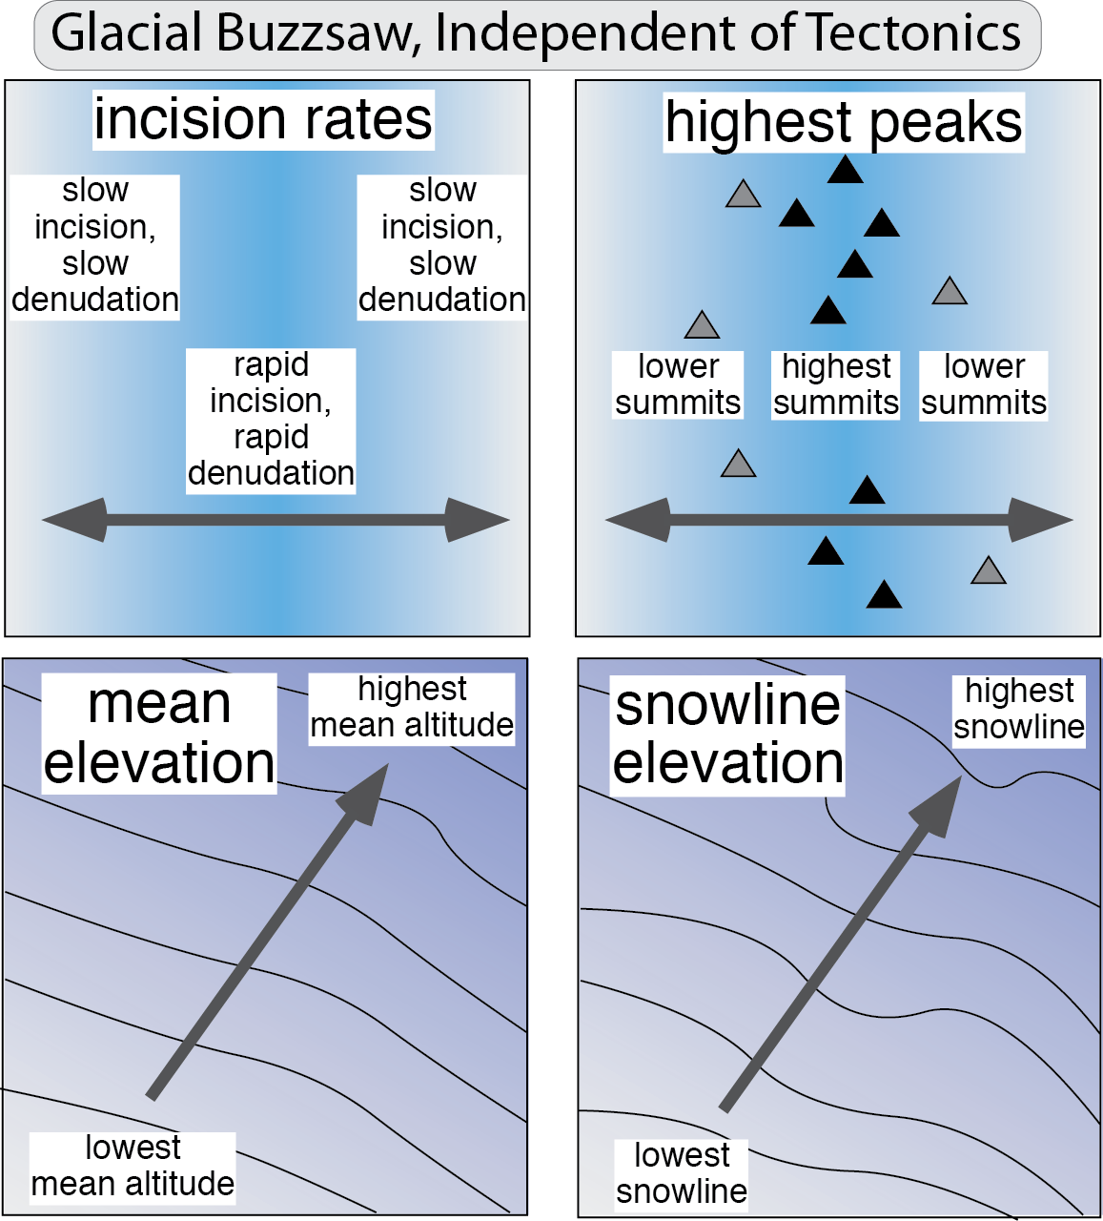
Burbank and Anderson, 2011, Tectonic Geomorphology, Chapter 10

Slide 39
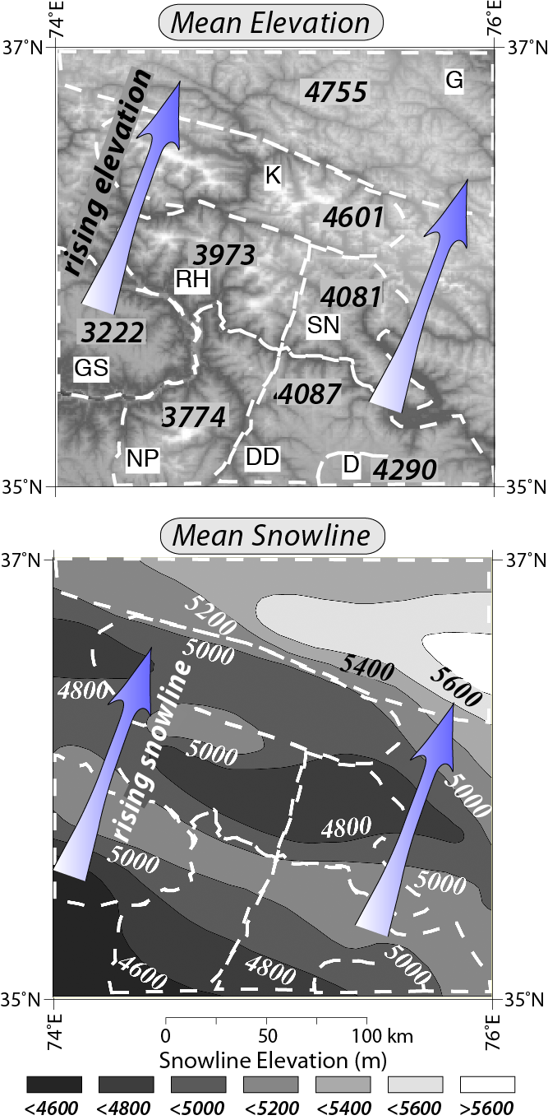
Burbank and Anderson, 2011, Tectonic Geomorphology, Chapter 10

Slide 40
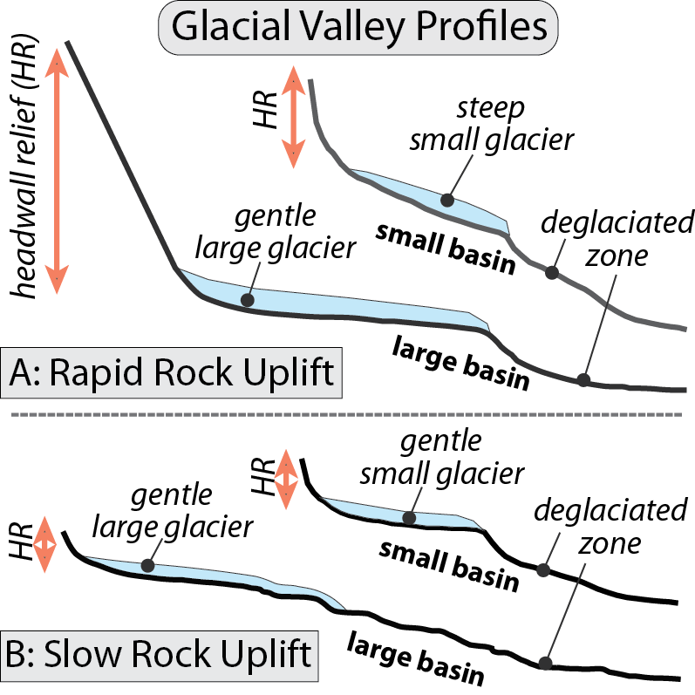
Burbank and Anderson, 2011, Tectonic Geomorphology, Chapter 10

Slide 41
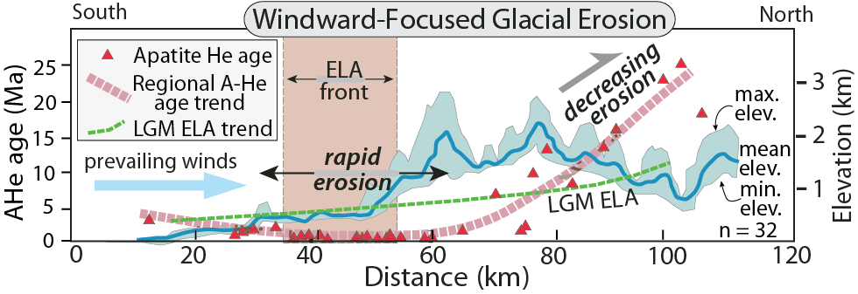
Burbank and Anderson, 2011, Tectonic Geomorphology, Chapter 10

Slide 42
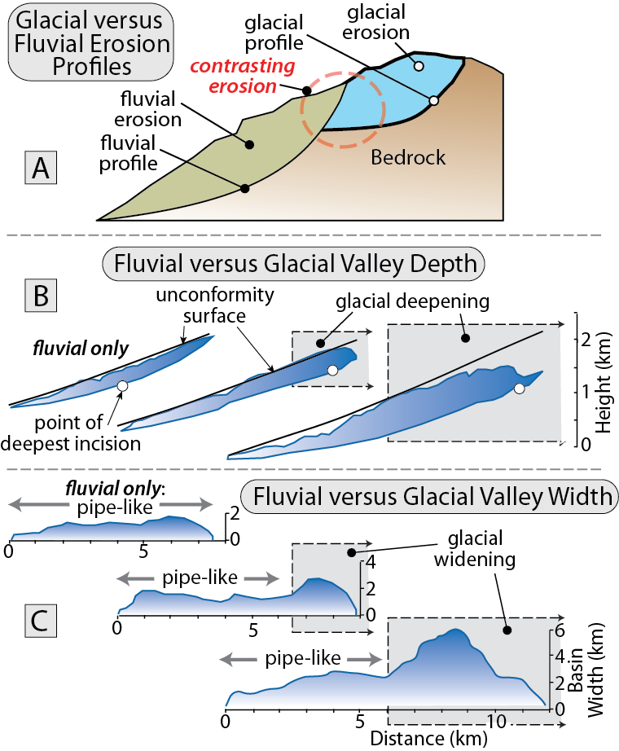
Burbank and Anderson, 2011, Tectonic Geomorphology, Chapter 10

Slide 43
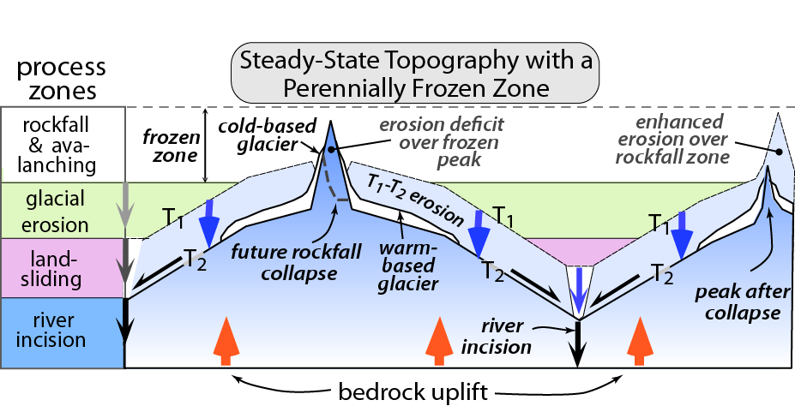
Burbank and Anderson, 2011, Tectonic Geomorphology, Chapter 10

Slide 44
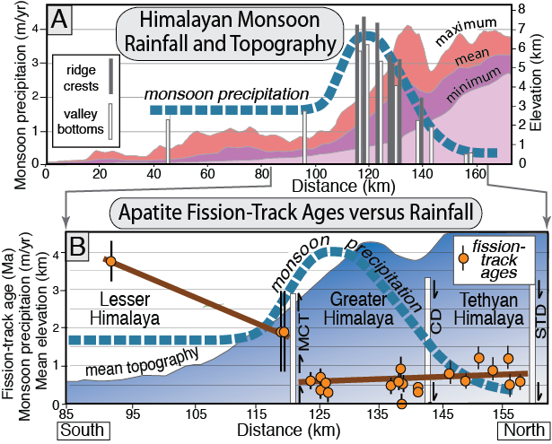
Burbank and Anderson, 2011, Tectonic Geomorphology, Chapter 10

Slide 45
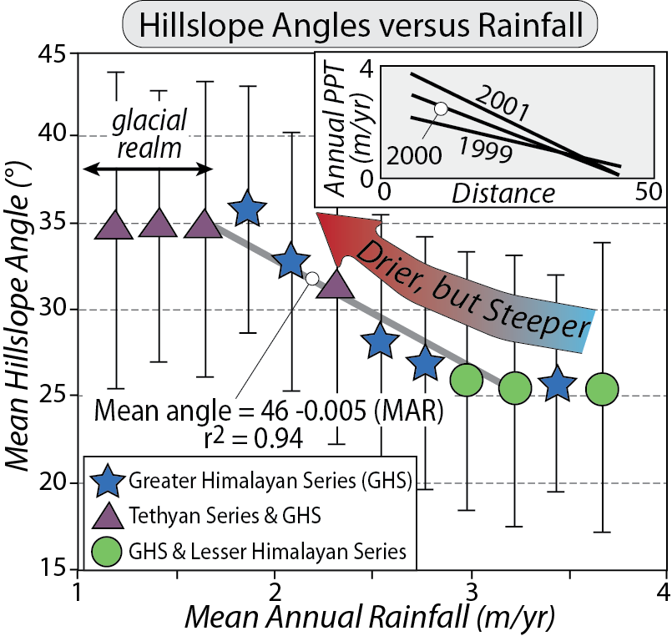
Burbank and Anderson, 2011, Tectonic Geomorphology, Chapter 10

Slide 46
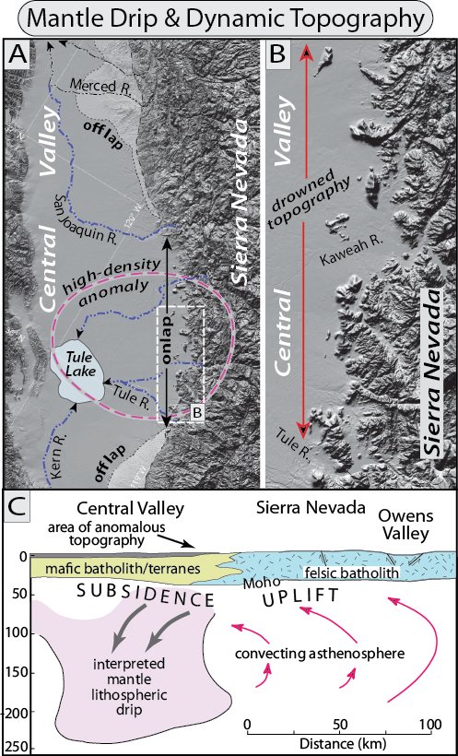
Burbank and Anderson, 2011, Tectonic Geomorphology, Chapter 10

Slide 47
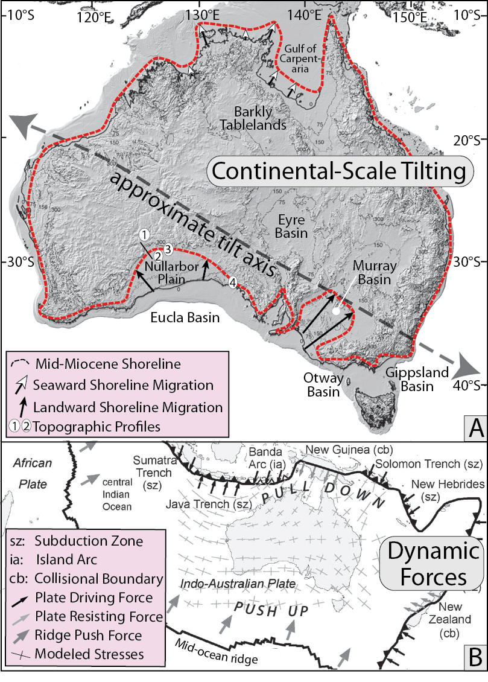
Burbank and Anderson, 2011, Tectonic Geomorphology, Chapter 10

Slide 48
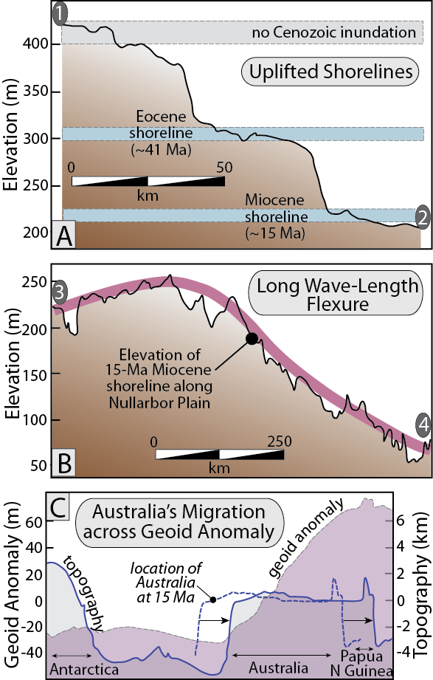
Burbank and Anderson, 2011, Tectonic Geomorphology, Chapter 10

Slide 49
Burbank and Anderson, 2011, Tectonic Geomorphology, Chapter 10

Slide 50
Burbank and Anderson, 2011, Tectonic Geomorphology, Chapter 10

Slide 51
Burbank and Anderson, 2011, Tectonic Geomorphology, Chapter 10

Slide 52
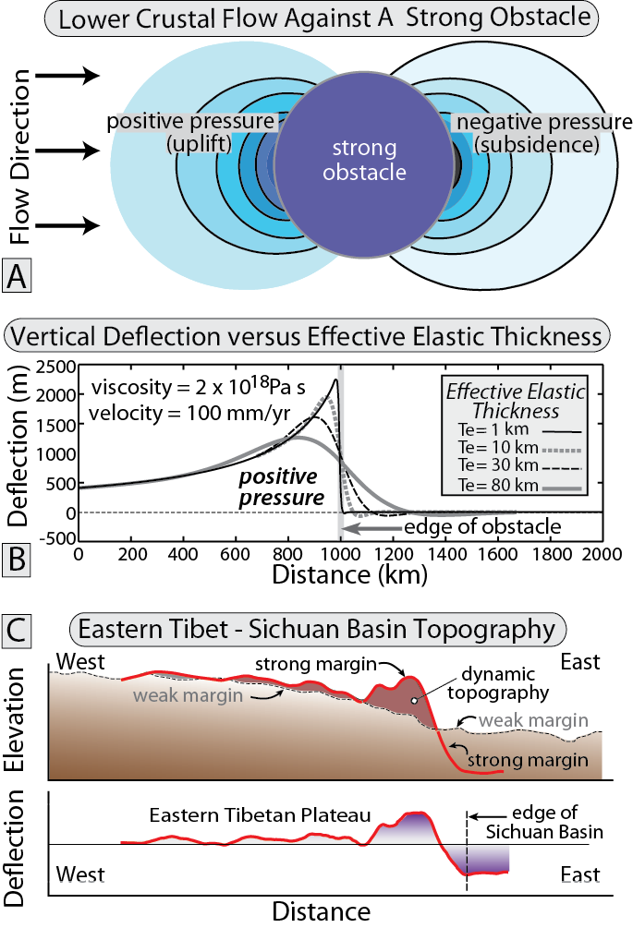
Burbank and Anderson, 2011, Tectonic Geomorphology, Chapter 10

Slide 53
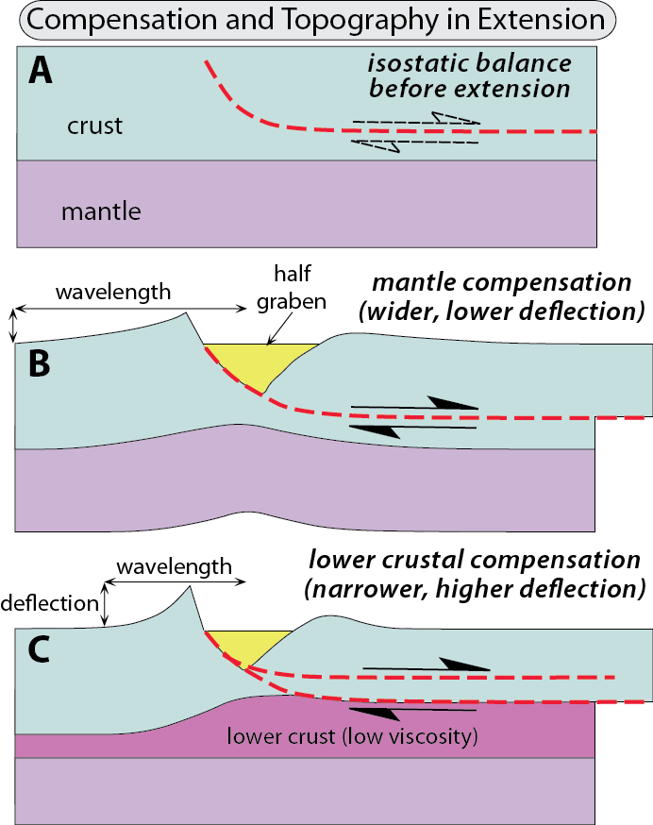
Burbank and Anderson, 2011, Tectonic Geomorphology, Chapter 10

Slide 54

Burbank and Anderson, 2011, Tectonic Geomorphology, Chapter 10

Slide 55

Burbank and Anderson, 2011, Tectonic Geomorphology, Chapter 10

Slide 56

Burbank and Anderson, 2011, Tectonic Geomorphology, Chapter 10

Slide 57

Burbank and Anderson, 2011, Tectonic Geomorphology, Chapter 10

Slide 58

Burbank and Anderson, 2011, Tectonic Geomorphology, Chapter 10

Slide 59

Burbank and Anderson, 2011, Tectonic Geomorphology, Chapter 10

Slide 60
Burbank and Anderson, 2011, Tectonic Geomorphology, Chapter 10

