Slide 1
Tectonic Geomorphology 2nd Edition Burbank and Anderson
Chapter 11: Numerical modeling of landscape evolution
Figures, Boxes, Plates, Tables

Slide 2
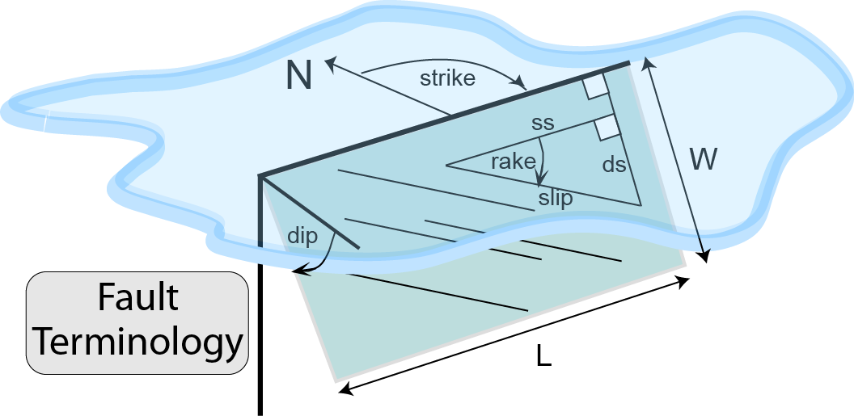
Burbank and Anderson, 2011, Tectonic Geomorphology, Chapter 11

Slide 3
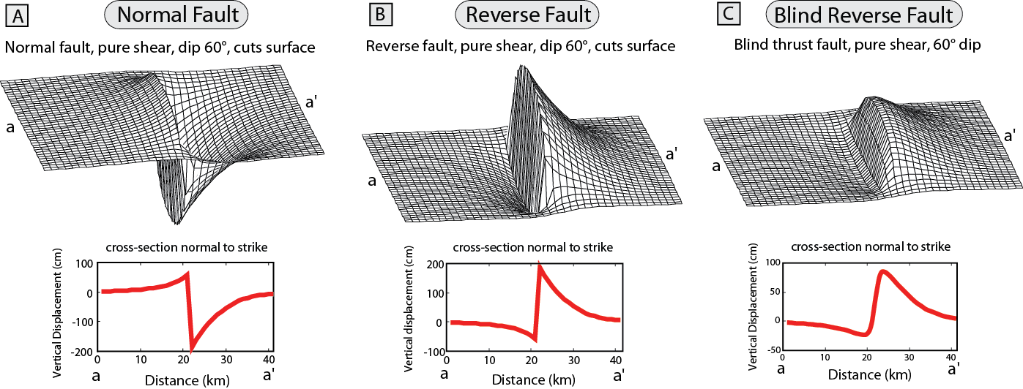
Burbank and Anderson, 2011, Tectonic Geomorphology, Chapter 11

Slide 4
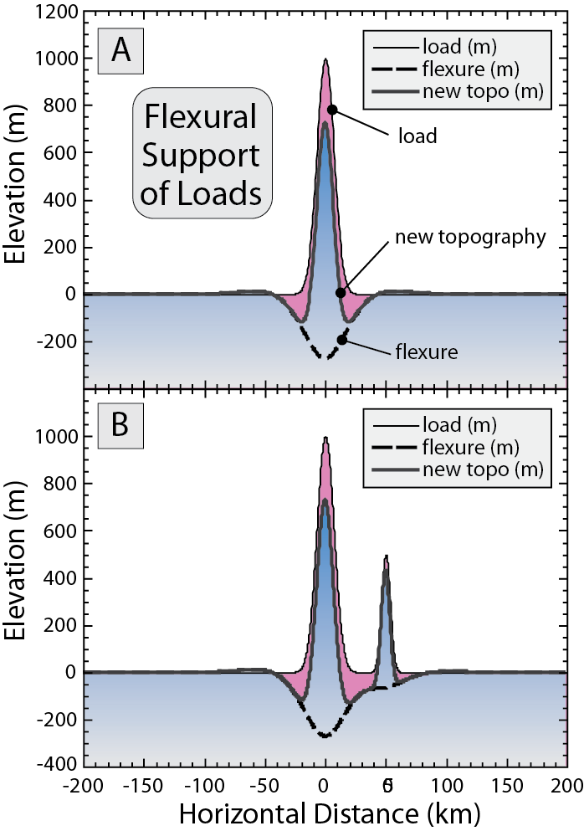
Burbank and Anderson, 2011, Tectonic Geomorphology, Chapter 11

Slide 5
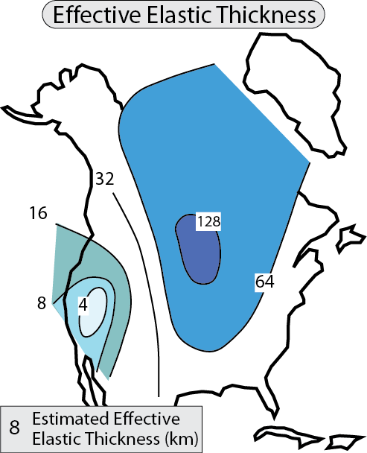
Burbank and Anderson, 2011, Tectonic Geomorphology, Chapter 11

Slide 6
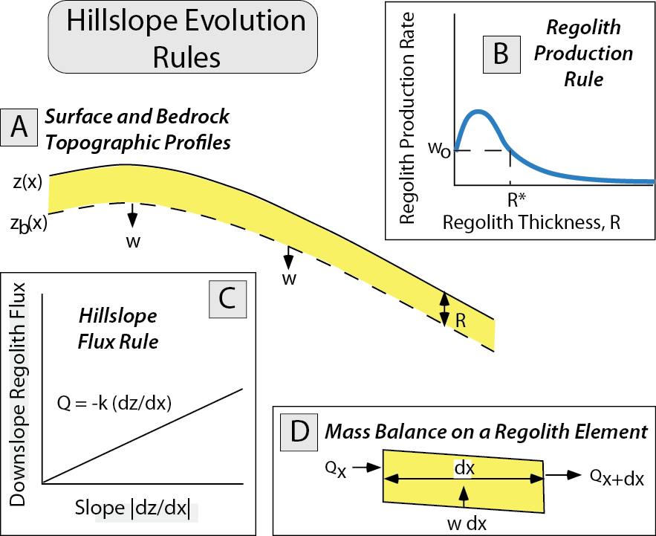
Burbank and Anderson, 2011, Tectonic Geomorphology, Chapter 11

Slide 7
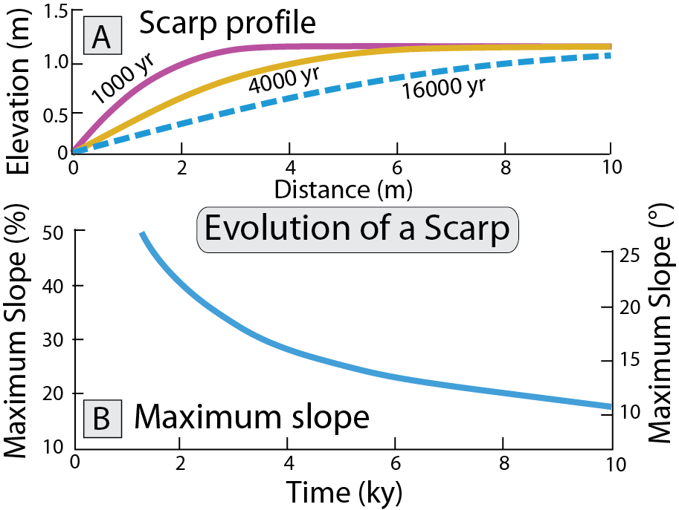
Burbank and Anderson, 2011, Tectonic Geomorphology, Chapter 11

Slide 8
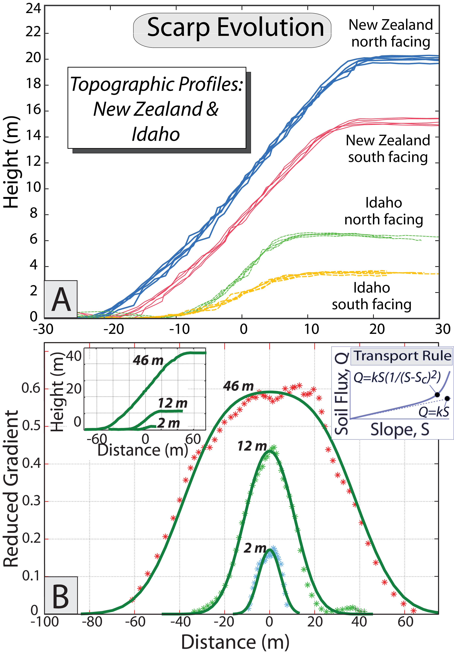
Burbank and Anderson, 2011, Tectonic Geomorphology, Chapter 11

Slide 9
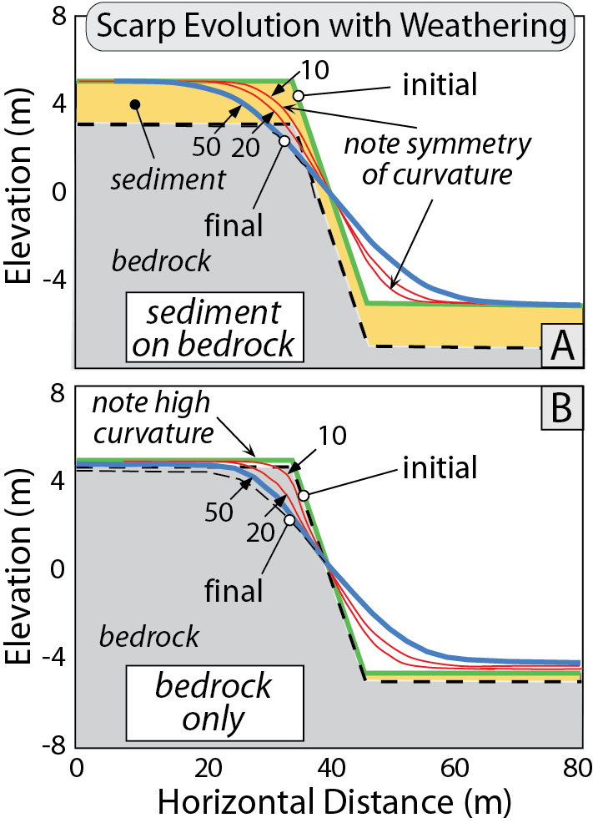
Burbank and Anderson, 2011, Tectonic Geomorphology, Chapter 11

Slide 10
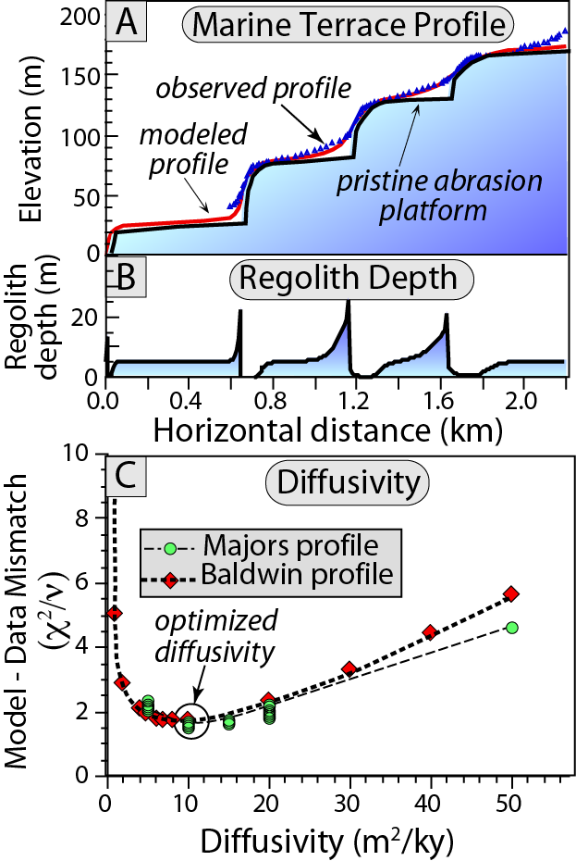
Burbank and Anderson, 2011, Tectonic Geomorphology, Chapter 11

Slide 11
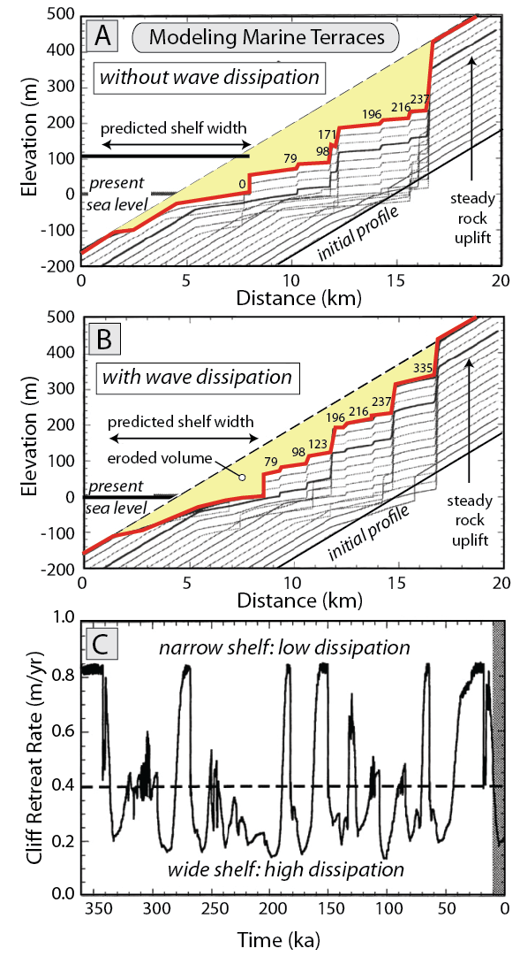
Burbank and Anderson, 2011, Tectonic Geomorphology, Chapter 11

Slide 12
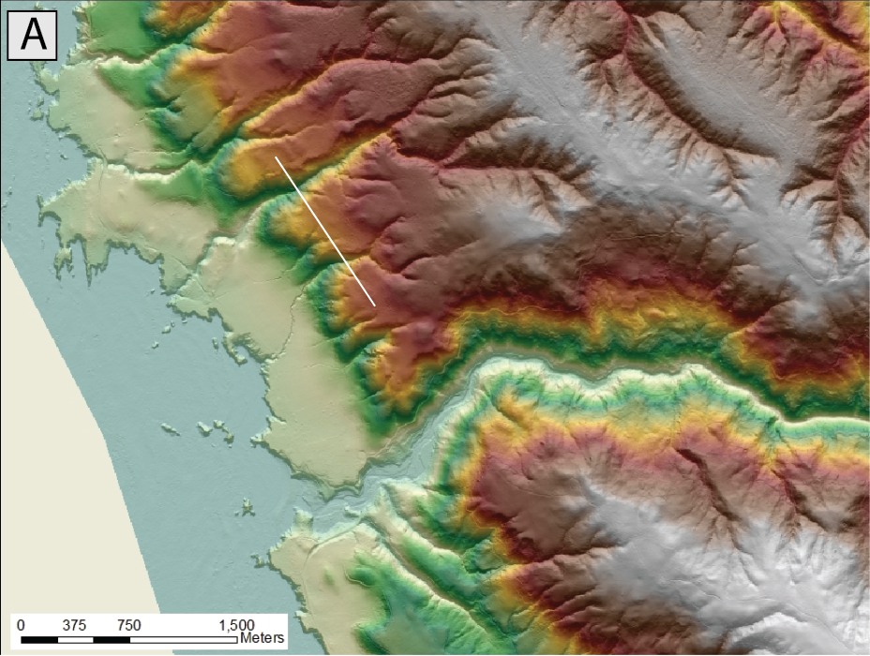
Burbank and Anderson, 2011, Tectonic Geomorphology, Chapter 11

Slide 13
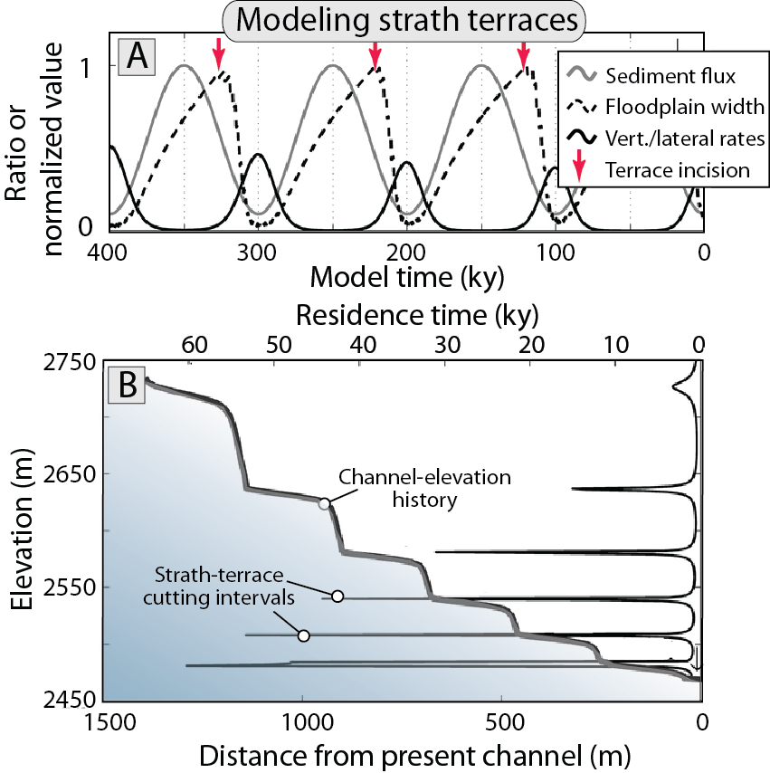
Burbank and Anderson, 2011, Tectonic Geomorphology, Chapter 11

Slide 14
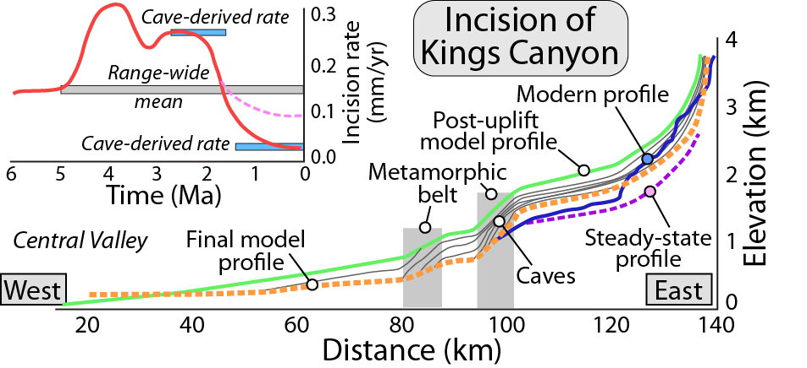
Burbank and Anderson, 2011, Tectonic Geomorphology, Chapter 11

Slide 15
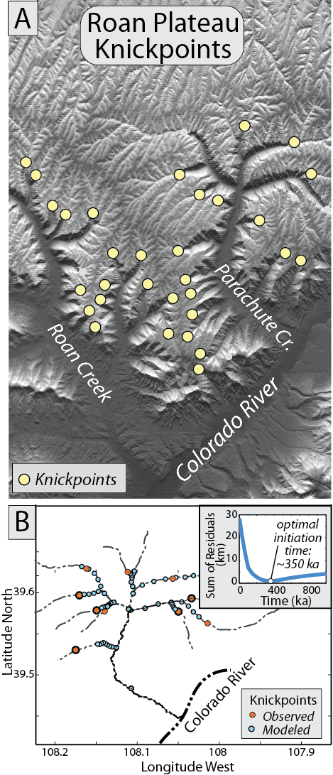
Burbank and Anderson, 2011, Tectonic Geomorphology, Chapter 11

Slide 16
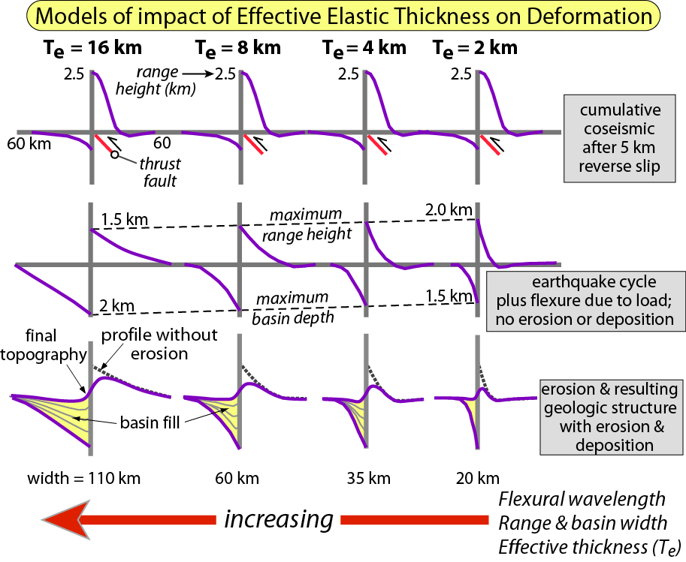
Burbank and Anderson, 2011, Tectonic Geomorphology, Chapter 11

Slide 17
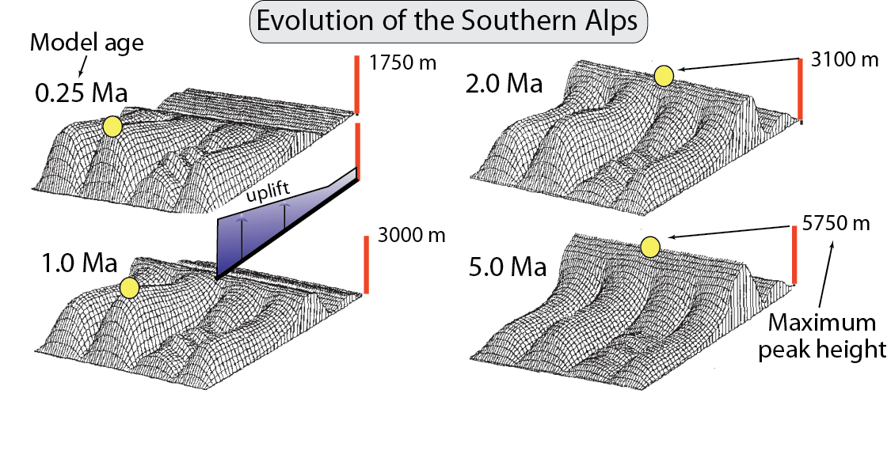
Burbank and Anderson, 2011, Tectonic Geomorphology, Chapter 11

Slide 18
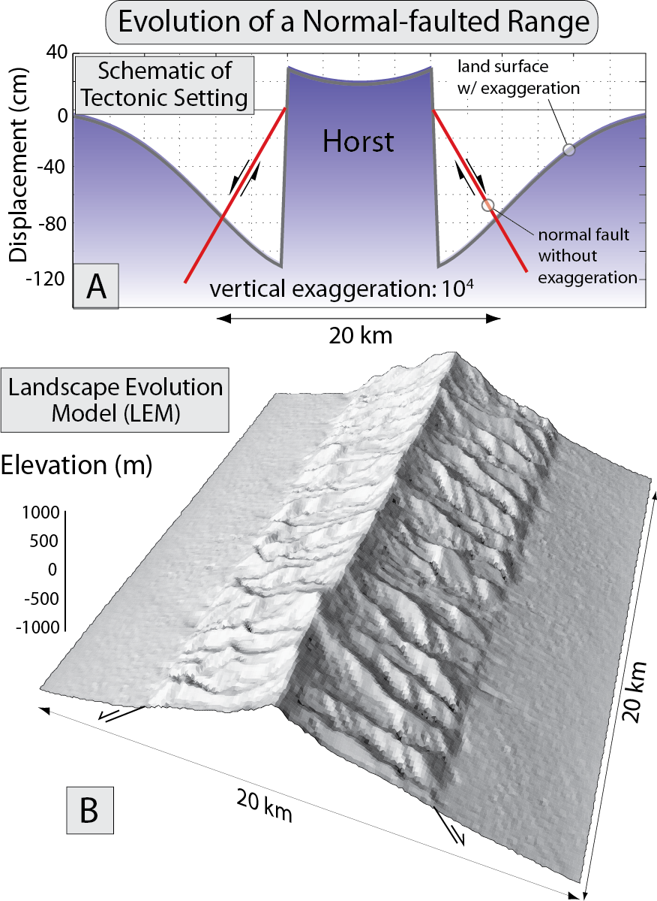
Burbank and Anderson, 2011, Tectonic Geomorphology, Chapter 11

Slide 19
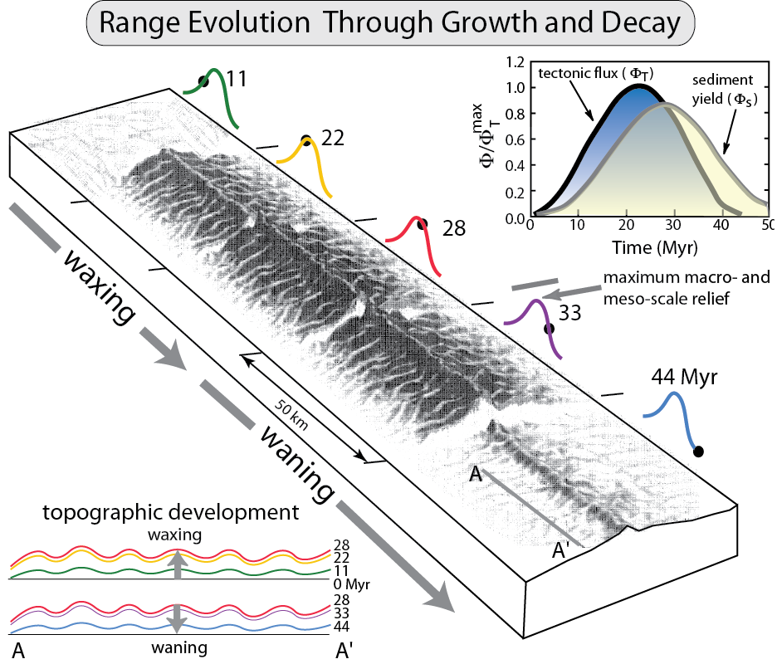
Burbank and Anderson, 2011, Tectonic Geomorphology, Chapter 11

Slide 20
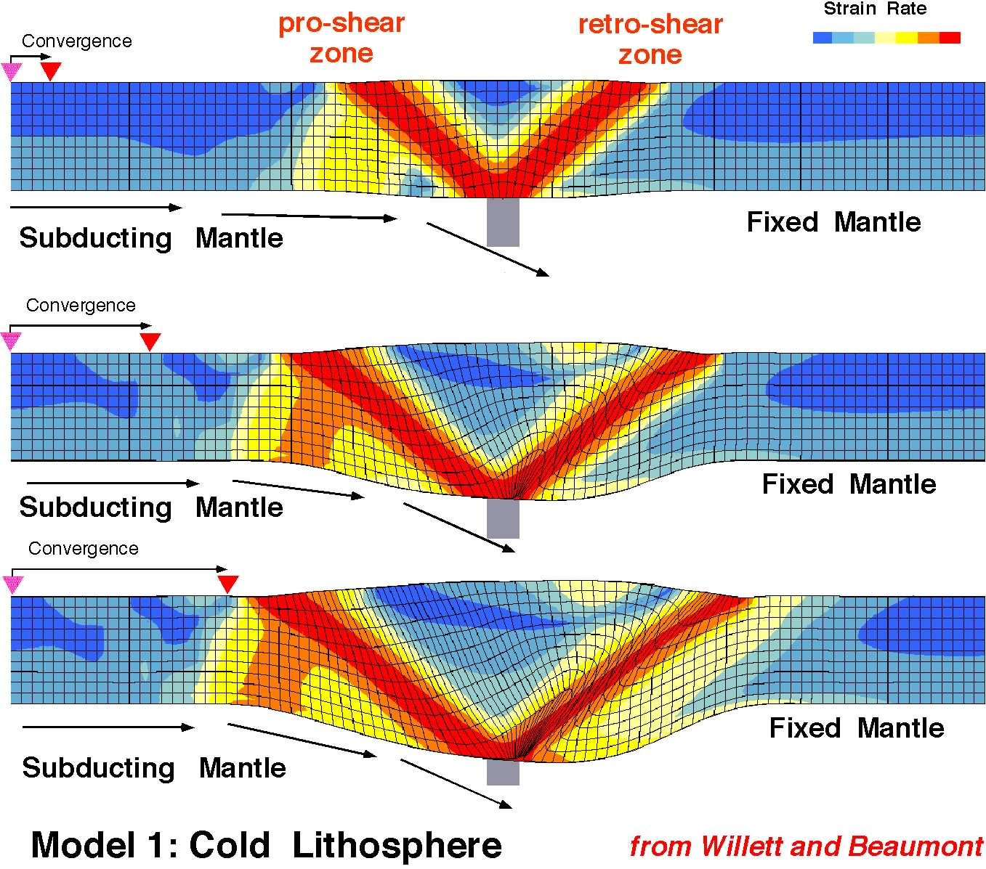
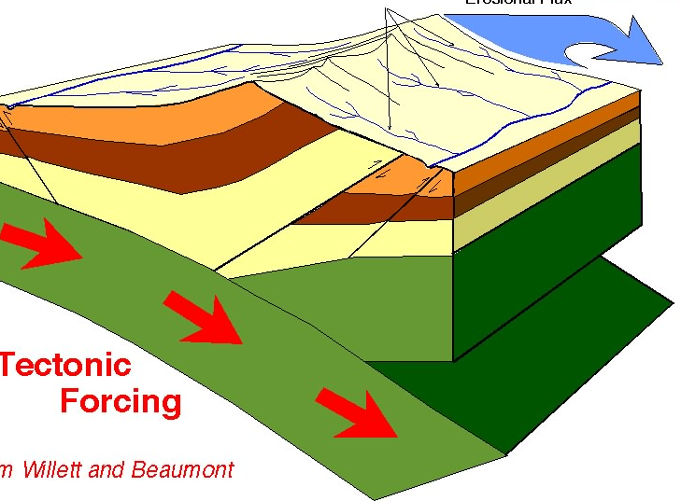
Strain without erosion
looking at this face in cross section
after Willett
• Symmetrical strain
• Broadening
• Thickening

Slide 21
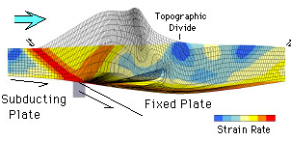
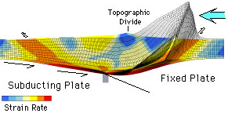
Orographic Exhumation (pro-side)
eroded mass
Contrast of Pro- and Retro-wedge erosion, topography, strain
highest topography
highest
strain
“S”
point
maximum
thickening
(retro-side)
eroded mass
highest topography
“S”
point
highest
strain
after Willett,
1999
maximum
thickening

Slide 22
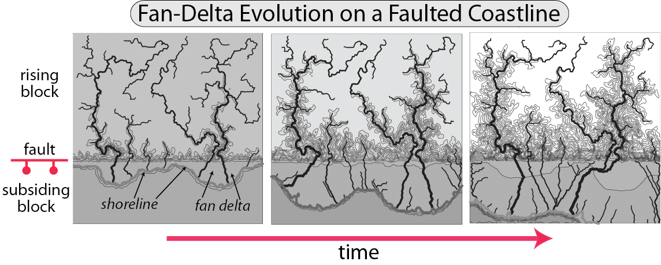
Burbank and Anderson, 2011, Tectonic Geomorphology, Chapter 11

Slide 23
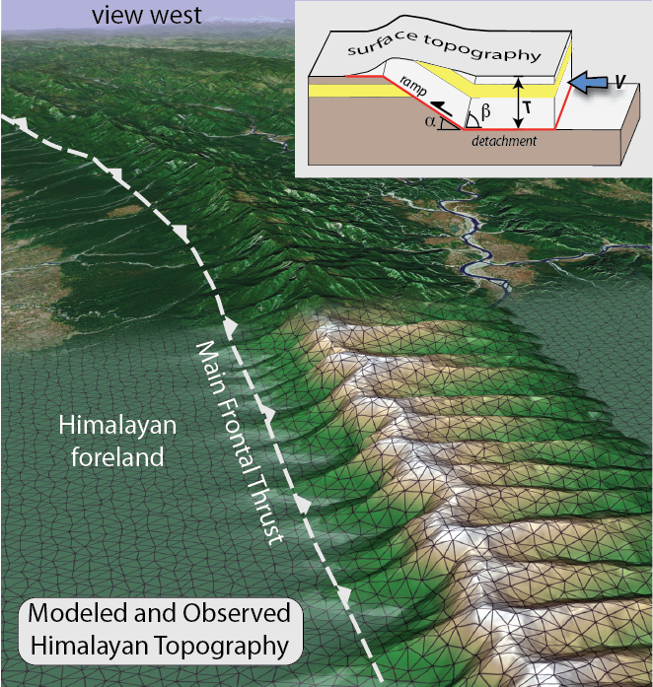
Burbank and Anderson, 2011, Tectonic Geomorphology, Chapter 11

Slide 24
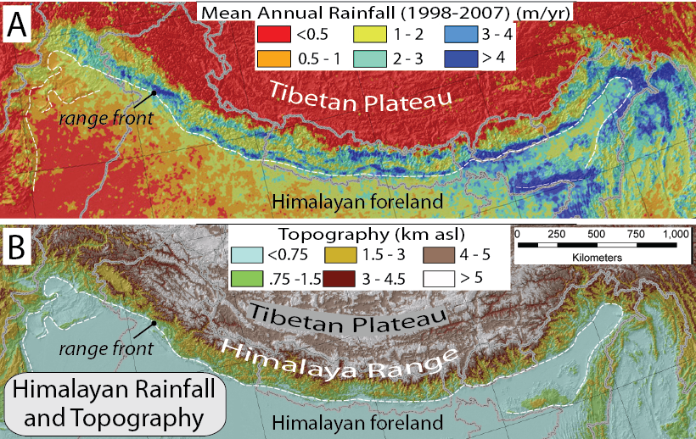
Burbank and Anderson, 2011, Tectonic Geomorphology, Chapter 11

Slide 25
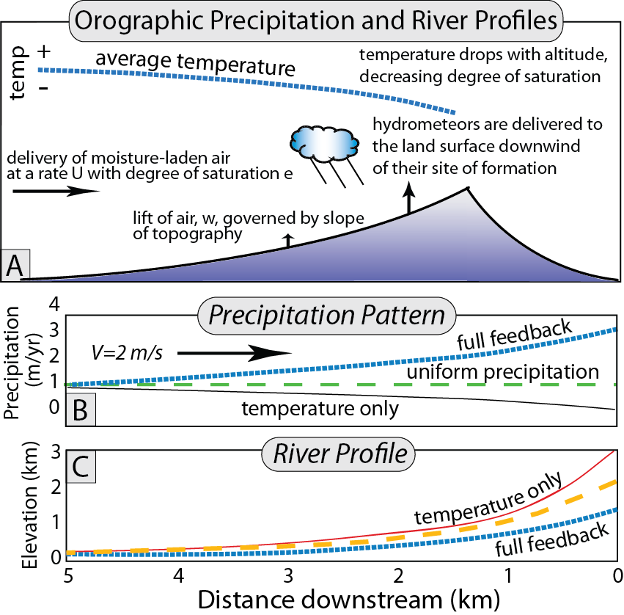
Burbank and Anderson, 2011, Tectonic Geomorphology, Chapter 11

Slide 26
Burbank and Anderson, 2011, Tectonic Geomorphology, Chapter 11

Slide 27
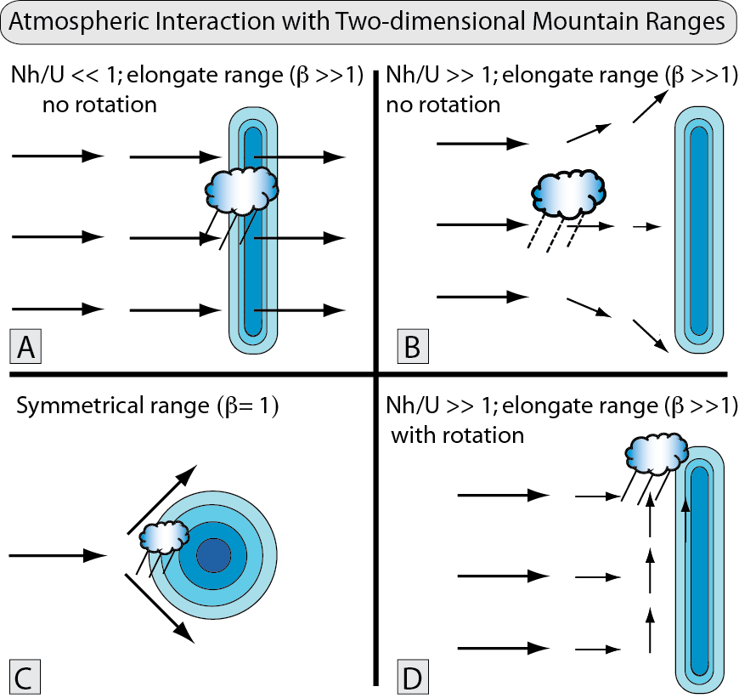
Burbank and Anderson, 2011, Tectonic Geomorphology, Chapter 11

Slide 28
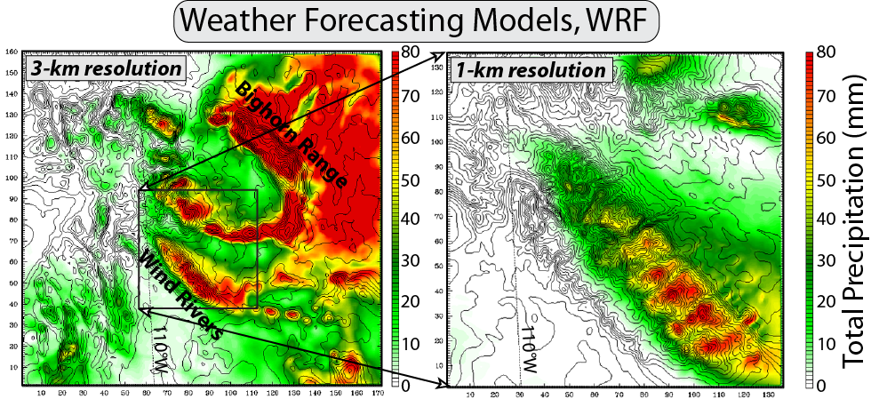
Burbank and Anderson, 2011, Tectonic Geomorphology, Chapter 11

Slide 29
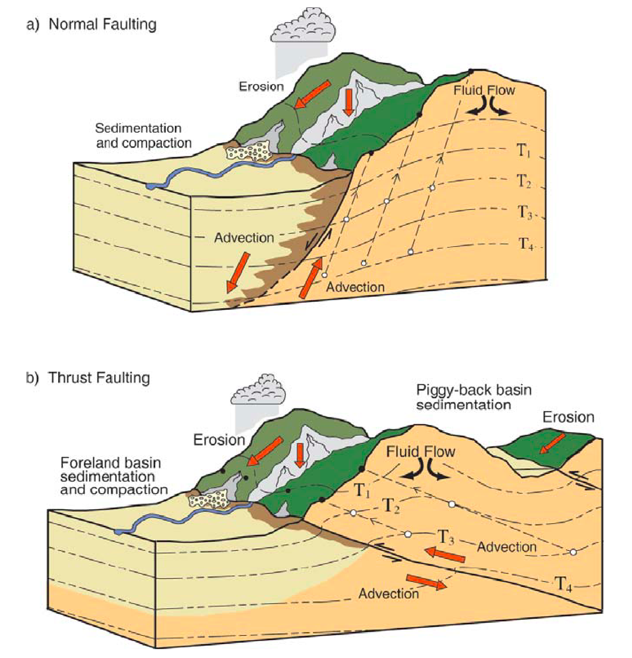
Burbank and Anderson, 2011, Tectonic Geomorphology, Chapter 11

Slide 30
Burbank and Anderson, 2011, Tectonic Geomorphology, Chapter 11

Slide 31
Burbank and Anderson, 2011, Tectonic Geomorphology, Chapter 11

Slide 32
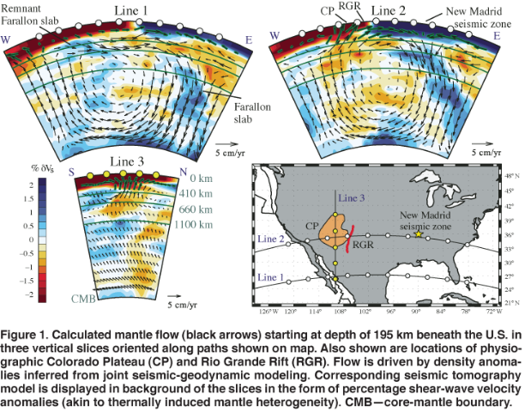
Notes:
Moucha, R., Forte, A. M., Rowley, D. B., Mitrovica, J. X., Simmons, N. A., and Grand, S. P., 2008, Mantle convection and the recent evolution of the Colorado Plateau and the Rio Grande Rift valley: Geology, v. 36, p. 439-442.

Slide 33
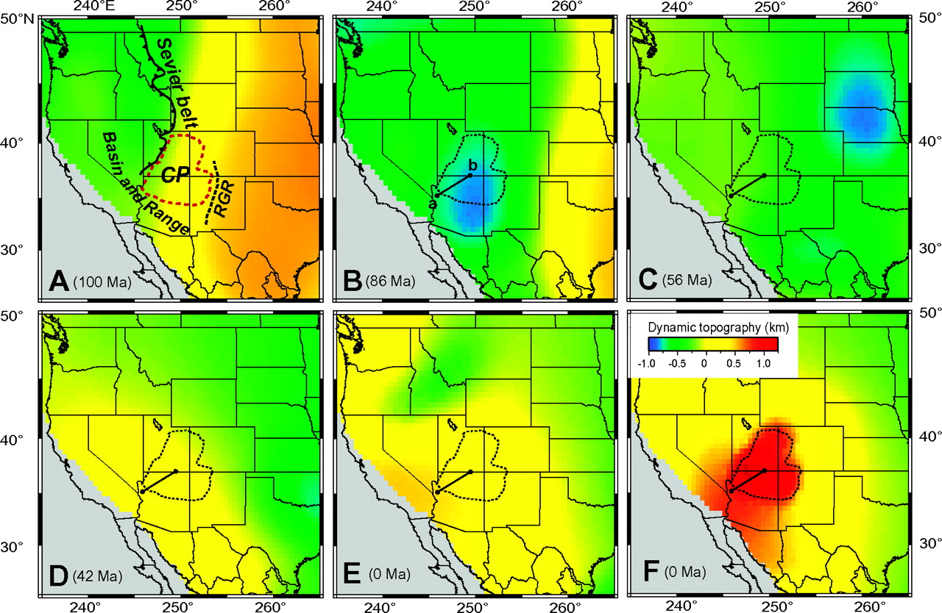
A–E: Predicted dynamic topography over western United States for five different geological times based on model M2.
Liu L , Gurnis M Geology 2010;38:663-666
©2010 by Geological Society of America
Notes:
A–E: Predicted dynamic topography over western United States for five different geological times based on model M2. F: Topography for present-day, based on M4. Line a–b is study profile of Flowers et al. (2008), as in Figure 2. Tectonic features are shown for their present-day location. CP—Colorado Plateau; RGR—Rio Grande Rift.

Slide 34
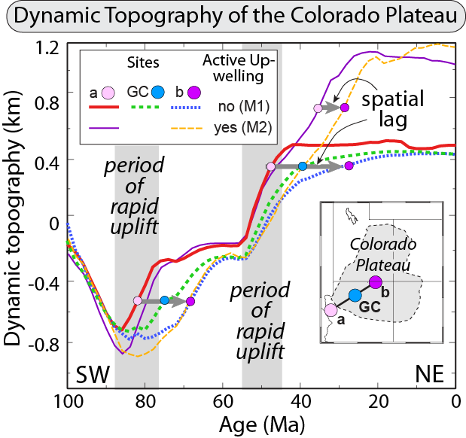
Burbank and Anderson, 2011, Tectonic Geomorphology, Chapter 11

Slide 35
Burbank and Anderson, 2011, Tectonic Geomorphology, Chapter 11

Slide 36
Burbank and Anderson, 2011, Tectonic Geomorphology, Chapter 11

Slide 37
Burbank and Anderson, 2011, Tectonic Geomorphology, Chapter 11

Slide 38
Burbank and Anderson, 2011, Tectonic Geomorphology, Chapter 11

Slide 39
Burbank and Anderson, 2011, Tectonic Geomorphology, Chapter 11

Slide 40
Burbank and Anderson, 2011, Tectonic Geomorphology, Chapter 11

Slide 41
Burbank and Anderson, 2011, Tectonic Geomorphology, Chapter 11

Slide 42
Burbank and Anderson, 2011, Tectonic Geomorphology, Chapter 11

Slide 43
Burbank and Anderson, 2011, Tectonic Geomorphology, Chapter 11

Slide 44
Burbank and Anderson, 2011, Tectonic Geomorphology, Chapter 11

Slide 45
Burbank and Anderson, 2011, Tectonic Geomorphology, Chapter 11

Slide 46
Burbank and Anderson, 2011, Tectonic Geomorphology, Chapter 11

