Slide 1
Location of “hum” using an array stacking method
Two main broadband seismic arrays equipped with STS-1 seismometers:
BDSN, California
F-NET, Japan
Data filtered in the band 150-400 sec, or use of Gaussian filter centered at specific periods
Stacking according to Rayleigh wave dispersion across the array

Slide 2
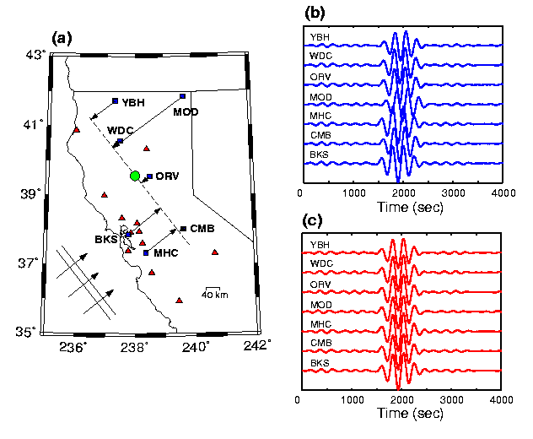
before
after

Slide 3
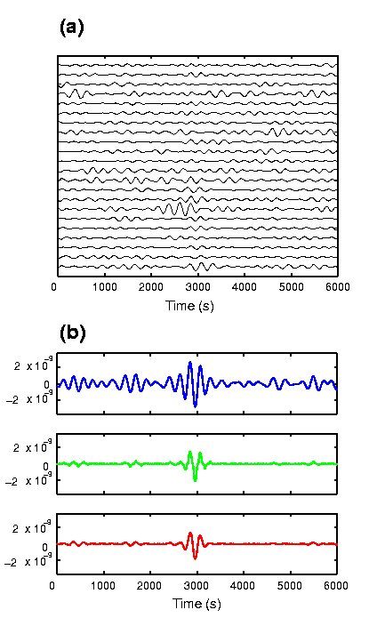
FNET
Jan 2, 2000
Mw 5.8
Δ = 36.31º
Straight stack
3rd root stack
Phase Weighted
Stack
Notes:
Example showing different types of stacking for a Mw 5.8 earthquake observed on FNET. Nothing is visible in the raw traces (this is filtered with a Gaussian filter centered at 250 s).

Slide 4
Stack Amplitude as a function of time and azimuth, FNET
01/02/2000
Mw 5.7
Δ = 74.17º
R1
T = 240 s
R2
R3
Notes:
Example for a small earthquake – period 240 s (Gaussian filter)

Slide 5
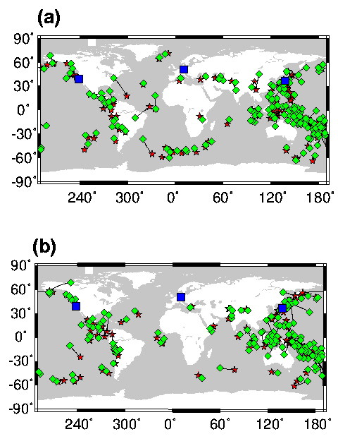
Year 2000
2000
Mw > 6.0
Year 2001
2001
T=240 s
Notes:
Detections of earthquakes – stars are locations from catalog – diamonds are locations using 3 arrays (FNET, BDSN and GRSN) – still at 240 s. this is for shallow earthquakes and they are all detected.

Slide 6
Low frequency locations
>85% M > 6 earthquakes can be located from low frequency analysis (~240 sec).
Very few “other point source” events found:
very rare “Slow earthquakes” (e.g. Beroza and Jordan, 1990), in contrast to the shorter period band 30-150 sec (e.g. Ekström et al., 2003).
Further analysis:
Distributed sources
random around the globe?

Slide 7
Year 2000 (degree 1)
Japan
California
Days
without
seismic
events
winter
6 month
average
summer
Rhie and Romanowicz, 2004

Slide 8
Year 2000: Days without earthquakes of M>5.5
Correl. Coef. =0.78
Winter
Summer
Winter
Red = BDSN = California
Blue = FNET = Japan
Rhie and Romanowicz, Nature, 2004

Slide 9
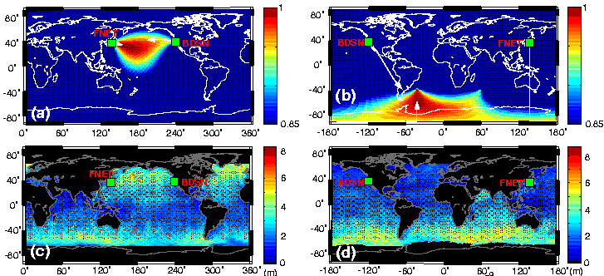
Seismic Data
Significant Wave Height (Topex-Poseidon)
Winter
Summer
Rhie and Romanowicz, Nature, 2004

Slide 10
Rhie and Romanowicz, 2006

