Slide 1
Detecting M8+ earthquakes
The Mw8.9/9.1 Japan earthquake

Slide 2
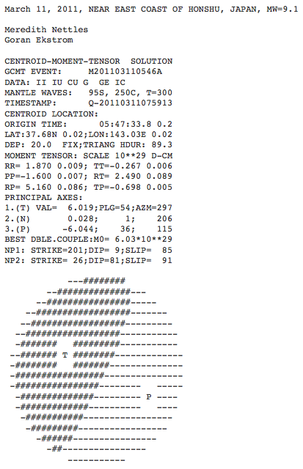
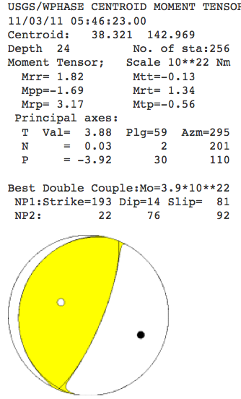
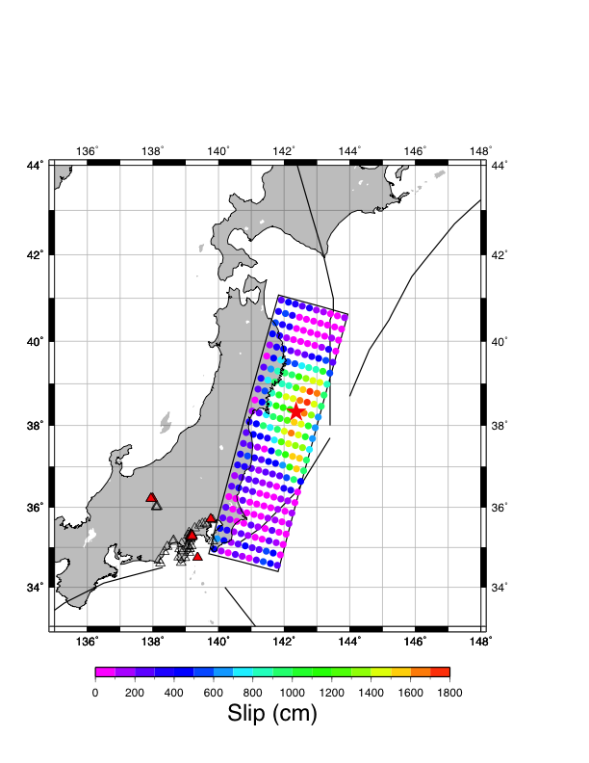
Using the finite fault model of Gavin Hayes, USGS

Slide 3
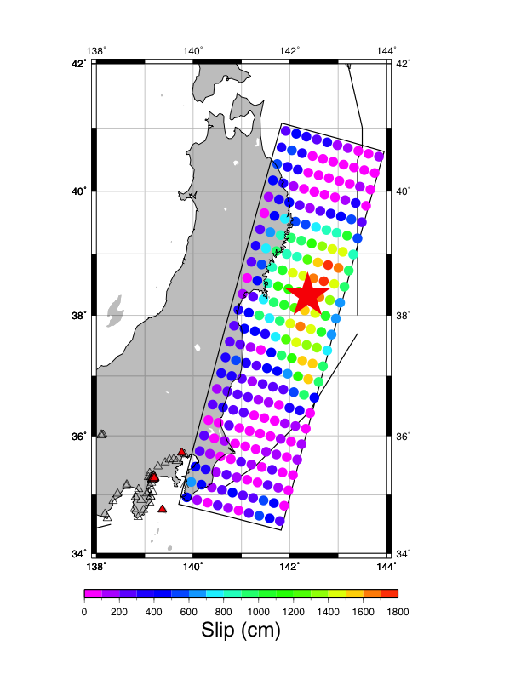

Slide 4
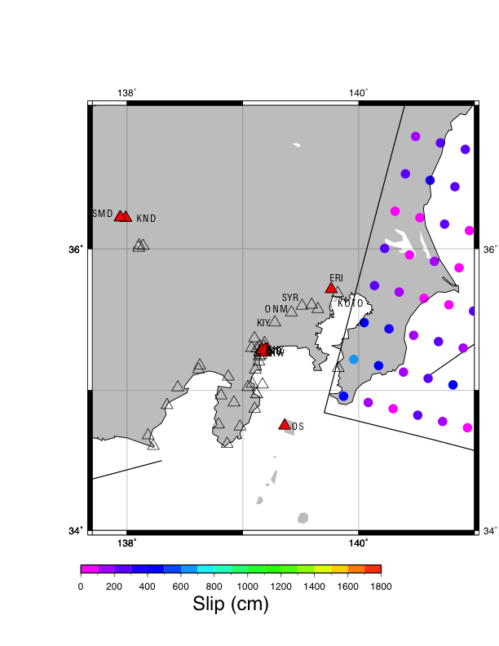

Slide 5
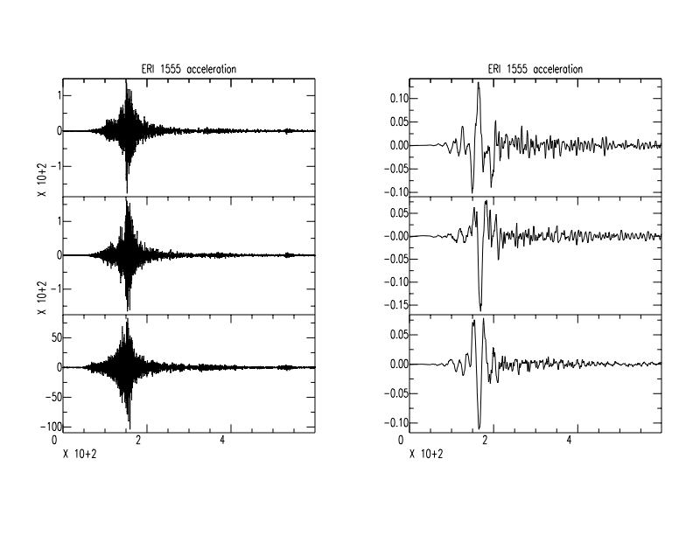
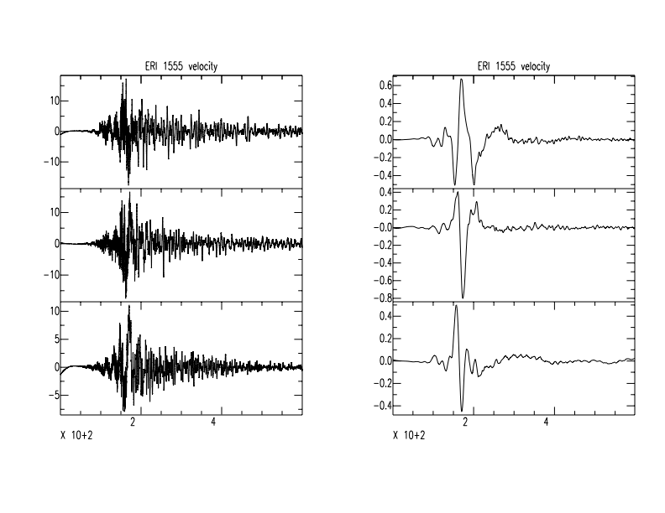
cm/s/s
cm/s/s
lp co 0.01 p 1
hp co 0.005 p 1
ERI
370.7 km from USGS epicenter
219 deg
cm/s
cm/s

Slide 6
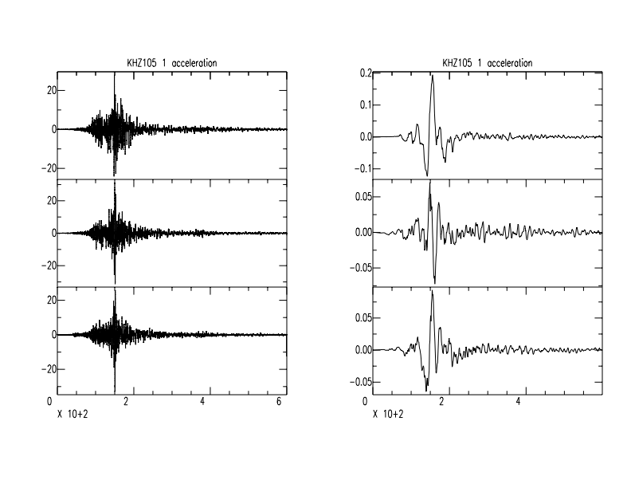
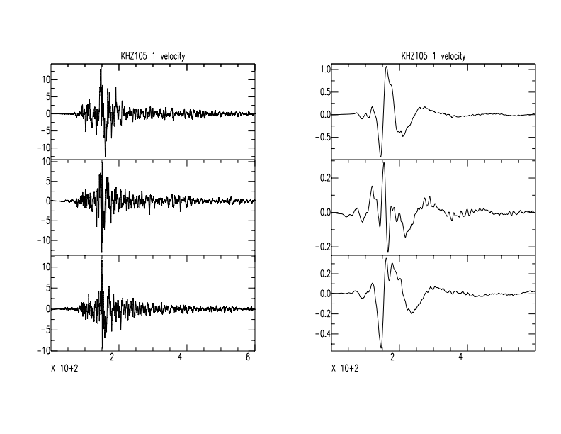
KHZ
439.04 km
220 degrees

Slide 7
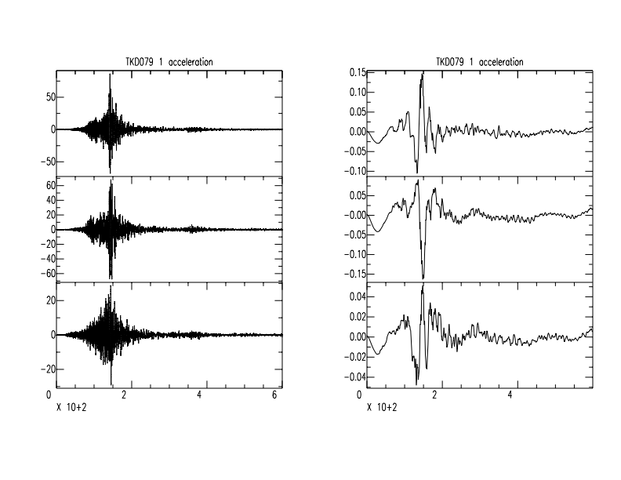
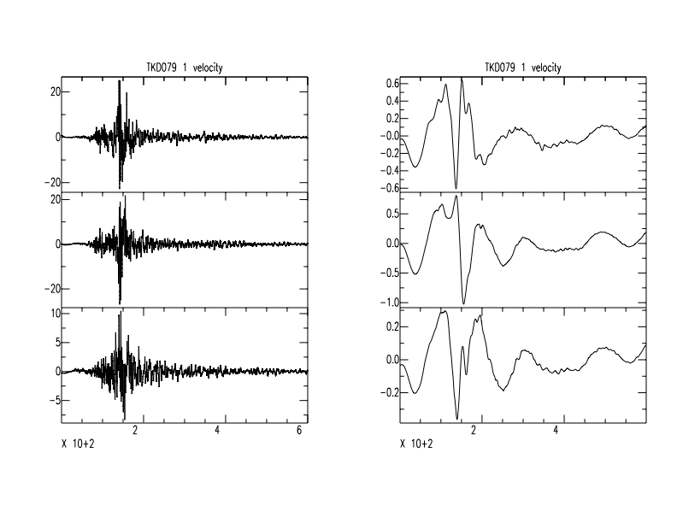
TKD
440.1 km
221 degrees

Slide 8
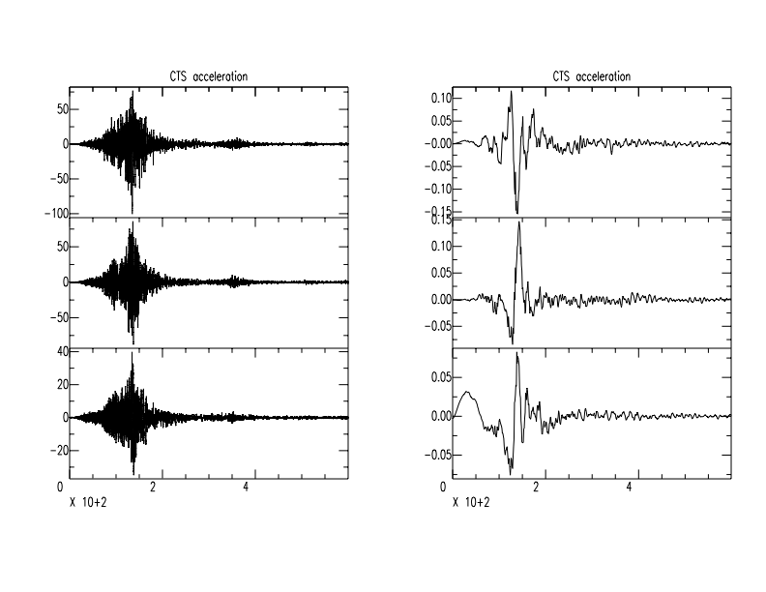
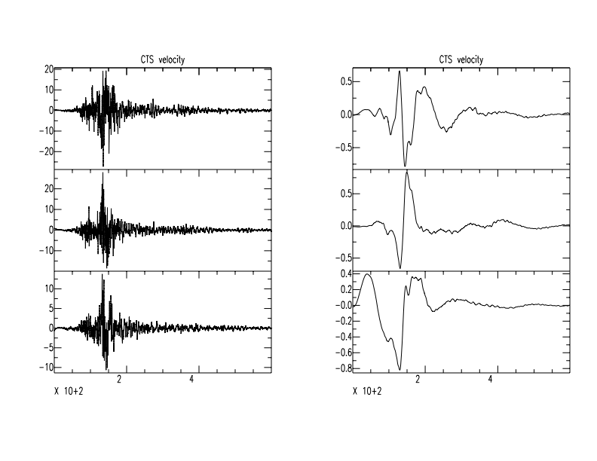
CTS
441.21 km
221 degrees

Slide 9
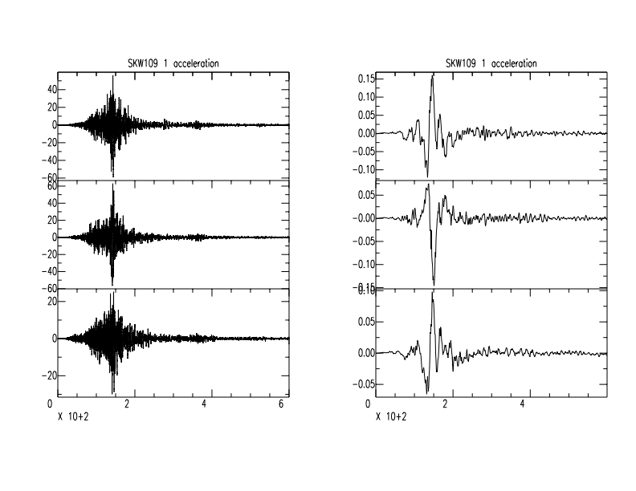
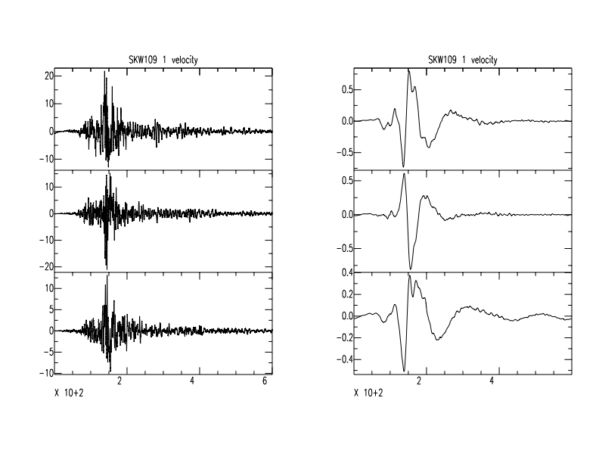
SKW
441.56 km
220.87 degrees

Slide 10
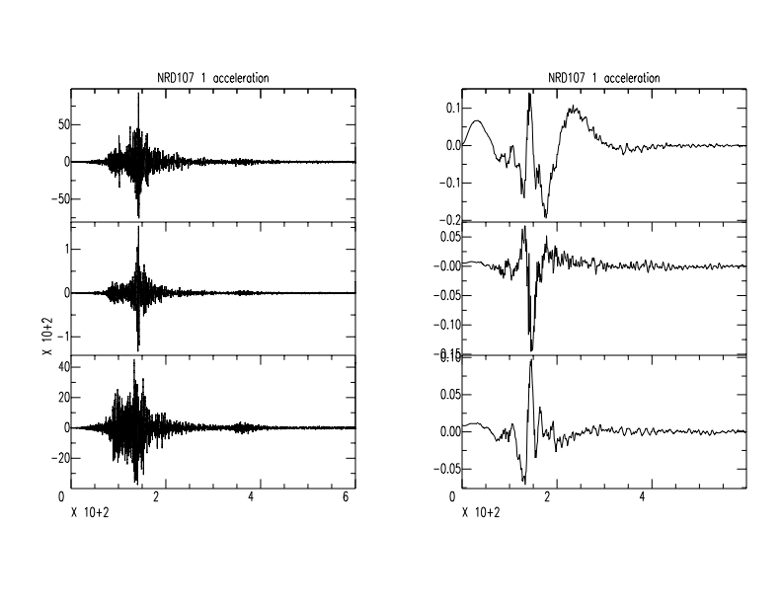
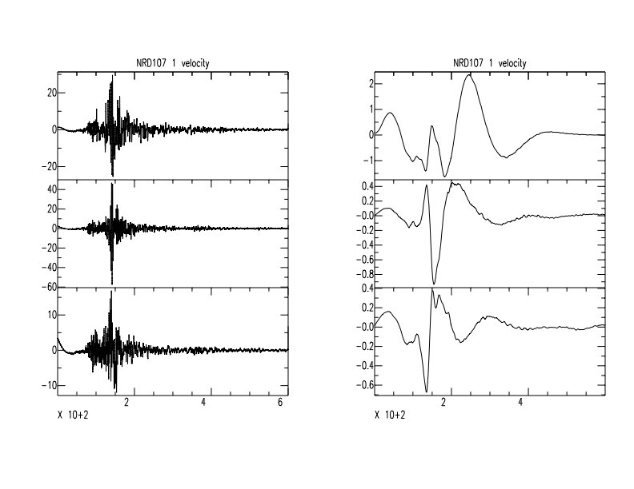
NRD
441.65 km
221 degrees

Slide 11
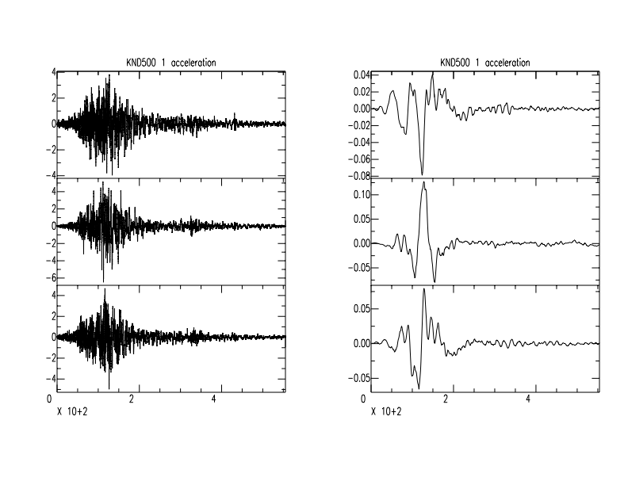
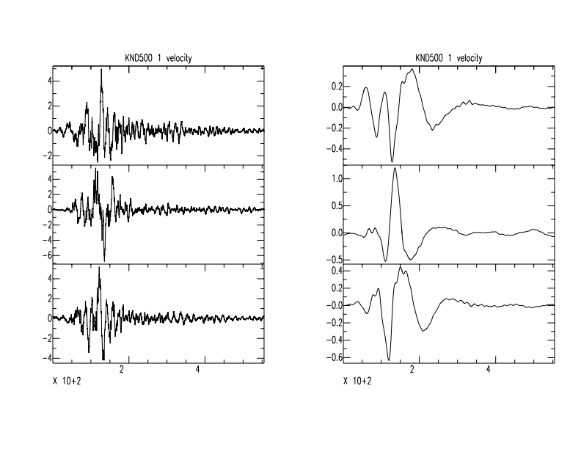
KND
453.42 km
240 degrees

Slide 12
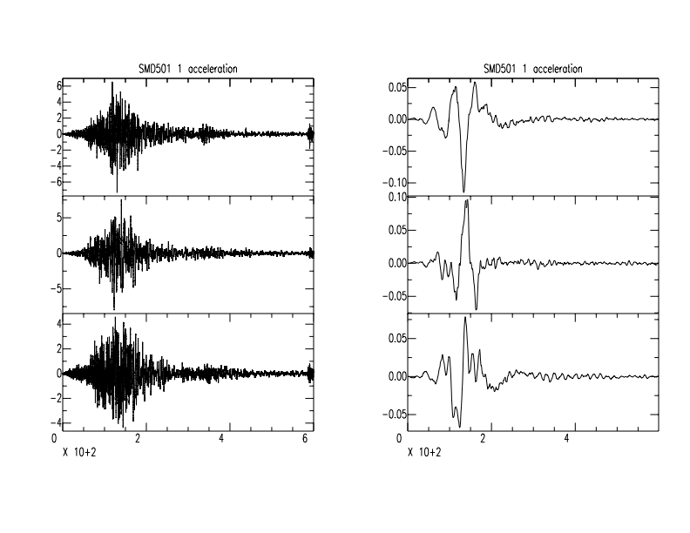
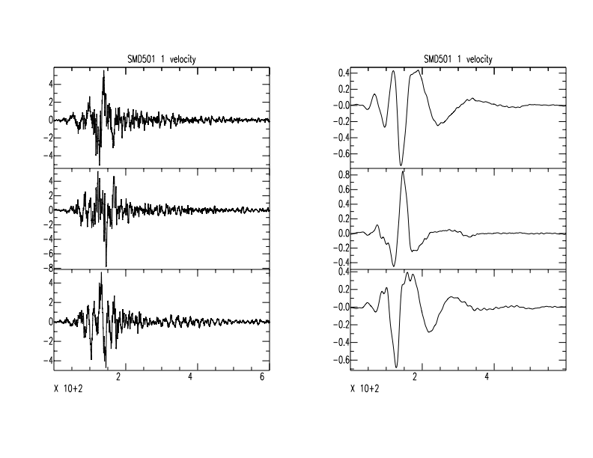
SMD
456.7 km
240 degrees

Slide 13
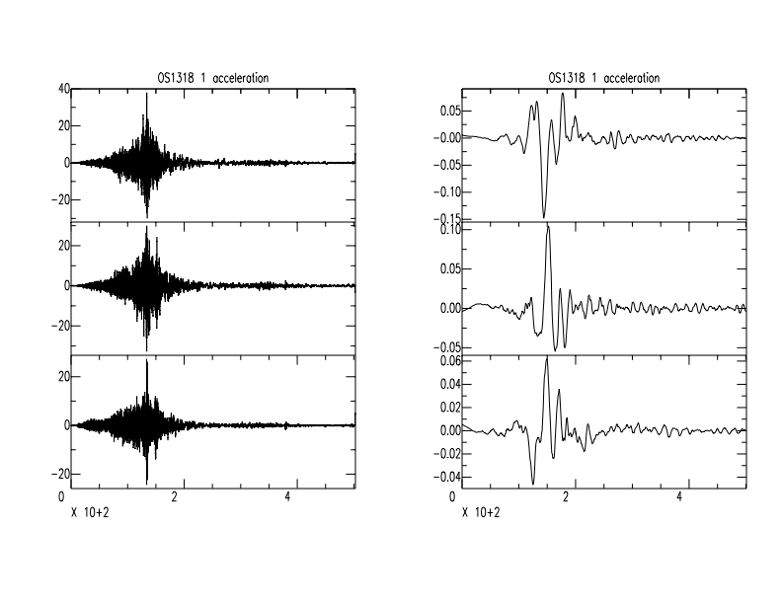
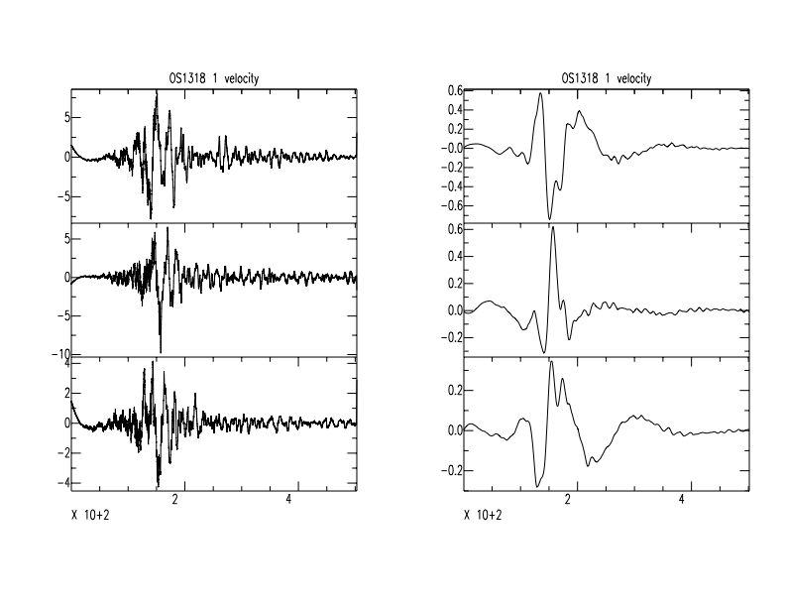
OS
479.29 km
215.09 degrees

Slide 14
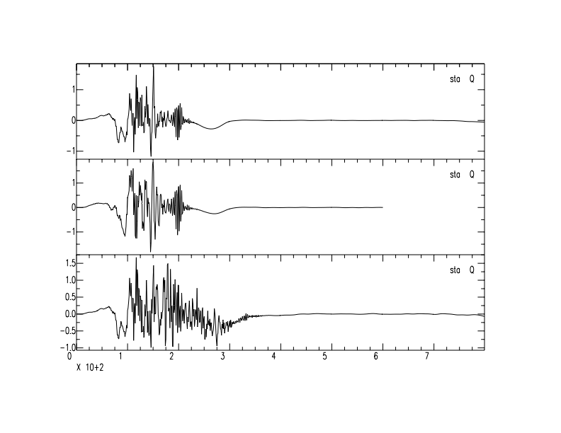
WDC - EAST

Slide 15
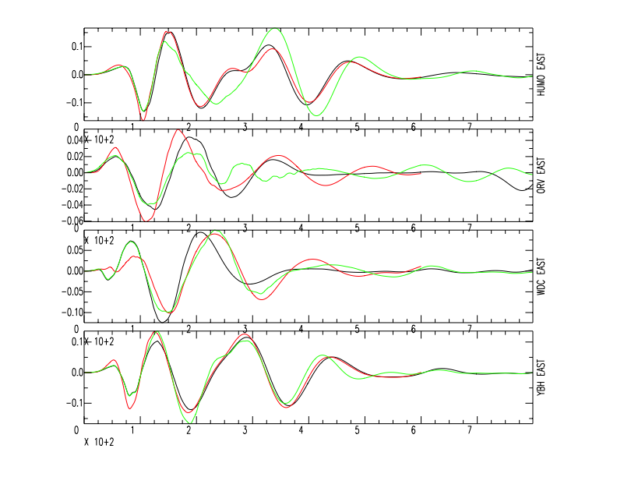

Slide 16
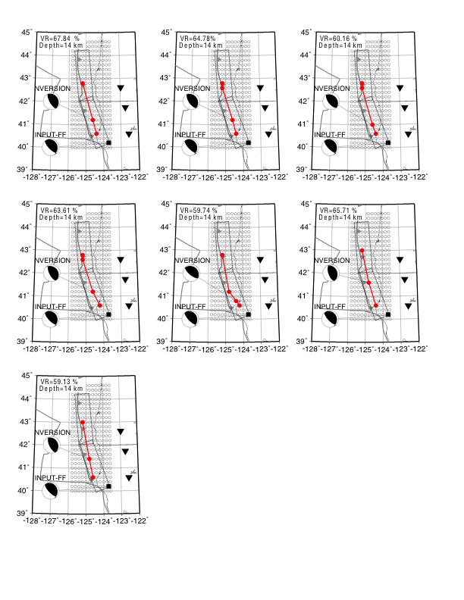
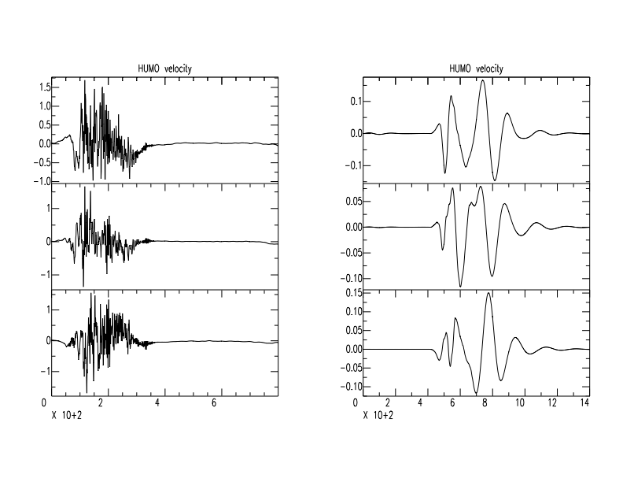
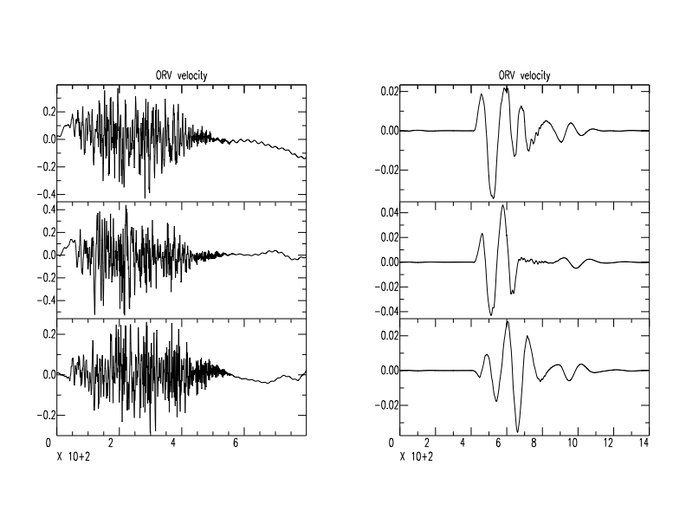
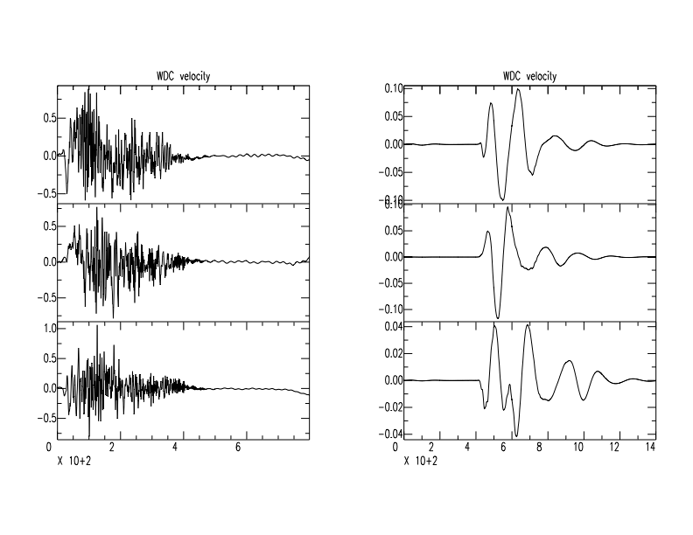
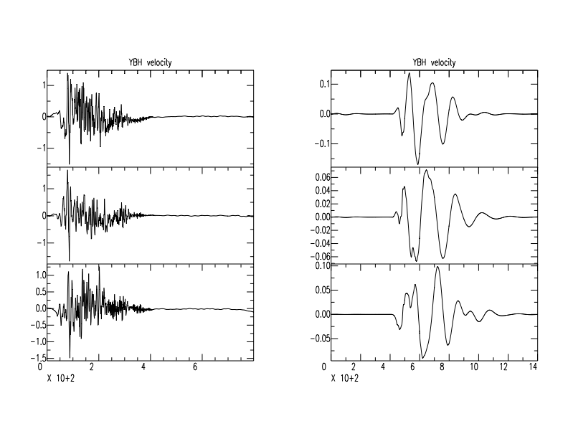
207.5 km
319 km
320.5 km
255.4 km
186.7 km
175.2 km
168.6 km
244.8 km

Slide 17
Detecting 23 M4+ earthquakes

Slide 18
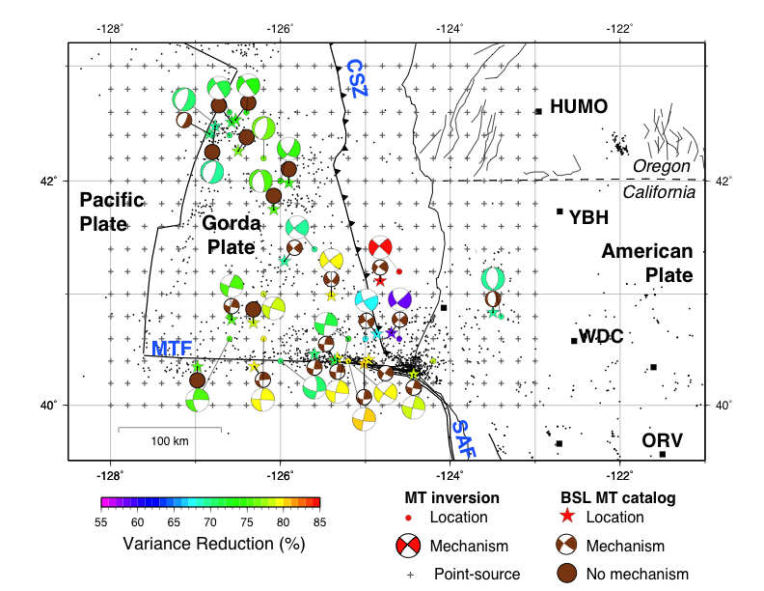
Using
lp co 0.045 p 1 n 1
hp co 0.018 p 1 n 1
Instead of
lp co 0.050 p 1 n 1
hp co 0.020 p 1 n 1

Slide 20
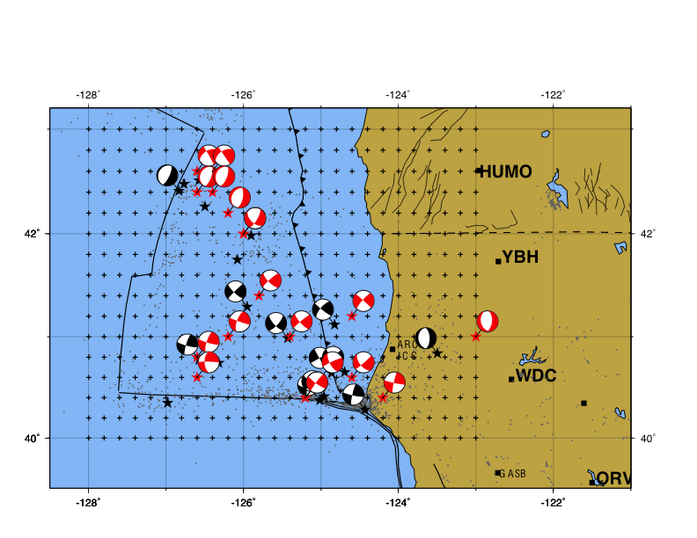
lp co 0.05 p 1 n 1
hp co 0.02 p 1 n 1
lp co 0.045 p 1 n 1
hp co 0.018 p 1 n 1

Slide 21
Comparison between the different filters
 | Horizontal | Vertical | Time | Magnitude | VR
bp co 0.02-0.05 p 2 | 20.18 | 19.86 | 0:00:04 | 0.09 | 74.39
lp/hp 0.02-0.05 p 1 | 25.52 | 21.05 | 0:00:05 | 0.10 | 70.92
lp/hp 0.018-0.045 p 1 | 18.70 | 18.04 | 0:00:03 | 0.10 | 74.38

