Slide 1
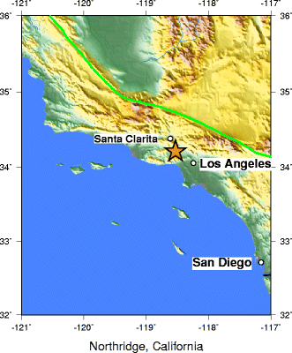
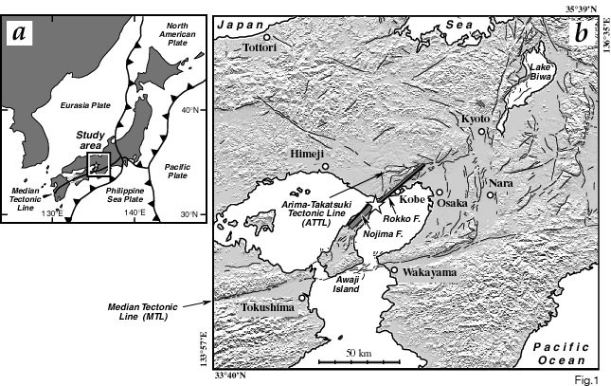
Northridge earthquake
Kobe earthquake
Reverse mechanism
Strike-slip earthquake
Date: January 17, 1994 (1994-01-17)
Origin time: 04:31 PST (12:30 UTC)
Magnitude 6.7 Mw
Depth: 17.0 km
Epicenter location: Reseda, California
Max. intensity: IX - Ruinous
Casualties: 72 killed over 9,000 injured
Date: January 17, 1995
Magnitude: Mw 6.8 (USGS)
Epicenter location: Awaji Island, Japan
Casualties: 6,434 killed, around 300,000 left homeless

