Slide 1

What controls the location, size
and shape of shallow landslides?
David Milledge
Department of Geography, Durham University, UK
Collaborators: Dino Bellugi (MIT), William E. Dietrich (UC Berkeley),
Jim McKean (USFS), D. Vaughan Griffiths (CSM).

Slide 2
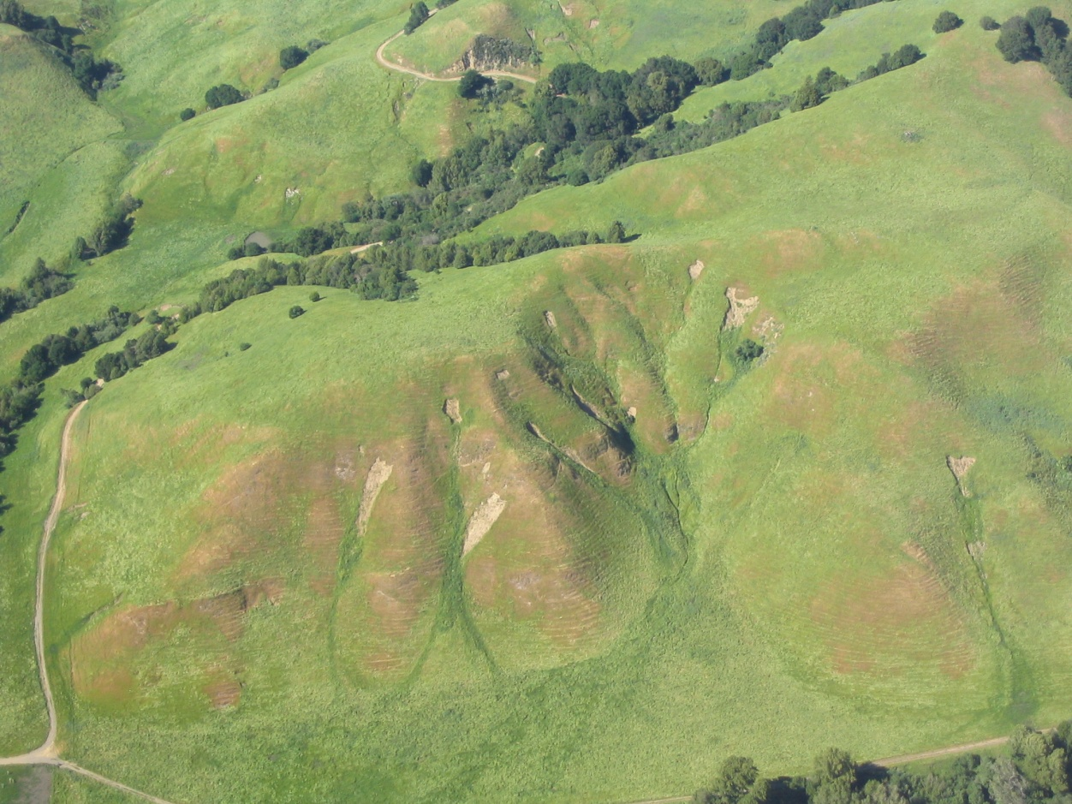
Outline
Context: shallow landslides
The infinite slope model
New 3D stability model
  Description & Testing
  Implications
Landscape scale application
  Description
  Implications
Landslides in forests should be larger than those in grasslands.
Landslide location can be strongly controlled by topography even when pore water pressure is not.
Landslide size is controlled by:
lateral resistance encouraging growth
AND
spatial pattern of strength etc. restricting growth.
There is an optimum failure plane depth ;
There is an optimum landslide shape (Length > Width);
There is a limit to how small landslides can be…
… even in cohesionless soils!
[Photo: Douglas Allen]

Slide 3
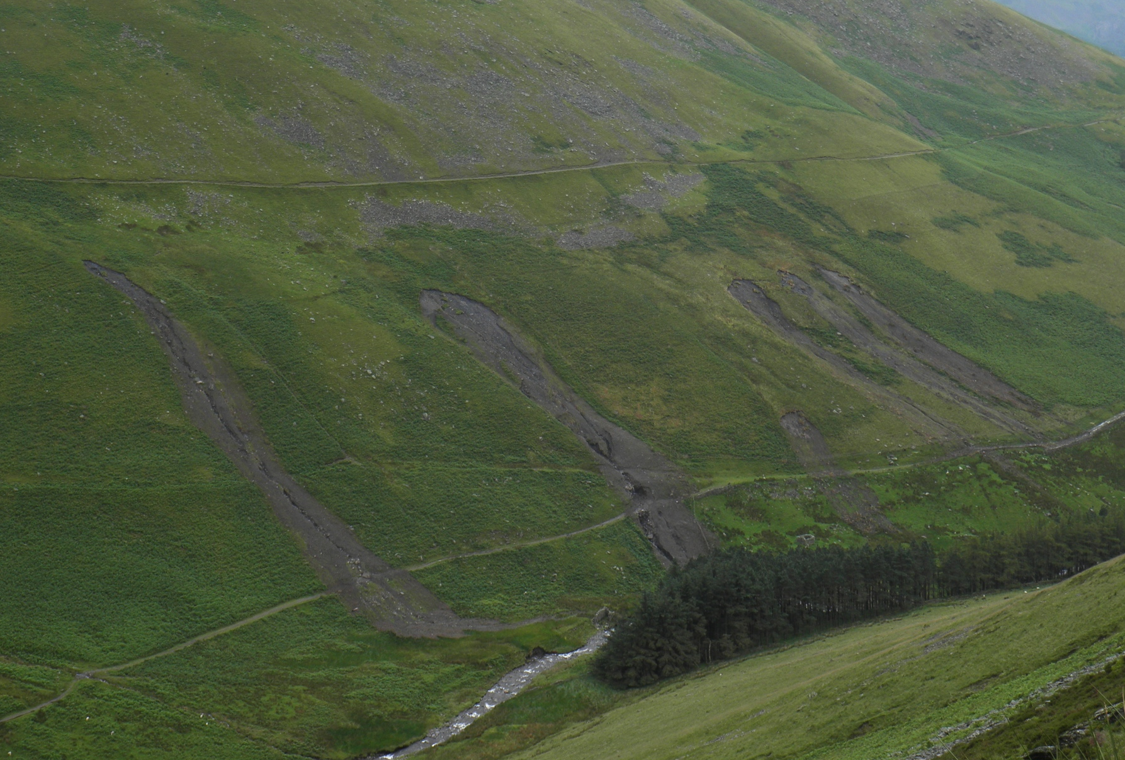
Cumbria, UK, 2012
[Photo: J.Warburton]

Slide 4
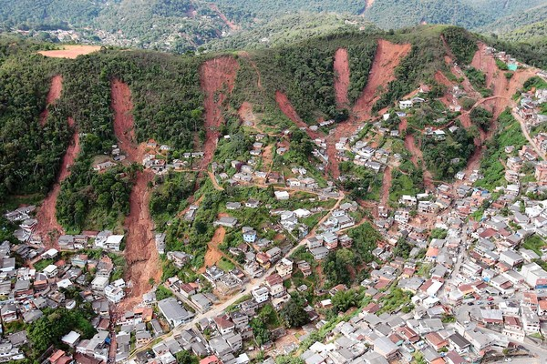
Near Rio de Janeiro, Brasil, January 2011, ~1500 casualties
[Photo: W.Dietrich]
Notes:
January 2011, near Rio.

Slide 5
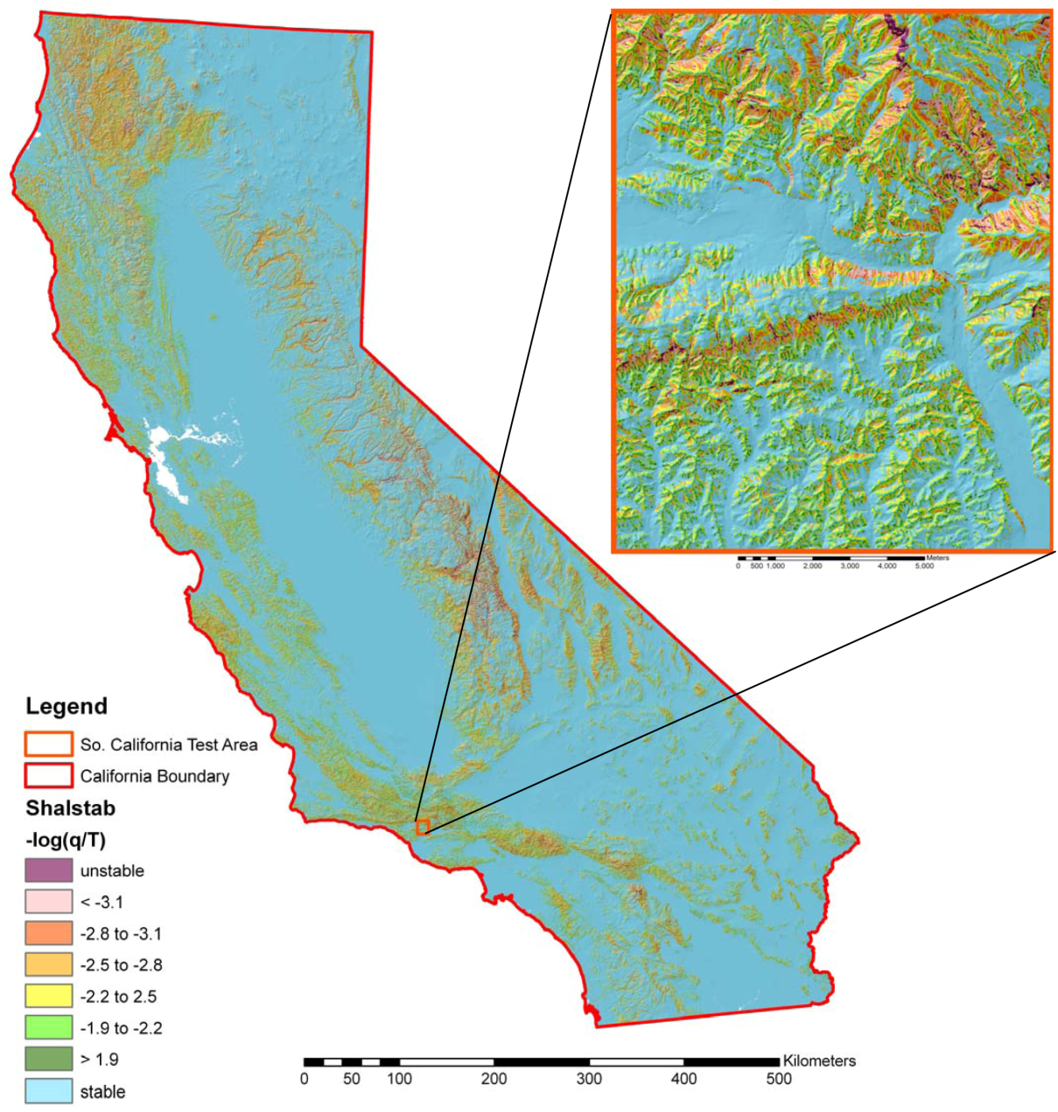
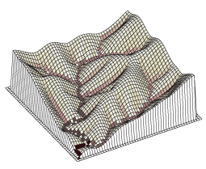
Risk Prediction
Landscape Evolution Modelling
[Dietrich & Montgomery, 1998; Bellugi, et al., 2011; Stock & Bellugi, 2011]
[Tucker and Bras, 1998]
Notes:
Nice property: simple to implement, here is a parallel version that Bellugi and others applied to all of California.
Landslides are grid cells, no size.
Overprediction.

Slide 6
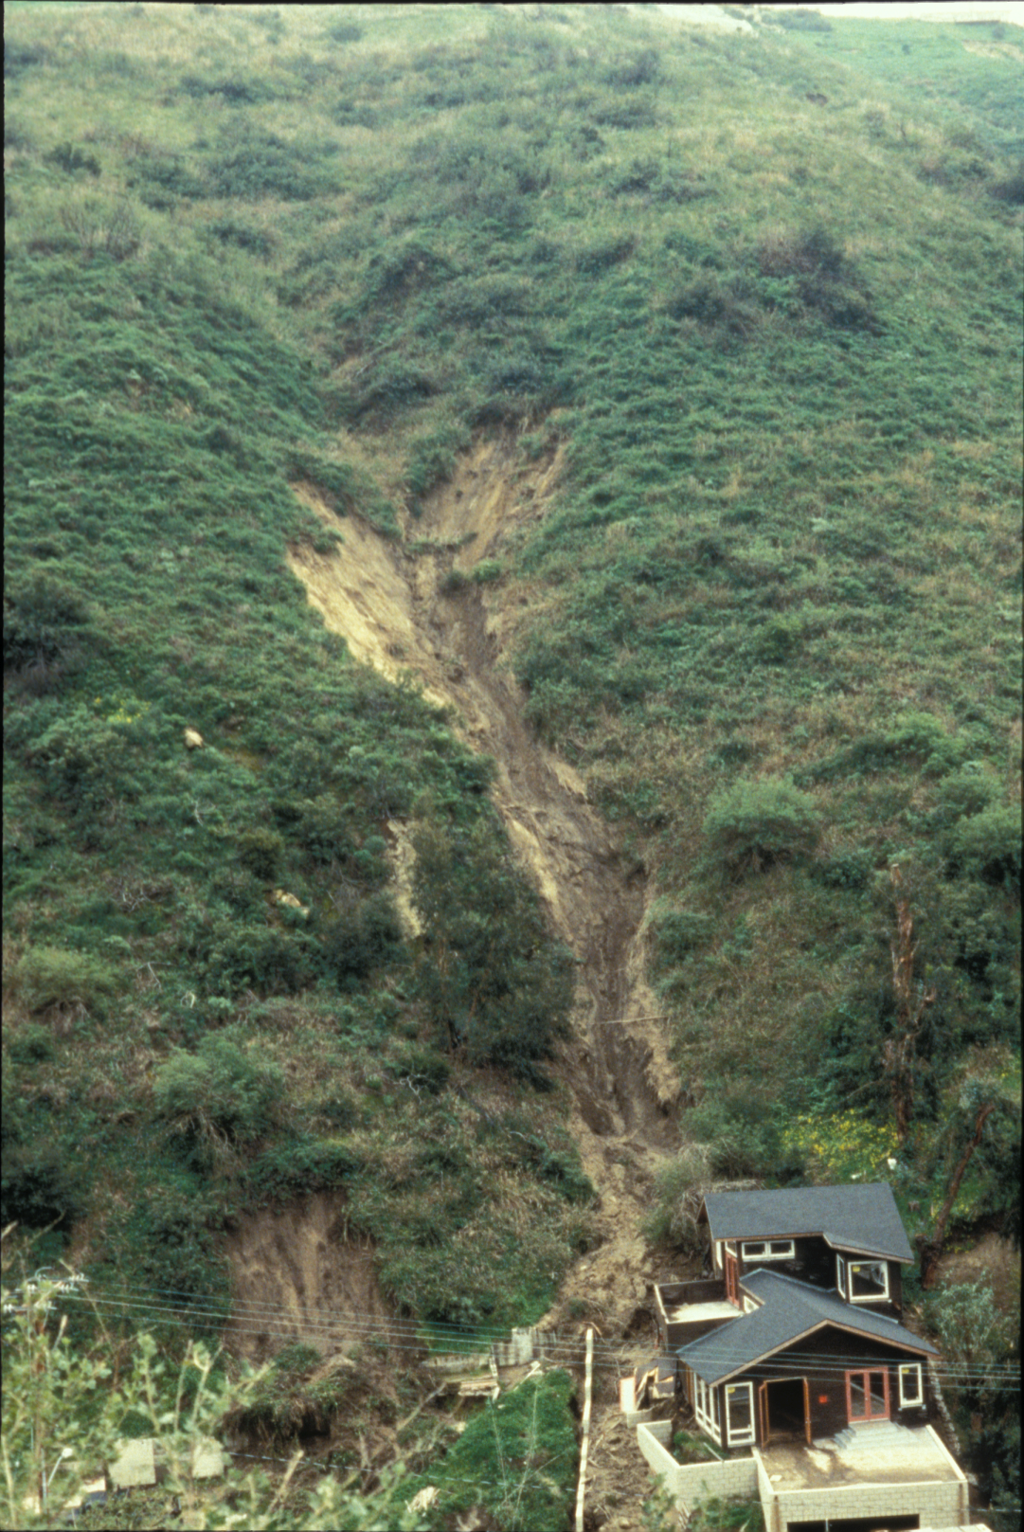
5 Key Questions:
Where?
When?
How big?
How far?
Mass gain or loss?
Laguna Beach, California, 1998

Slide 7
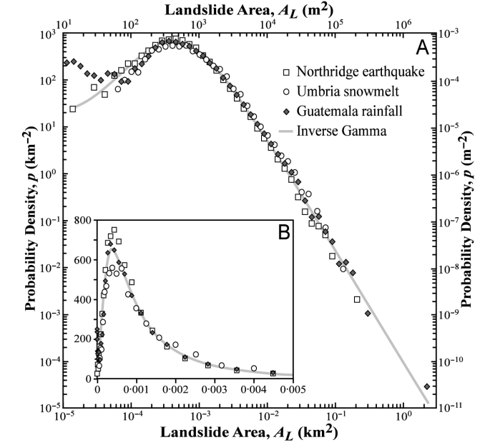
Landslide size distributions
Most landslides
we will see today
Malamud, et al., 2005]
Notes:
Also common practice to measure landslides and plot the size distribution. Power law, problems with mapping, sampling issues, can be loosely used as probability

Slide 8
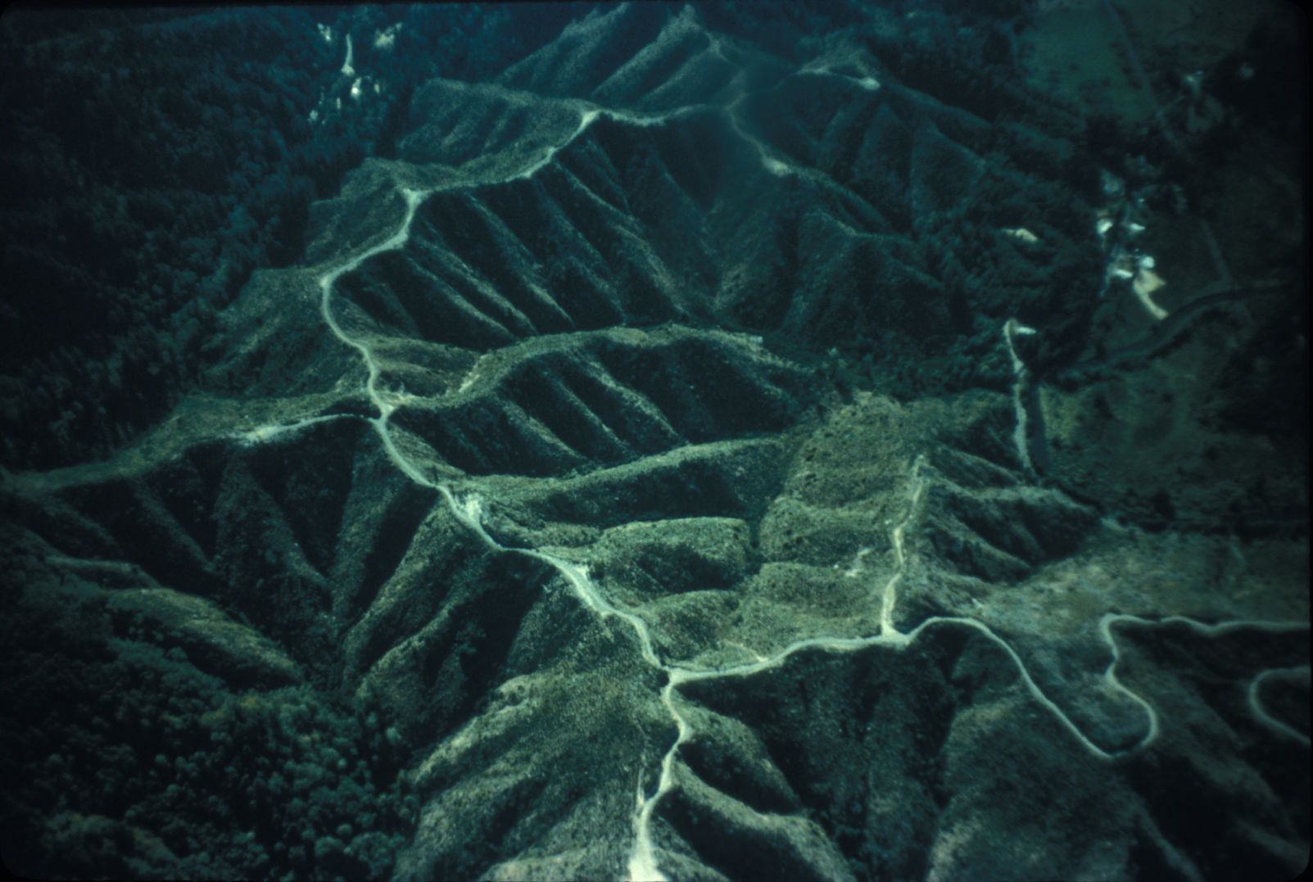
Ridge and Valley topography in the Oregon Coast Range

Slide 9
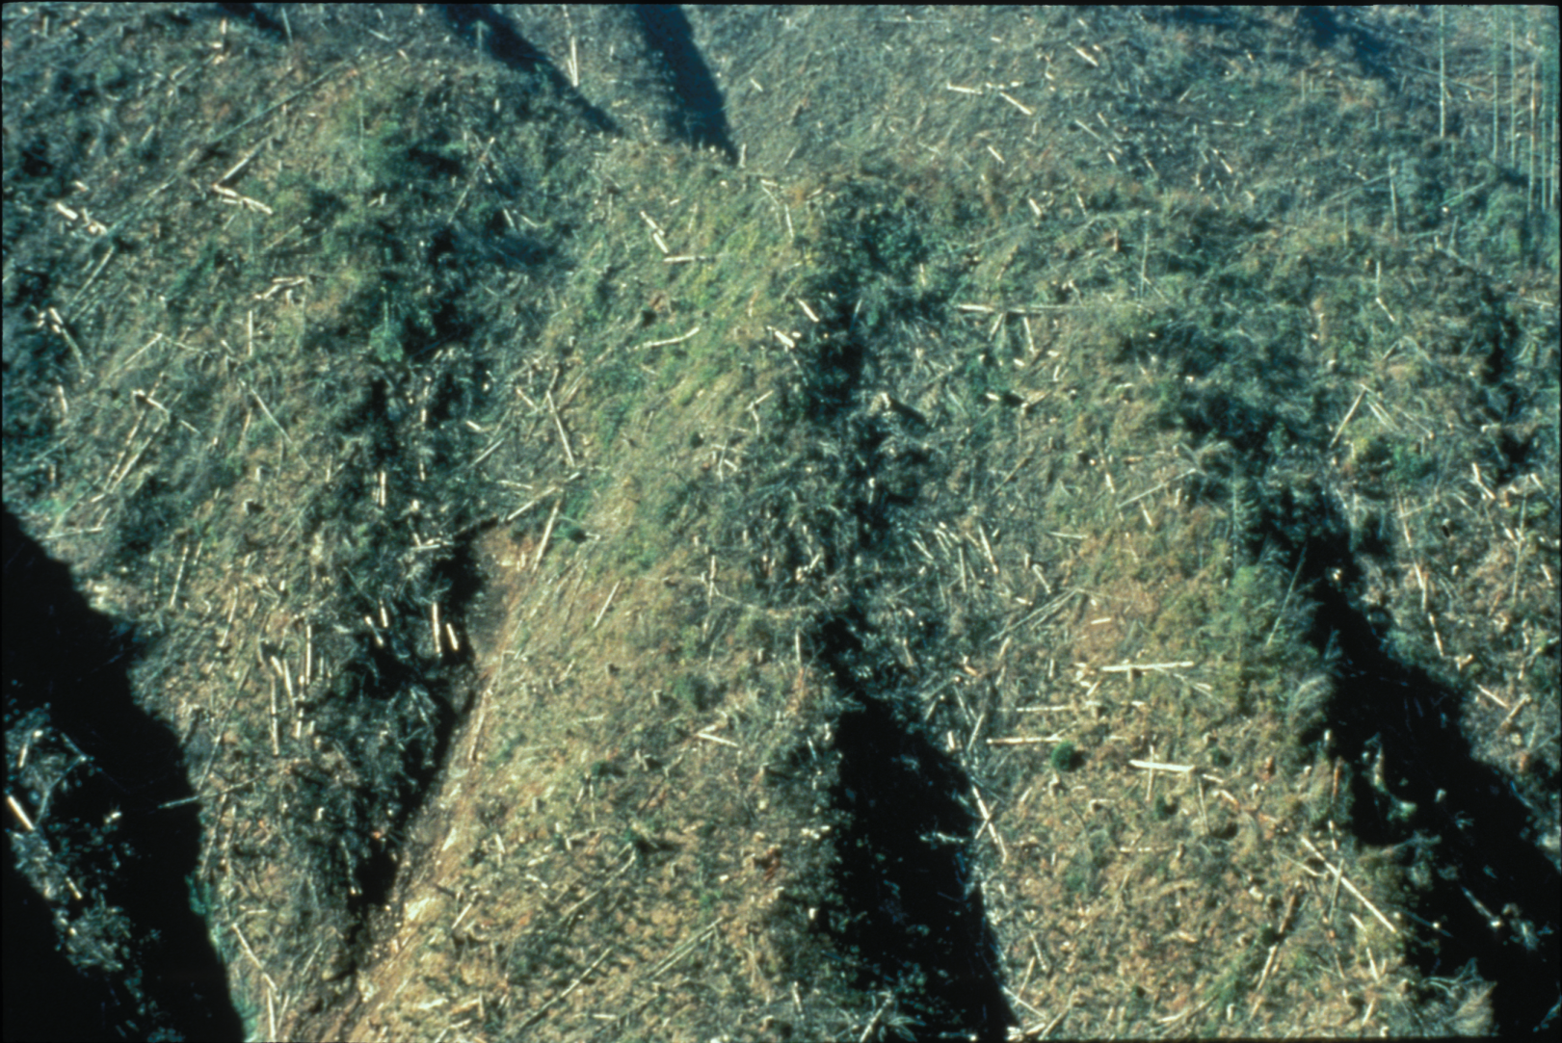
Hollows in the Oregon Coast Range
[Dietrich]

Slide 10
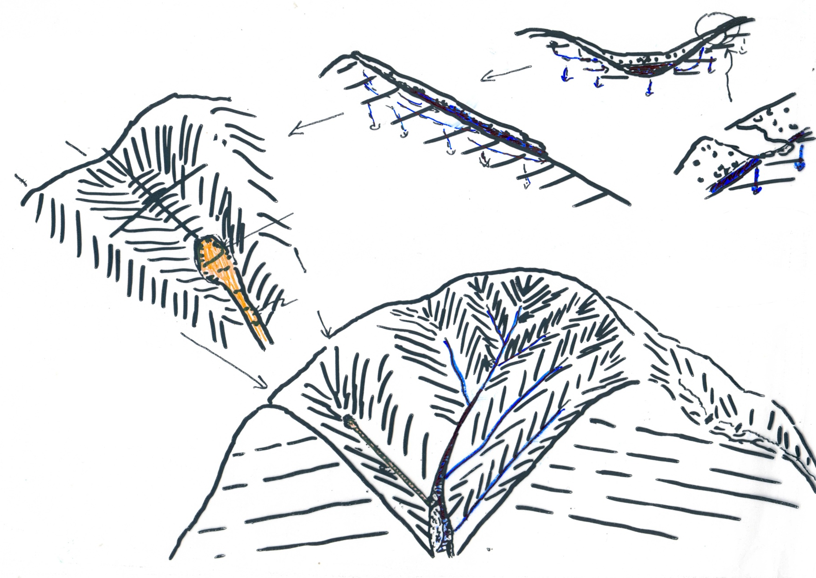
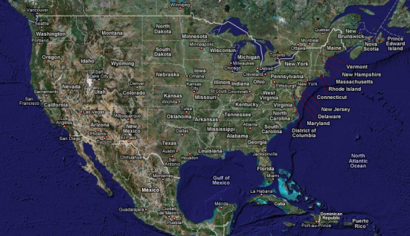
An Example: processes shaping the Oregon Coast Range
B
Colluvium accumulation
B’
A
Unchanneled valley
Downslope transport
Hollow
A
A’
mt. beavers
Nose
B’
Landslide scar
Soil production from bedrock
B
A’
Debris flow runout
Deep seated landslide
Shallow landslide

Slide 11
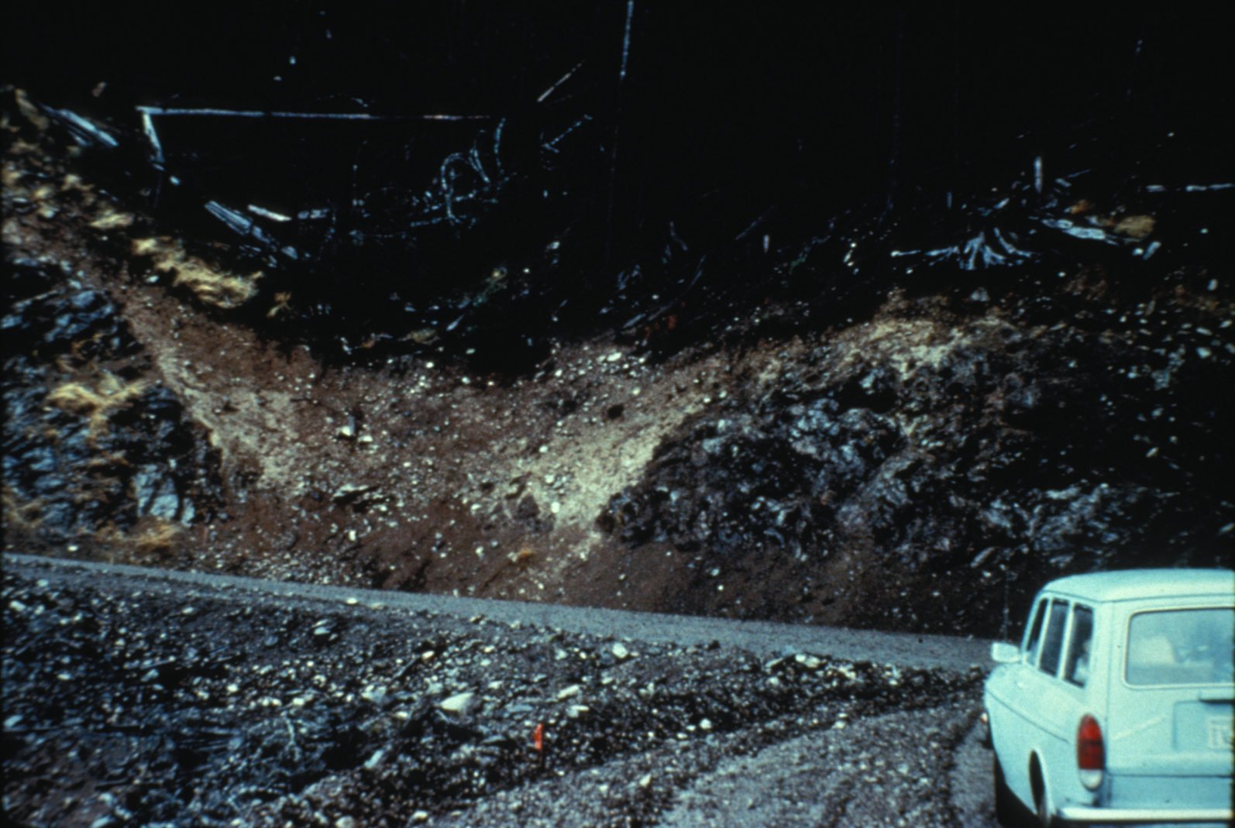
Hollows in the Oregon Coast Range
[Dietrich]

Slide 12
Risk Prediction
Landscape Evolution Modelling
[Dietrich & Montgomery, 1998; Bellugi, et al., 2011; Stock & Bellugi, 2011]
[Tucker and Bras, 1998]
Notes:
Nice property: simple to implement, here is a parallel version that Bellugi and others applied to all of California.
Landslides are grid cells, no size.
Overprediction.

Slide 13
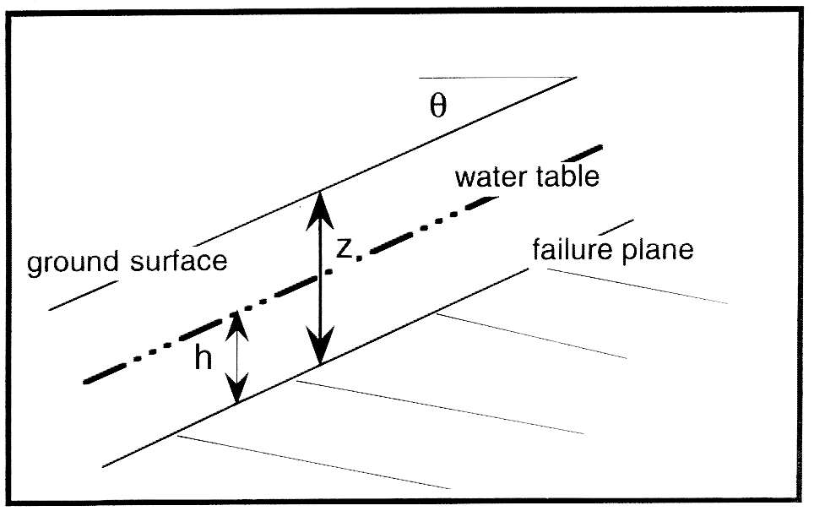
Infinite slope framework
Infinite inclined plane with angle θ
Failure plane parallel to the surface
Failure occurs at soil/bedrock boundary
Flow parallel to the failure boundary
Key assumptions:

Slide 14
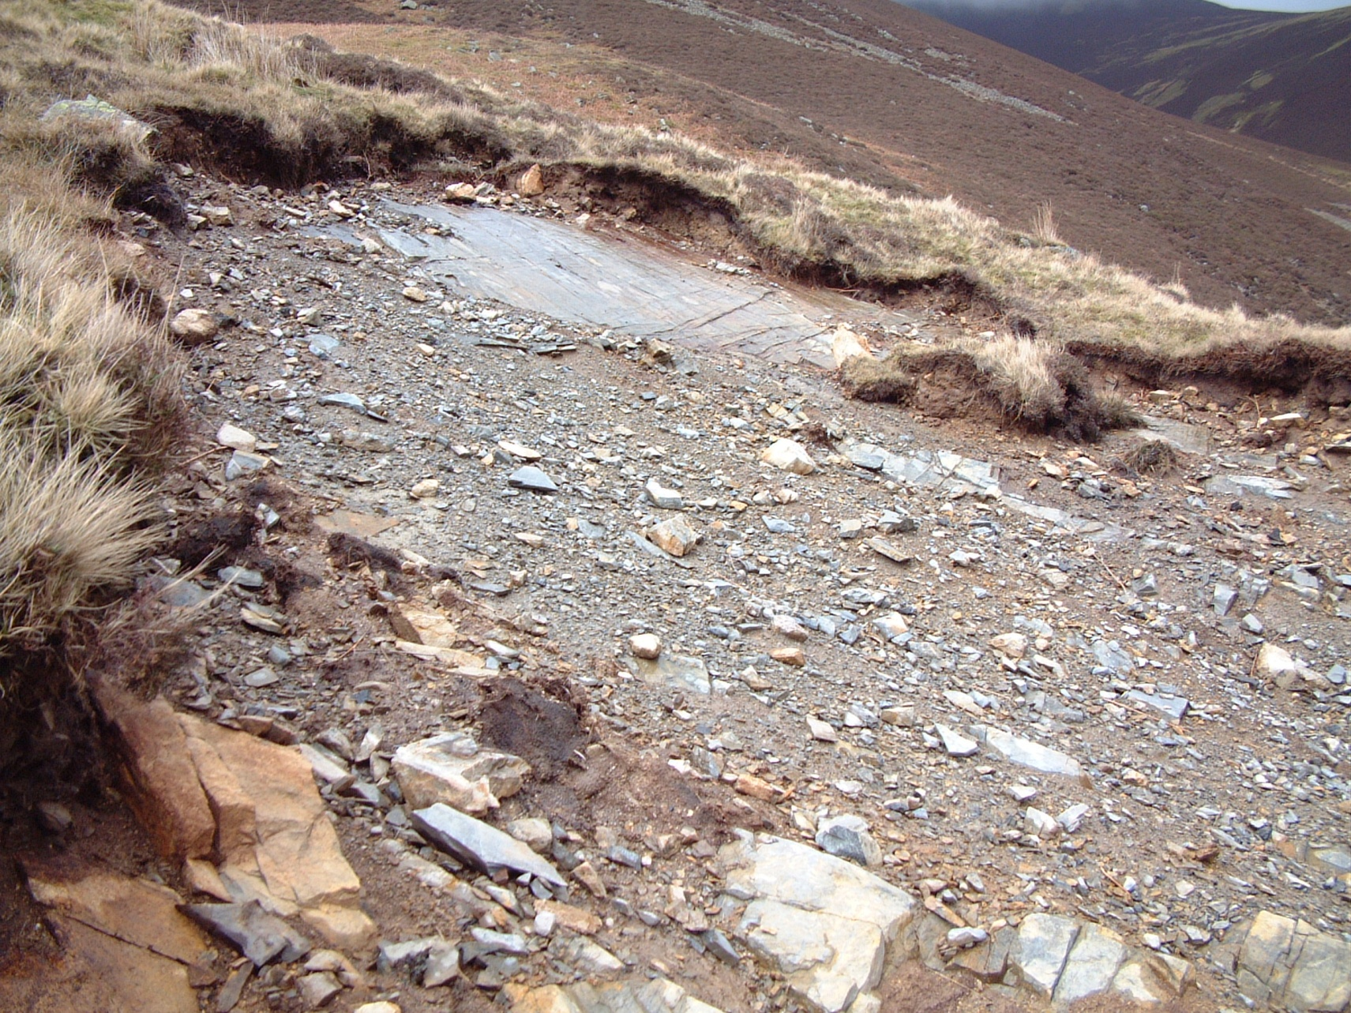
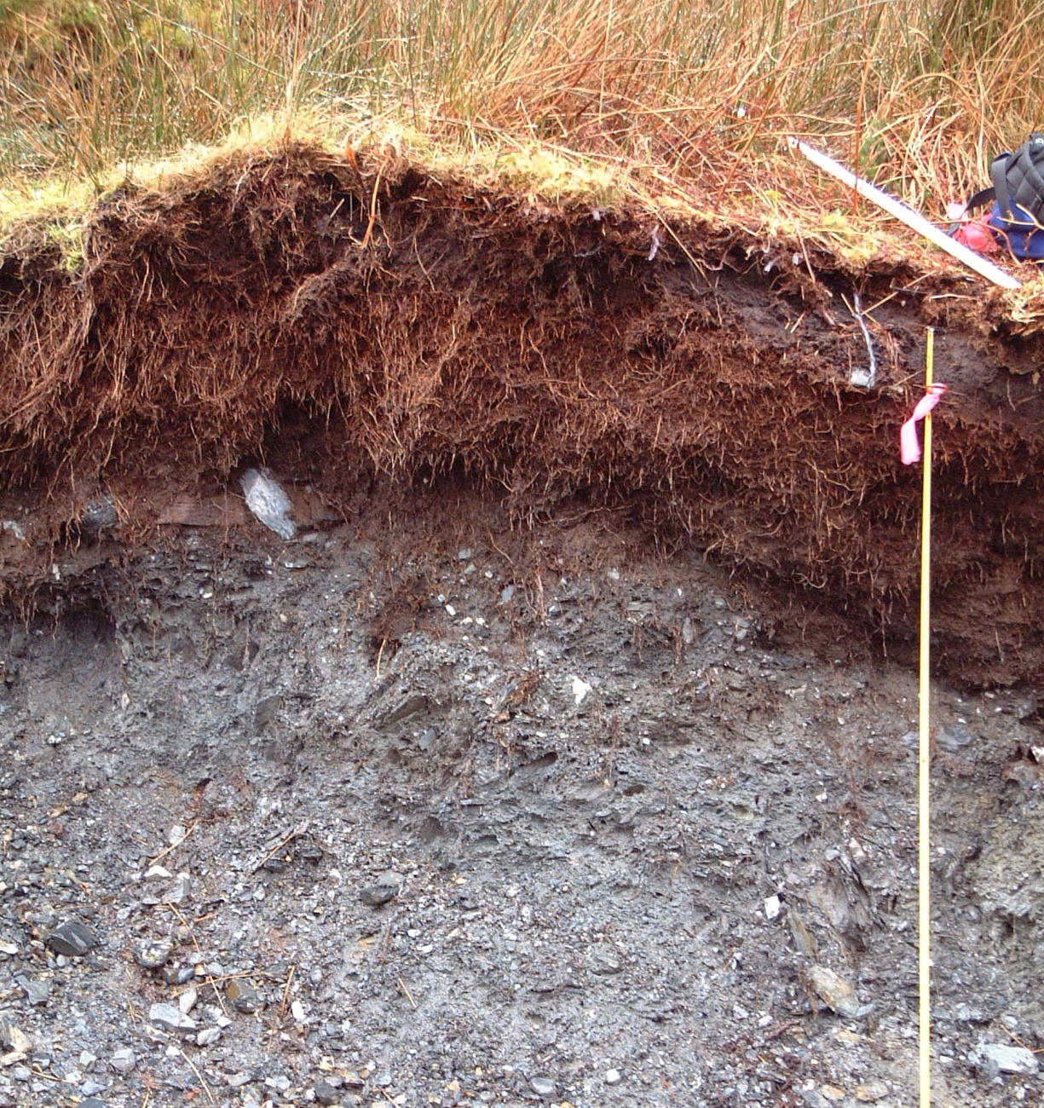
Lateral reinforcement matters
Notes:
Broken roots on the sides of scars suggesting that the sides matter.

Slide 15
Antecedents: wedge method
[Chen, 1981; Figure from Eid, 2010]

Slide 16
3-D Slope stability model
Based on Wedge Method
(Chen, 1981)
Consider forces on all 5 boundaries
Include cohesion & friction
F_{sb} =basal shear resistance
F_{sl} = lateral shear resistance
F_{p} = passive wedge resistance
F_{a} = active wedge driving force
F_{d} = block driving force
l = block length
w = block width
z = failure plane depth
θ = failure plane slope
Notes:
For this reason, infinite slope stability models won’t suffice. We need to go to a fully three-dimensional force balance.
Considers the forces on all 5 boundaries.
In particular, this model includes the active, passive, and at rest earth pressures, which act on the upslope, downslope, and on the sides of such an idealized block.
This idea was conceived by Jim McKean I’ve recently been working on how we can best do it it follows initial work by Prof RC Chen on engineering slopes in the 80s.

Slide 17
3-D Slope stability model
Spatial Data:
Elevation
Soil depth
Water table height
Root strength field
Material Properties:
Friction angle
Bulk density
Assumptions:
Rigid block
Failure plane location
Notes:
List the inputs. – note same as inf slope so hasn’t cost us lots of new parameters.
An implicit assumption in this kind of force balance, is that a landslide behaves as a rigid block.
While not very realistic, here we are only concerned with what might set the initial scale of the failure, and for this purpose we feel this is a reasonable simplification.

Slide 18
3-D Slope stability model
Grid application based on Hovland’s method of columns
  i.e. ratio of the sum of driving and resisting forces
But include new treatment of boundaries
[Hovland 1977]
Notes:
Block assumes spatially uniform parameters but we need spatially varying.
Use hoveland’s method which is the sum of the resisting forces over sum of the driving forces. But has no edge effects
So we apply our wedge treatment to the landslide boundaries.
Make the landslide here into a grid! Add Dino’s figure on rotating the forces and taking the vector sum.

Slide 19
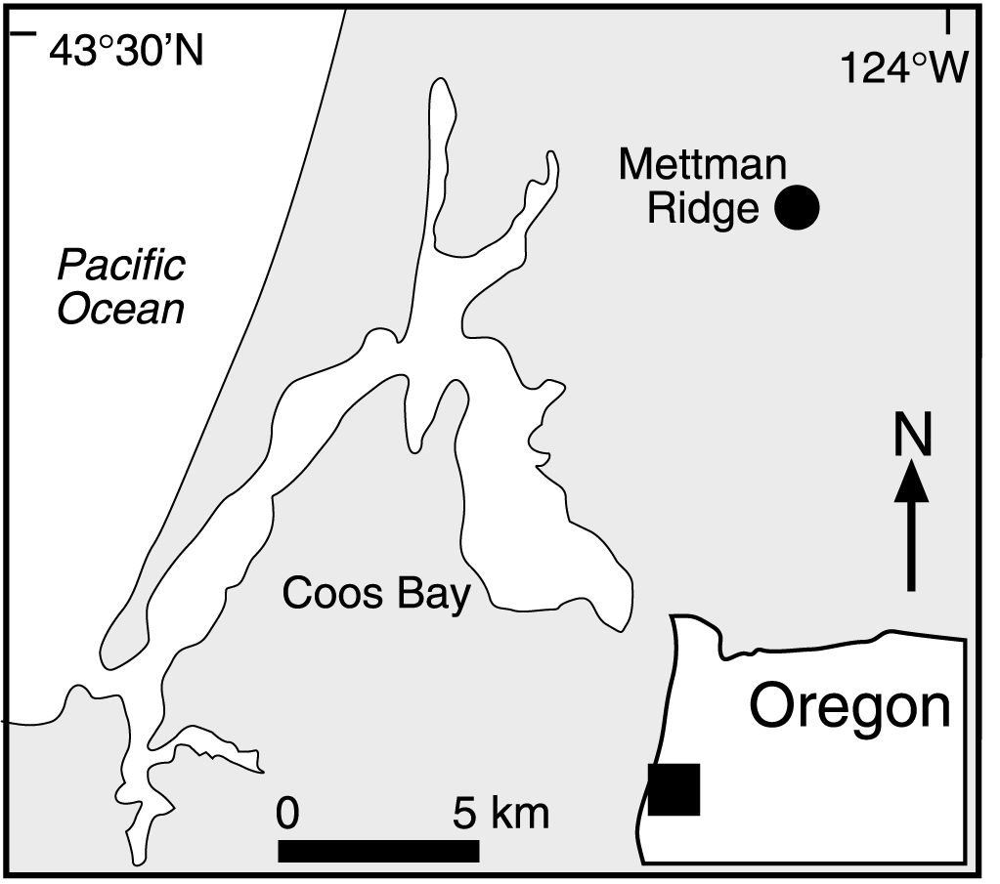
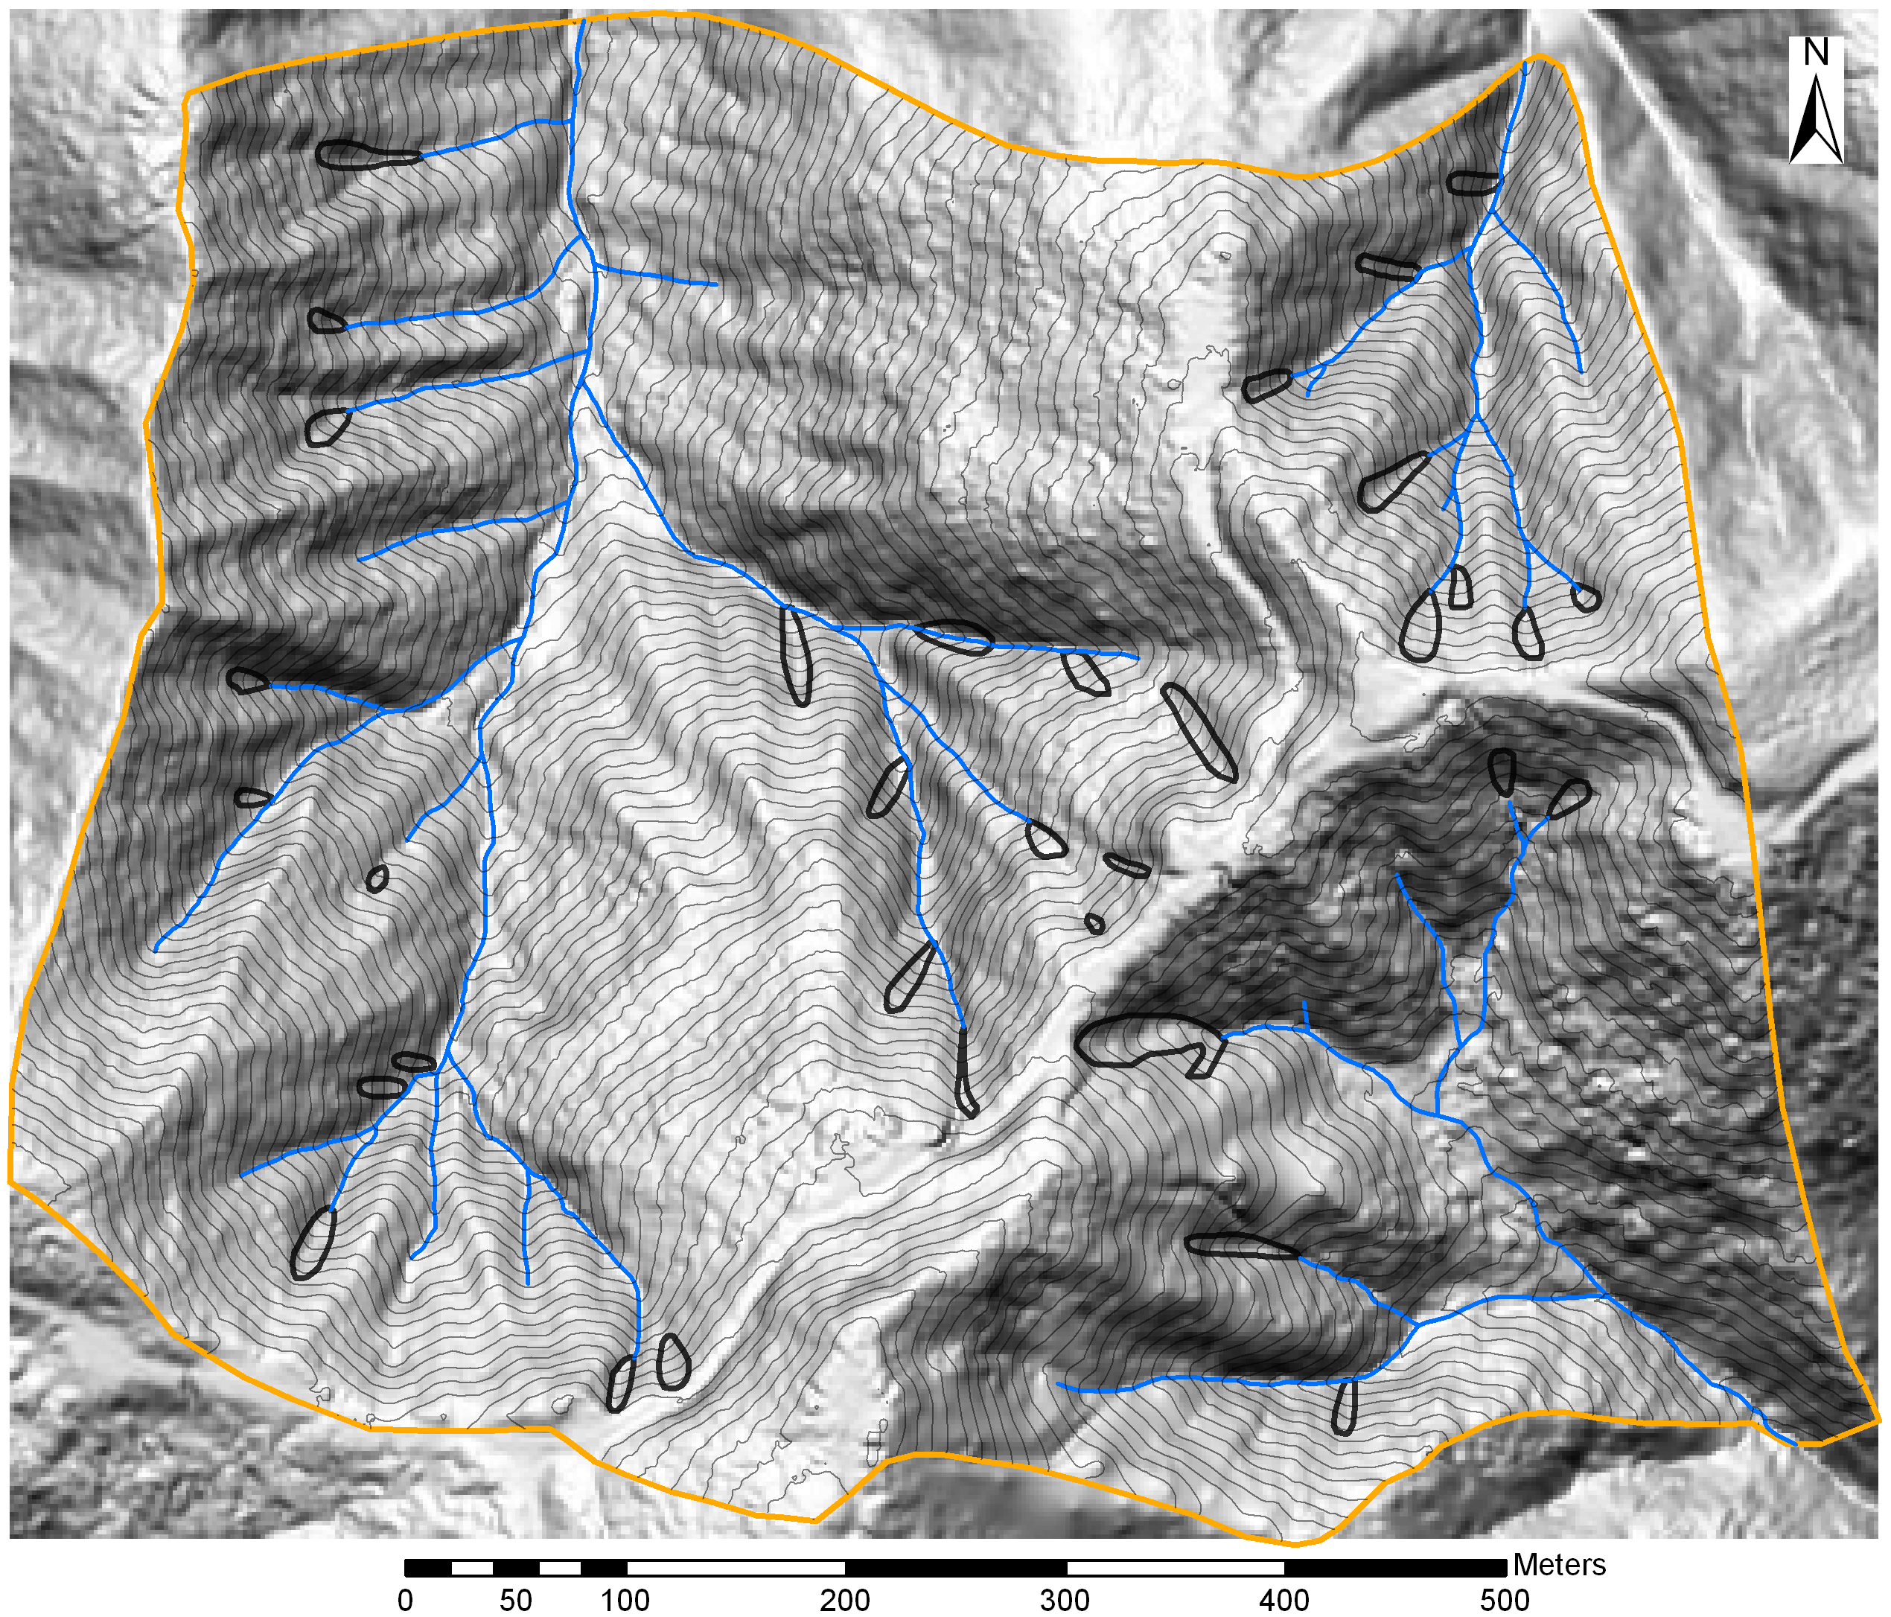
Model testing: Coos Bay landslide

Slide 20
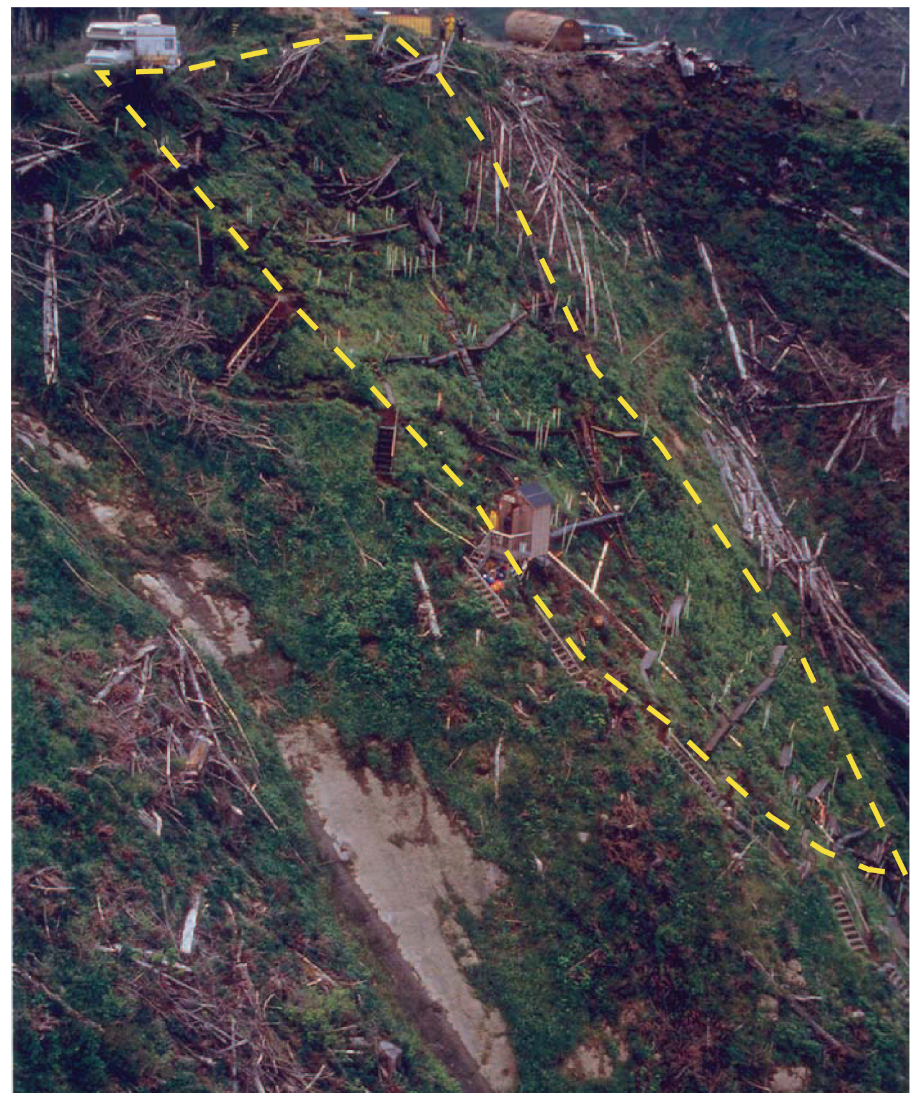
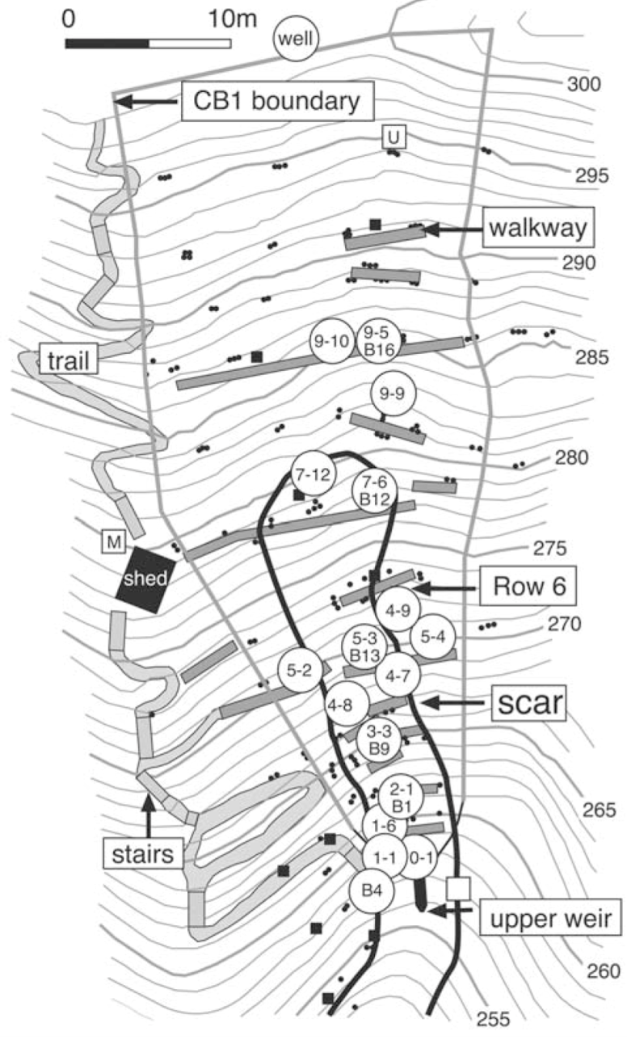
Model testing: Coos Bay landslide
[Montgomery et al 2009, Ebel et al 2007]

Slide 21
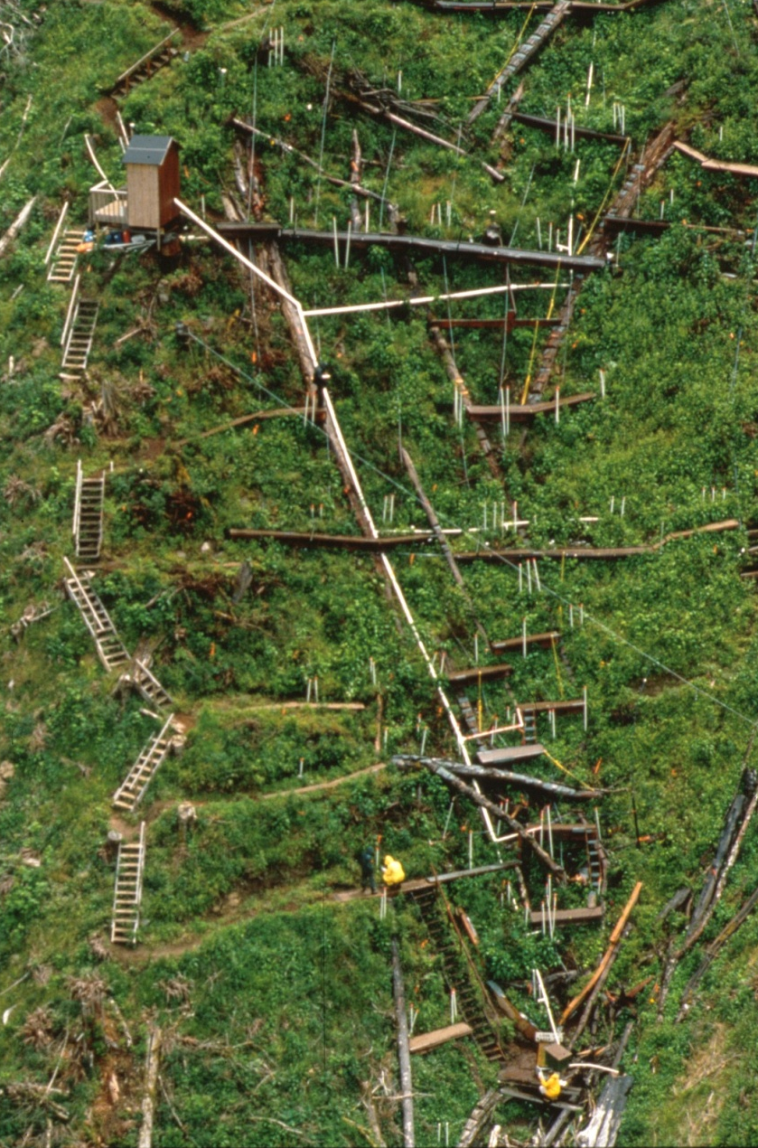
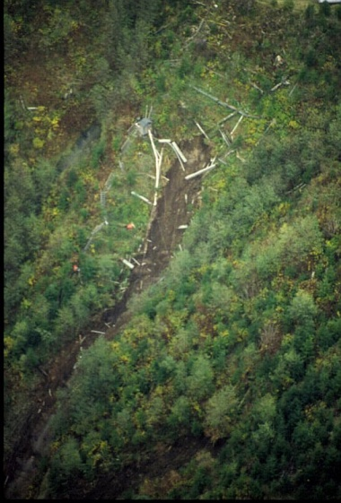
Model testing: Coos Bay landslide
[Photos: Dietrich]

Slide 22
Model testing: Coos Bay landslide
Fully parameterized:
Spatial:
  Soil depth
  Pore pressure
  Surface topography
Measured:
  Root strength
  Friction angle
  Soil density
[Schmidt et al., 2001; Montgomery et al 2009]

Slide 23
Model testing: Coos Bay landslide
Fully parameterized:
Spatial:
  Soil depth
  Pore pressure
  Surface topography
Measured:
  Root strength
  Friction angle
  Soil density
[Montgomery et al 2009]

Slide 24
Model testing: Coos Bay landslide
Fully parameterized:
Spatial:
  Soil depth
  Pore pressure
  Surface topography
Measured:
  Root strength
  Friction angle
  Soil density
[Montgomery et al 2009]

Slide 25
Model test: CB1 landslide 1996
Smaller shapes
more stable due
to resistance
on edges
Larger shapes more stable
due to reduced pore
pressure & soil depth
Smaller
Larger
Notes:
Minima at or near observed size, tradeoff between size and param patchiness.
Upper less stable than lower, happened first?
Only show results for the upper, pick the log spiral and go with that.
Change the axis label to say size growth (m)
Explain as +1 means 1 m added all the way round the landslide -1 means 1m stripped off all the way round.
Add labels
Fs increase on Right because pwp and soil depth decrease
FS increases on Left because added resistance of the sides

Slide 26
Results: optimum depth
Parameters:
density = 1600 kg m⁻³
friction angle = 40°
slope = 36°
saturation ratio = 1
C₀ = 8000 kPa
j = 4.96 m⁻¹
length = 4 m
width = 2 m

Slide 27
Results: optimum depth
Parameters:
density = 1600 kg m⁻³
friction angle = 40°
slope = 36°
saturation ratio = 1
C₀ = 8000 kPa
j = 4.96 m⁻¹
length = 4 m
width = 2 m
Notes:
Minima at or near observed size, tradeoff between size and param patchiness.
Upper less stable than lower, happened first?

Slide 28
Results: optimum depth
Parameters:
density = 1600 kg m⁻³
friction angle = 40°
slope = 36°
saturation ratio = 1
C₀ = 8000 kPa
j = 4.96 m⁻¹
length = 4 m
width = 2 m
Notes:
Minima at or near observed size, tradeoff between size and param patchiness.
Upper less stable than lower, happened first?
Dimensions fixed, parameters used

Slide 29
Results: optimum shape
Parameters:
density = 1600 kg m⁻³
friction angle = 40°
slope = 36°
saturation ratio = 1
C₀ = 8000 kPa
j = 4.96 m⁻¹
Notes:
Minima at or near observed size, tradeoff between size and param patchiness.
Upper less stable than lower, happened first?

Slide 30
Results: optimum shape
Parameters:
density = 1600 kg m⁻³
friction angle = 40°
slope = 36°
saturation ratio = 1
C₀ = 8000 kPa
j = 4.96 m⁻¹
Notes:
Minima at or near observed size, tradeoff between size and param patchiness.
Upper less stable than lower, happened first?

Slide 31
Results: optimum shape
Parameters:
density = 1600 kg m⁻³
friction angle = 40°
slope = 36°
saturation ratio = 1
C₀ = 8000 kPa
j = 4.96 m⁻¹
[Milledge, 2008]
Notes:
Minima at or near observed size, tradeoff between size and param patchiness.
Upper less stable than lower, happened first?

Slide 32
Results: optimum shape
Parameters:
density = 1600 kg m⁻³
friction angle = 40°
slope = 36°
saturation ratio = 1
C₀ = 8000 kPa
j = 4.96 m⁻¹
[Milledge, 2008]
Notes:
Minima at or near observed size, tradeoff between size and param patchiness.
Upper less stable than lower, happened first?

Slide 33
Results: optimum shape
Parameters:
density = 1600 kg m⁻³
friction angle = 40°
slope = 36°
saturation ratio = 1
C₀ = 8000 kPa
j = 4.96 m⁻¹
Notes:
Minima at or near observed size, tradeoff between size and param patchiness.
Upper less stable than lower, happened first?

Slide 34
Results: optimum shape
Parameters:
density = 1600 kg m⁻³
friction angle = 40°
slope = 36°
saturation ratio = 1
C₀ = 8000 kPa
j = 4.96 m⁻¹
Notes:
Minima at or near observed size, tradeoff between size and param patchiness.
Upper less stable than lower, happened first?

Slide 35
Results: optimum shape
Parameters:
density = 1600 kg m⁻³
friction angle = 40°
slope = 36°
saturation ratio = 1
C₀ = 8000 kPa
j = 4.96 m⁻¹
Notes:
Minima at or near observed size, tradeoff between size and param patchiness.
Upper less stable than lower, happened first?

Slide 36
Results: optimum shape
Parameters:
density = 1600 kg m⁻³
friction angle = 40°
slope = 36°
saturation ratio = 1
C₀ = 8000 kPa
j = 4.96 m⁻¹
[Milledge, 2008]
Notes:
Minima at or near observed size, tradeoff between size and param patchiness.
Upper less stable than lower, happened first?

Slide 37
Results: optimum depth
Parameters:
density = 1600 kg m⁻³
friction angle = 40°
slope = 36°
saturation ratio = 1
C₀ = 8000 kPa
j = 4.96 m⁻¹
length = 4 m
width = 2 m
Notes:
Minima at or near observed size, tradeoff between size and param patchiness.
Upper less stable than lower, happened first?
Dimensions fixed, parameters used

Slide 38
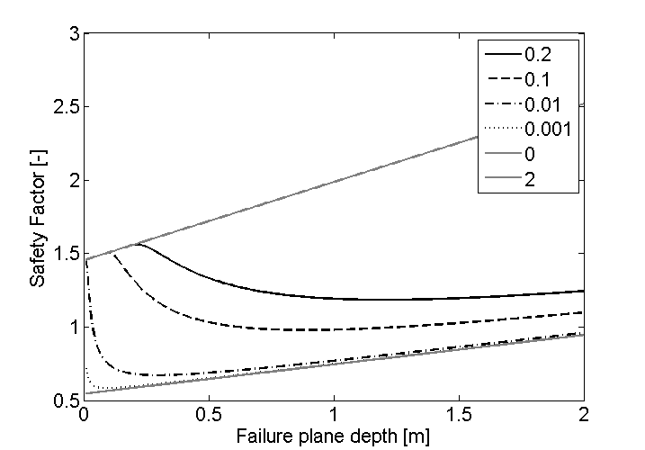
Results: cohesionless soil
Zw [m]
Parameters:
density = 1600 kg m⁻³
friction angle = 40°
slope = 34°
C = 0 kPa
length = 10 m
width = 10 m
Zw = 2
Zw = 0.2
Z
Zw
Zw = 0
h
Notes:
Minima at or near observed size, tradeoff between size and param patchiness.
Upper less stable than lower, happened first?
Dimensions fixed, parameters used

Slide 39

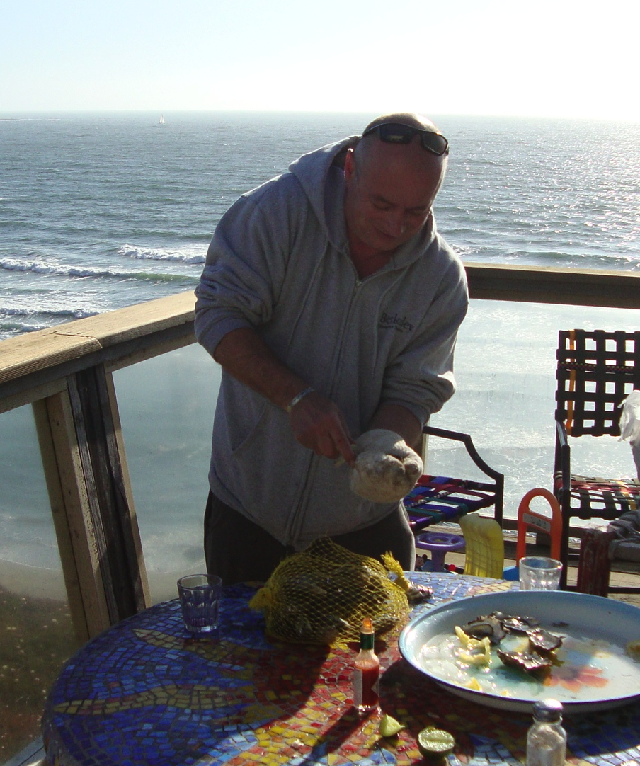
Landslide search: new approach
Dino Bellugi
Dino Bellugi
Notes:
Dino Bellugi has been working on this problem for his PhD. Everything I’m going to show you from here on is the result of his work. He’s just finishing up at the moment and is going to MIT to continue thinking about this problem with Taylor Perron and others.

Slide 40
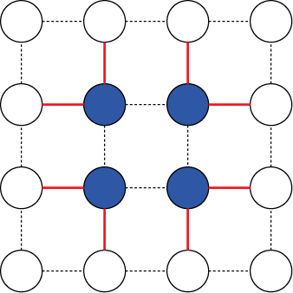
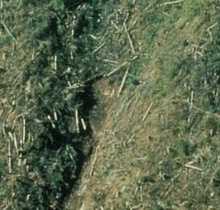
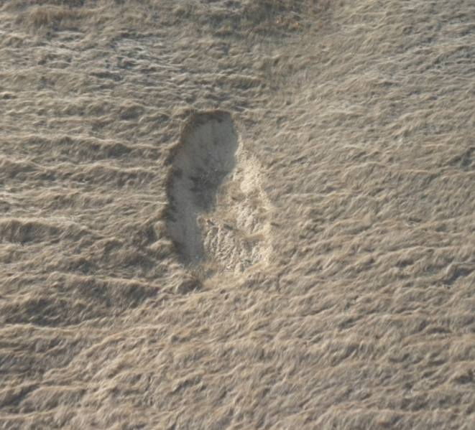
Landslide search: new approach
A clustering application
Notes:
Constrast between a group of cells and their neighbors

Slide 41
Landslide search: new approach
Discretize landscape into grid of cells
Associate each cell with a node in a graph
Nodes: landscape cells annotated by driving forces
Links: resistive forces between neighboring grid cells

Slide 42
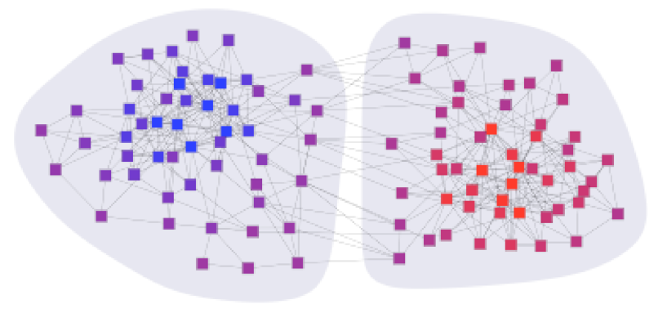
Spectral clustering
Represent data as vertices V of a graph G
Connect pairs of vertices by an edge E
Edges have weights W representing their similarity
The graph construction depends on the application
A
B
Loss function: Normalized Cut
[Shi & Malik, 2000]
[Slide adapted from CS294, “Practical Machine Learning”, Michael Jordan]
Notes:
Shi and Malik 2000: the normalized cut

Slide 43
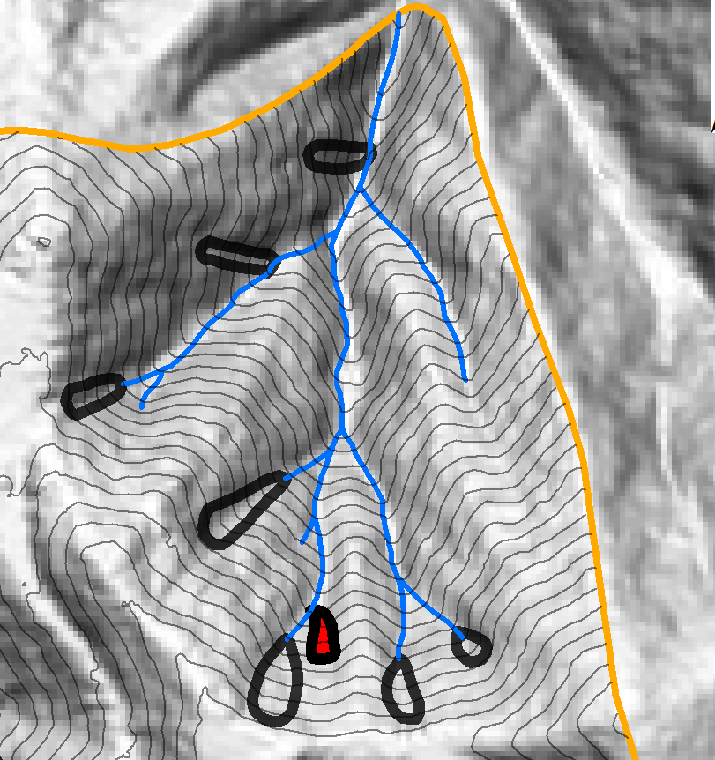
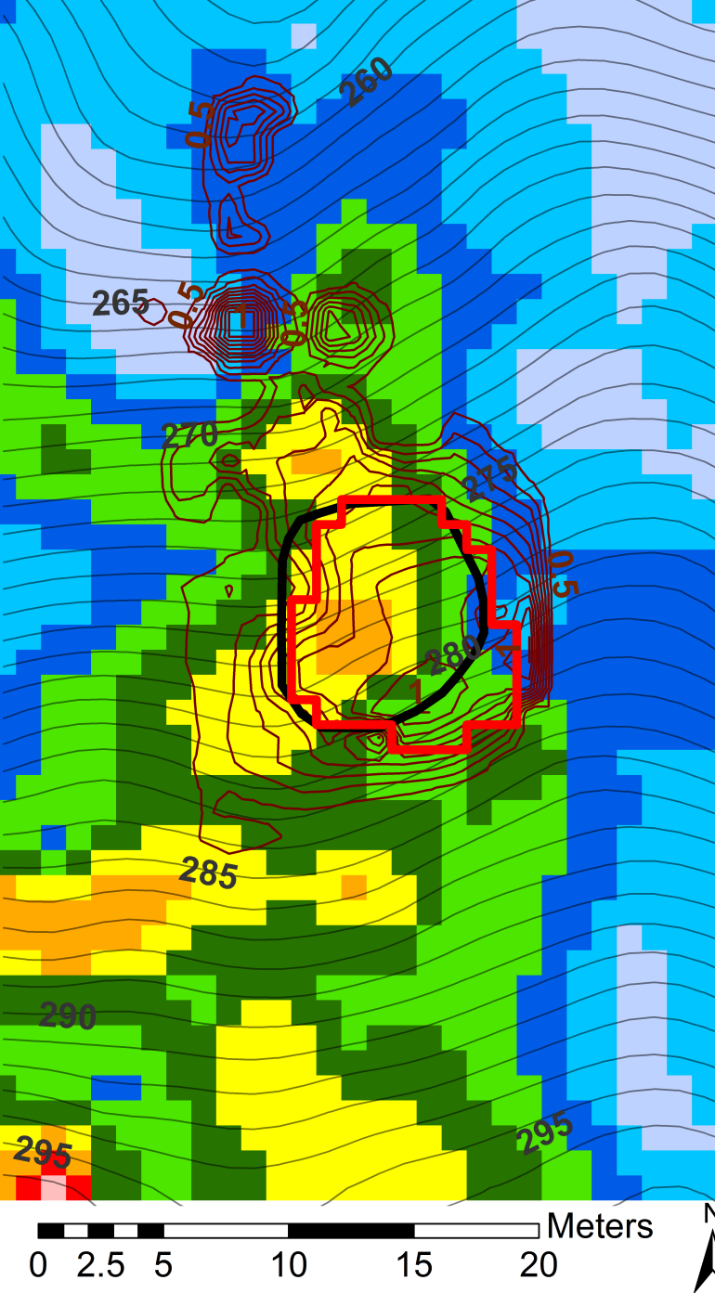
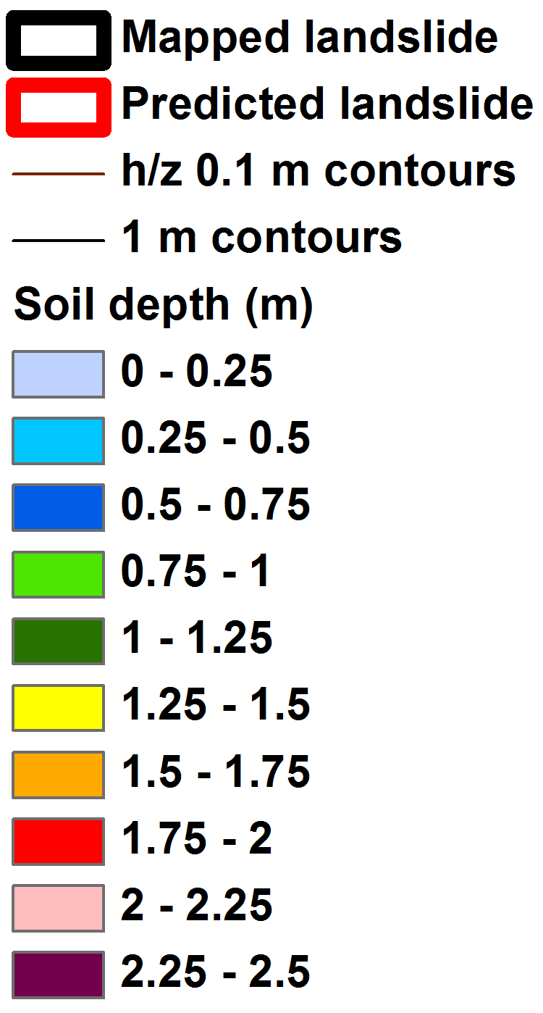
Model testing: Coos Bay landslide
Fully parameterized:
  Measured soil depth
  Measured pore pressure
  Root strength:
    Exponential function of depth
    Integrates to measured values

Slide 44
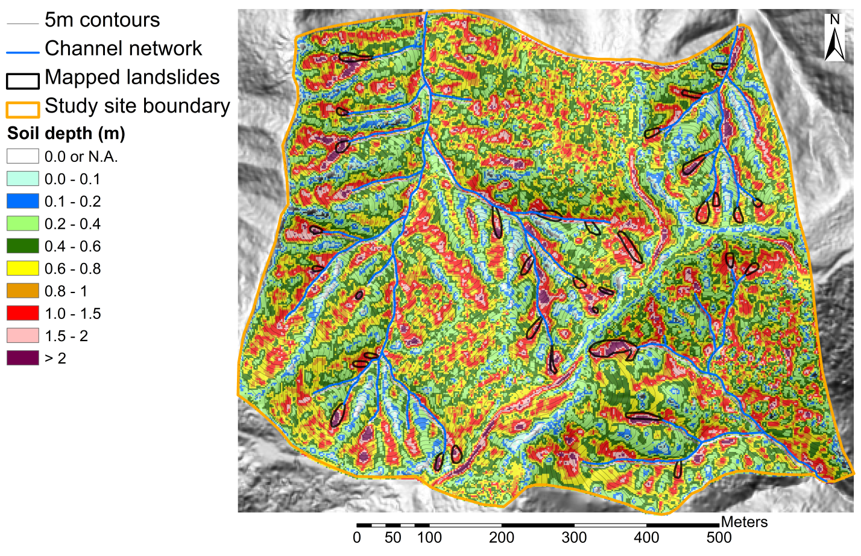
Soil depth
Soil production:
Soil transport:
Regionally calibrated
Coupled finite-difference
Run for 6000 years
No landsliding in
this realization!
Observation:
landslides in
thick soils
[Roering et al., 1999; Heimsath et al., 2001]
Notes:
Soil production model predicting that production decreases exponentially with depth
Soil transport model, predicting transport increases non linearly with slope.
Coupled in a finite-difference scheme, run to match observations.
Regionally calibrated, realistic results.
However all hollows filled (no landsliding).
Landslides in thick soils (hollows)

Slide 45
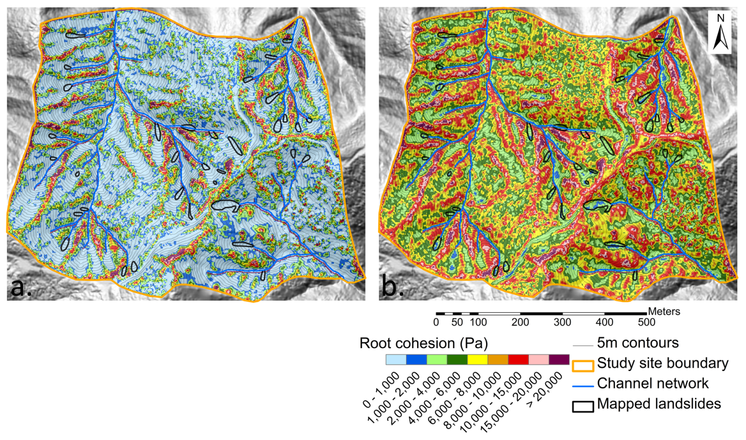
Root Strength
Exponential:
Total:
Lateral:
Basal
From
CB-1
data
a: basal, b: lateral
C_{r0} = 21666 Pa
j = 4.96 m⁻¹
Observation: landslides in low root strength
[Benda & Dunne, 1997; Schmidt et al., 2001; Montgomery et al., 2009]
Notes:
Root strength contribution decreases exponentially with depth.
Integrate to get total, divide to get average.
Constraints: strength/depth data and spatial average.
Landslides in low strength

Slide 46
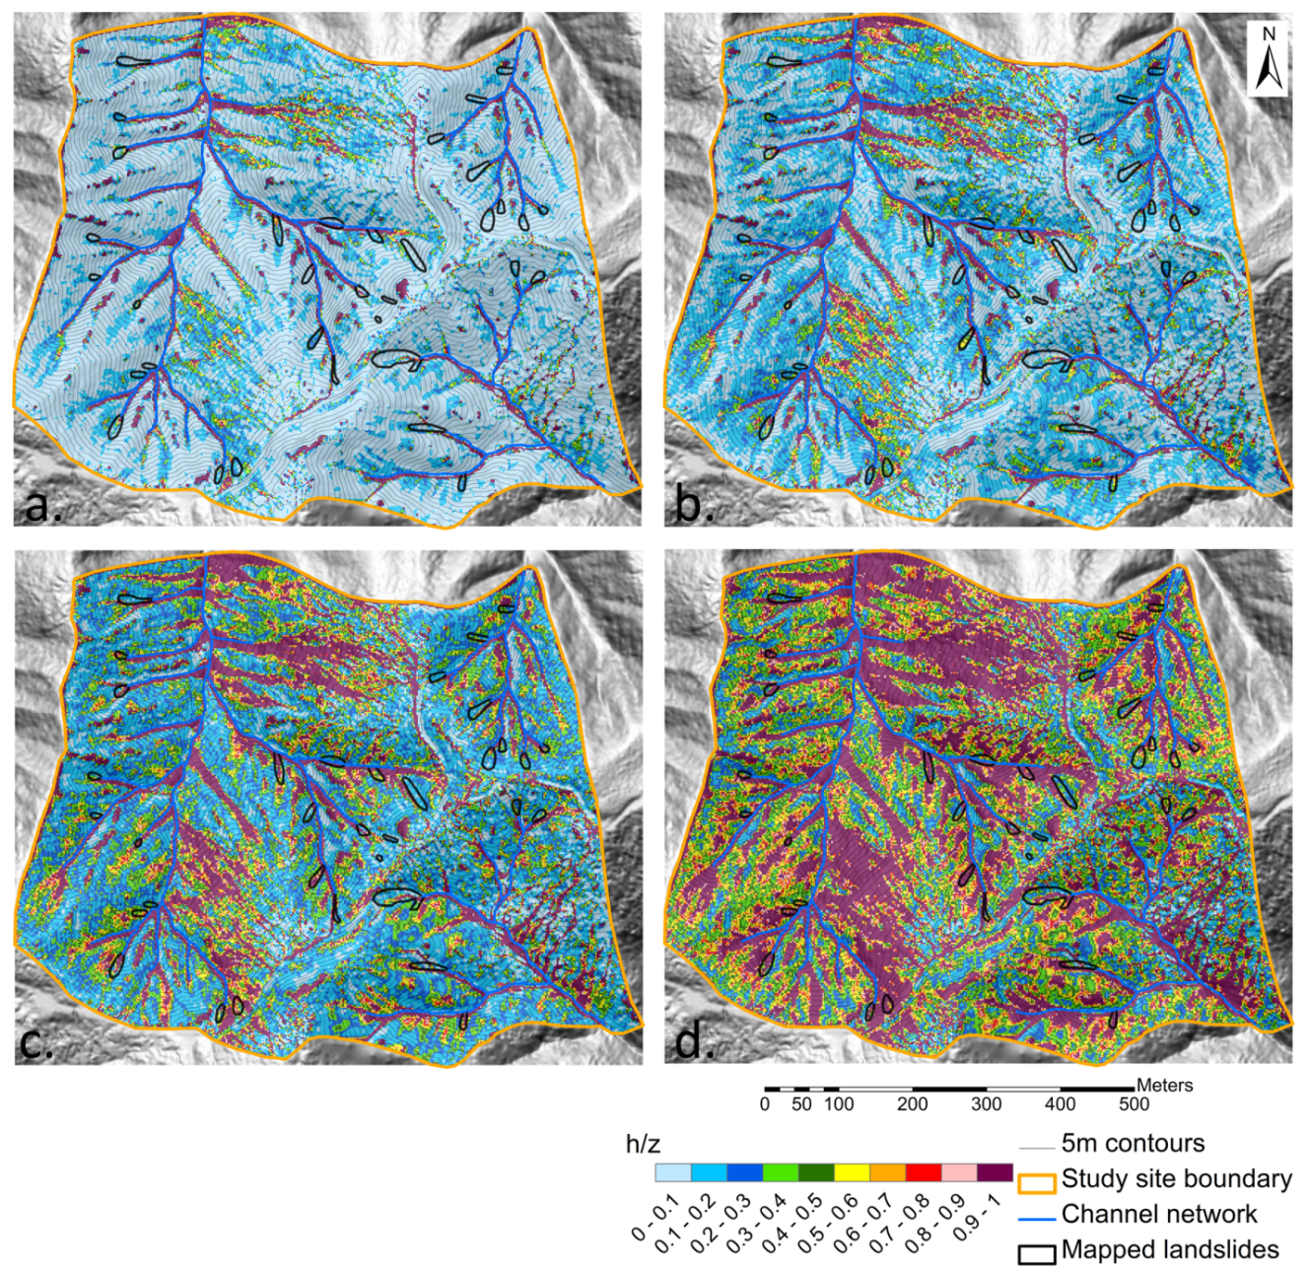
Steady State Hydrology
(topographically steered)
log (q/K) (1/m) |  | q (m/day) (for K=65m/day)
-3.1 |  | 0.05135
-2.8 |  | 0.1027
-2.5 |  | 0.2054
-2.2 |  | 0.41145
Steady state precipitation
(generally not reached!)
Saturation ratio h/z
log(q/K): a: -3.1, b: -2.8, c: -2.5, d: -2.2
[Dietrich & Montgomery, 1998]
Notes:
Intuition behind steady state: h increases with area and with q, decreases with T and slope. Increasing q/t expands saturated field outward from convergent areas. Generally, landslides intersect areas which saturate. Every increment here doubles the precipitation

Slide 47
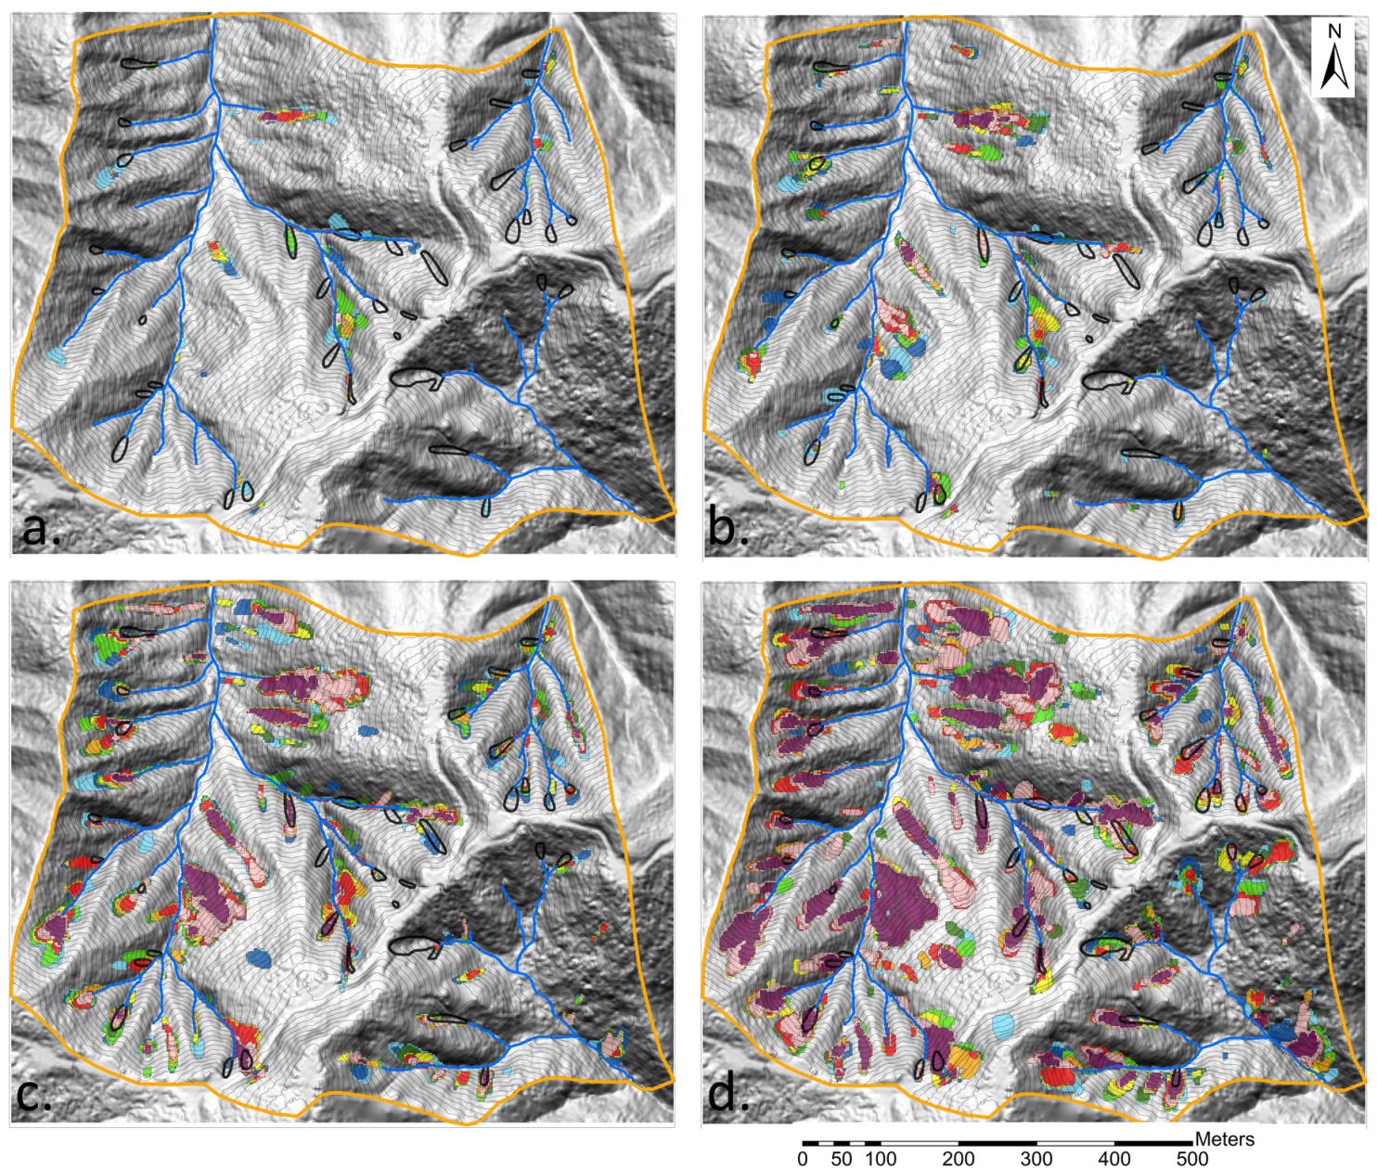
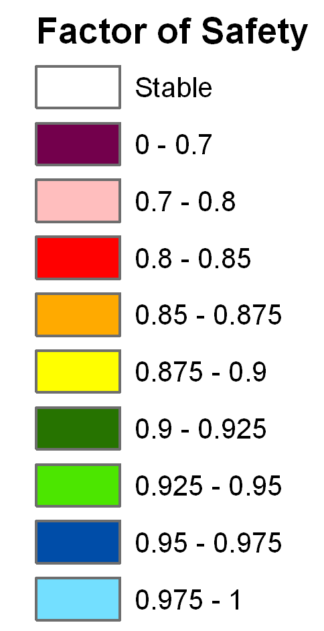
Varying the precipitation assuming shallow subsurface flow
Steady state precipitation from 6 mm/day to 818 mm/day
Modelled soil depth
Uniform root strength
(CB1 avg. 4600 Pa)
Colours indicate factor of safety (purple most unstable)
All landslides FS < 1
(they can overlap)
log(q/K) = a) -3.1, b) -2.8, c) -2.5, d) -2.2
Notes:
Discrete landslides, generally in the right places, roughly the right size (a little smaller). Number increases with precipitation.
Lots of overlapping landslides.
We we present them all, as subtle differences may determine the outcomes.
Also mention that they track on shalstab (same hydrology)

Slide 48
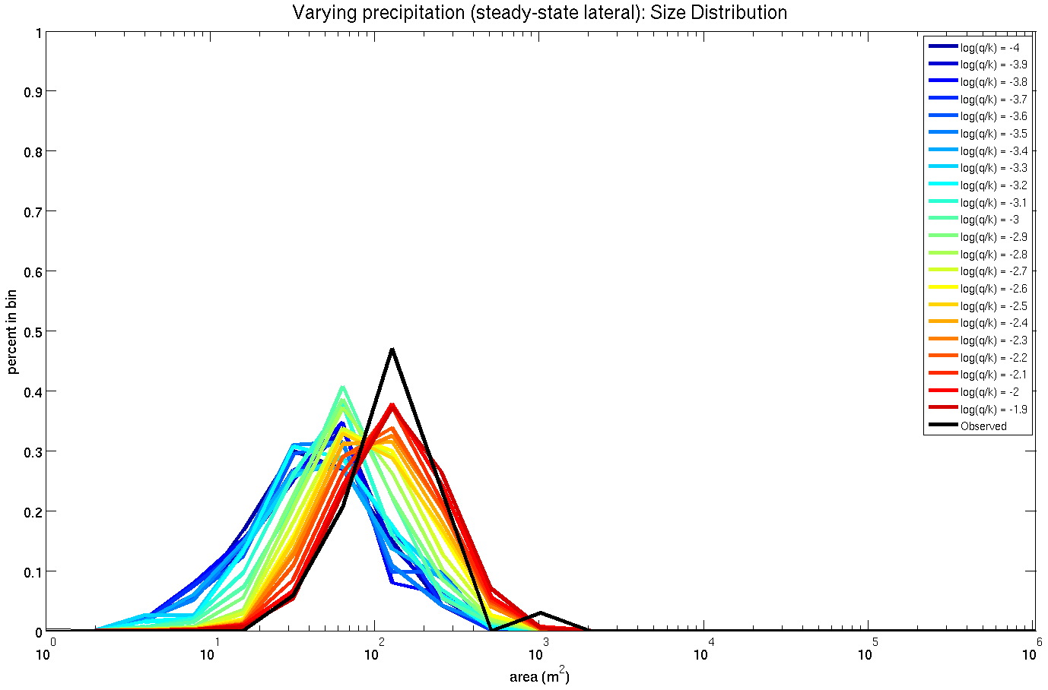
Size Distribution
(shallow subsurface flow)
Wetter
Drier -> smaller
Wetter -> larger
(matching observations)
Smaller size
Larger size
Notes:
Size gets bigger with more steady state precipitation as the saturated field expands
MENTION THAT THIS IS CHARACTERISTIC SIZE ACROSS A LANDSCAPE: as conditions are varied, landslides sample different parts of the landscape!

Slide 49
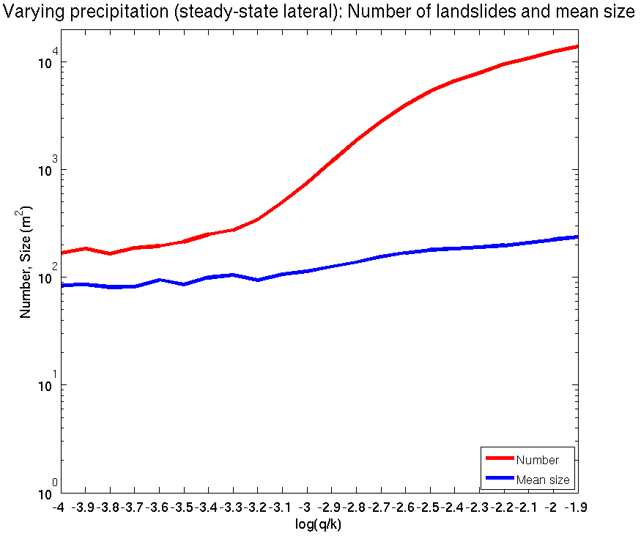
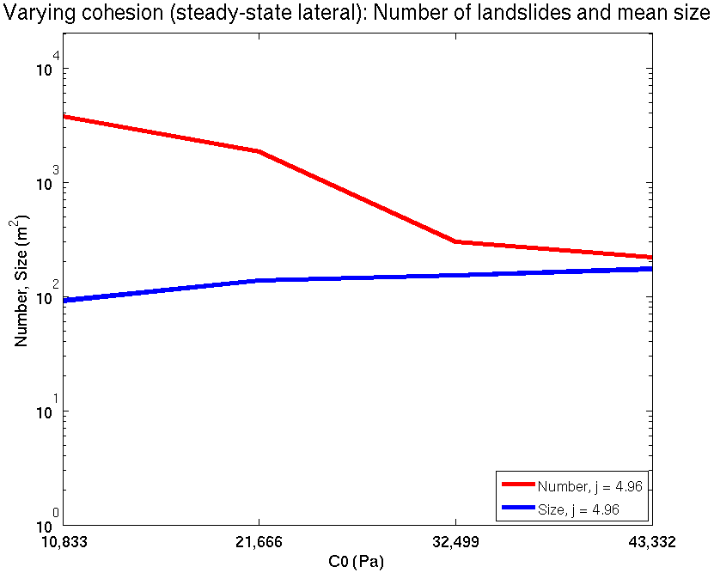
Opposite trends for: precipitation v root strength
Increasing precipitation: more landslides, bigger landslides
Increasing root strength: fewer landslides, bigger landslides
Notes:
Unexpected result: opposite trend! Increasing precipitation generates more, bigger landslides; increasing cohesion less, bigger landslides; much different with lower shape

Slide 50
Hydrological controls: shallow subsurface flow
Steady state precipitation from 6 mm/day to 818 mm/day
Modelled soil depth
Uniform root strength
(CB1 avg. 4600 Pa)
Colours indicate factor of safety (purple most unstable)
All landslides FS < 1
(they can overlap)
log(q/K) = a) -3.1, b) -2.8, c) -2.5, d) -2.2
Notes:
Discrete landslides, generally in the right places, roughly the right size (a little smaller). Number increases with precipitation.
Lots of overlapping landslides.
We we present them all, as subtle differences may determine the outcomes.
Also mention that they track on shalstab (same hydrology)

Slide 51
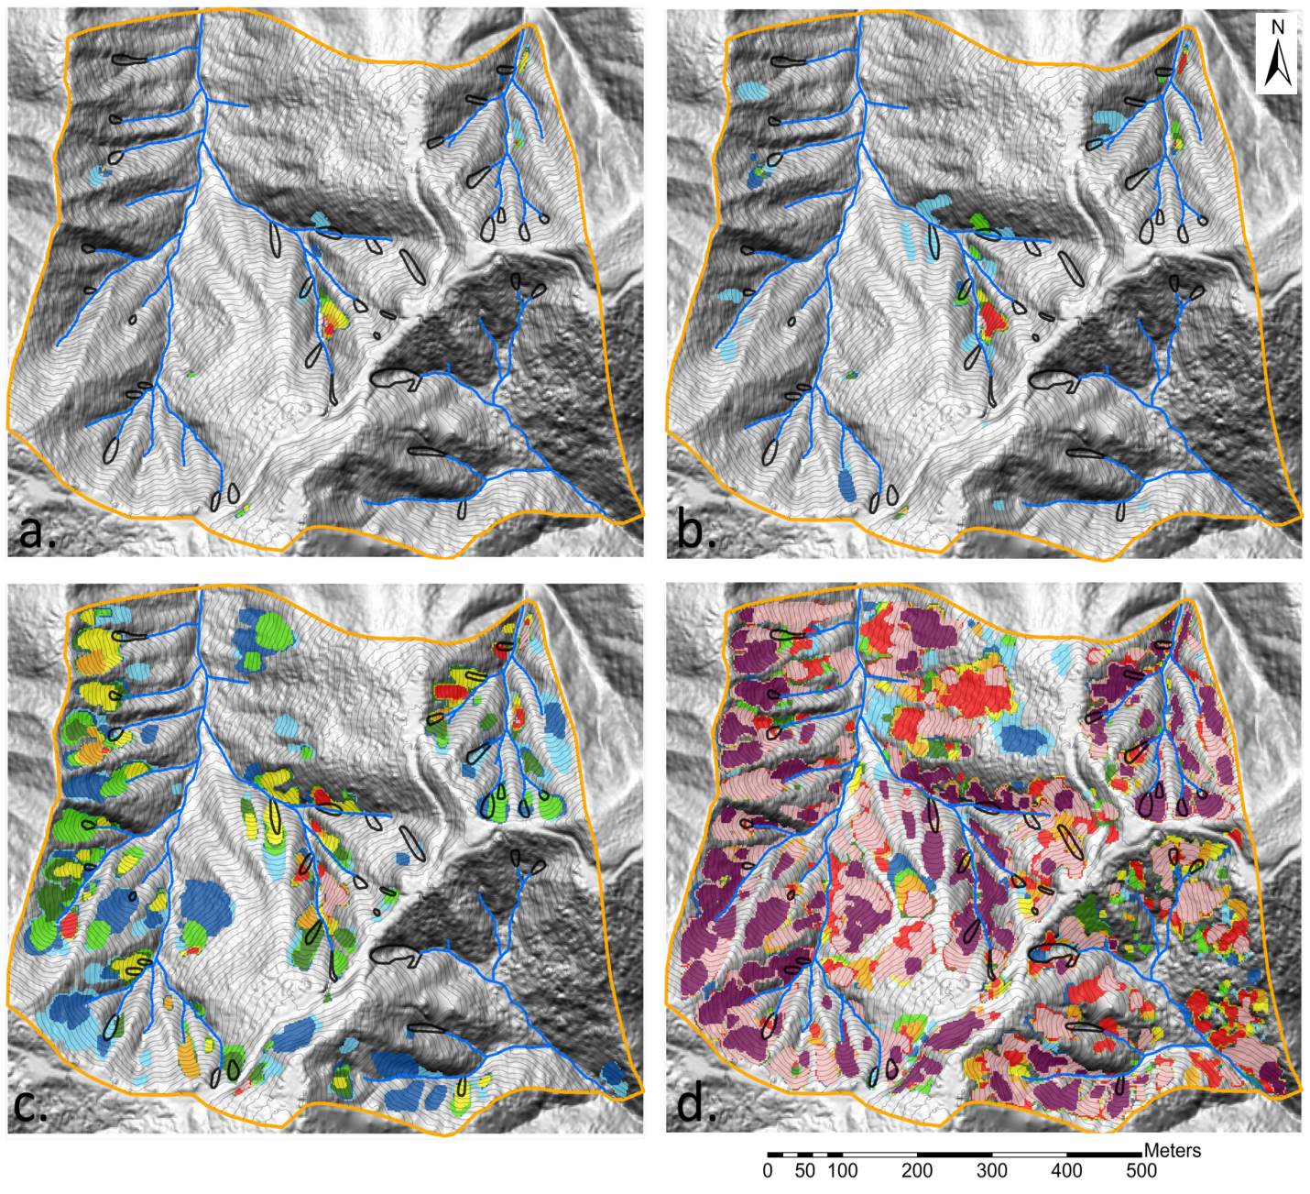
Hydrological Controls: vertical infiltration
Instantaneous (vertical) precipitation from 5 mm to 40 mm
Modelled soil depth
Uniform root strength
(CB1 avg. 4600 Pa)
Colours indicate factor of safety (purple most unstable)
Aggregated predictions
p (mm): a) 5, b) 10, c) 20, d) 40
Notes:
Discrete landslides, further upslope but still in the hollows, larger size

Slide 52

Transient dynamic hydrology
(varying antecedent soil moisture)
Dynamic hydrology
November 1996 storm
10-minute rainfall data
Predictions at storm peak
Vary antecedent soil moisture
Modeled soil depth
Uniform root strength
(CB1 avg. 4600 Pa)
a: 0%, b: 10%, c: 20%, d: 40%
Notes:
Increasing number and size with increasing soil moisture.
Water table rises more quickly when wetter
High pore pressure field expands

Slide 53
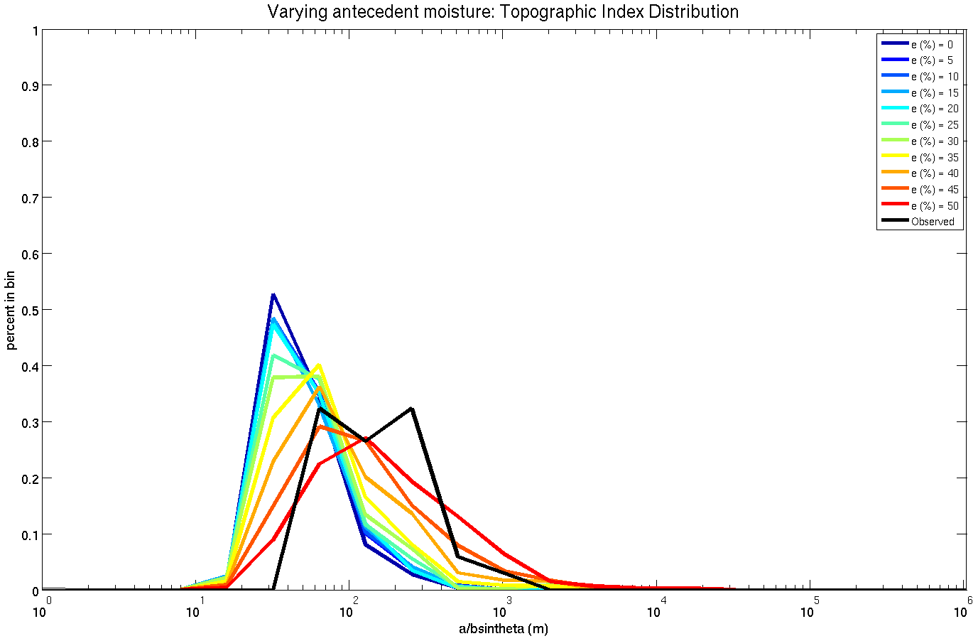
Topographic Index Distribution
(dynamic hydrology)
Wetter
Wetter -> higher drainage area
(matching observations)
Steep slope
High drainage area
Notes:
Start with high slope goes to higher drainage area as it gets wetter

Slide 54
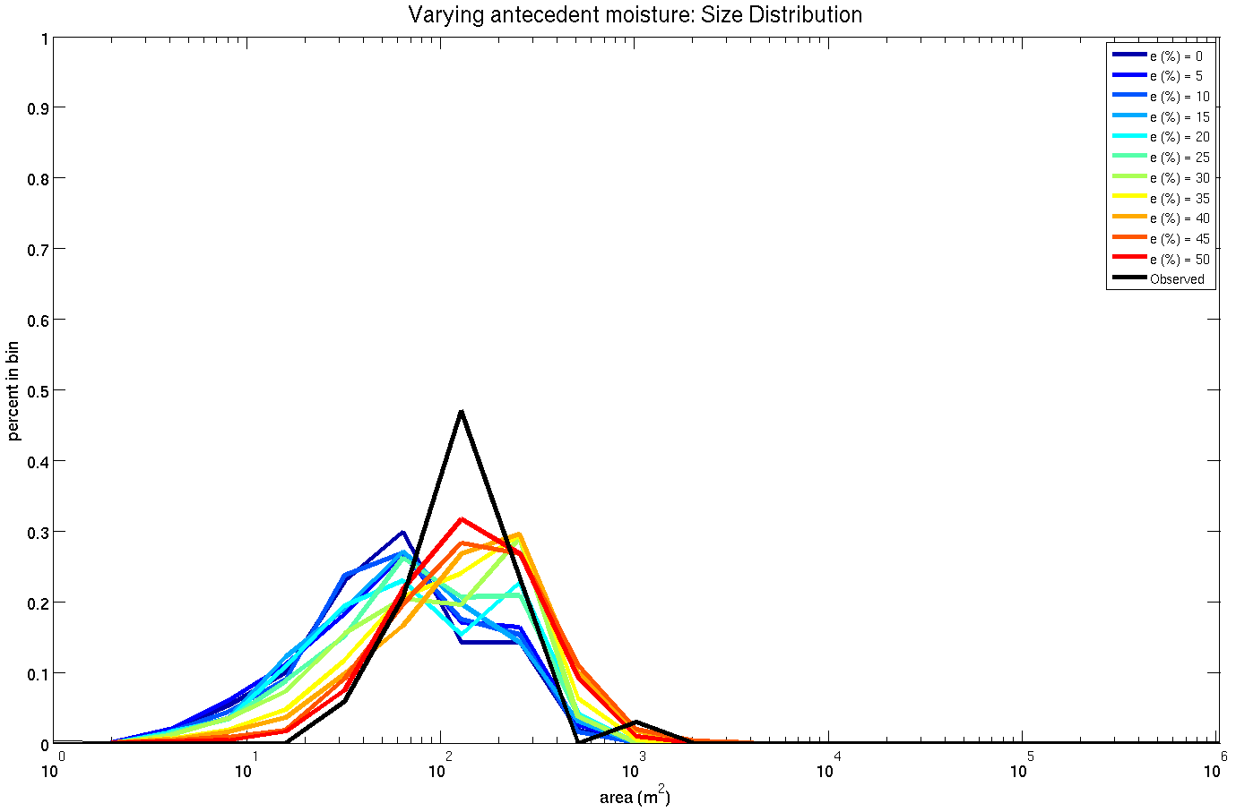
Size Distribution
(dynamic hydrology)
Wetter -> larger
(matching observations)
Smaller size
Larger size
Notes:
Again size gets bigger as saturated field expands

Slide 55
But… best fit to PDFs predict too many slides!
Dynamic hydrology
November 1996 storm
10-minute rainfall data
Predictions at storm peak
Vary antecedent soil moisture
Modeled soil depth
Uniform root strength
(CB1 avg. 4600 Pa)
a: 0%, b: 10%, c: 20%, d: 40%
Notes:
Increasing number and size with increasing soil moisture.
Water table rises more quickly when wetter
High pore pressure field expands

Slide 56
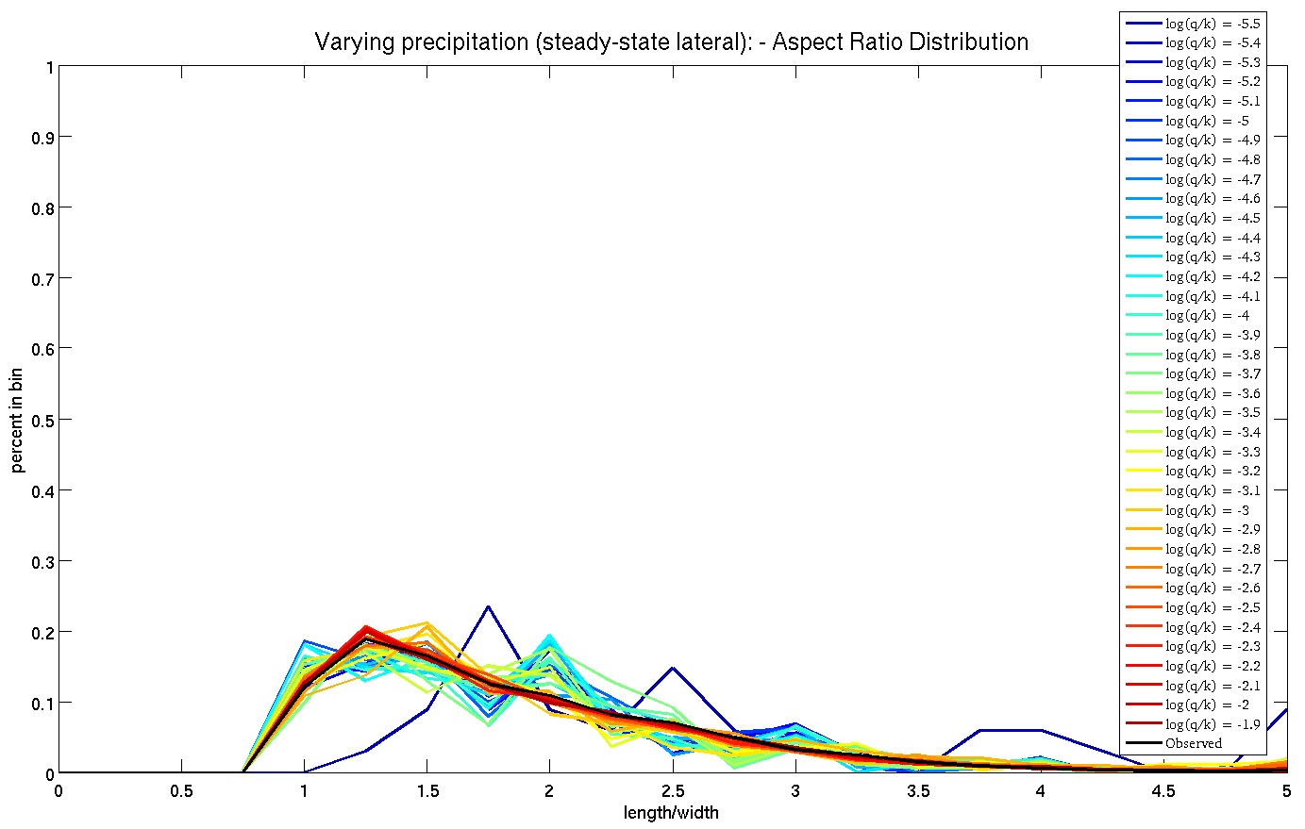
But…
we can’t predict correct aspect ratios!
Observed aspect ratio

Slide 57
Summary
Earth pressure theory can be used to develop a simple 3D stability model.
Using methods of spectral clustering, discrete collections of unstable cells can be identified across a landscape.
This new search model coupled to the proposed three-dimensional slope stability model demonstrates that shallow landslide size is controlled by the spatial pattern of colluvium thickness, pore pressure and root strength. Local topography, as it controls these properties, then can strongly influence the location and size of shallow landsliding.
Our model predicts shallow landslides to be more numerous and larger with greater rainfall, and less numerous and larger smaller with decreasing root strength.
Notes:
1) No standard theory exits for modeling the passive and active earth pressures controlling the stability of shallow landslides on steep landscapes.
We propose one solution, but further investigation is needed.
2)Using methods of spectral clustering, discrete collection of cells that together define unstable ground can be identified across a landscape. The method does not depend on the slope stability model.
3) This new search model coupled to the proposed three-dimensional slope stability model demonstrates that shallow landslide size is controlled by the spatial pattern of colluvium thickness, pore pressure and root strength. Local topography, as it controls these properties, then can strongly influence the location and size of shallow landsliding.
Our model predicts shallow landslides to be more numerous and larger with greater precipitation, and more numerous but smaller with decreasing root strength.
The model results depend strongly on topography, hence high resolution topographic data are important.
Many models exist to predict runoff and pore pressures, but few models exist to predict colluvium thickness and root strength patterns. Field investigations are needed to map the spatial structure of colluvium thickness and root strength contribution in order to test and develop theories.
Field campaigns that map landslide size and local conditions at failure are needed to test and improve models.
The model framework can be applied across watersheds and used to explore effects of changing precipitation and vegetation on shallow landslide slope stability.

Slide 58
Extra slides

Slide 59
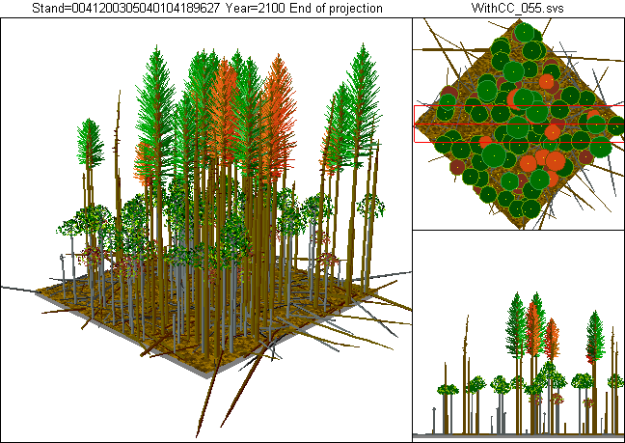
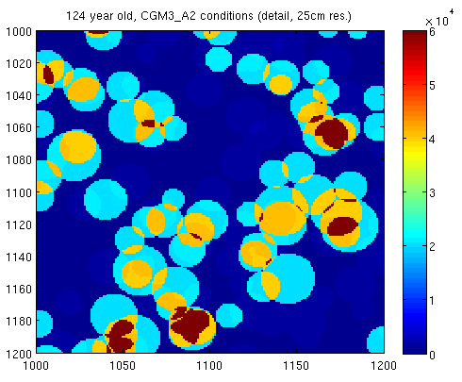
Introducing spatial heterogeneity
124 year old forest stand, average root strength per grid cell: 11601 Pa
[Crookston, et al., 2010]

Slide 60
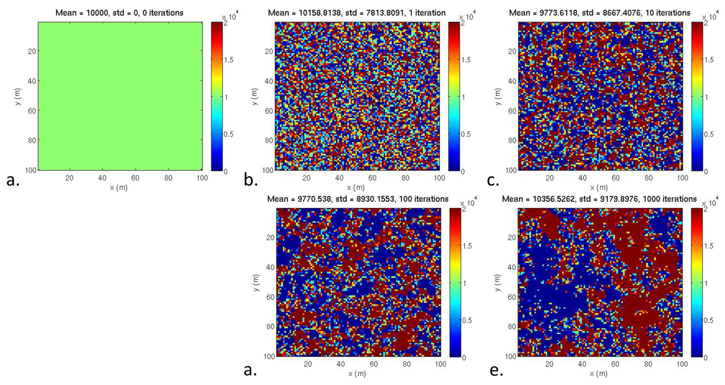
Introducing spatial heterogeneity

Slide 61
F_{sl} = lateral shear resistance
s_{c} = lateral shear stress
σ_{x}’ = effective lateral stress
l = block length
w = block width
z = failure plane depth
[Chen, 1981; Burroughs, 1985; Arellano and Stark, 2000]

Slide 62
3-D Slope stability model
Methods of estimating F_{p} & F_{a}
Requires: Sloping surface & c-φ soil
Options: Rankine, Coulomb, Log-Spiral
F_{w} = weight force
F_{a} = active wedge driving force
F_{p} = passive wedge resistance
θ = failure plane slope
δ = wall friction angle
Notes:
Explain here we are interested in how much push is required to fail the downslope wedge
This is exactly the same question that is being asked in these EP questions

Slide 63
Driving force (F_{d})
σ_{z} = total vertical stress
γ_{s} = soil unit weight
z = failure plane depth
θ = failure plane slope
l = block length
w = block width
Notes:
For this reason, infinite slope stability models won’t suffice. We need to go to a fully three-dimensional force balance.
Considers the forces on all 5 boundaries.
In particular, this model includes the active, passive, and at rest earth pressures, which act on the upslope, downslope, and on the sides of such an idealized block.
This idea was conceived by Jim McKean I’ve recently been working on how we can best do it it follows initial work by Prof RC Chen on engineering slopes in the 80s.

Slide 64
Resistance: basal (F_{sb})
σ_{z} = total vertical stress
σ_{z}’ = effective vertical stress
u = pore water pressure
γ_{s} = soil unit weight
γ_{w} = water unit weight
m = saturation ratio (h/z)
h = water table height
z = failure plane depth
c_{b}’ = basal cohesion
ϕ’ = friction angle
Notes:
For this reason, infinite slope stability models won’t suffice. We need to go to a fully three-dimensional force balance.
Considers the forces on all 5 boundaries.
In particular, this model includes the active, passive, and at rest earth pressures, which act on the upslope, downslope, and on the sides of such an idealized block.
This idea was conceived by Jim McKean I’ve recently been working on how we can best do it it follows initial work by Prof RC Chen on engineering slopes in the 80s.

Slide 65
Resistance: cross-slope (F_{sc})
σ_{z}’ = effective vertical stress
σ_{x}’ = effective lateral stress
m = saturation ratio (h/z)
z = failure plane depth
c_{l}’ = lateral cohesion
ϕ’ = friction angle
K₀ = ‘at rest’ EP coefficient
[Chen, 1981; Burroughs, 1985; Arellano and Stark, 2000]
Notes:
For this reason, infinite slope stability models won’t suffice. We need to go to a fully three-dimensional force balance.
Considers the forces on all 5 boundaries.
In particular, this model includes the active, passive, and at rest earth pressures, which act on the upslope, downslope, and on the sides of such an idealized block.
This idea was conceived by Jim McKean I’ve recently been working on how we can best do it it follows initial work by Prof RC Chen on engineering slopes in the 80s.

Slide 66
Resistance: cross-slope (F_{sc})
σ_{z}’ = effective vertical stress
σ_{x}’ = effective lateral stress
m = saturation ratio (h/z)
z = failure plane depth
c_{l}’ = lateral cohesion
ϕ’ = friction angle
K₀ = ‘at rest’ EP coefficient
[Jaky, 1944]
[Chen, 1981; Burroughs, 1985; Arellano and Stark, 2000]
Notes:
For this reason, infinite slope stability models won’t suffice. We need to go to a fully three-dimensional force balance.
Considers the forces on all 5 boundaries.
In particular, this model includes the active, passive, and at rest earth pressures, which act on the upslope, downslope, and on the sides of such an idealized block.
This idea was conceived by Jim McKean I’ve recently been working on how we can best do it it follows initial work by Prof RC Chen on engineering slopes in the 80s.

Slide 67
Resistance: downslope (F_{p})
Methods of estimating K_{p}
Requirements:
  -Sloping surface
  -c-φ soil
Rankine: Mazindrani & Gangali (1997)
Coulomb: Chugh & Smart (1981)
Log-Spiral: Soubra & Macuh (2002)
σ_{z}’ = effective vertical stress
σ_{p}’ = effective passive stress
K_{p} = ‘passive’ EP coefficient
δ = wall friction angle
Notes:
Explain here we are interested in how much push is required to fail the downslope wedge
This is exactly the same question that is being asked in these EP questions

Slide 68
Resistance: downslope (F_{p})
δ = wall friction angle
Notes:
For this reason, infinite slope stability models won’t suffice. We need to go to a fully three-dimensional force balance.
Considers the forces on all 5 boundaries.
In particular, this model includes the active, passive, and at rest earth pressures, which act on the upslope, downslope, and on the sides of such an idealized block.
This idea was conceived by Jim McKean I’ve recently been working on how we can best do it it follows initial work by Prof RC Chen on engineering slopes in the 80s.

Slide 69
Drive / resistance: upslope (F_{a})
δ = wall friction angle
Notes:
For this reason, infinite slope stability models won’t suffice. We need to go to a fully three-dimensional force balance.
Considers the forces on all 5 boundaries.
In particular, this model includes the active, passive, and at rest earth pressures, which act on the upslope, downslope, and on the sides of such an idealized block.
This idea was conceived by Jim McKean I’ve recently been working on how we can best do it it follows initial work by Prof RC Chen on engineering slopes in the 80s.

Slide 70
Model testing: benchmarking
[Griffiths & Lane, 1999;
Griffiths et al., 2011;
Milledge et al., 2012]

Slide 71
Model testing: benchmarking
Log Spiral
Rankine
Notes:
Pick four runs that are in a just stable state. I.e. they have inf slope fos of 1 or just less.
Show the dotty plot for factor of safety.

Slide 72
Model testing: benchmarking

Slide 73
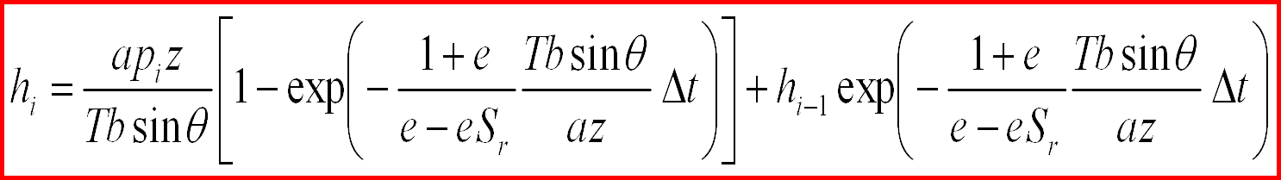
Transient dynamic hydrology
(November 1996 storm)
Current water table
height
Steady-state
Time-varying exponential decay
Previous water table
height
Time-varying exponential decay
Instantaneous lateral redistribution every 10 minutes
Captures value and variability of measured data
[Rosso et al., 2006]
[Slide: M.C. Rulli]
Notes:
Simplest step up from steady state. Same assumptions but captures the transient state

Slide 74
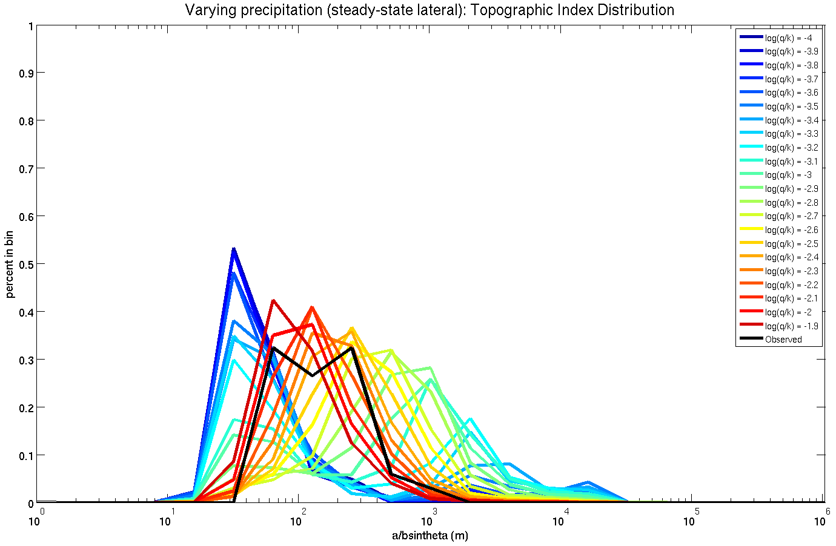
Topographic Index Distribution
(shallow subsurface flow)
Then both in steep slopes and high drainage area
Initially only in steep slopes
Wetter
Expand to middle range (matching observations)
Steep slope
High drainage area
Notes:
With little precipitation landslides can only happen on high slopes. As precipitation increases these landslides get bigger, but other can pop up at lower slopes because of increased pore pressure. As these grow, the median location comes back to the middle

Slide 75
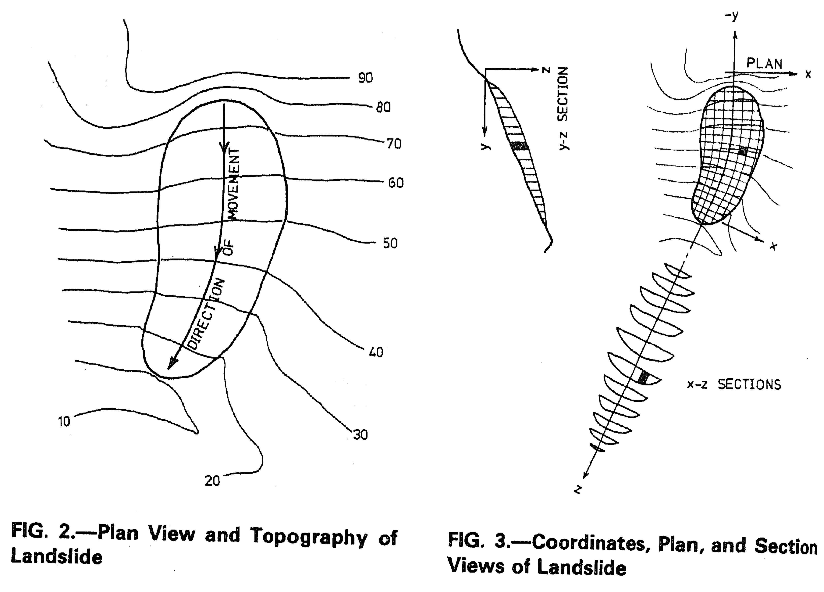
Antecedents: Hovland’s method
[Hovland, 1977]

