Slide 1
Women in Science: my own case study
Barbara Romanowicz
University of California at Berkeley
Sponsored by the Li Ka Shing Foundation
Women in Science Distinguished Speaker Series

Slide 2
About the Li Ka Shing Foundation
For almost three decades, the Li Ka Shing Foundation has sought to enhance the impact of its philanthropy through two strategic objectives- to nurture a culture of giving and to foster creativity, constructive engagement, and sustainability. Education and medicine form the key areas of work for the Li Ka Shing Foundation. Shantou University is a cornerstone project of the Li Ka Shing Foundation. It is uniquely the only public university that is supported by private funds and its mission is to engineer education reform and to promote global learning in China. The Li Ka Shing Foundation and other charities established by Mr. Li Ka Shing have supported grants, sponsorships, and commitments of over HK$10.9 billion.

Slide 3
Lay out
Part I: Biographical notes:
  how I became a geophysicist/seismologist?
Part II: questions:
  What makes a successful female scientist?

Slide 4
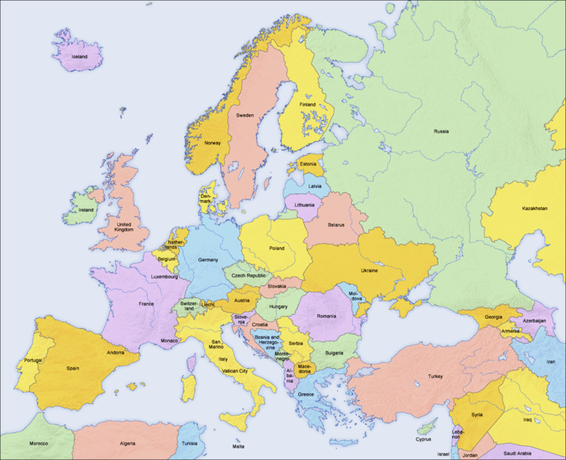

Slide 5
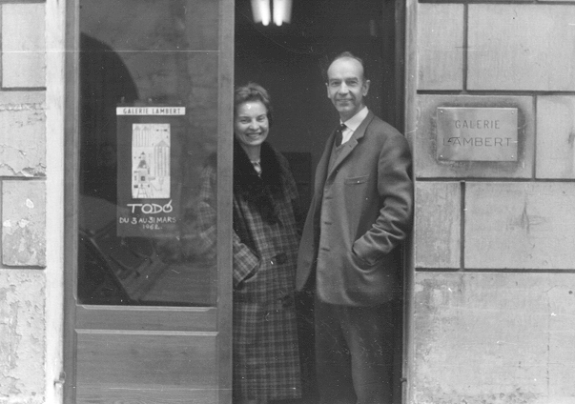

Slide 6
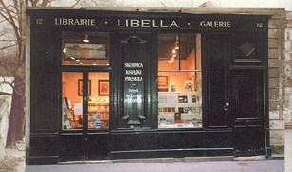

Slide 7
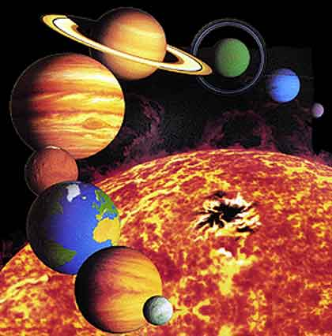
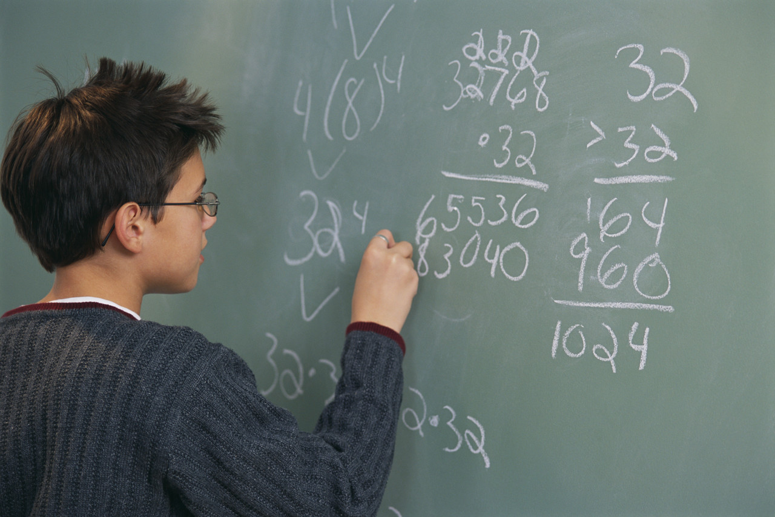
Mathematics

Slide 8
Mathematics
Polish
German
French
Japanese
Russian
English
Spanish

Slide 9
1967: Baccalauréat Mathematics section

Slide 10
1967: Baccalauréat Mathematics section
1967-70: Préparation Ecole Normale Supérieure, Mathematics

Slide 11
1967: Baccalauréat Mathematics section
1967-70: Préparation Ecole Normale Supérieure, Mathematics
1970-73: Bachelor’s degree in Pure Mathematics, Agrégation

Slide 12
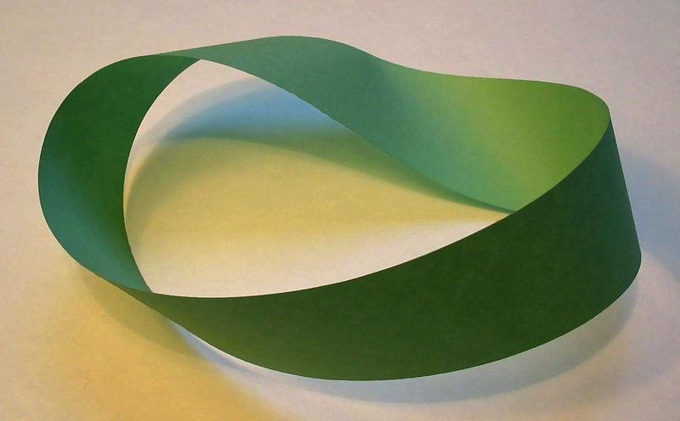
1967: Baccalauréat Mathematics section
1967-70: Préparation Ecole Normale Supérieure, Mathematics
1970-73: Bachelor’s degree in Pure Mathematics, Agrégation
Topology

Slide 13

1967: Baccalaureat Mathematics section
1967-70: Préparation Ecole Normale Supérieure, Mathematics
1970-73: Bachelor’s degree in Pure Mathematics, Agrégation.
Topology
Number theory

Slide 14
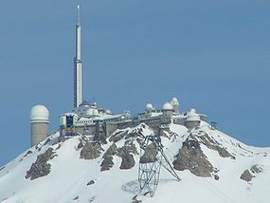
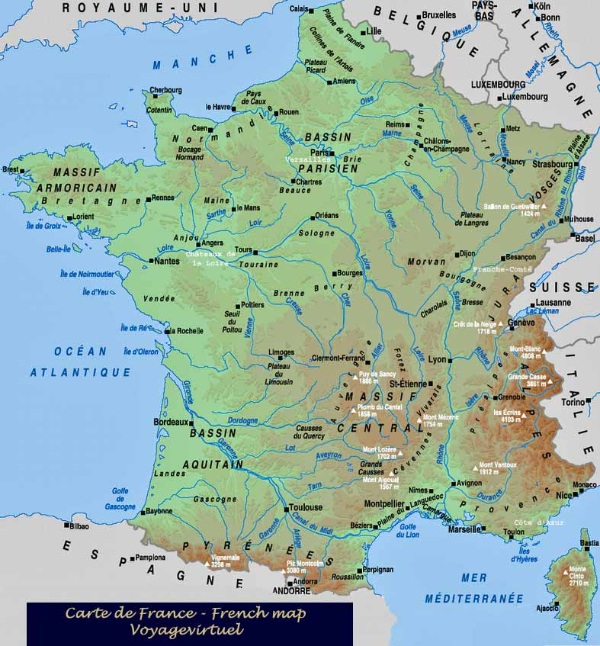
Internship, Observatoire du Pic du Midi, Pyrenees, France
1972

Slide 15
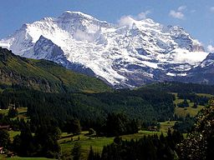
Internship, Observatoire du Pic du Midi, Pyrenees, France
1972
Hiking….

Slide 16
Internship, Observatoire du Pic du Midi, Pyrenees, France
1972

Slide 17
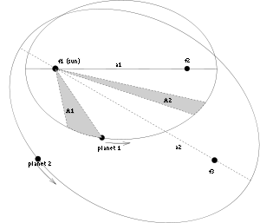
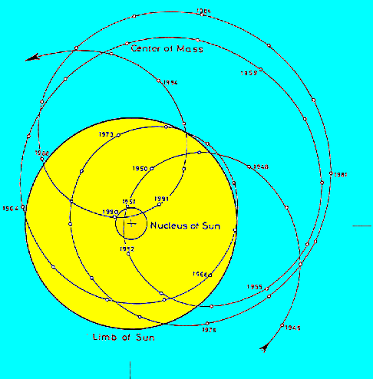
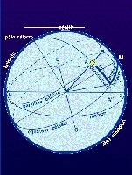
Fundamental Astronomy,
Astrometry

Slide 18

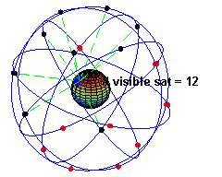
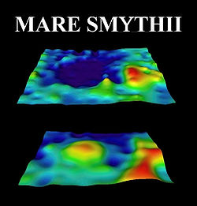
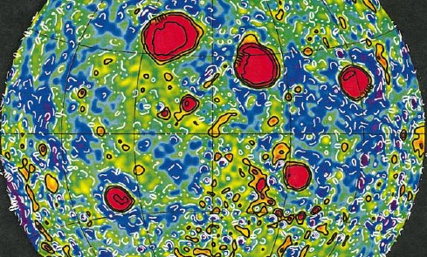
Satellite Geodesy
LUNAR MASCONS

Slide 19
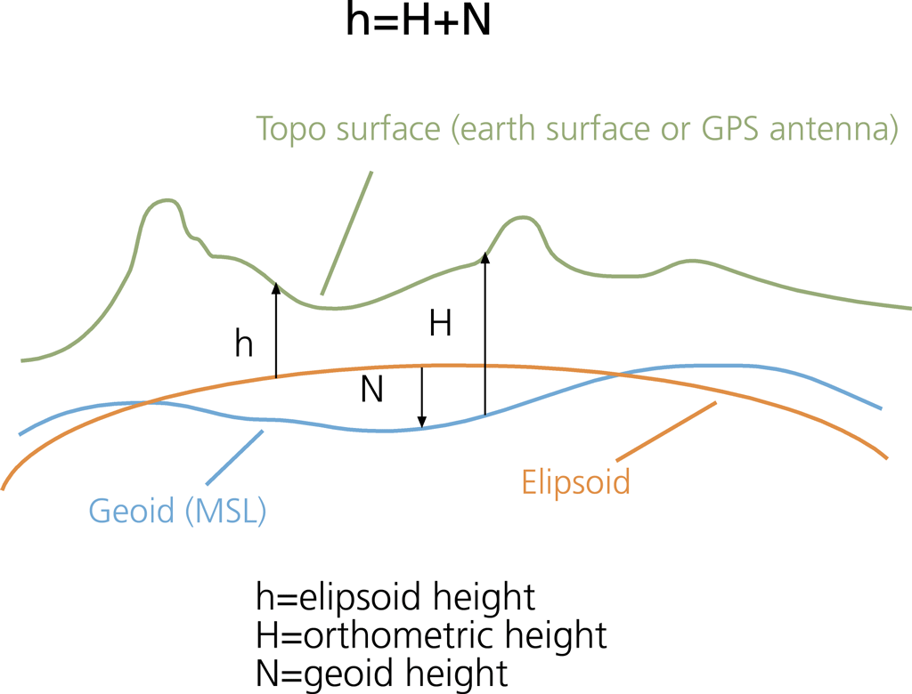
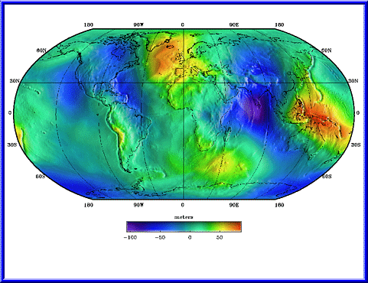
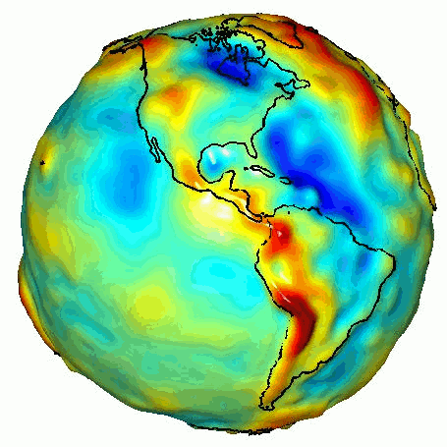
Earth’s geoid and gravity field reflects
Internal structure

Slide 20
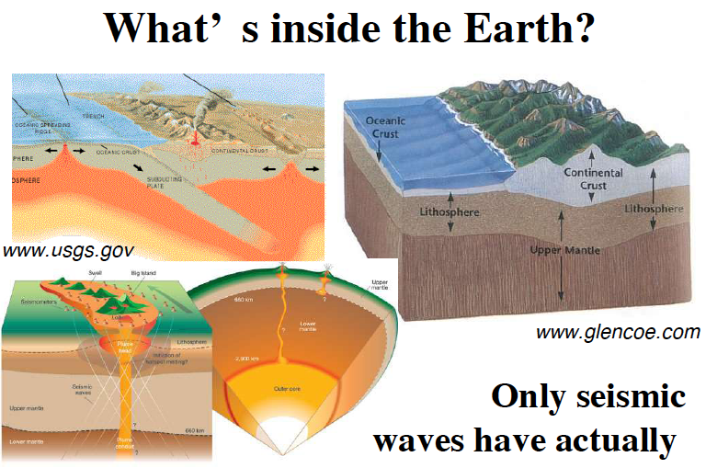

Slide 21
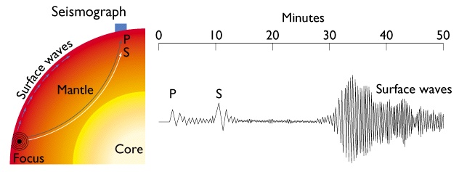
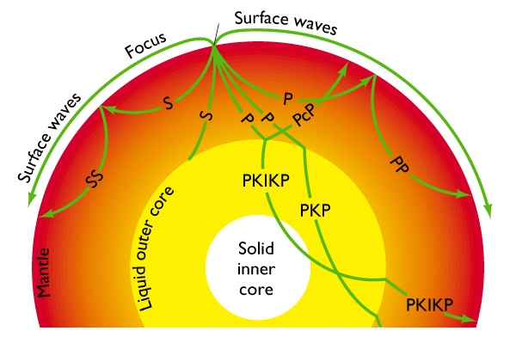

Slide 22
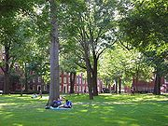
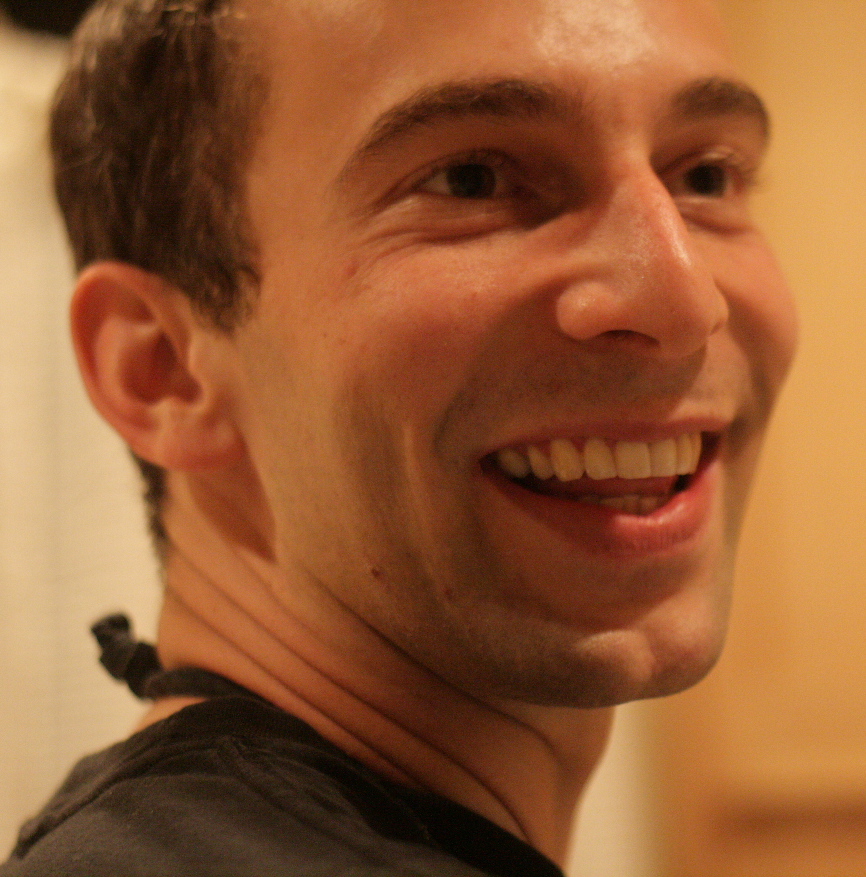
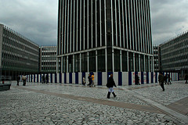
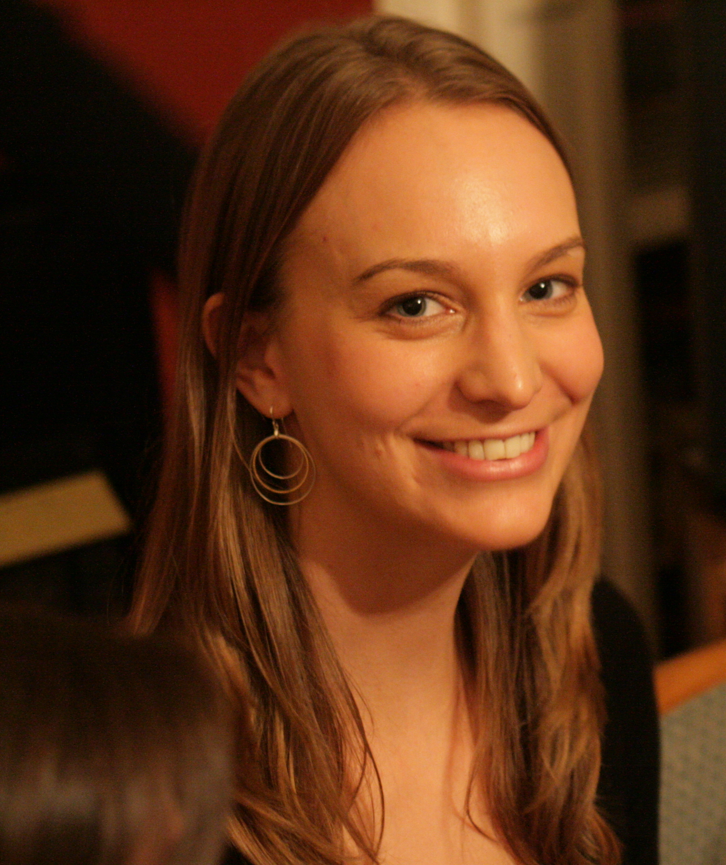
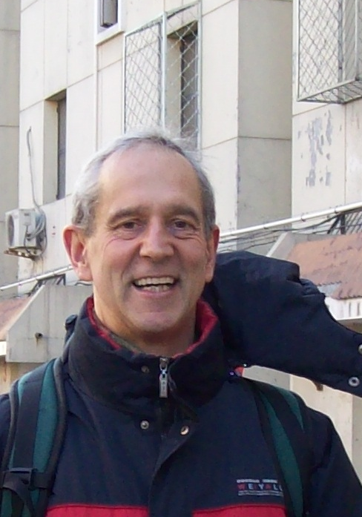
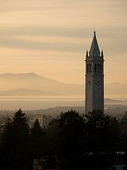
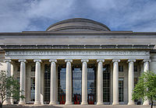
Harvard, 1973-75
Martin, 1982
Institut de Physique du Globe, Paris
1975-79, 1981-90
Magda, 1984
Married Mark Jonikas
1979
Univ. of California, Berkeley
1991-present
MIT, 1979-81

Slide 23
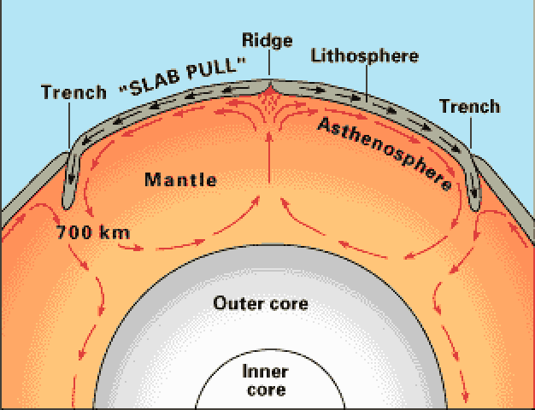

Slide 24
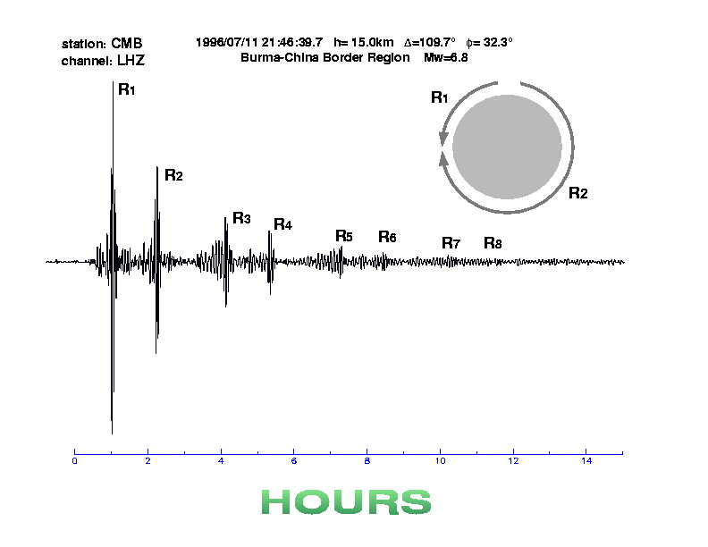

Slide 25
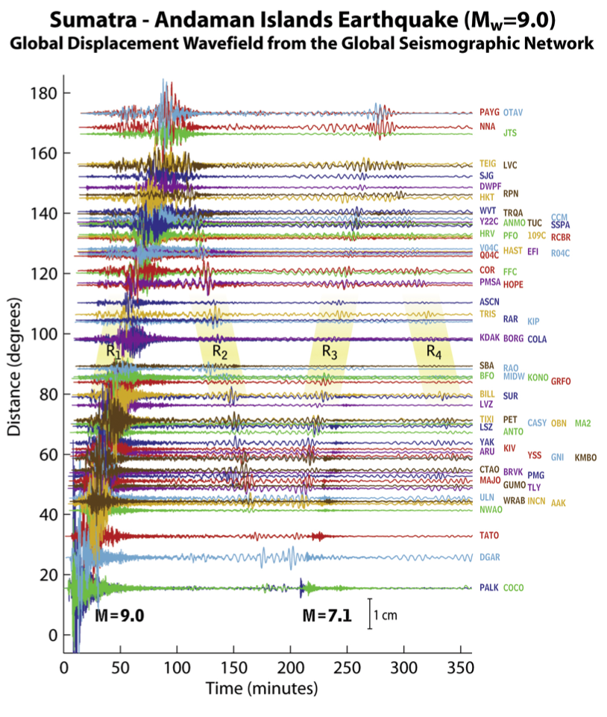
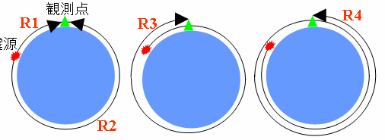

After Park et al, 2005
Notes:
Figure 1. a) Map of station locations for the Global Seismographic Network with realtime or near-real time data availability from the Sumatra Andaman Islands earthquake, showing distance in degrees. b) Six hours of vertical ground shaking forthe Sumatra-Andaman Islands Earthquake at GSN stations worldwide displayed against distance from the source. The ground motions are dominated by surface waves (Rayleigh waves), which produced peak-to-peak amplitudes of over 1 cm (see scale at lower right) everywhere on Earth's surface. The series of major arrivals at each station involve R1 (Rayleigh wave that travels along the minor great circle arc), R2 (Rayleigh wave traveling along the major great circle arc), R3 (the same pulse asR1, but with an additional global circuit), and R4 (the same pulse as R2 with an additional global circuit). Signals for a large (Mw=7.1) aftershock are visible at the closest stations at a time delay of about 200 minutes.

Slide 26
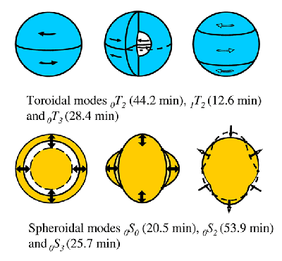

Slide 28
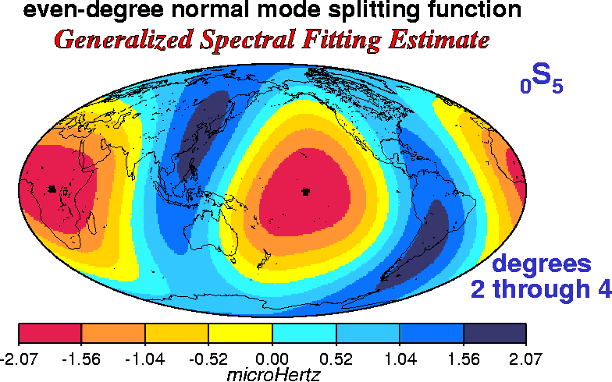
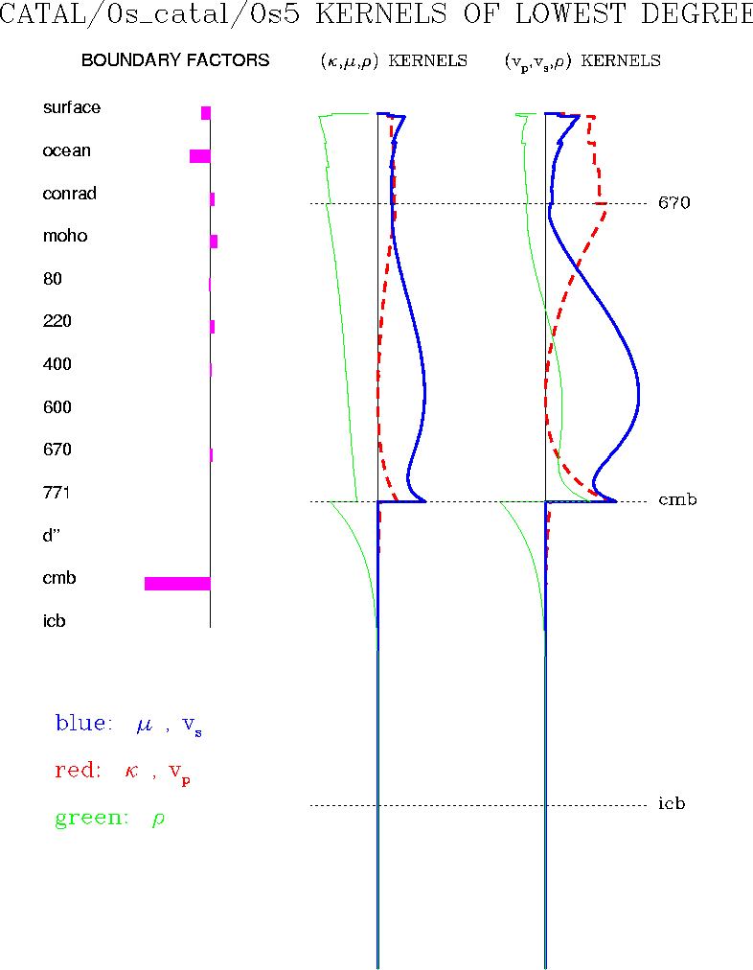
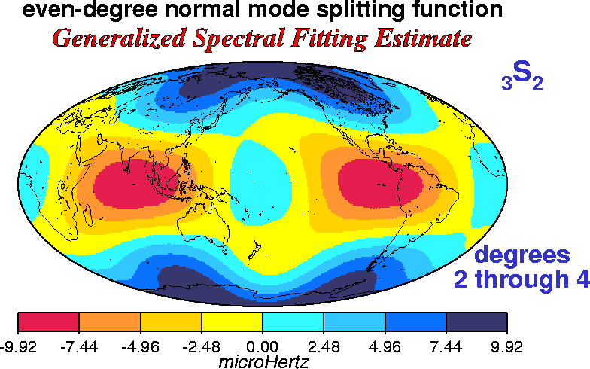
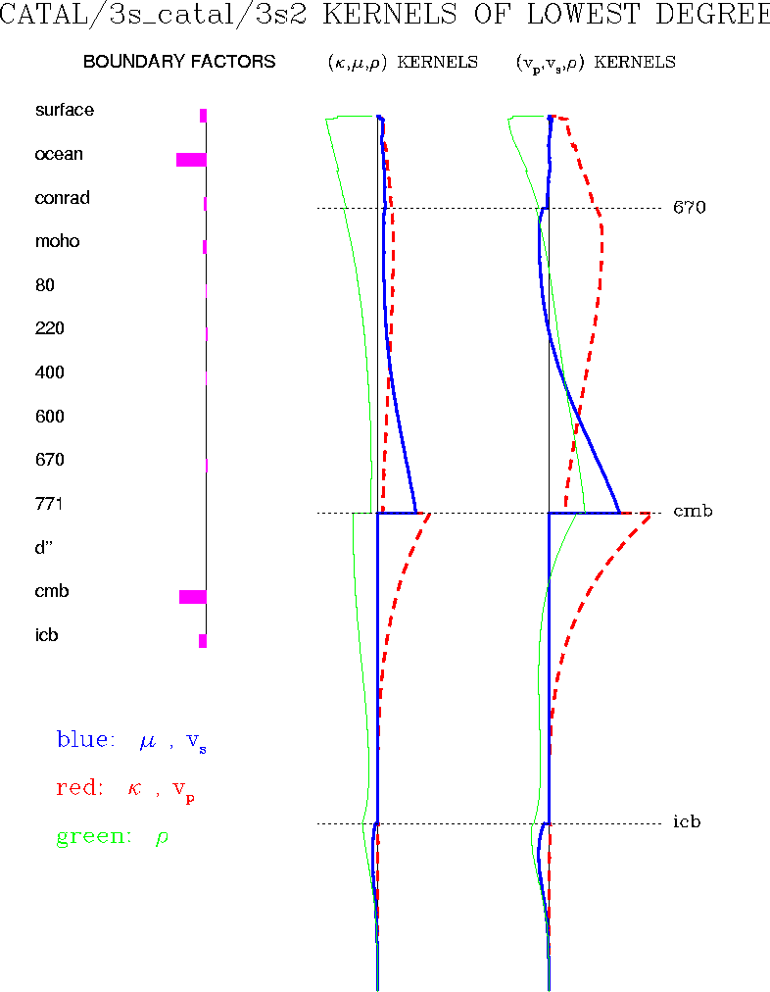
Mantle
mode
CMB
ICB
Core
mode
CMB
ICB
Ritzwoller et al. database

Slide 29
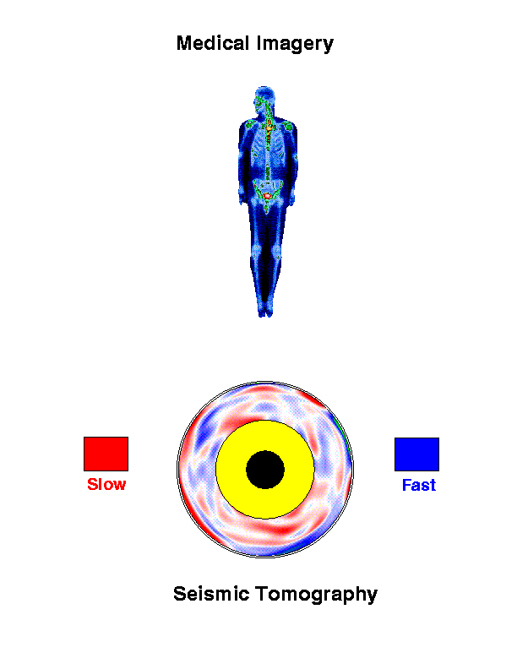
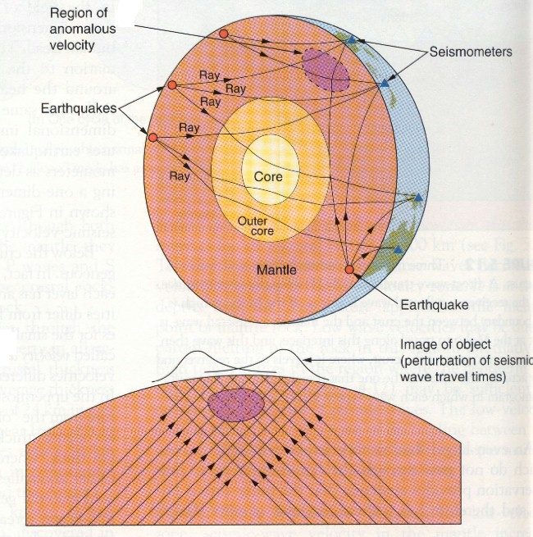
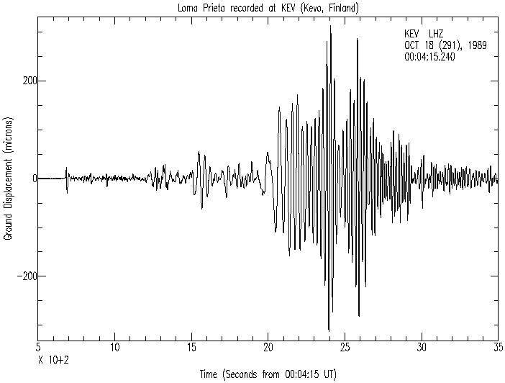
Surface waves
P
S
SS

Slide 30
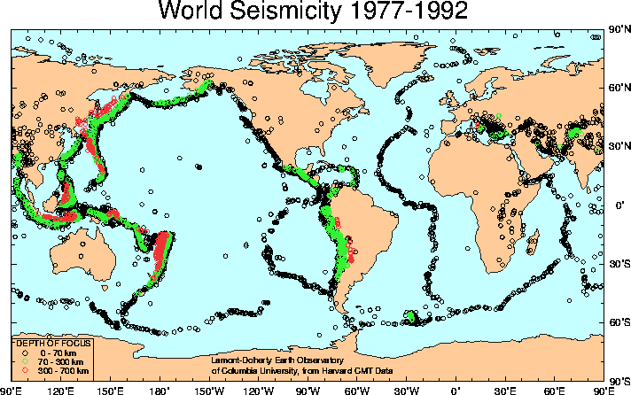
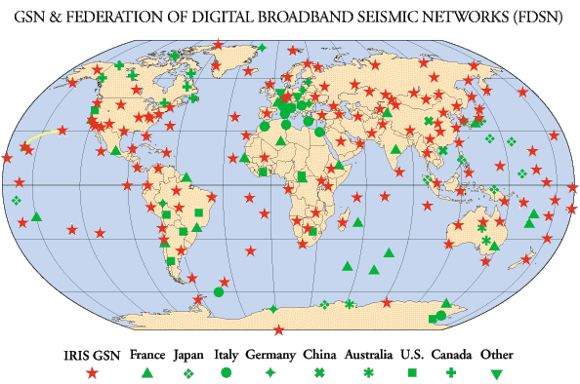
Sources
Stations

Slide 31
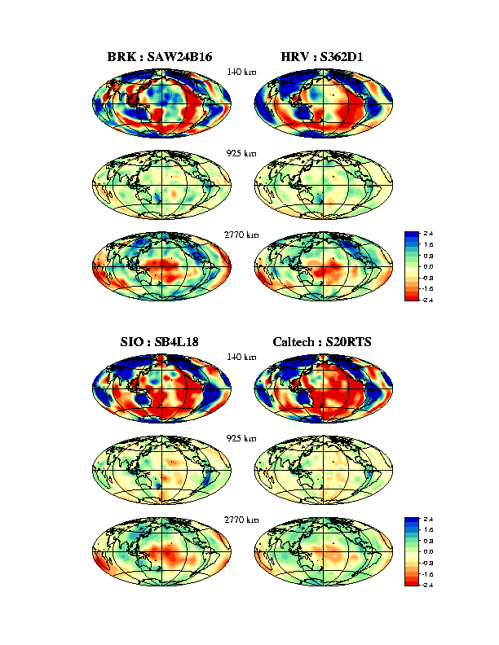
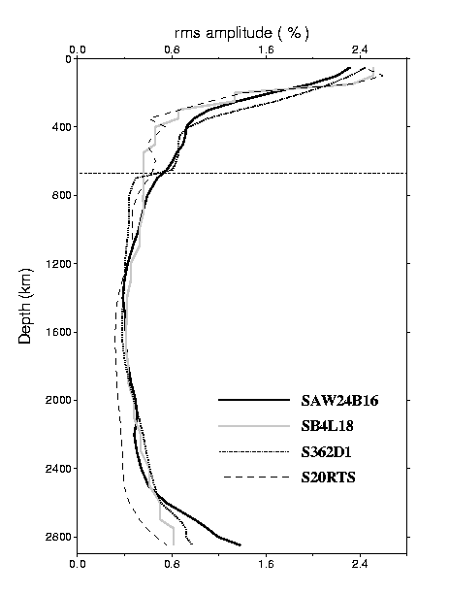
3D Shear Velocity
Models
140 km
925 km
2770 km

Slide 32
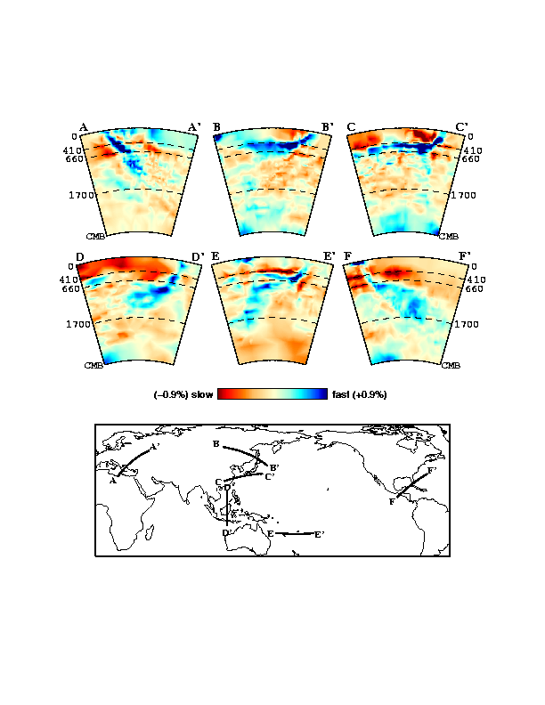
Van der Hilst et al., 1998

Slide 33
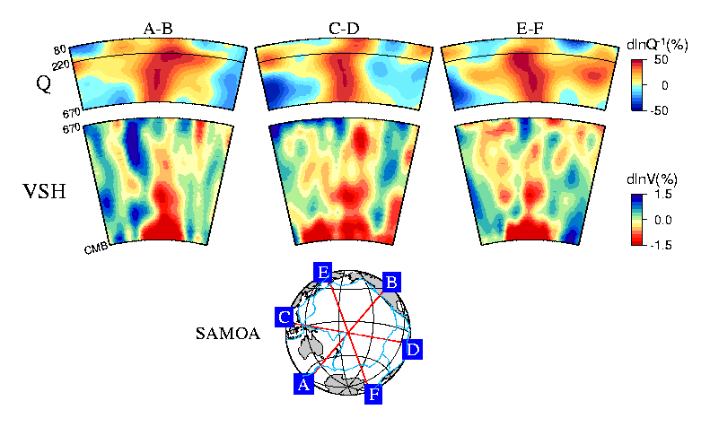

Slide 34
Part II

Slide 35
How to become a successful scientist?
Learn English well
Get exposed to research work
Choose a good research advisor
Develop independent and critical thinking
Read, read, read…
Be patient
Have confidence in yourself

Slide 36
As a woman, what do you think are our advantages/strengths and weaknesses in doing scientific research?
Good at multi-tasking
Good at communication
Good practical sense
Lack of confidence to express ideas
Fear of criticism and confrontation

Slide 37
Do you have any struggle between the balance of career and personal/family life?
Know how to prioritize
Be well organized
Save the best hours of the day for focused thinking
Help from family

Slide 38
Do you think it is more difficult for a woman to become a successful scientist than a man?
You need to have passion for your work
Think independently and boldly
Be prepared to work hard to prove your worth
Strike the right balance between assertiveness (confidence) and aggressivity

Slide 39
In your research life what impressed you most?
Progressively, improved ability to find good topics to work on and make meaningful contributions

Slide 40
Right now we need to read too many articles to catch up with latest achievements in research. Will you tell us how to read so many articles efficiently?
Important to prioritize reading
Focus the topic, start from a recent article (a review if it exists) and follow up on references
Develop skills to judge whether an article is an incremental technical contribution or includes important new concepts/tools (abstract and conclusions)

Slide 41
Some of the students want to apply for doctoral studies in America, please give them some suggestions?
It is better to first do a masters’ project in China, to get exposed to research work
Learn English well – this is essential
Choose graduate programs that offer a variety of expertise

Slide 42
Women might be emotional or sensitive, but Science is rational or sensible. How do women bring their advantages into play in scientific research ?
Can’t generalize
Women may be more practical and intuitive – can approach problems in a different manner
Women are generally patient and sometimes meticulous – can tackle problems that require these skills

Slide 43
One may encounter such a situation: doesn't have good ideas and feels not able to go any further. What to do in this case?
?
First of all, don’t wait around for ideas.
If you don’t know what to do next, ask for advice
If you lack inspiration to continue, work on something else for a while

Slide 44
As a female student in Geophysics, what kind of jobs can we look for other than scientific research?
As a student in Geophysics you acquire many different skills and are familiar with many tools.
    Environmental agency
    Natural/man made hazard analysis
    Finance
    Computer programming
    ….

Slide 45
As a female student in Geophysics, what kind of jobs can we look for other than scientific research?
As a student in Geophysics you acquire many different skills and are familiar with many tools.
    Environmental agency
    Natural/man made hazard analysis
    Finance
    Computer programming
    ….

Slide 46
Many female students are interested in geophysics but they have difficulties in their studies, which make them want to give up. What they should do?
You need to determine:
  whether you really like the life of a scientist
  whether you enjoy trying to solve a problem without knowing how long it will take to find a solution
Geophysics is a vast discipline, choose aspects in which you have good skills (theory, observation, modeling, field work..)

Slide 47
We are interested in developing a career in geophysics. Besides diligence and taking full advantage of university resources, are there any other effective approaches? For example, how did you make it?

Slide 48
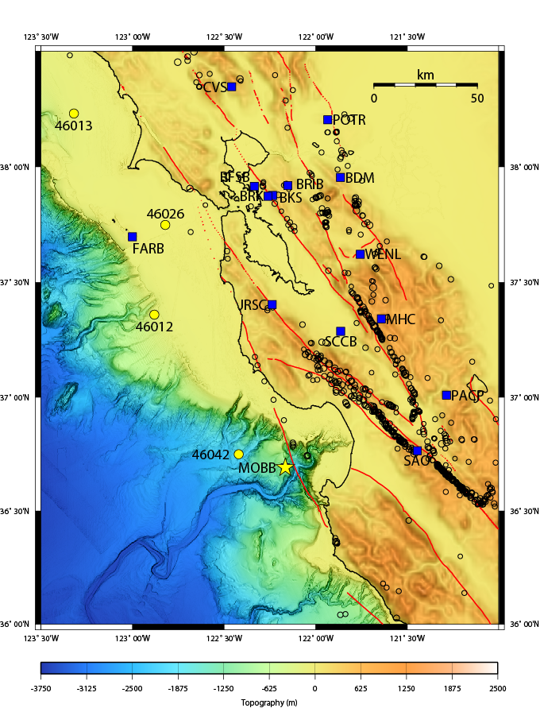
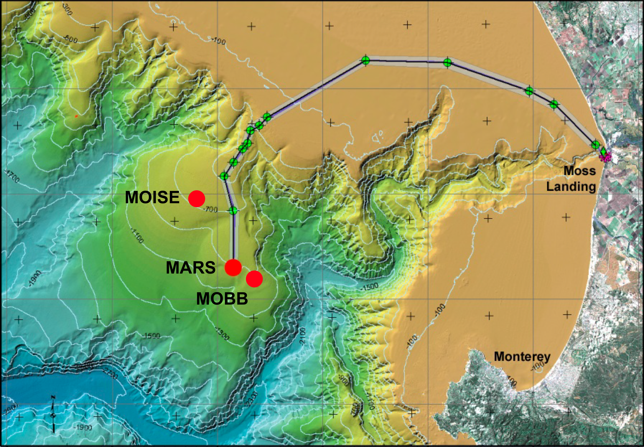
Monterey bay
Ocean Bottom
Broadband seismic
station
MBARI/
UCB

Slide 49
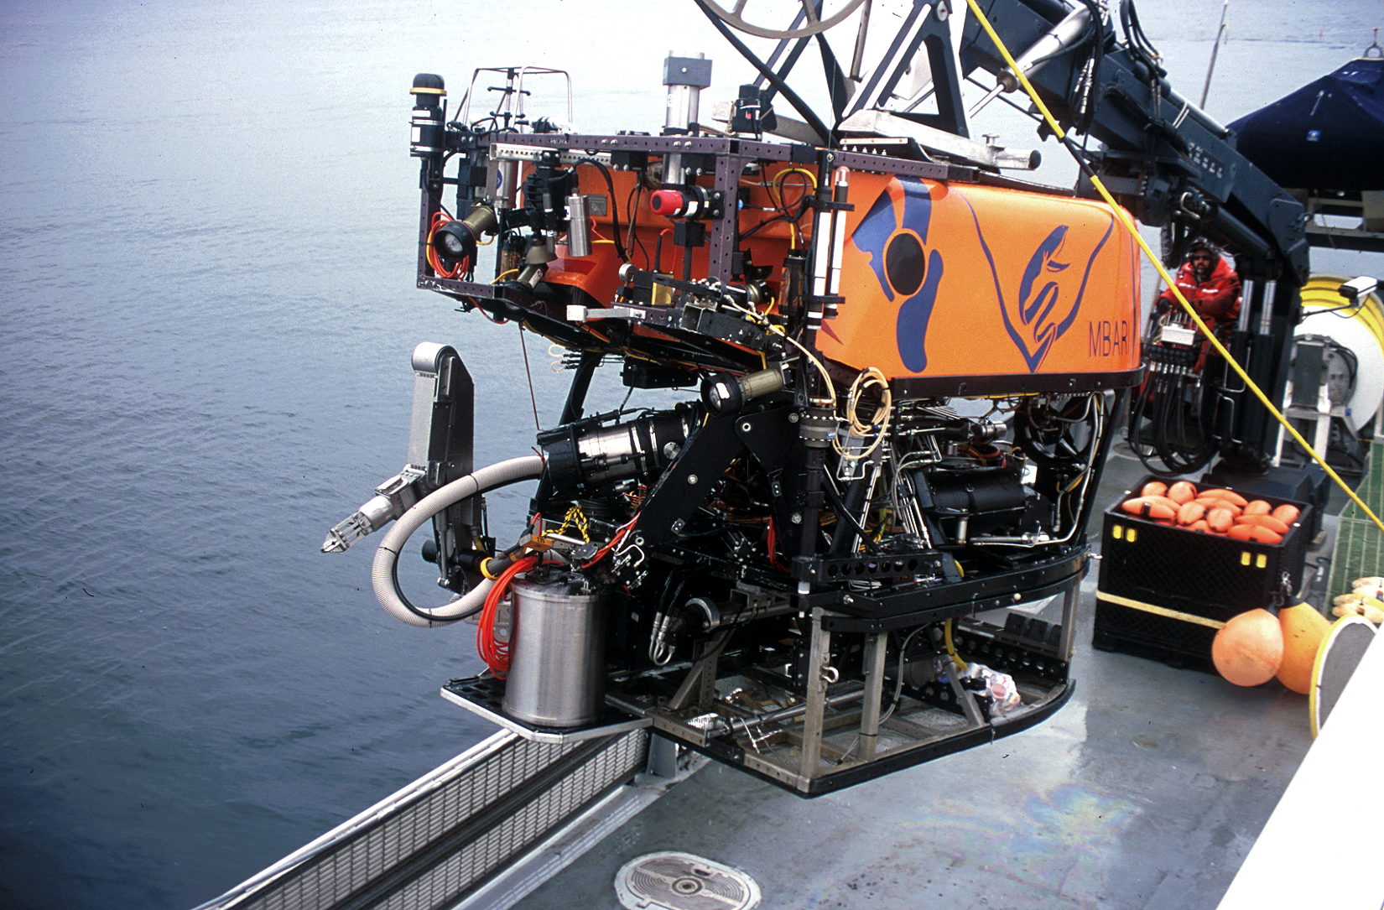
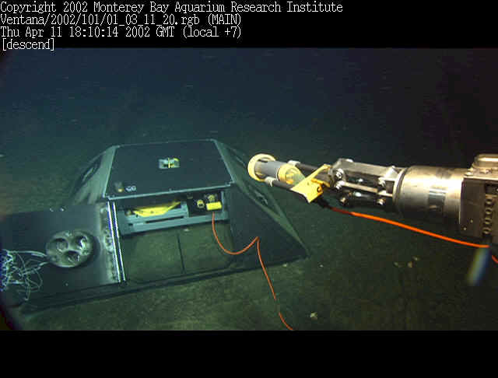





Slide 50

Notes
- low noisevery broad band seismometers (STS-1) essential for “hum” studies
• global seismic network
• regional arrays
- Very broad band seismometer such
as the one in Monterey Bay (MOBB) useful
for infragravity wave studies.

Slide 51

2800 km depth
from Kustowski, 2006

Slide 52


Slide 53


Slide 54

Marone and Romanowicz, 2007

Slide 55

Global Transverse Component Stacks
Shearer, 1991

